Slide 1



Endava Tech Courses
OCTOBER @22
if (IT == true) {
git.setStatus(Status.MANDATORY);
}
ELENA HAJDEU-CHICAROS – TEODOR VRABIE

Slide 2
Endava Tech Courses
OCTOBER @22
Git - what is it?
01
Git repo - local and remote, git workflow
02
What is .gitignore file?
03
Basic git concepts: add, commit, status, log …
04
Working with remote repo
05
00 — Agenda
ELENA HAJDEU-CHICAROS – TEODOR VRABIE

Slide 3
Endava Tech Courses
OCTOBER @22
Branching strategy
06
Undo changes in GIT: reset & revert
07
Git Rebase
08
Git Merge
09
Conflicts
10
00 — Agenda
ELENA HAJDEU-CHICAROS – TEODOR VRABIE

Slide 4





Endava Tech Courses
OCTOBER @22
WHAT IS GIT?
Git - version history for the code,
Code backup, synchronization…
… multiple contributors and version control
Real life projects generally have multiple developers working in parallel. So, a version control system like git is needed to ensure there are no code conflicts between the developers.
Installation: https://git-scm.com/downloads
01 — What is Git?
ELENA HAJDEU-CHICAROS – TEODOR VRABIE

Slide 5
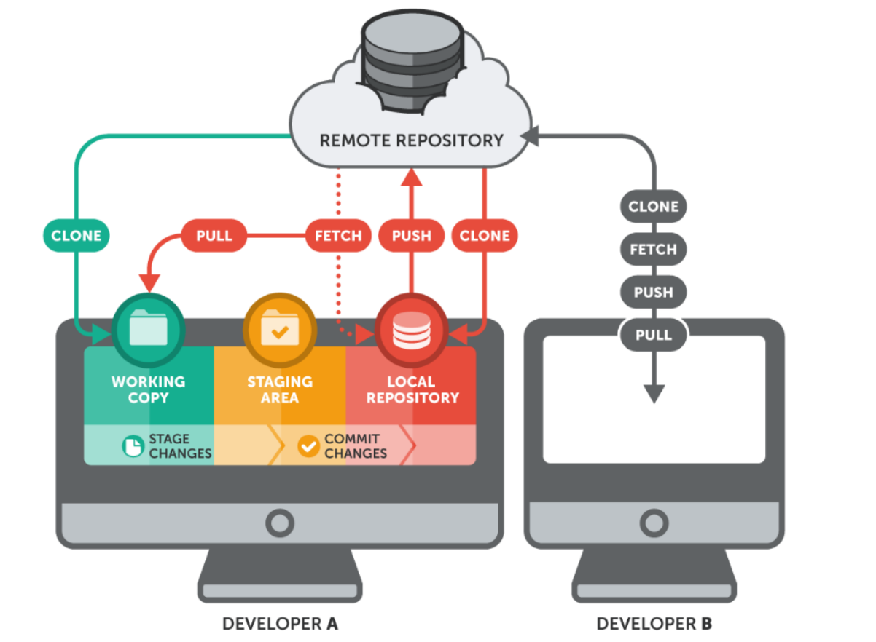

Endava Tech Courses
OCTOBER @22
GIT REPOSITORY - LOCAL AND REMOTE
GIT WORKFLOW
A repository is a folder that is being tracked by GIT
02 — Git repo - local and remote, git workflow
ELENA HAJDEU-CHICAROS – TEODOR VRABIE

Slide 6

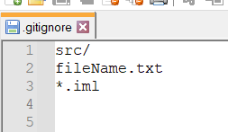

Endava Tech Courses
OCTOBER @22
WHAT IS .gitignore file?
Example of .gitignore file
A file in your repo can be:
Tracked – a file which has been previously staged or committed;
Untracked – a file which has not been staged or committed;
Ignored – a file which Git has been explicitly told to ignore
03 — What is .gitignore file?
ELENA HAJDEU-CHICAROS – TEODOR VRABIE

Slide 7


Endava Tech Courses
OCTOBER @22
BASIC GIT CONCEPTS
version = commit
Working area
Staging area
Local Repository
Remote Repository
git log
git add fileName.ext
git log --all --graph
git add .
git init
git diff
git commit –m “message"
git status
git commit –m “message“ – –amend
rm –rf .git – remove git from folder
git reset fileName.ext
git reset .
In order to do starting configuration of the git open git-bash or cmd. in opened console write next:
git config – –global user.name "john doe"
git config – –global user.email johndoe@example.com
git stash – saves a stash
git stash apply – applies a stash
git stash drop – removes a stash
04 — Basic Git concepts
ELENA HAJDEU-CHICAROS – TEODOR VRABIE

Slide 8


Endava Tech Courses
OCTOBER @22
BASIC GIT CONCEPTS
version = commit
git checkout 23523442c33465d8cef56c9c0dcf6df35cfb510a
Commit hash:
23523442c33465d8cef56c9c0dcf6df35cfb510a
1st commit
2nd commit
3rd commit
MASTER
MASTER
MASTER
HEAD
HEAD
HEAD
04 — Basic Git concepts
ELENA HAJDEU-CHICAROS – TEODOR VRABIE

Slide 9

Endava Tech Courses
OCTOBER @22
BASIC GIT CONCEPT
version = commit
Still exist
1st commit
2nd commit
3rd commit
HEAD
MASTER
git log –all – –graph
New BRANCH
4th commit
HEAD
04 — Basic Git concepts
ELENA HAJDEU-CHICAROS – TEODOR VRABIE

Slide 10



Endava Tech Courses
OCTOBER @22
CREATE A REMOTE REPO
For the next step, you’ll need a GitHub account.
Sign into GitHub and go to the new repository page. Create a new repository, choosing any name you like.
Now you’re going to add this repo on GitHub as a remote to your local repository. Run the following commands:
git remote add origin <the url of your repo on github> - link local repo with remote one
git remote -v – check if the repositories are linked
git remote remove origin – removes the linkage
between local and remote repos
Bitbucket
05 — Working with remote repo
ELENA HAJDEU-CHICAROS – TEODOR VRABIE

Slide 11

Endava Tech Courses
OCTOBER @22
WORKING WITH REMOTE REPO
If git commit amend is used git push <repo_name> <branch_name> -f
git push <repo_name> <branch_name>
Remote repo
Upload = push
Download = pull
git fetch
Local repo
git pull <repo_name> <branch_name>
git config – –global credential.username “username”
If you want to pull locally an existent remote repo:
git clone <the url of your repo on github> <folder_name_to_save>
05 — Working with remote repo
ELENA HAJDEU-CHICAROS – TEODOR VRABIE

Slide 12
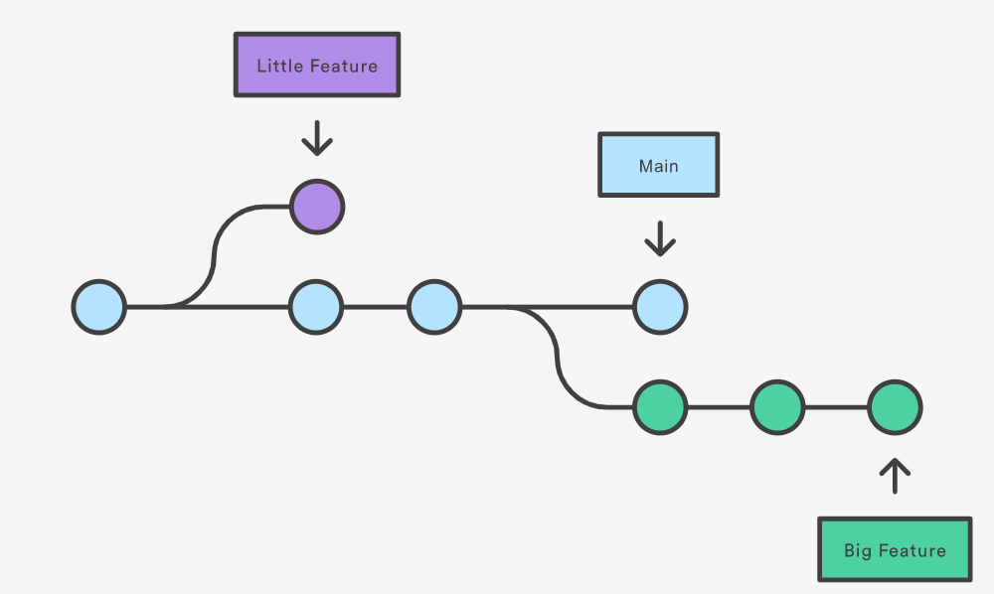
Endava Tech Courses
OCTOBER @22
BRANCHING - WHAT IS?
A branch represents an independent line of development.
Branching allows us to work on multiple things at the same time, accepting multiple contributors.
06 — Branching strategy
ELENA HAJDEU-CHICAROS – TEODOR VRABIE

Slide 13
Endava Tech Courses
OCTOBER @22
BRANCHING - WHAT IS?
git branch <branch_name> - create a new branch
git checkout <branch_name> - switch to an existing branch
git checkout –b <branch_name> - create a branch and switch to it
06 — Branching strategy
ELENA HAJDEU-CHICAROS – TEODOR VRABIE

Slide 14
Endava Tech Courses
OCTOBER @22
BRANCHING STRATEGY
The git BRANCHING STRATEGY is the strategy that software development teams adopt when writing, merging and deploying code when using a version control system (a set of rules).
06 — Branching strategy
ELENA HAJDEU-CHICAROS – TEODOR VRABIE

Slide 15
Endava Tech Courses
OCTOBER @22
BRANCH NAME CONVENTION
The main idea behind the git branching strategy is to isolate your work into different types of branches. There are five different branch types in total:
Main
Develop
Feature
Release
Hotfix
06 — Branching strategy
ELENA HAJDEU-CHICAROS – TEODOR VRABIE

Slide 16
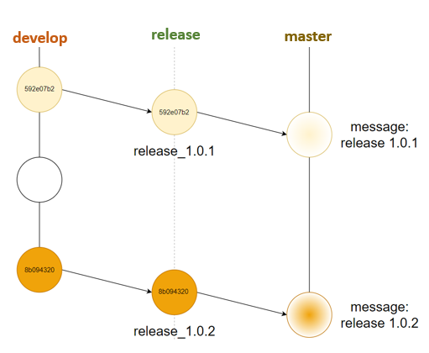
Endava Tech Courses
OCTOBER @22
BRANCHING STRATEGY
Any code in the main branch should be deployable.
Create new descriptively-named branches off the main branch for new work, such as feature/add-new-payment-types.
Commit new work to your local branches and regularly push work to the remote.
To request feedback or help, or when you think your work is ready to merge into the main branch, open a pull request.
After your work or feature has been reviewed and approved, it can be merged into the main branch.
06 — Branching strategy
ELENA HAJDEU-CHICAROS – TEODOR VRABIE

Slide 17

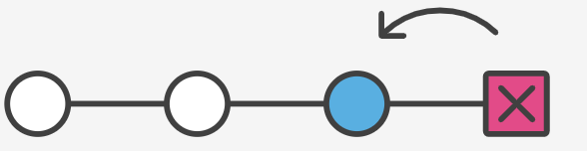
Endava Tech Courses
OCTOBER @22
Undo changes in GIT: reset & revert
revert is the command we use when we want to take a previous commit and add it as a new commit, keeping the log intact.
reset is the command we use when we want to move the repository back to a previous commit, discarding any changes made after that commit.
- -soft - -mixed - -hard
07 — Undo changes in Git: reset &revert
ELENA HAJDEU-CHICAROS – TEODOR VRABIE

Slide 18
Endava Tech Courses
OCTOBER @22
Undo changes in GIT: reset & revert
UNDOING A SPECIFIC COMMIT (THAT HAS BEEN PUSHED)
git revert commit_hash --no-edit
git push origin <branch_name>
UNDOING LOCAL CHANGES THAT HAVE BEEN COMMITTED (BUT NOT PUSHED)
It will be as if the bad commits never happened.
Here's If you have made local commits that you don't like, and they have not been pushed yet you can reset things back to a previous good commit.
git reset <commit_hash>
git reset --hard <commit_hash>
UNDOING YOUR LAST COMMIT (THAT HAS NOT BEEN PUSHED)
git reset --soft head~
git add .
git commit –m “Message”
Even though the commits are no longer showing up in the log, it is not removed from Git.
07 — Undo changes in Git: reset &revert
ELENA HAJDEU-CHICAROS– TEODOR VRABIE

Slide 19
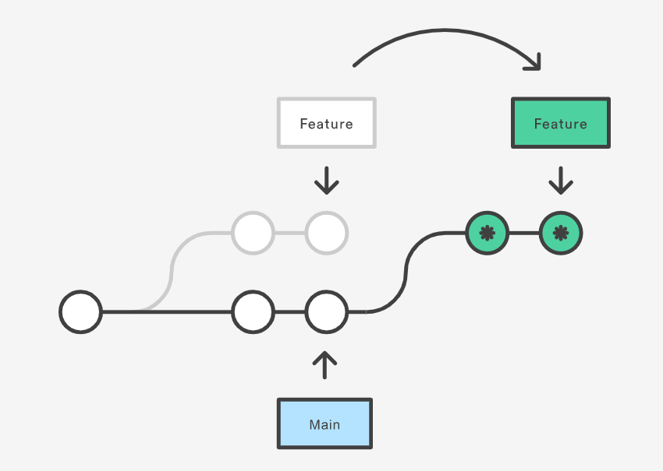
Endava Tech Courses
OCTOBER @22
GIT REBASE
Rebase is one of two Git utilities that specializes in integrating changes from one branch onto another.
git checkout <branch_name>
git rebase <the_branch_where_to_rebase_name>
08 — Git rebase
ELENA HAJDEU-CHICAROS – TEODOR VRABIE

Slide 20
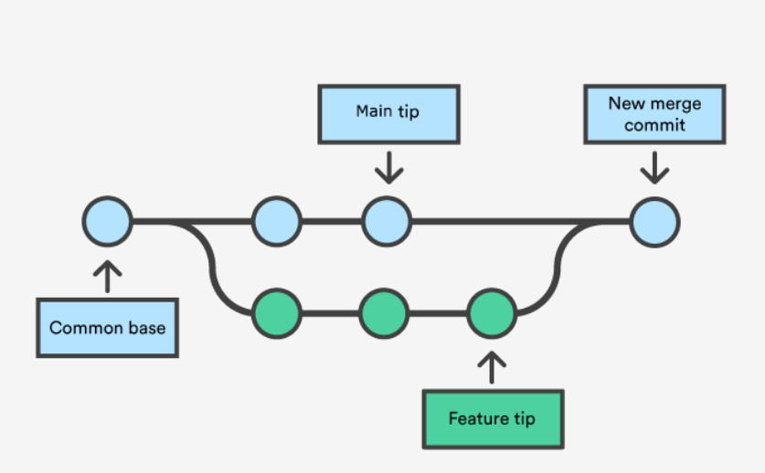
Endava Tech Courses
OCTOBER @22
GIT MERGE
Merging is the second git's way of putting a forked history back together again.
The git merge command lets you take the independent lines of development created by git branch and integrate them into a single branch.
git checkout <the_branch_where_to_merge_name>
git merge <branch_name >
09 — Git merge
ELENA HAJDEU-CHICAROS – TEODOR VRABIE

Slide 21
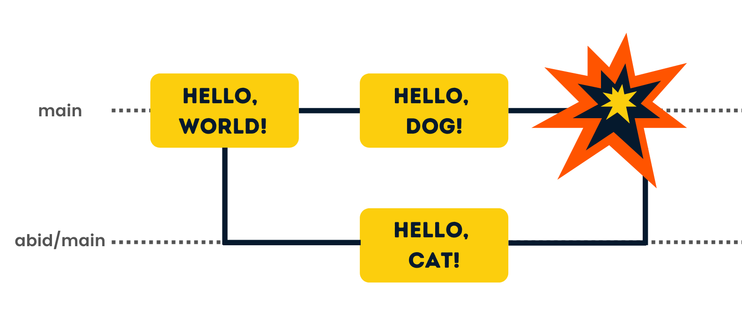
Endava Tech Courses
OCTOBER @22
CONFLICTS
Conflicts are a common part of the Git experience.
They appear due to git merge, git rebase, …
10 — Conflicts
ELENA HAJDEU-CHICAROS – TEODOR VRABIE

Slide 22
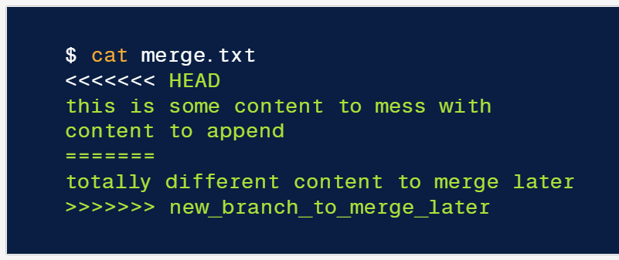
Endava Tech Courses
OCTOBER @22
CONFLICTS
The most direct way to resolve a conflict is to edit the conflicted file.
Once the file has been edited use git add merge.txt to stage the new merged content. To finalize the merge, create a new commit by executing:
git commit –m “Commit message”
Git will see that the conflict has been resolved and creates a new merge commit to finalize the merge.
10 — Conflicts
ELENA HAJDEU-CHICAROS – TEODOR VRABIE

Slide 23


Endava Tech Courses
OCTOBER @22
Useful links
https://supersimple.dev/courses/git-github-complete-course-20211/
https://www.atlassian.com/git
THANK YOU!
Hajdeu-Chicaros ELENA
Vrabie TEODOR

