Slide 1


Endava Tech Courses
OCTOBER @22
JAVA Course
SQL
DAMANCIUC XENIA
SENIOR JAVA ENGINEER
IVAN KULISNKI
SENIOR JAVA ENGINEER
00 — Thumbnail
DAMANCIUC XENIA – IVAN KULISNSKI

Slide 2

Endava Tech Courses
OCTOBER @22
Relational database & RDBMS
01
Data types
02
Main SQL commands
03
Constraints
04
Aliases
05
Operators, Functions &Statements
06
01 — Agenda
DAMANCIUC XENIA – IVAN KULISNKI

Slide 3


| Endava Tech Courses
OCTOBER @22
Relational database & RDBMS
01 — Agenda
DAMANCIUC XENIA – IVAN KULISNKI

Slide 4

Endava Tech Courses
OCTOBER @22
DATABASE
Collection of information that is organized so that it can be easily accessed, managed and updated.
01 — Relational database & RDBMS
DAMANCIUC XENIA – IVAN KULISNKI

Slide 5
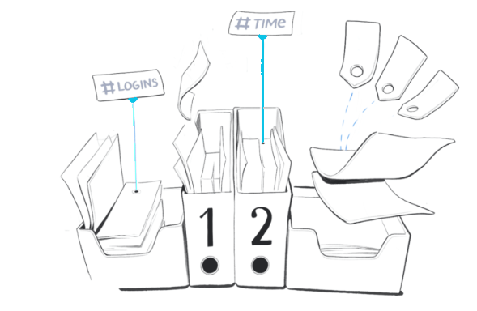

Endava Tech Courses
OCTOBER @22
DBMS – DATABASE MANAGEMENT SYSTEM
STRUCTURES HOW WE ORGANIZE DATA
INTERACTS WITH STORED DATA
4 FUNDAMENTAL
WAYS
01 — Relational database & RDBMS
DAMANCIUC XENIA – IVAN KULISNKI

Slide 6
Endava Tech Courses
OCTOBER @22
DBMS – DATABASE MANAGEMENT SYSTEM
RELATIONAL
Tables are used to hold information about the objects to be represented in the database.
The rows in the table represent a collection of related values of one object or entity.
Each row in a table could be marked with a unique identifier called a primary key, and rows among multiple tables can be made related using foreign keys.
This data can be accessed in many ways without reorganizing the database tables themselves.
mov_id | integer
mov_title | char(50)
mov_time | integer
mov_lang | char(50)
mov_dt_rel | date
movie
01 — Relational database & RDBMS
DAMANCIUC XENIA – IVAN KULISNKI

Slide 7
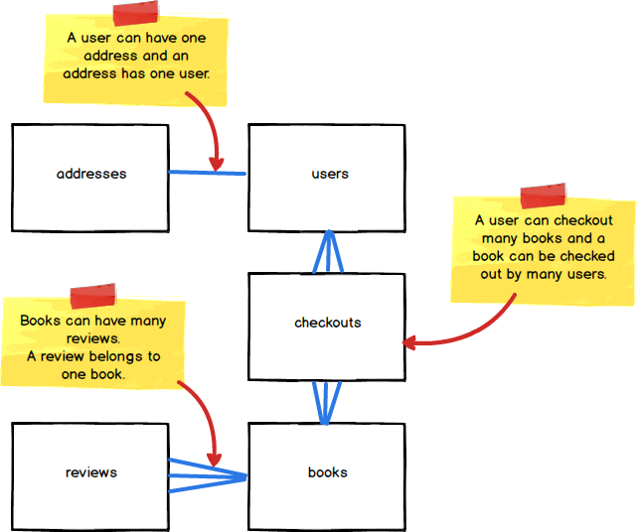
Endava Tech Courses
OCTOBER @22
DBMS – DATABASE MANAGEMENT SYSTEM
RELATIONSHIPS
1:1 – Both tables can have only one record on each side of the relationship.
1:n - The table contains only one record that relates to none, one, or many records in the related table.
m:n - Each record in both tables can relate to any number of records (or no records) in the other table.
01 — Relational database & RDBMS
DAMANCIUC XENIA – IVAN KULISNKI

Slide 8
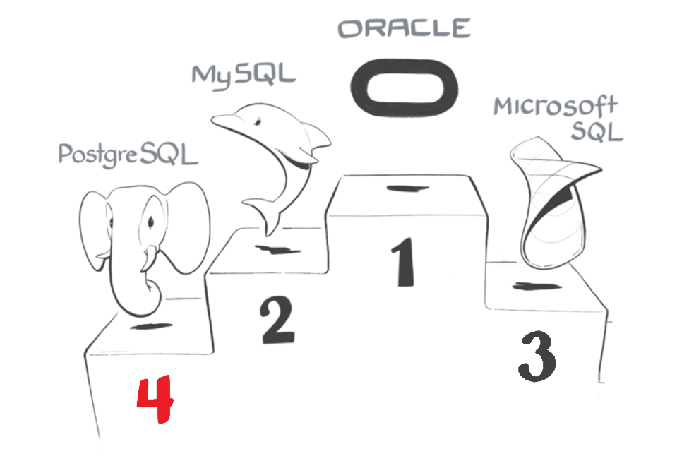
Endava Tech Courses
OCTOBER @22
DBMS – DATABASE MANAGEMENT SYSTEM
RELATIONAL
01 — Relational database & RDBMS
DAMANCIUC XENIA – IVAN KULISNKI

Slide 9
| Endava Tech Courses
OCTOBER @22
DATA TYPES
01 — Agenda
DAMANCIUC XENIA – IVAN KULISNKI

Slide 10

Endava Tech Courses
OCTOBER @22
ANSI SQL DATA TYPES
Character
Binary
Numeric
Date/time
Boolean
Array
02 — Data types
DAMANCIUC XENIA – IVAN KULISNKI

Slide 11
Endava Tech Courses
OCTOBER @22
CHARACTER DATA TYPES
Fixed length
Variable length
CHARACTER (n)
CHAR (n)
CHARACTER
CHAR
CHARACTER VARYING (n)
VARCHAR (n)
CHARACTER VARYING
CHAR VARYING
VARCHAR
TEXT
blank padded
with a limit
1 character
any size
02 — Data types
DAMANCIUC XENIA – IVAN KULISNKI

Slide 12
Endava Tech Courses
OCTOBER @22
NUMERIC & APPROXIMATE NUMERIC​
EXACT
Approximate
SMALLINT, INT2​
INTEGER, INT, INT4​
BIGINT, INT8​
REAL, FLOAT4
DOUBLE PRECISIOON, FLOAT8
FLOAT(n)
NUMERIC(p, s), DECIMAL (p, s)
NUMERIC(p), DECIMAL(p)​
NUMERIC, DECIMAL​
integer types
floating point types
arbitrary precision numbers​
02 — Data types
DAMANCIUC XENIA – IVAN KULISNKI

Slide 13
Endava Tech Courses
OCTOBER @22
DATE & TIME
INTERVAL
INTERVAL
Date
TIME
TIMESTAMP(p) [TIME ZONE]
TIMESTAMP [TIME ZONE]
INTERVAL(p)
INTERVAL
DATE
TIME(p) [TIME ZONE]
TIME [TIME ZONE]
02 — Data types
DAMANCIUC XENIA – IVAN KULISNKI

Slide 14
Endava Tech Courses
OCTOBER @22
MONEY
MONEY
MONEY
BOOLEAN
BOOLEAN
BOOLEAN, BOOL
ARRAY
ARRAY
<type>[][]…​
02 — Data types
DAMANCIUC XENIA – IVAN KULISNKI

Slide 15
Endava Tech Courses
OCTOBER @22
DATA TYPES
UUID
XML
JSON
ENUM
BIT STRING
DOMAIN
02 — Data types
DAMANCIUC XENIA – IVAN KULISNKI

Slide 16
| Endava Tech Courses
OCTOBER @22
MAIN SQL COMMANDS
03 — Agenda
DAMANCIUC XENIA – IVAN KULISNKI

Slide 17
Endava Tech Courses
OCTOBER @22
DATA MANIPULATION LANGUAGE (DML)
DATA DEFINITION LANGUAGE (DDL)
DATA CONTROL LANGUAGE (DCL)
DATA MANIPULATION LANGUAGE (DML)
TRANSACTION CONROL LANGUAGE (TCL)
Consists of the SQL commands that can be used to define the database schema.
Deals with the rights, permissions, and other controls of the database system.
Deals with the manipulation of data present in the database.
Deals with the transaction within the database.
03 — SQL Main commands
DAMANCIUC XENIA – IVAN KULISNKI

Slide 18
Endava Tech Courses
OCTOBER @22
DATA MANIPULATION LANGUAGE (DML)
CREATE
ALTER
DROP
TRUNCATE
This command is used to create database and database objects. For example, database, table, index, view, etc.
This command is used to alter the structure of the database. Can modify the characteristics of an existing attribute or add a new attribute.
This statement allows us to remove entire database and database objects from our DBMS.
This statement allows us to delete all the rows from the table.
03 — SQL Main commands
DAMANCIUC XENIA – IVAN KULISNKI

Slide 19

Endava Tech Courses
OCTOBER @22
DATA DEFINITION LANGUAGE (DDL)
CREATE DATABASE
This statement is used to create a new database.
CREATE DATABASE database_name;
CREATE TABLE table_name(
column_name_1 data_type(size),
column_name_2 data_type(size),
column_name_3 data_type(size),
...
);
CREATE TABLE
This statement is used to create a table in a database.
03 — SQL Main commands
DAMANCIUC XENIA – IVAN KULISNKI

Slide 20
Endava Tech Courses
OCTOBER @22
DATA DEFINITION LANGUAGE (DDL)
ALTER TABLE
This statement is used to add a column, modify, drop, rename a column or rename a table.
ALTER TABLE table_name
ADD column_name column_type;
ALTER TABLE table_name
ALTER COLUMN column_name column_type;
DROP
This statement is used to destroy an existing database, table, index or view.
DROP DATABASE database_name;
TRUNCATE TABLE
This statement is used to delete data inside the table and not the itself.
TRUNCATE TABLE table_name;
03 — SQL Main commands
DAMANCIUC XENIA – IVAN KULISNKI

Slide 21
Endava Tech Courses
OCTOBER @22
DATA MANIPULATION LANGUAGE (DML)
SELECT
UPDATE
INSERT
DELETE
This command is used to return a result set of records, from one or more tables.
This statement changes the data of one or more records in a table. Either all rows can be updated, or a subset may be chosen using a condition.
This statement adds one or more records to any single table in a relational database.
This statement removes one or more records from a table. A subset may be defined for deletion using a condition, otherwise all records will be removed.
03 — SQL Main commands
DAMANCIUC XENIA – IVAN KULISNKI

Slide 22
Endava Tech Courses
OCTOBER @22
DATA DEFINITION LANGUAGE (DDL)
SELECT
This statement is used to select data.
SELECT
column_name_1, column_name_2
FROM table_name;
SELECT * FROM table_name;
SELECT DISTINCT
This statement is used to used to return only distinct (different) values.
SELECT DISTINCT
column_name_1, column_name_2
FROM table_name;
SELECT LIMIT
This statement is used to specify the number of records to return.
SELECT​
column_name_1,​ column_name_2 ​
FROM table_name​
LIMIT row_count
03 — SQL Main commands
DAMANCIUC XENIA – IVAN KULISNKI

Slide 23
Endava Tech Courses
OCTOBER @22
DATA DEFINITION LANGUAGE (DDL)
INSERT INTO
This statement is used to insert new records in a table.
INSERT INTO table_name
(column_name_1, column_name_2)
VALUES
(value_1, value_2);
INSERT INTO
table_name
VALUES
(value_1, value_2);
UPDATE
Used to update existing records in a table.
UPDATE table_name
SET column_name_1 = value_1
WHERE column_name = some_value;
03 — SQL Main commands
DAMANCIUC XENIA – IVAN KULISNKI

Slide 24
Endava Tech Courses
OCTOBER @22
DATA DEFINITION LANGUAGE (DDL)
DELETE
It is used to delete rows in a table.
DELETE FROM table_name WHERE some_column = some_value;
03 — SQL Main commands
DAMANCIUC XENIA – IVAN KULISNKI

Slide 25
| Endava Tech Courses
OCTOBER @22
CONSTRAINTS
03 — Agenda
DAMANCIUC XENIA – IVAN KULISNKI

Slide 26
Endava Tech Courses
OCTOBER @22
CONSTRAINTS
NOT NULL​
Indicates that a column cannot store NULL value.​
​
​
CREATE TABLE table_name( ​
column_name_1 INT NOT NULL, ​
column_name_2 VARCHAR(30) NOT NULL, column_name_3 INT ​
); ​
​
​
DEFAULT​
Specifies a default value when no value is provided.​
​
​
CREATE TABLE table_name( ​
column_name_1 INT,​
column_name_2 VARCHAR(30) DEFAULT 'VALUE’, column_name_3 INT ​
); ​
​
CHECK​
Guarantees that the value in a column meets a specific condition.​
​
CREATE TABLE table_name( ​
column_name_1 INT, ​
column_name_2 VARCHAR(30), ​
column_name_3 INT CHECK(column_name_3 > 100) ​
); ​
​
UNIQUE​
Ensures that each row for a column must have a unique value.​
​
CREATE TABLE table_name( ​
column_name_1 INT UNIQUE, ​
column_name_2 VARCHAR(30), ​
column_name_3 INT ​
); ​
​
04 — Constraints
DAMANCIUC XENIA – IVAN KULISNKI

Slide 27



Endava Tech Courses
OCTOBER @22
CONSTRAINTS
PRIMARY KEY​
Consists of one or more columns whose data contained within are used to uniquely identify each row in the table. It is the combination of NOT NULL + UNIQUE.​
​
​
CREATE TABLE table_name( ​
column_name_1 INT PRIMARY KEY, ​
column_name_2 VARCHAR(30) NOT NULL,
column_name_3 INT ​
); ​
​
​
COLUMN_1 is PRIMARY KEY. All values are UNIQUE.
COLUMN_1 | COLUMN_2
1 | A
2 | B
3 | C
ERROR: There’s already value “1” in the COLUMN_1 which is a PRIMARY KEY.
1 | X
04 — Constraints
DAMANCIUC XENIA – IVAN KULISNKI

Slide 28
Endava Tech Courses
OCTOBER @22
CONSTRAINTS
Foreign key
Consists of one or more columns in a table that refers to the primary key in another table. It allows duplicates and NULL values.
CREATE TABLE table_name( column_name_1 INT PRIMARY KEY IDENTITY, column_name_2 INT REFERENCES another_table(column_name_from_another_table) );
COLUMN_1 is PRIMARY KEY. All values are UNIQUE.
COLUMN_1 | COLUMN_2
1 | A
2 | B
3 | C
ERROR: There’s already value “1” in the COLUMN_1 which is a PRIMARY KEY.
1 | X
04 — Constraints
DAMANCIUC XENIA – IVAN KULISNKI

Slide 29

Endava Tech Courses
OCTOBER @22
CONSTRAINTS
COLUMN_1 is PRIMARY KEY. All values are UNIQUE.
COLUMN_1 is FOREIGN KEY.
PARENT TABLE
CHILD TABLE
COLUMN_1 | COLUMN_2
1 | A
2 | B
3 | C
COLUMN_1 | COLUMN_2
1 | A
2 | B
NULL | C
ERROR: Value “4” doesn’t exist in the PARENT TABLE.
4 | X
04 — Constraints
DAMANCIUC XENIA – IVAN KULISNKI

Slide 30
| Endava Tech Courses
OCTOBER @22
ALIASES
03 — Agenda
DAMANCIUC XENIA – IVAN KULISNKI

Slide 31
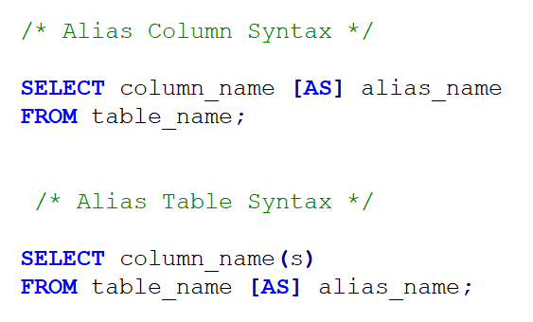
Endava Tech Courses
OCTOBER @22
TABLE AND COLUMN ALIASES
ALIASES
This statement is used to give a table or a column in a table, a temporary name.
05 — Aliases
DAMANCIUC XENIA – IVAN KULISNKI

Slide 32
| Endava Tech Courses
OCTOBER @22
SQL OPERATORS, FUNCTIONS AND STATEMENTS​
03 — Agenda
DAMANCIUC XENIA – IVAN KULISNKI

Slide 33
Endava Tech Courses
OCTOBER @22
SQL OPERATORS
SELECT ​
column_name_1, ​
column_name_2 ​
FROM table_name ​
WHERE column_name OPERATOR VALUE; ​
WHERE CLAUSE
This statement is used to give a table or a column in a table, a temporary name.
WHERE OPERATORS
Operators can be used the WHERE clause: ​
OPERATOR​
= ​
<>​
>​
<​
>=​
<=​
!= OR <>​
BETWEEN between an inclusive range​
LIKE or SIMILAR TO search for a pattern​
IN or NOT IN to specify multiple possible values for a column
06 — SQL Operators, functions and statements
DAMANCIUC XENIA – IVAN KULISNKI

Slide 34
Endava Tech Courses
OCTOBER @22
SQL OPERATORS
LIKE OPERATOR
Used in a WHERE clause to search for a specified pattern in a column.
SELECT ​
column_name_1, ​
column_name_2 ​
FROM table_name ​
WHERE column_name ​
LIKE pattern; ​
SELECT ​
column_name_1, ​
column_name_2 ​
FROM table_name ​
WHERE ​
column_name LIKE '%es’ --starting with any character, followed by "es" ​
OR column_name LIKE '_es’ --starting with "l", followed by any character, ​
OR column_name LIKE 'l_n_on’ --followed by "n", followed by any character, ​ followed by "on" ​
LIKE WILDCARDS
Used to substitute for any character(s) in a string.
Wildcard​ | Description​
%​ | A substitute for zero or more characters​
_​ | A substitute for a single character​
06 — SQL Operators, functions and statements
DAMANCIUC XENIA – IVAN KULISNKI

Slide 35
Endava Tech Courses
OCTOBER @22
SQL OPERATORS
AND
Displays a record if the first AND the second condition are true.
SELECT * FROM table_name WHERE table_column_1 = 'Value1’ AND table_column_2 = 'Value2’;
SELECT * FROM table_name WHERE table_column_1 = 'Value1’ OR table_column_2 = 'Value2';
OR
Displays a record if either the first condition OR the second condition is true. ​
ORDER BY
Used to sort the result-set by one or more columns. ​ By default, it sorts the records in ascending order.
SELECT * FROM ​ table_name ​ ORDER BY ​column_name ​ASC | DESC; ​
06 — SQL Operators, functions and statements
DAMANCIUC XENIA – IVAN KULISNKI

Slide 36
Endava Tech Courses
OCTOBER @22
STRING FUNCTIONS
Char_length(expression) or character_length(expression)
Returns the length of a string.
LOWER(expression)
Converts a string to lower-case.​​
upper(expression)
Converts a string to upper-case.​​
REPLACE (expression, search_string, replacement_ string)
Replaces all occurrences of a substring within a string, with a new substring.
CONCAT(expression1, expression2, …) VS​ CONCATENATION OPERATOR (||) VS​
CONCAT_WS(separator, expression1, expression2, …)​
Adds two or more strings together. ​
​
SUBSTRing (expression ,start , length) or
SUBSTR(expression ,start , length)
Extracts some characters from a string.
06 — SQL Operators, functions and statements
DAMANCIUC XENIA – IVAN KULISNKI

Slide 37
Endava Tech Courses
OCTOBER @22
STRING FUNCTIONS
TRIM([leading | trailing | both] [characters from string)
​
Removes leading and trailing spaces (or other specified characters) from a string.​
RTRIM(string text [, characters text]))​
Removes the longest string containing only characters from characters (a space by default) from the end of string.​
POSITION (expression_to_find , expression_to_search) OR​
STRPOS(expression_to_search, expression_to_find)​
​
Returns the position of a substring in a string.​
LTRIM(string text [, characters text]))​
Removes the longest string containing only characters from characters (a space by default) from the start of string.​
06 — SQL Operators, functions and statements
DAMANCIUC XENIA – IVAN KULISNKI

Slide 38
Endava Tech Courses
OCTOBER @22
DATE FUNCTIONS
CURRENT_DATE
​
Returns the current database system date.​
DATE_PART(text, timestamp) OR​
DATE_PART(text, interval) OR​
EXTRACT(field from timestamp) OR​
EXTRACT(field from interval) ​
​
Retrieves subfields such as year or hour from date/time values. Source must be a value expression of type timestamp, time, or interval. ​
CURRENT_TIME​
Returns the current database system time.​
CURRENT_TIMESTAMP​
Returns the current date and time (start of current transaction).​
06 — SQL Operators, functions and statements
DAMANCIUC XENIA – IVAN KULISNKI

Slide 39
Endava Tech Courses
OCTOBER @22
ADVANCED FUNCTIONS
COALESCE​
Returns the first non-null value in a list.​
CASE ​
It goes through conditions and returns a value when the first condition is met (like an if-then-else statement). So, once a condition is true, it will stop reading and return the result. If no conditions are true, it returns the value in the ELSE clause.​
​
If there is no ELSE part and no conditions are true, it returns NULL.​
​
​
NULLIF​
Returns NULL if two expressions are equal​
CAST (expression AS target_type) or​
:: OPERATOR​
Converts a value of one data type into another. ​
06 — SQL Operators, functions and statements
DAMANCIUC XENIA – IVAN KULISNKI

Slide 40


