Slide 1


Endava Tech Courses
OCTOBER @22
JAVA Course
SQL
DAMANCIUC XENIA
SENIOR JAVA ENGINEER
IVAN KULISNKI
SENIOR JAVA ENGINEER
00 — Thumbnail
DAMANCIUC XENIA – IVAN KULISNSKI

Slide 2

Endava Tech Courses
OCTOBER @22
Aggregate functions
01
Subqueries
02
JOINs and UNION
03
TCL
04
INDEXEs
05
01 — Agenda
DAMANCIUC XENIA – IVAN KULISNKI

Slide 3


| Endava Tech Courses
OCTOBER @22
AGGREGATE(GROUP) FUNCTIONS
01 — Agenda
DAMANCIUC XENIA – IVAN KULISNKI

Slide 4
Endava Tech Courses
OCTOBER @22
AGGREGATE FUNCTIONS
COUNT
Returns the number of records returned by a select query.
SUM
Calculates the sum of a set of values.​
MAX
Returns the maximum value in a set of values.​
AVG
Returns the average value of an expression.​
MIN​
Returns the minimum value in a set of values.​​
06 — Aggregate (GROUP) functions
DAMANCIUC XENIA – IVAN KULISNKI

Slide 5
Endava Tech Courses
OCTOBER @22
GROUP BY & HAVING
SELECT column_name, AVG(column_name) AS 'Average’ FROM table_name WHERE some_column = some_value GROUP BY column_name;
GROUP BY
This statement is used in conjunction with aggregate functions to group the result-set by one or more columns. ​
SELECT column_name, AVG(column_name) AS 'Average’ FROM table_name WHERE some_column = some_value GROUP BY column_name HAVING AVG(column_name) > 10;
HAVING
This statement enables you to specify conditions that filter which group results appear in the results.
01 — Aggregate (GROUP) functions
DAMANCIUC XENIA – IVAN KULISNKI

Slide 6
| Endava Tech Courses
OCTOBER @22
SUBQUERIES
01 — Agenda
DAMANCIUC XENIA – IVAN KULISNKI

Slide 7
Endava Tech Courses
OCTOBER @22
SUBQUERIES
A sub-query is a query within a query. You can create subqueries within your SQL statements.​
These sub-queries can reside in the WHERE clause, the FROM clause, the SELECT clause or JOINs.​
Sub-queries must be enclosed with parenthesis.​
A sub-query must be put in the right hand of the comparison operator.​
A sub-query cannot contain an ORDER-BY clause.​
A query can contain more than one sub-query.
SELECT column_name_1
FROM table_name_1
WHERE val IN (SELECT column_name_2 FROM table_name_2 WHERE condition);
02 — Subqueries
DAMANCIUC XENIA – IVAN KULISNKI

Slide 8
| Endava Tech Courses
OCTOBER @22
JOINs & UNION
03 — Agenda
DAMANCIUC XENIA – IVAN KULISNKI

Slide 9
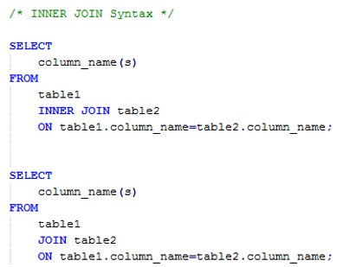
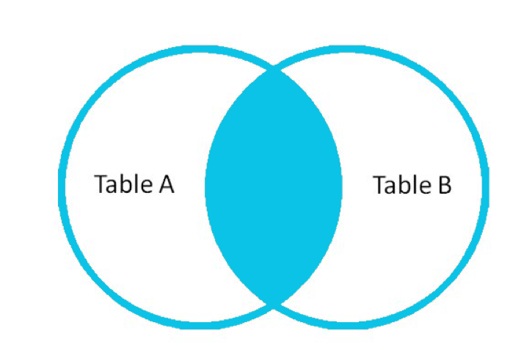
Endava Tech Courses
OCTOBER @22
JOINs
INNER JOIN
Returns all rows when there is at least one match in BOTH tables.​
03 — JOINs & UNION
DAMANCIUC XENIA – IVAN KULISNKI

Slide 10
Endava Tech Courses
OCTOBER @22
JOINs
INNER JOIN
Returns all rows when there is at least one match in BOTH tables.​
intern_id​ | intern_name​ | stream_id​
1​ | Alex​ | 1​
2​ | John​ | 1​
3​ | Ana​ | 2​
4​ | Rick​ | NULL​
stream_id​ | stream_name​
1​ | Java​
2​ | .NET​
3​ | iOS​
intern_id​ | intern_name​ | stream_id​ | stream_name​
1​ | Alex​ | 1​ | Java​
2​ | John​ | 1​ | Java​
3​ | Ana​ | 2​ | .NET​
03 — JOINs & UNION
DAMANCIUC XENIA – IVAN KULISNKI

Slide 11
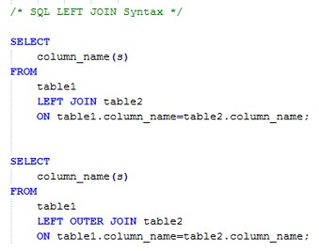
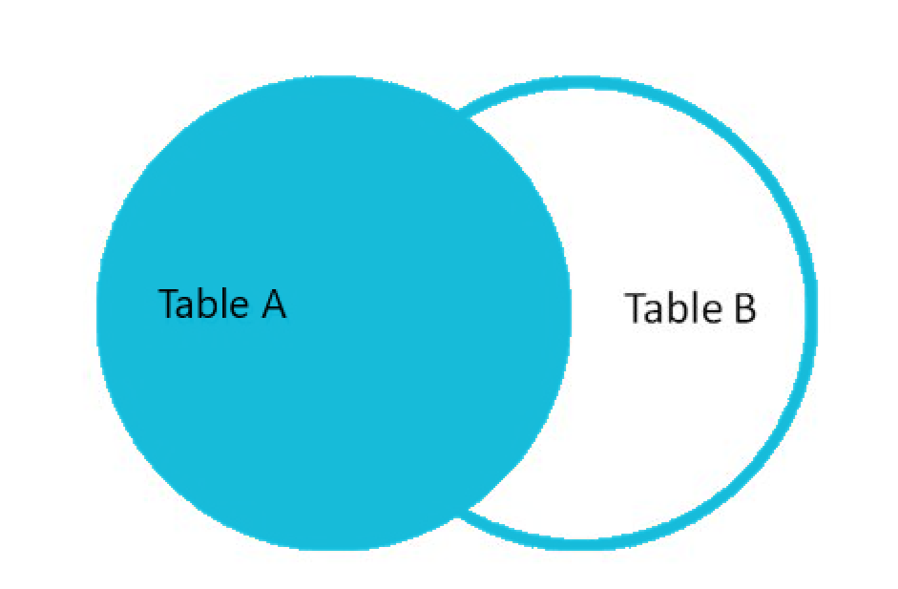
Endava Tech Courses
OCTOBER @22
JOINs
LEFT JOIN
Returns all rows from the left table (table1), with the matching rows in the right table (table2). ​
The result is NULL in the right side when there is no match.
03 — JOINs & UNION
DAMANCIUC XENIA – IVAN KULISNKI

Slide 12
Endava Tech Courses
OCTOBER @22
JOINs
LEFT JOIN
Returns all rows from the left table (table1), with the matching rows in the right table (table2). ​
The result is NULL in the right side when there is no match.
intern_id​ | intern_name​ | stream_id​
1​ | Alex​ | 1​
2​ | John​ | 1​
3​ | Ana​ | 2​
4​ | Rick​ | NULL​
stream_id​ | stream_name​
1​ | Java​
2​ | .NET​
3​ | iOS​
intern_id​ | intern_name​ | stream_id​ | stream_name​
1​ | Alex​ | 1​ | Java​
2​ | John​ | 1​ | Java​
3​ | Ana​ | 2​ | .NET​
4​ | Rick​ | NULL​ | NULL​
03 — JOINs & UNION
DAMANCIUC XENIA – IVAN KULISNKI

Slide 13
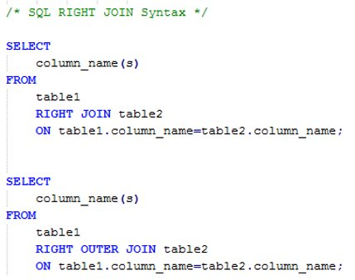
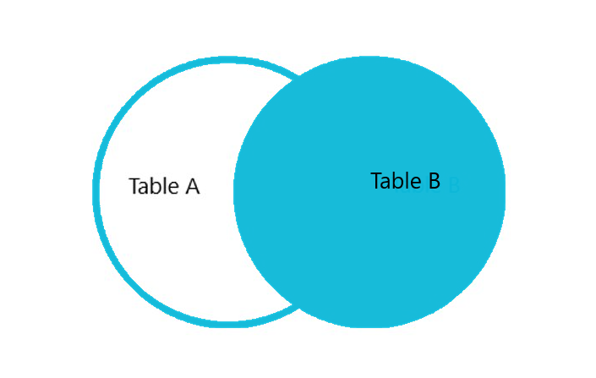
Endava Tech Courses
OCTOBER @22
JOINs
RIGHT JOIN
Returns all rows from the right table (table2), with the matching rows in the right table (table1). ​
The result is NULL in the left side when there is no match.
03 — JOINs & UNION
DAMANCIUC XENIA – IVAN KULISNKI

Slide 14
Endava Tech Courses
OCTOBER @22
JOINs
RIGHT JOIN
Returns all rows from the right table (table2), with the matching rows in the right table (table1). ​
The result is NULL in the left side when there is no match.
intern_id​ | intern_name​ | stream_id​
1​ | Alex​ | 1​
2​ | John​ | 1​
3​ | Ana​ | 2​
4​ | Rick​ | NULL​
stream_id​ | stream_name​
1​ | Java​
2​ | .NET​
3​ | iOS​
stream_id​ | stream_name​ | intern_id​ | intern_name​ | stream_​ id​
1​ | Java​ | 1​ | Alex​ | 1​
1​ | Java​ | 2​ | John​ | 1​
2​ | .NET​ | 3​ | Ana​ | 2​
3​ | iOS​ | NULL​ | NULL​ | NULL​
03 — JOINs & UNION
DAMANCIUC XENIA – IVAN KULISNKI

Slide 15
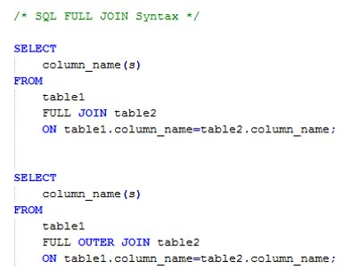
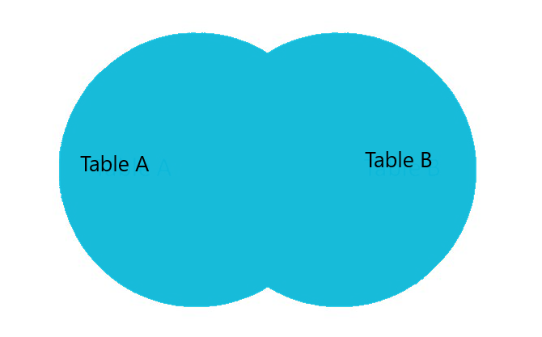
Endava Tech Courses
OCTOBER @22
JOINs
FULL JOIN
Returns all rows from the left table (table1) and from the right table (table2).​
The FULL OUTER JOIN keyword combines the result of both LEFT and RIGHT joins.
03 — JOINs & UNION
DAMANCIUC XENIA – IVAN KULISNKI

Slide 16
Endava Tech Courses
OCTOBER @22
JOINs
FULL JOIN
Returns all rows from the left table (table1) and from the right table (table2).​
The FULL OUTER JOIN keyword combines the result of both LEFT and RIGHT joins.
intern_id​ | intern_name​ | stream_id​
1​ | Alex​ | 1​
2​ | John​ | 1​
3​ | Ana​ | 2​
4​ | Rick​ | NULL​
stream_id​ | stream_name​
1​ | Java​
2​ | .NET​
3​ | iOS​
intern_id​ | intern_name​ | stream_id​ | stream_name​
1​ | Alex​ | 1​ | Java​
2​ | John​ | 1​ | Java​
3​ | Ana​ | 2​ | .NET​
4​ | Rick​ | NULL​ | NULL​
NULL​ | NULL​ | 3​ | iOS​
03 — JOINs & UNION
DAMANCIUC XENIA – IVAN KULISNKI

Slide 17
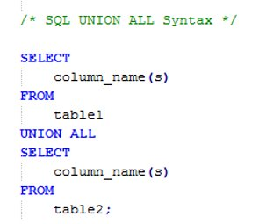
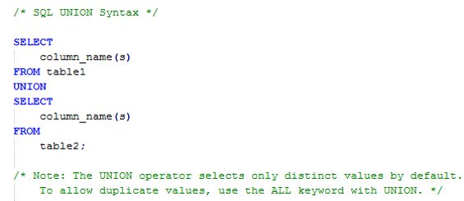
Endava Tech Courses
OCTOBER @22
JOINs
SELF JOIN
It’s a regular join, but the table is joined with itself.​
SELECT column_name(s) FROM table1 T1, table1 T2 WHERE condition;
UNION
This operator combines the result of two or more SELECT statements
01 — Aggregate (GROUP) functions
DAMANCIUC XENIA – IVAN KULISNKI

Slide 18
| Endava Tech Courses
OCTOBER @22
TRANSACTION CONROL LANGUAGE (TCL)
03 — Agenda
DAMANCIUC XENIA – IVAN KULISNKI

Slide 19
Endava Tech Courses
OCTOBER @22
TRANSACTION
A transaction is a unit of work that is performed against a database. Transactions are units or sequences of work accomplished in a logical order, whether in a manual fashion by a user or automatically by some sort of a database program.
A transaction is the propagation of one or more changes to the database.
Transactional control commands are only used with the DML commands INSERT, UPDATE and DELETE only. They cannot be used while creating tables or dropping them because these operations are automatically committed in the database.
02 — Subqueries
DAMANCIUC XENIA – IVAN KULISNKI

Slide 20
Endava Tech Courses
OCTOBER @22
ACID
ATOMICITY
CONSISTENCY
ISOLATION
DURABILITY
Ensures that all operations within the work unit are completed successfully; otherwise, the transaction is aborted at the point of failure and previous operations are rolled back to their former state.
Ensures that the database properly changes states upon a successfully committed transaction
Enables transactions to operate independently of and transparent to each other.
Ensures that the result or effect of a committed transaction persists in case of a system failure.
03 — SQL Main commands
DAMANCIUC XENIA – IVAN KULISNKI

Slide 21
Endava Tech Courses
OCTOBER @22
TRANSACTION CONROL LANGUAGE (TCL)
BEGIN TRANSACTION
COMMIT
ROLLBACK
Ensures that all operations within the work unit are completed successfully; otherwise, the transaction is aborted at the point of failure and previous operations are rolled back to their former state.
Ensures that the database properly changes states upon a successfully committed transaction
Enables transactions to operate independently of and transparent to each other.
03 — SQL Main commands
DAMANCIUC XENIA – IVAN KULISNKI

Slide 22
| Endava Tech Courses
OCTOBER @22
INDEXES
03 — Agenda
DAMANCIUC XENIA – IVAN KULISNKI

Slide 23

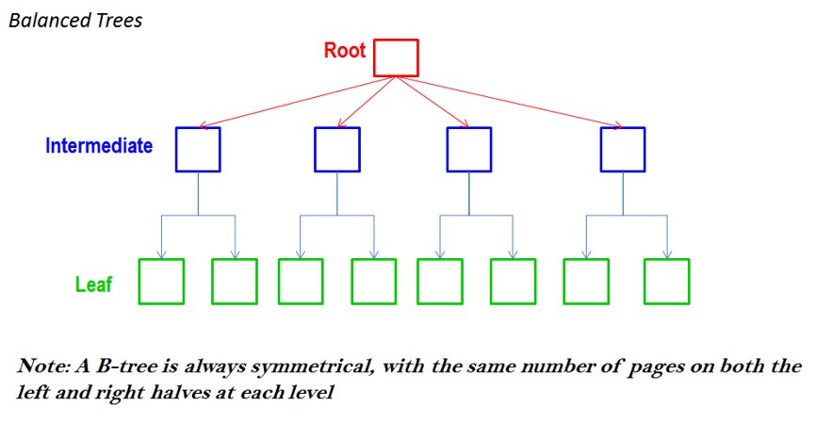
Endava Tech Courses
OCTOBER @22
INDEXEs
INDEX allows the database application to find data fast; without reading the whole table.​
05 — Aliases
DAMANCIUC XENIA – IVAN KULISNKI

Slide 24


