Slide 1


Endava Tech Courses
OCTOBER @22
Java LOGGING
Sooner or later, every Java application needs logging
ELENA HAJDEU-CHICAROS

Slide 2
Endava Tech Courses
OCTOBER @22
Java Logging basics
01
Logging frameworks
02
Logging levels
03
How to start: Configuration
04
What to log?
05
What not to log?
06
00 — Agenda
ELENA HAJDEU-CHICAROS

Slide 3


Endava Tech Courses
OCTOBER @22
JAVA LOGGING BASICS
WHAT IS?
In a clear way, logging is just a fancy word to define a process of keeping a record of all data input, processes, data output, and results in a program.
WHY?
Useful logs can provide the developer (especially when someone must debug/maintain someone else’s code) with tremendous help when trying to understand what the code does.
WHEN?
You may log every operation of an application, log only when errors occur, or log critical operations done by a user, especially if you want to have control of who’s doing what for audit purposes.
01 — Java Logging basics
ELENA HAJDEU-CHICAROS

Slide 4


Endava Tech Courses
OCTOBER @22
JAVA LOGGING BASICS
Good logging requires three things:
The log messages need to provide the required information to understand what the application does internally.
Writing log messages must be as efficient as possible so that it doesn’t affect the performance of your application.
You need to be able to adapt the logging details to different deployment environments and situations.
While you still need to decide yourself which log messages you should write for each use case, you don’t need to worry about requirement 2 and 3.
Various logging frameworks already solved these technical requirements.
You only need to choose one of them and use it to write your log messages.
01 — Java Logging basics
ELENA HAJDEU-CHICAROS

Slide 5
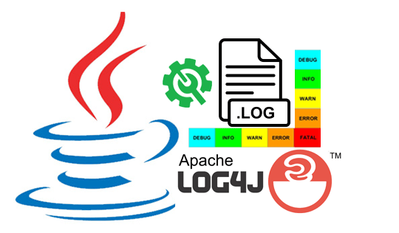
Endava Tech Courses
OCTOBER @22
LOGGING FRAMEWORKS
Java provides a built-in framework in the java.Util.Logging package.
There are also many third-party frameworks including Log4j, Logback and Tinylog.
You can also use an abstraction layer, such as SL4J (Simple Logging Façade for Java) and Apache Commons Logging, which decouples your code from the underlying logging framework so you can switch between logging frameworks on the fly.
02 — Logging frameworks
ELENA HAJDEU-CHICAROS

Slide 6


Endava Tech Courses
OCTOBER @22
LOGGING FRAMEWORKS
Logback was written by the same developer who implemented Log4j with the goal to become its successor.
It follows the same concepts as Log4j but was rewritten to:
improve the performance,
support SLF4J natively,
implement several other improvements like advanced filtering options and automatic reloading of logging configurations.
02 — Logging frameworks
ELENA HAJDEU-CHICAROS

Slide 7

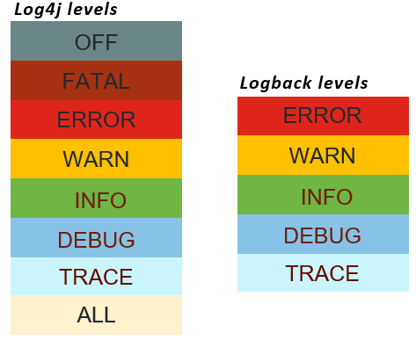
Endava Tech Courses
OCTOBER @22
LOGGING LEVELS
Log levels provide a way to categorize logs by their severity, or their impact on the overall health and stability of the application.
logger.info("Application successfully started on port 8080");
logger.error("Database connection is down", exception);
logger.warn("Invalid bank account number for record=[{}]", 53);
03 — Logging levels
ELENA HAJDEU-CHICAROS

Slide 8
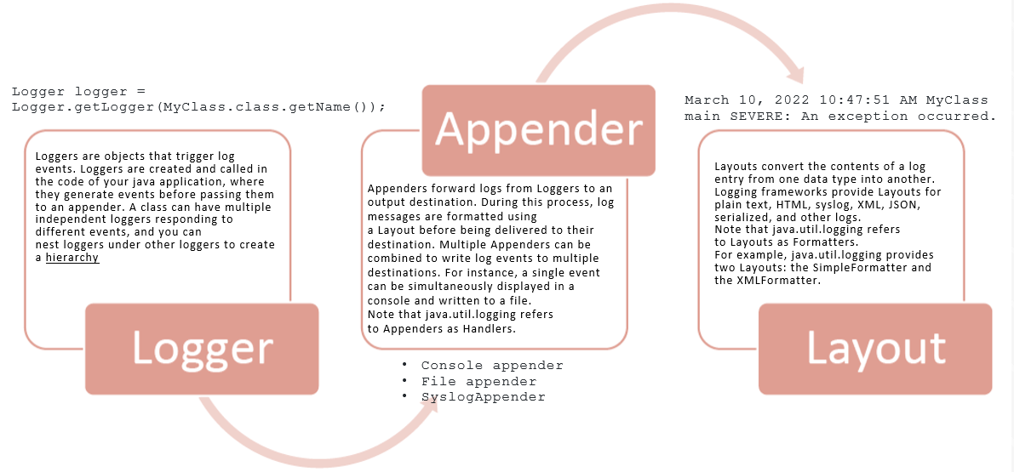
Endava Tech Courses
OCTOBER @22
HOW TO START: CONFIGURATION
04 — How to start: Configurations
ELENA HAJDEU-CHICAROS

Slide 9

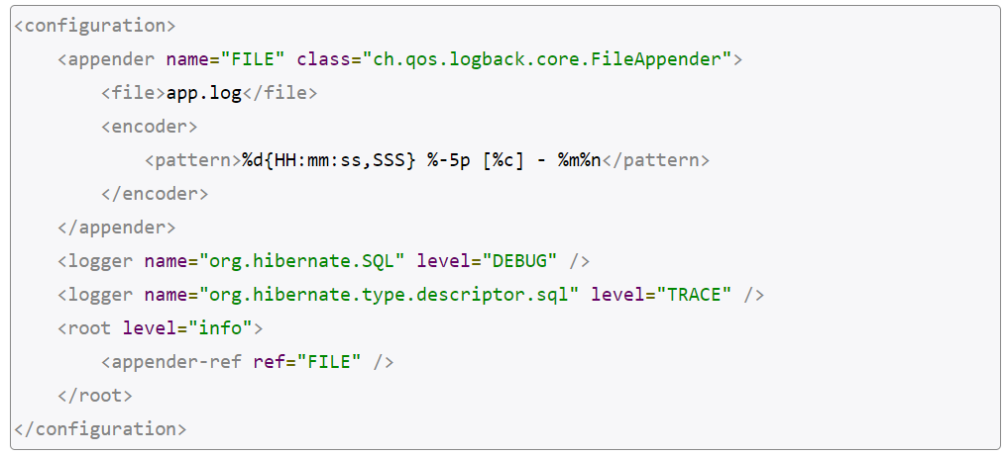
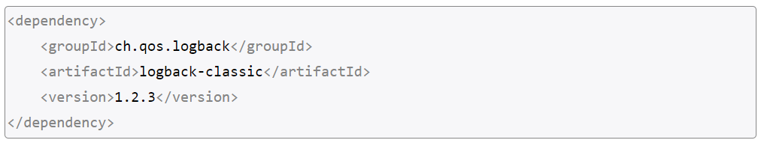
Endava Tech Courses
OCTOBER @22
HOW TO START: CONFIGURATION
Write appender configuration in a logback.xml file
Adding dependencies in POM file if necessary
Create a new Logger
private final Logger logger = LoggerFactory.getLogger(this.getClass().getName());
04 — How to start: Configuration
ELENA HAJDEU-CHICAROS

Slide 10


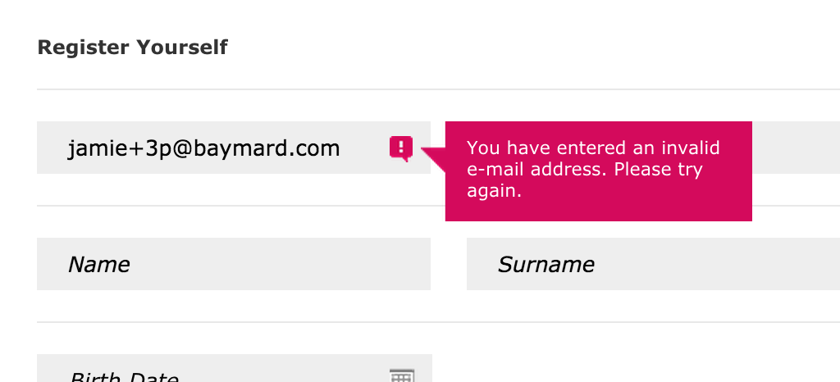
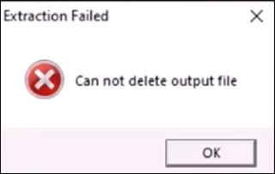
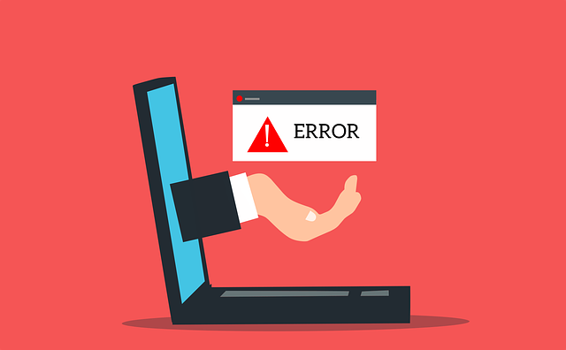
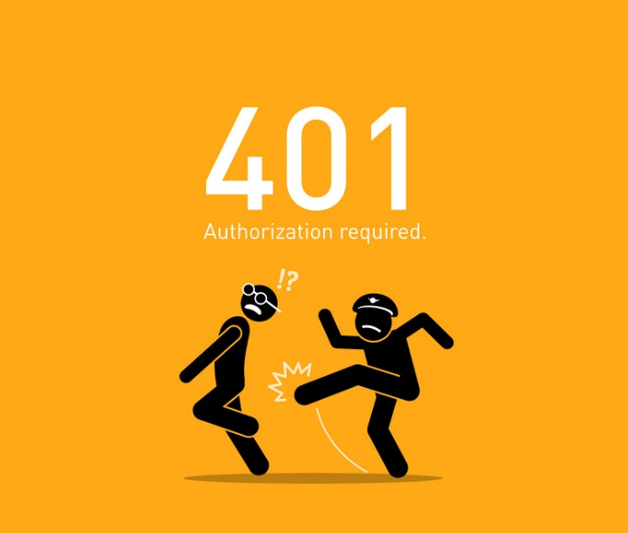
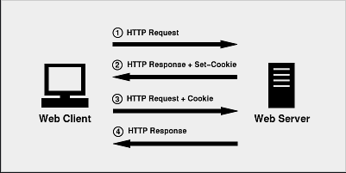
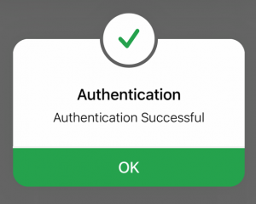
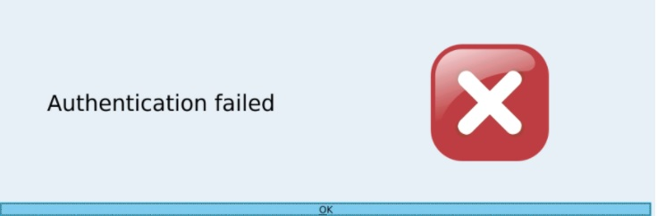
Endava Tech Courses
OCTOBER @22
WHAT TO LOG?
The application logs must record "when, where, who and what" for each event
Where possible, always log:
Use of higher-risk functionality e.g. network connections, addition or deletion of users, changes to privileges, assigning users to tokens, adding or deleting tokens, use of systems administrative privileges, access by application administrators, all actions by users with administrative privileges, access to payment cardholder data, use of data encrypting keys, key changes, creation and deletion of system-level objects, data import and export including screen-based reports, submission of user-generated content - especially file uploads
Input validation failures e.g. protocol violations, unacceptable encodings, invalid parameter names and values
Output validation failures e.g. database record set mismatch, invalid data encoding
Application and related systems start-ups and shut-downs, and logging initialization (starting, stopping or pausing)
Authentication failures
Authorization (access control) failure
Session management failures e.g. cookie session identification value modification
Application errors and system events e.g. syntax and runtime errors, connectivity problems, performance issues, third party service error messages, file system errors, file upload virus detection, configuration changes
Authentication successes
05 — What to log?
ELENA HAJDEU-CHICAROS

Slide 11



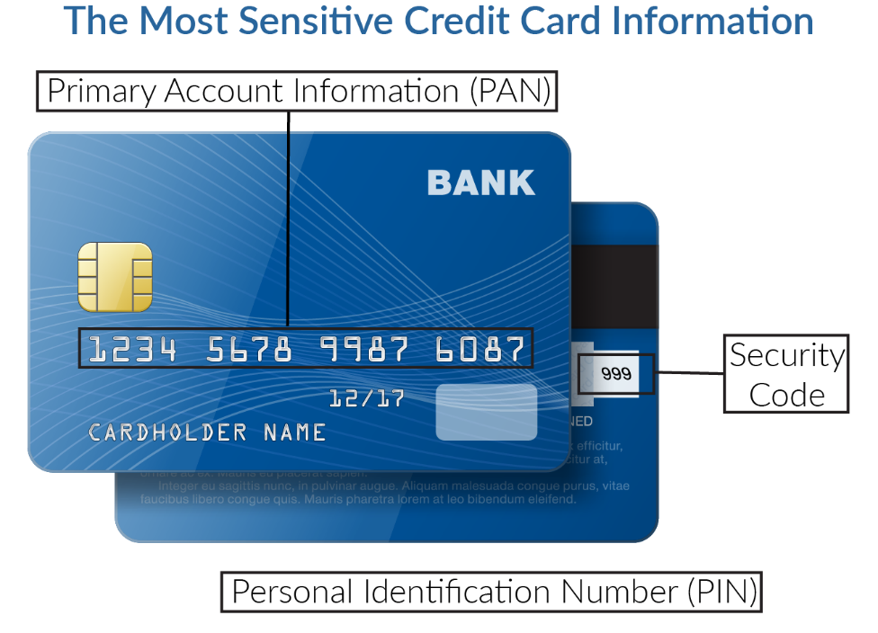

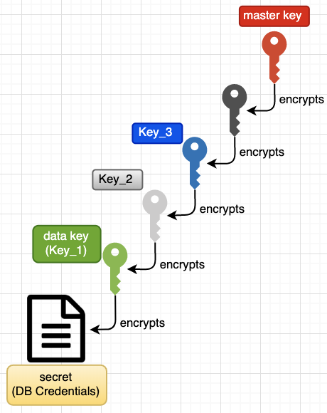
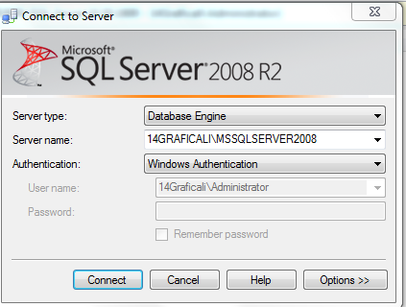

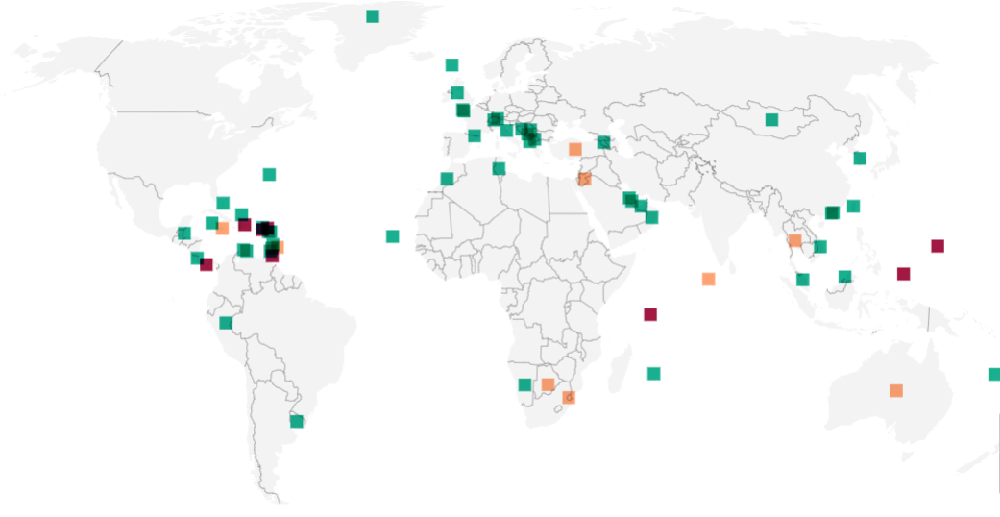
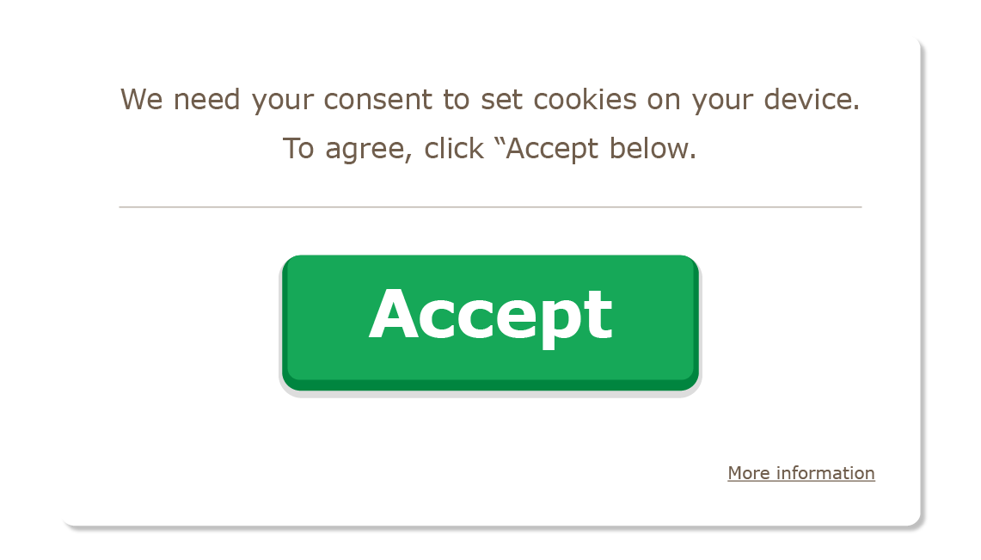
Endava Tech Courses
OCTOBER @22
WHAT NOT TO LOG?
The following should not usually be recorded directly in the logs, but instead should be
removed, masked, sanitized, hashed or encrypted:
Application source code
Access tokens
Sensitive personal data and some forms of personally identifiable information (PII) e.g. health, government identifiers, vulnerable people
Authentication passwords
Bank account or payment card holder data
Information it is illegal to collect in the relevant jurisdictions
Information a user has opted out of collection, or not consented to e.g. use of do not track, or where consent to collect has expired
Database connection strings
Encryption keys and other master secrets
Commercially-sensitive information
06 — What not to log?
ELENA HAJDEU-CHICAROS

Slide 12


Endava Tech Courses
OCTOBER @22
USEFUL LINKS
http://logging.apache.org/log4j/2.x/manual/configuration.html
https://www.baeldung.com/java-logging-intro
https://stackify.com/compare-java-logging-frameworks/
THANK YOU!
Hajdeu-Chicaros ELENA

