Slide 1
Guitarmageddon
By Erik Halliwell

Slide 2
About Erik
- 4th Year Engineering Physics student at UofA
- Passionate about analog electronics and audio

Slide 3
The Project
In order to save space on Erik’s pedalboard, going to condense multiple important pedals into one package.

Slide 4
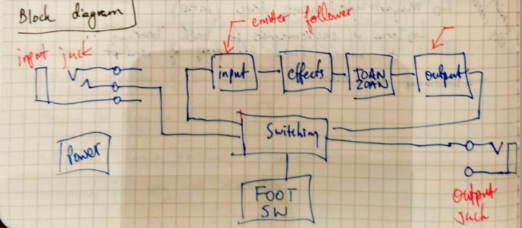
Block Diagram

Slide 5
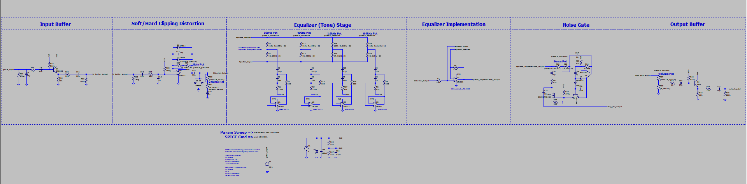
High Level Schematic

Slide 6
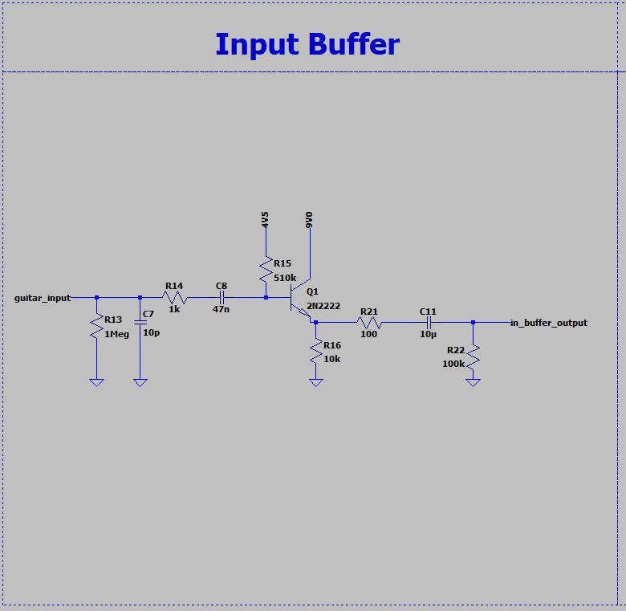
Input Buffer

Slide 7
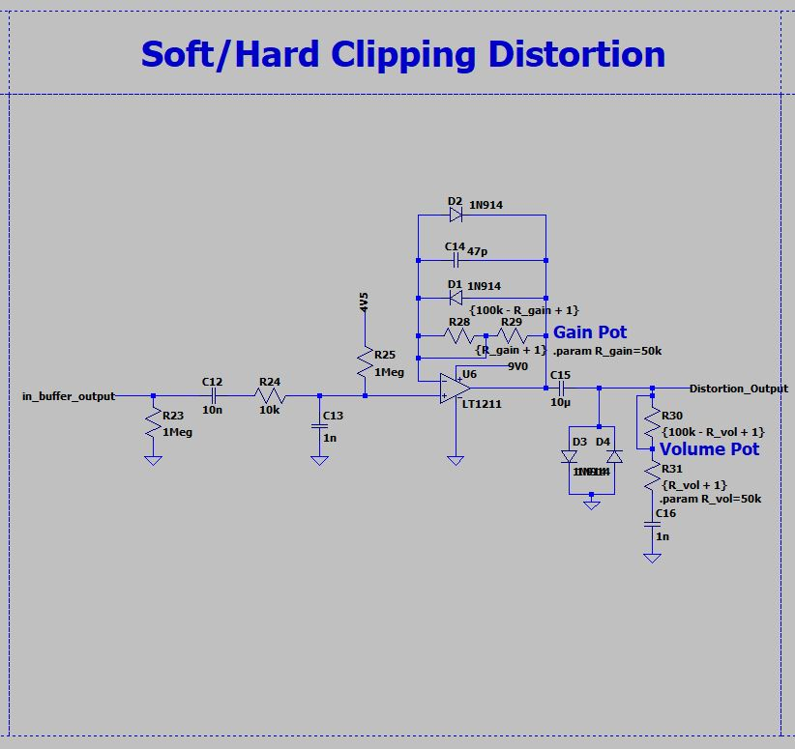
Distortion Stage

Slide 8
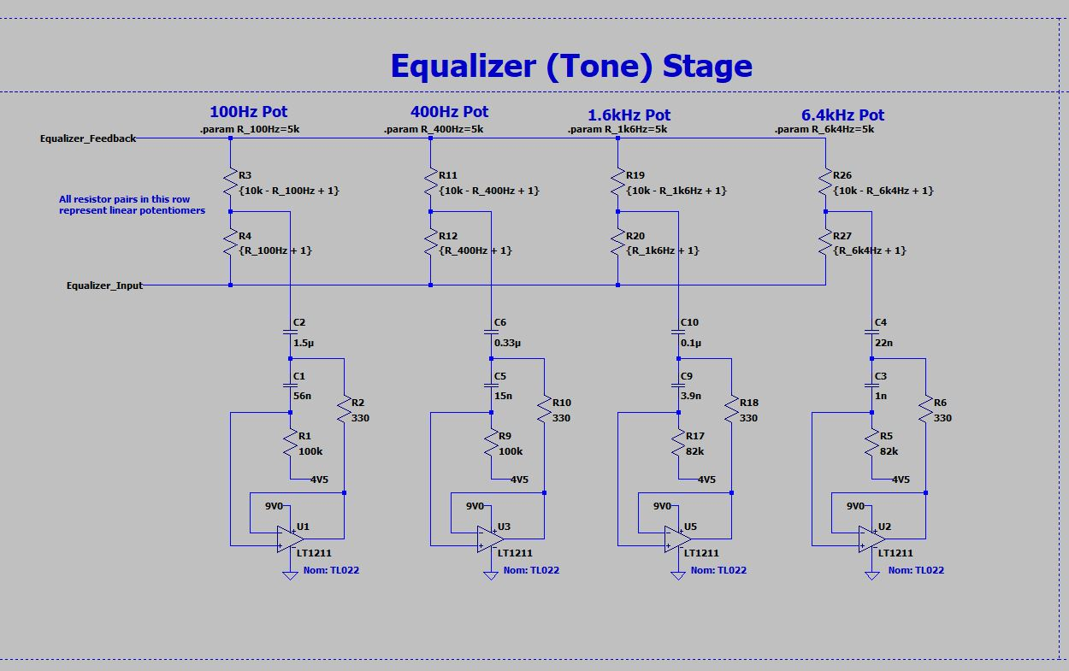
4 Band Equalizer

Slide 9
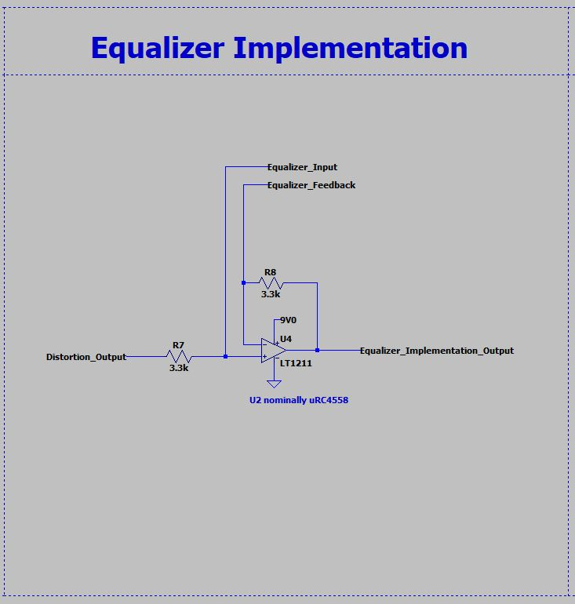
Equalizer Implementation

Slide 10
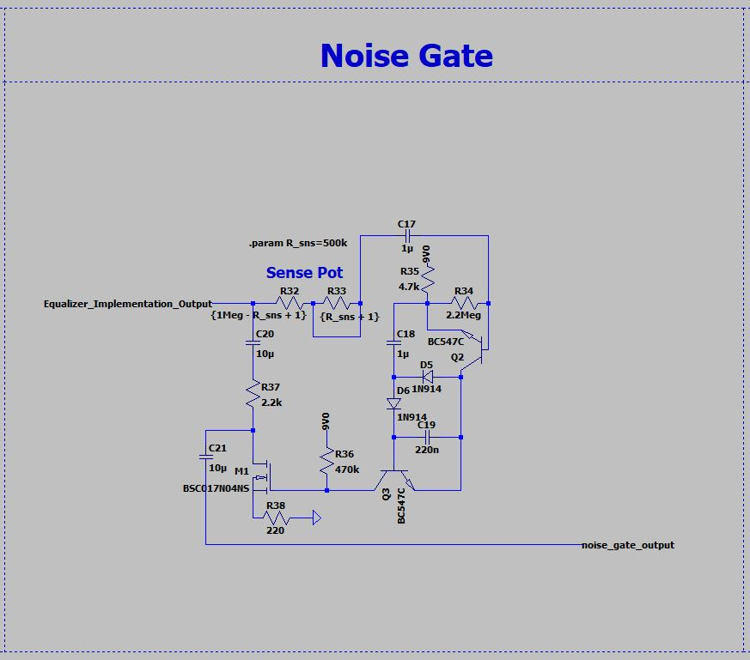
Noise gate

Slide 11
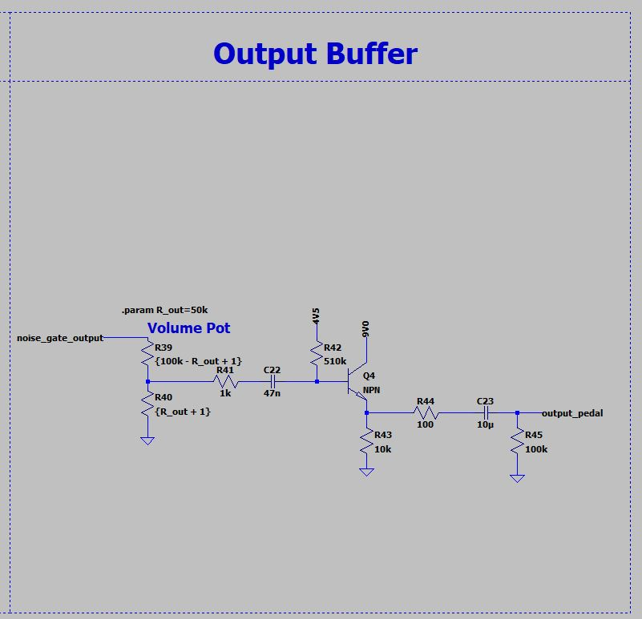
Output Buffer

Slide 12
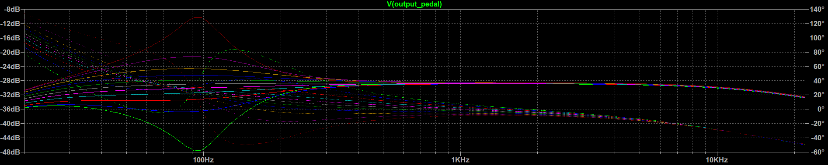
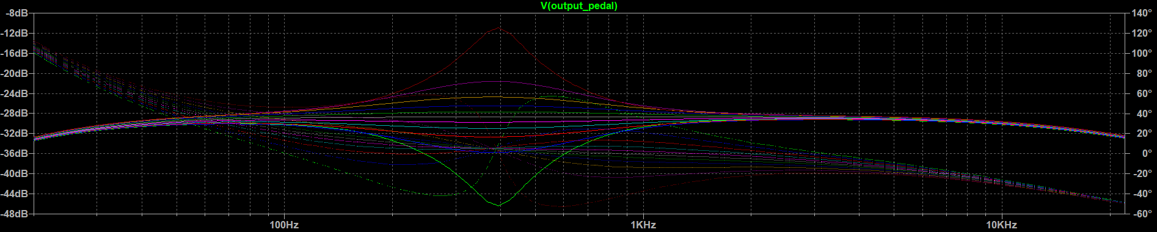
Equalizer Simulation Results 1
100Hz Frequency Response
400Hz Frequency Response

Slide 13
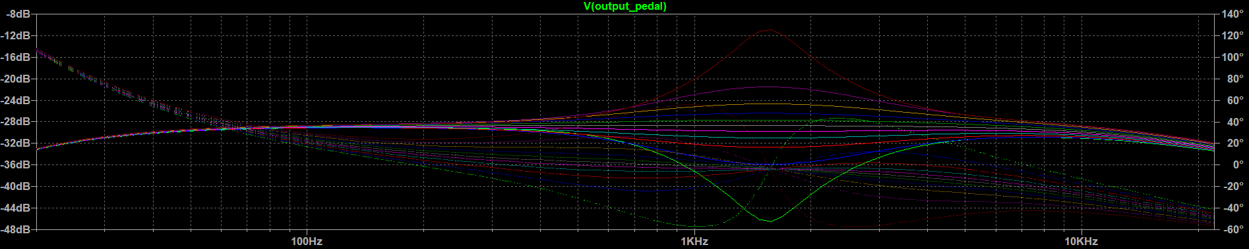
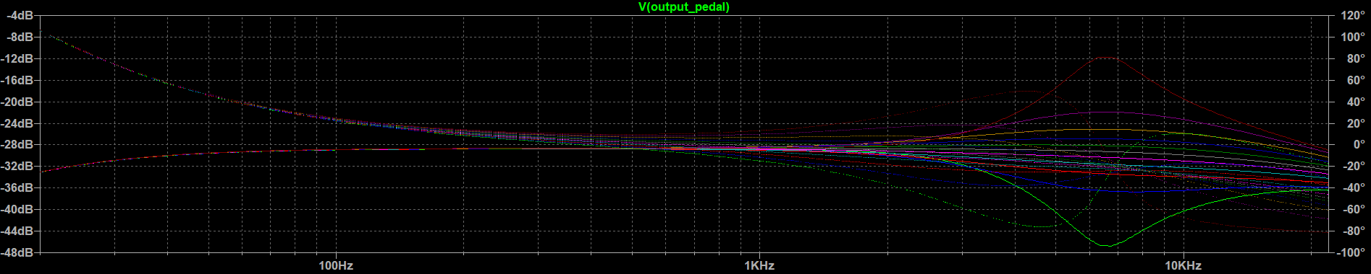
Equalizer Simulation Results 2
1.6kHz Frequency Response
6.4kHz Frequency Response

Slide 14
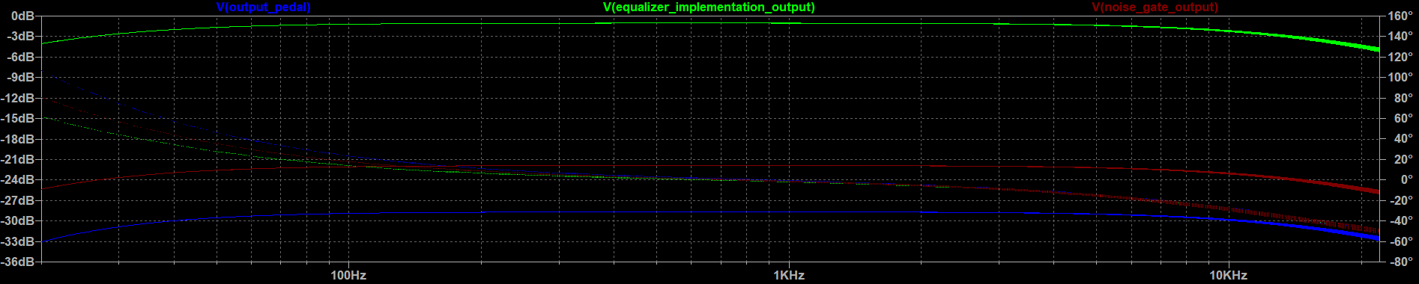
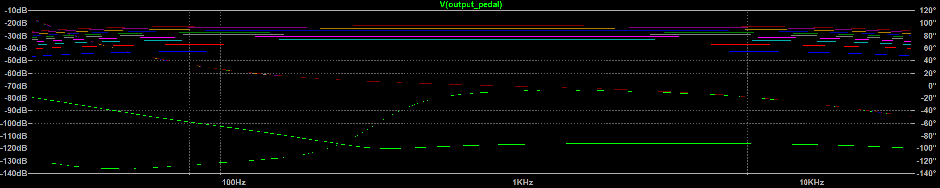
Noise gate and master volume simulations
Noise Gate Effectiveness
Master Volume Sweep

Slide 15
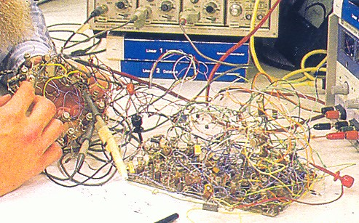

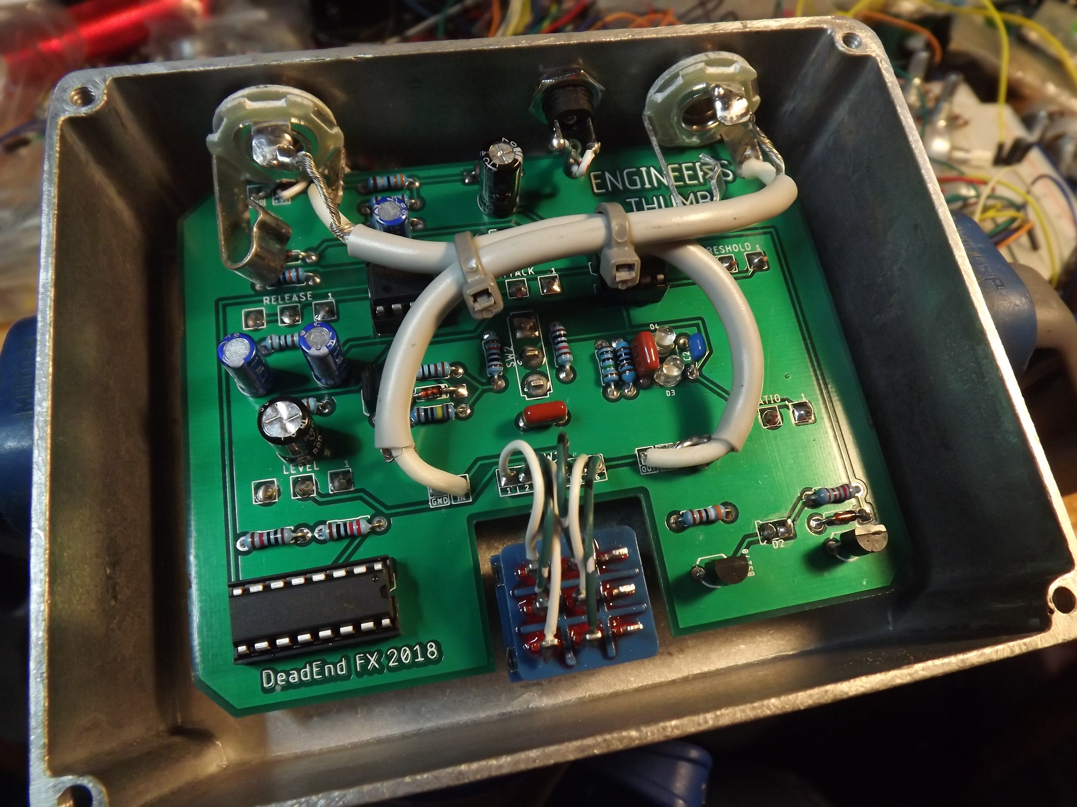
Where it’s headed

Slide 16
Learnings and Challenges
Ltspice potentiometers
Noise gate design

Slide 17

Thank You! Questions?

Slide 18
References
https://neatcircuits.com/doctor_pedal.htm
https://github.com/Cushychicken/ltspice-guitar-pedals
https://www.hobby-hour.com/electronics/s/ge7-equalizer.php

