Slide 1
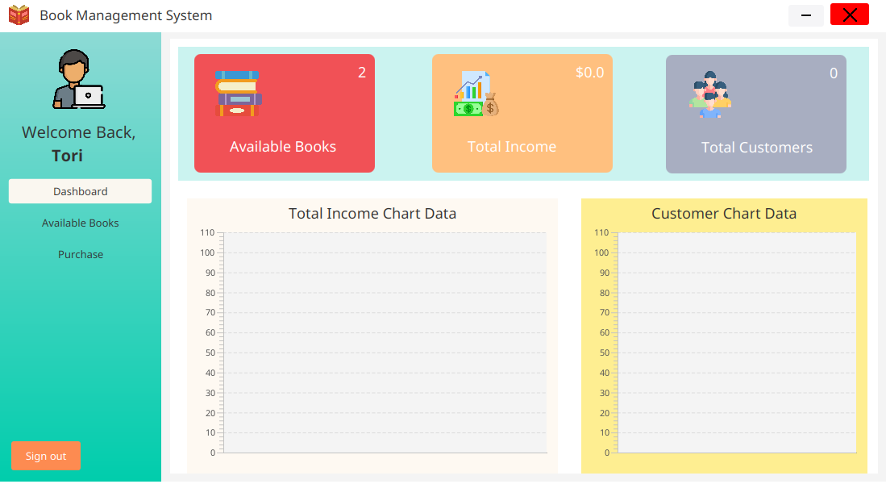
Book Management System

Slide 2
Challenges
Introvert
Poor communication skill
Newbie
New to these technologies

Slide 3
Tools and Technologies
Java
JDBC
SQL
Intellij
Xampp

Slide 4

Dashboard Glimpse

Slide 5
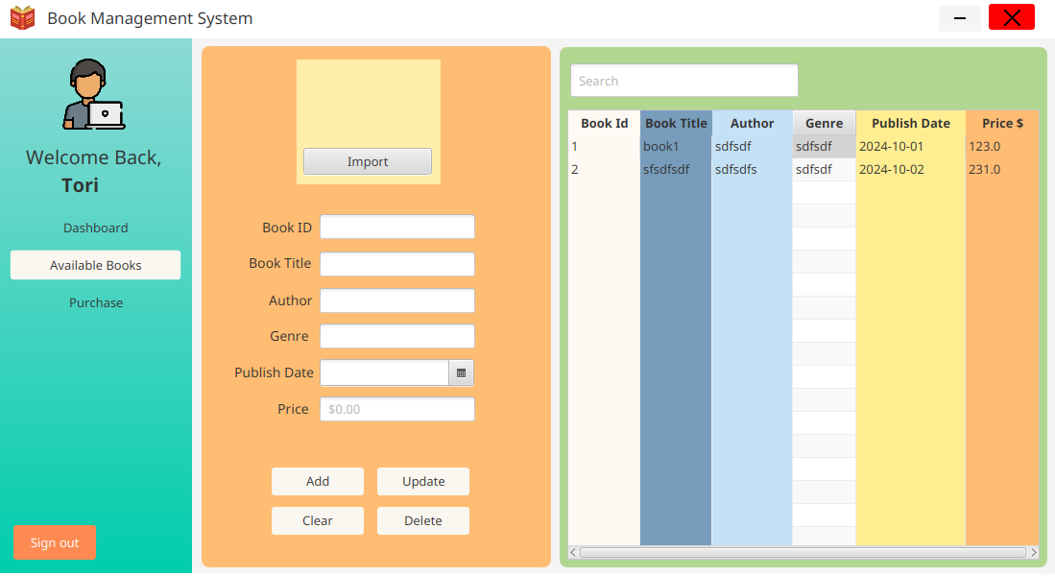
Available Books

Slide 6
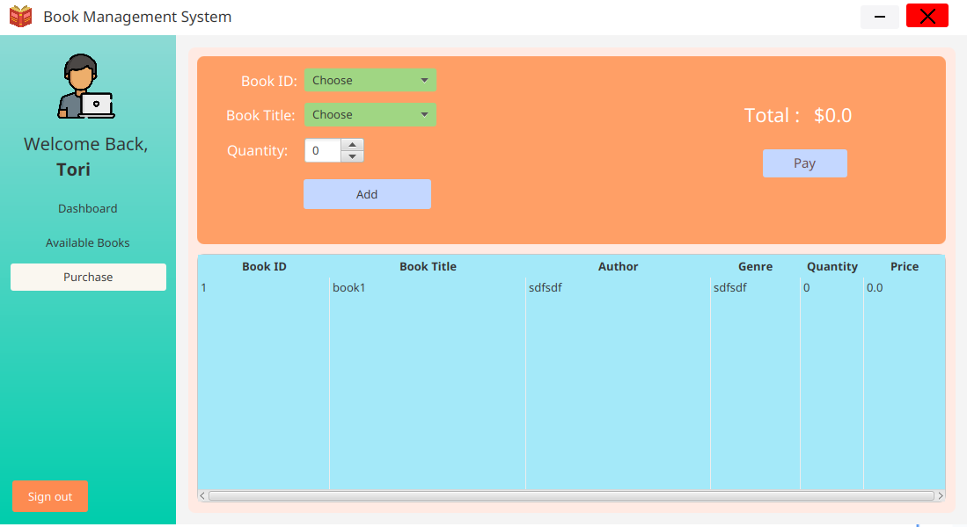
Purchase

