Slide 1


ESTIMATING THE AGE-CONDITIONED AVERAGE TREATMENT EFFECTS CURVES:
AN APPLICATION FOR ASSESSING LOAD-MANAGEMENT STRATEGIES IN THE NBA
Shinpei Nakamura-Sakai¹
Collaborators: Laura Forastiere², Brian Macdonald¹
¹ Yale University, Department of Statistics and Data Science
² Yale University, Department of Biostatistics

Slide 2
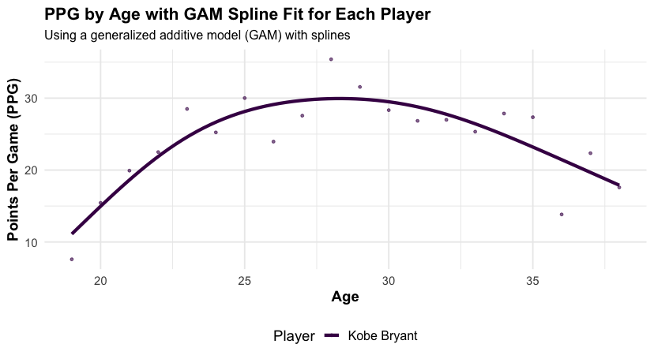
What is an age-curve?

Slide 3
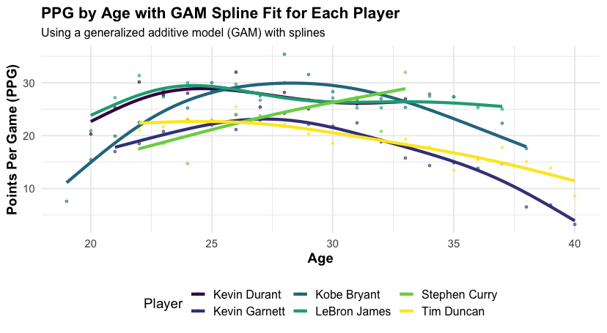
Age-Curves are heterogeneous

Slide 4
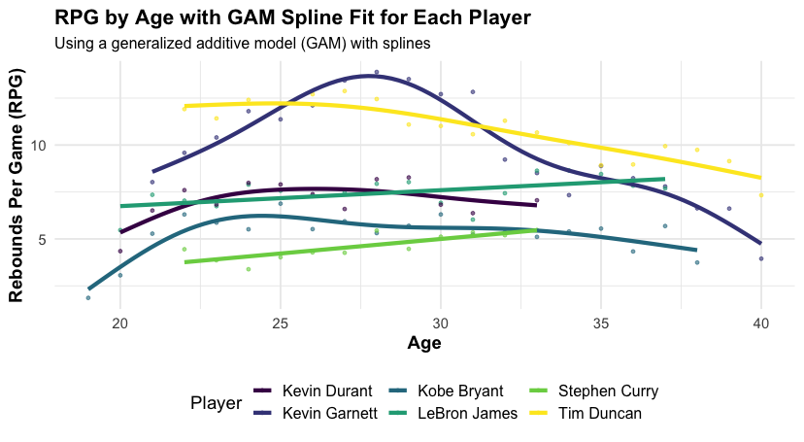
Age-Curves are heterogeneous

Slide 5
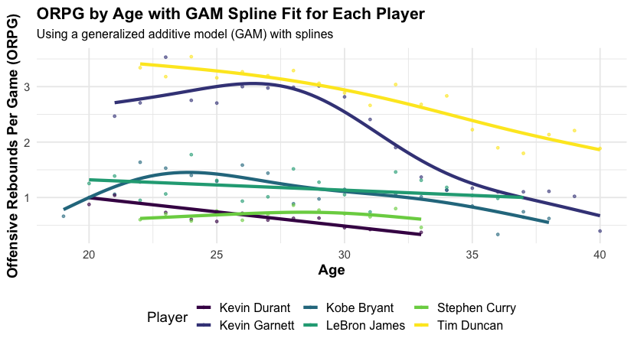
Age-Curves are heterogeneous

Slide 6
Contribution
Game-level data diverging from traditional season-level data approach
There are numerous game-level confounders to consider including the back-to-back games, team you play for, the team you compete against, home court advantage, the teammates and opponents you encounter, the geographic location of the game, the season year, and various other relevant factors
Provide framework to estimate the Age-Conditioned Treatment Effect (ACTE) which
Enables the identification of causal effects under certain assumptions
Capture non-linear trends easier than the previous regression-based methods
Applied the methodology to study the effects of rest on multiple performance metrics across different ages
We find that the rest generally affects positively, but not constantly where the heterogeneity is driven by multiple factors
Notes:
What inspired to use causal inference

Slide 7
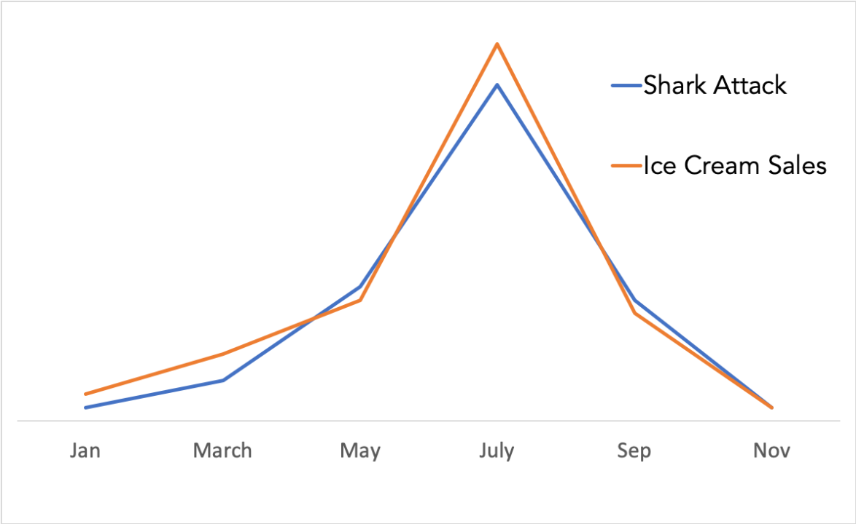
Causal Inference
Correlation vs causation
Does eating ice cream cause shark attack?
Reference: www.linkedin.com/pulse/understanding-difference-between-correlation-shark-candela/

Slide 8



Why causal inference?
Correlation vs causation
Does eating ice cream cause shark attack?
Correlation
Causation

Slide 9



Why causal inference?
Correlation vs causation
Does getting rebound cause more points?
Rebound per game
Correlation?
Causation?
Points per game
Rest
Notes:
Now these are the treatments

Slide 10
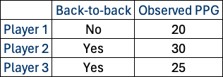
Causal Inference
Example: 3 players, Resting at least one day is the treatment, outcome is Points per game (PPG)
Question: Is resting improve PPG?
Notes:
Aspitin to rest

Slide 11
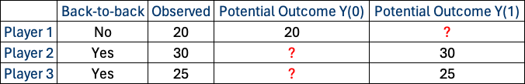
Causal Inference
Example: 3 players, Resting at least one day is the treatment, outcome is Points per game (PPG)
Question: Does resting improve PPG?
Maybe but maybe not. Let’s use the potential outcome framework
Notes:
Aspitin to rest

Slide 12
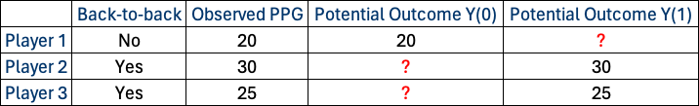
Causal Inference
Example: 3 players, Resting at least one day is the treatment, outcome is Points per game (PPG)
Question: Does resting improve PPG?
Maybe but maybe not. Let’s use the potential outcome framework
Notes:
Aspitin to rest

Slide 13
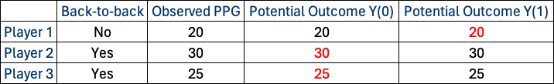
Causal Inference
Example: 3 players, Resting at least one day is the treatment, outcome is Points per game (PPG)
Question: Does resting improve PPG?
Maybe but maybe not. Let’s use the potential outcome framework
For example, in this case, treatment effect is zero
Notes:
Aspitin to rest

Slide 14

Framework
Conditional Expectation Function (CEF)
Consider $N$ units, age $A∈ℤ$ , treatment $W∈\{0,1\}$, $Y(w)$ potential outcome of unit $i$ for treatment $w$ Then the CEF is defined as:
$μ_{0}\left(a,x\right)≔𝔼[Y_{i}(0)|A_{i}=a, X_{i}=x]$ and $μ_{1}\left(a,x\right)≔𝔼[Y_{i}(1)|A_{i}=a, X_{i}=x]$
Under this framework, our main causal estimand of interest is the ACTE, that is:
$τ\left(a\right)≔𝔼\left[Y_{i}\left(1\right)−Y_{i}\left(0\right) | A=a\right]=𝔼_{𝒳}[μ_{1}\left(a,x\right)−μ_{0}(a,x)]$
Takeaway: $μ_{0}$ is the expectation for the control group and $μ_{1}$ is for treatment group and $τ\left(a\right)$ is the difference at age $a$
Notes:
Probably remove the identification.

Slide 15
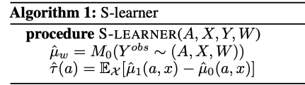
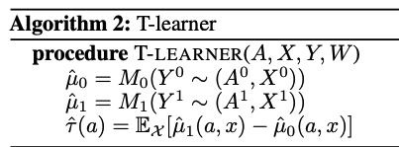
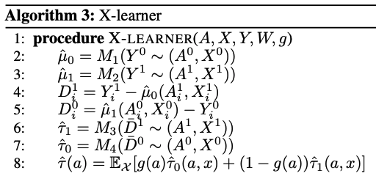

Estimation of ACTE
To estimate the ACTE/$τ\left(a\right)$ we use three meta-learning framework by Künzel et. al (2019) where it allows us to use ANY predictive model (or any supervised ML model)
S-learner: S-learner uses a `single’ model
T-learner: T-learner uses `two’ models, one for treatment and one for control group
X-learner: X-learner `crosses’ the information of treatment and control groups. Using total of `four’ models
Notes:
Put in appendix the algorithms
Give examples of meta-learners
Define OLS and RF and stress that OLS is with spline

Slide 16
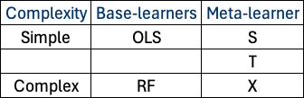
How to pick the right estimator and learner?
Flexibility is good but which learner and estimator should we choose?
As always, the answer depends on the concrete application, effect size, and complexity of the hypothesis
S-learner is effective when the dataset is relatively small, or treatment effect is uniform across the observations
T-learner excels with larger datasets that can support separate models for treated and control groups
X-learner stands out in scenarios where treatment effects are expected to be highly heterogeneous or when there is an imbalance between treated and control group

Slide 17
Simulations Scenarios
Scenario 1: Constant treatment effect
Scenario 2: Linear treatment effect
Scenario 3: Non-linear treatment effect
Notes:
Contatn treatment effect means rest affects equal through ages

Slide 18
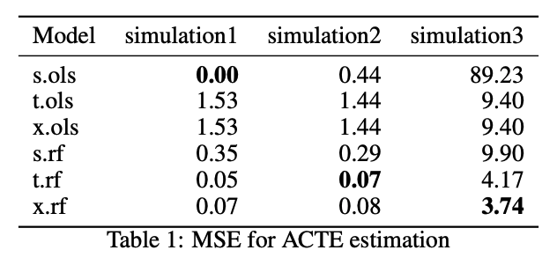
Simulations Results
Flexibility is good but which learner and estimator should we choose?

Slide 19
Application to NBA data to assess effect of load-management
Success: Kawhi Leonard 2018-2019 season. Played only 60/82 regular season games, he was in top form for the playoffs, leading the Raptors to their championship
Critiques: Impact on regular season’s significance, diminishing fan engagement. Leading to Player Participation Policy for the 2023-2024 season, requiring star players to participate more frequently.
Contribution: Quantitative analysis of load management’s precise impact remains scarce, particularly in comparison to the effects of playing in back-to-back games. In this study, we apply the ACTE framework to measure the impact of rest on players, segmented by age.
Note: While randomized controlled trial would be ideal it is infeasible for practical challenge in the NBA. Hence, we do observational.
Notes:
What players covariates and seasons.

Slide 20
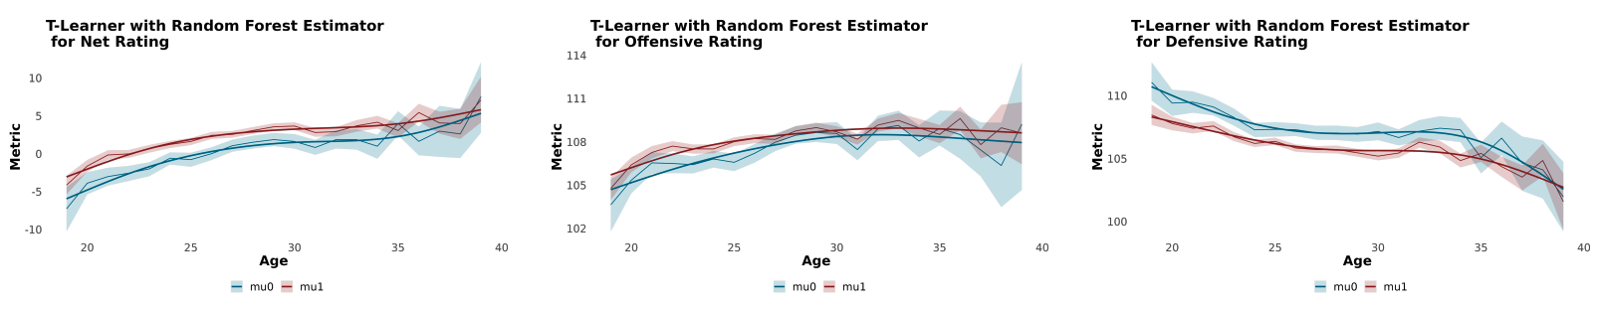
Conditional Expectation Function (CEF) for T-learner with Random Forest
Net, offensive, and defensive ratings
Not significant for young and old players due to lack of sample size
Non rested players tend to be more defensive liability compared to effect on offence
Notes:
I should explain why we are showing
Add distribution in appendix
Red is rest and blue is back-to-back

Slide 21
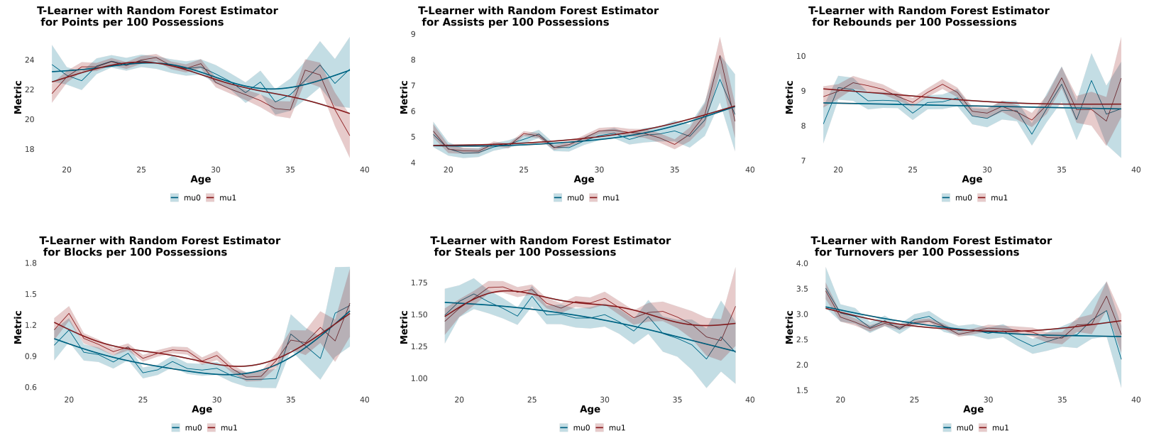
Conditional Expectation Function (CEF) for T-learner with Random Forest
Normalized box score statistics
Notes:
Vertical axis is the metrix and horizontal axis is always age

Slide 22
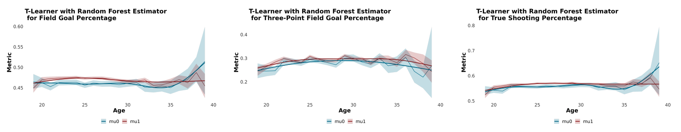
Conditional Expectation Function (CEF) for T-learner with Random Forest
Shooting percentage
The effect is more pronounced for field goal percentage than for three-point field goal percentage. This is likely because the play becomes more physical as players get closer to the rim
Young and old player effects not significant due to sample size

Slide 23
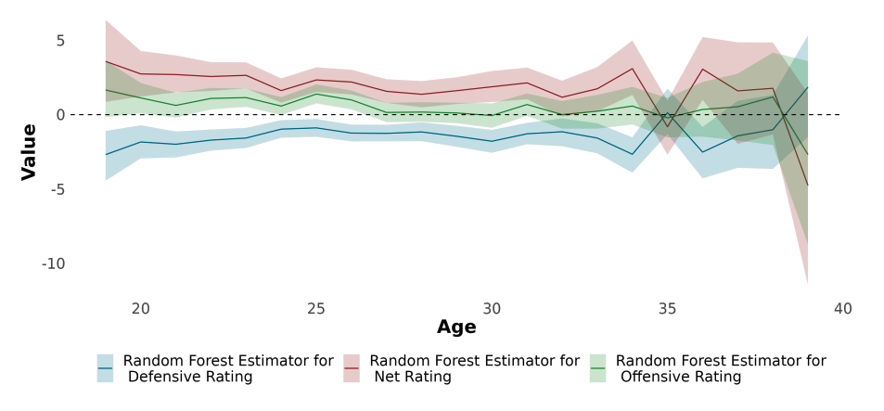
ACTE for X-learner with Random Forest
Net, offensive, and defensive ratings
Notes:
Y-axis is not the treatment effect

Slide 24
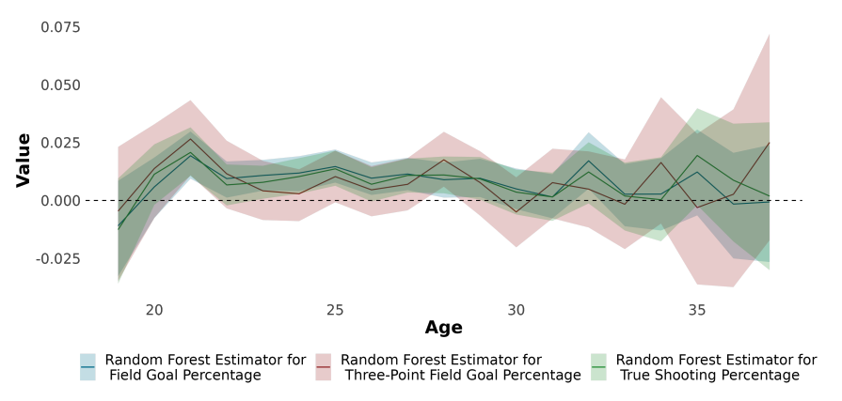
ACTE for X-learner with Random Forest
Shooting percentage

Slide 25
Discussion and future work
Rest matters: More on defensive end than in offensive end
Advances the age-curve literature by
incorporating rich game-level data
Devising framework for causal effect estimation
Allowing to capture non-linear trends using flexible machine learning models
Meta-learning framework for multiple treatment problem: Allows to differentiate between one day vs two days rest
Rest and fatigue: Potentially relate with the fatigue index
Notes:
Add limitations

Slide 26
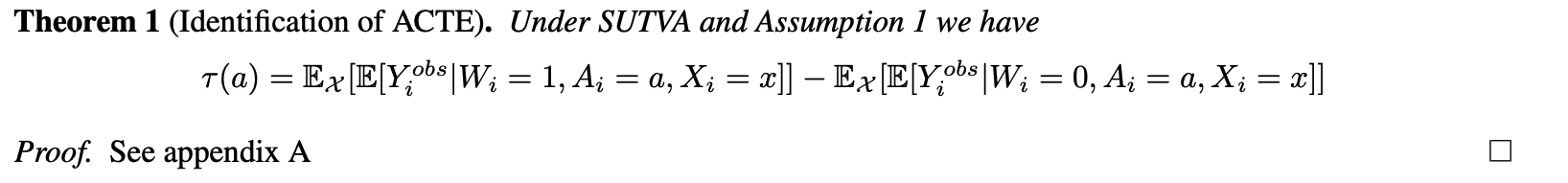
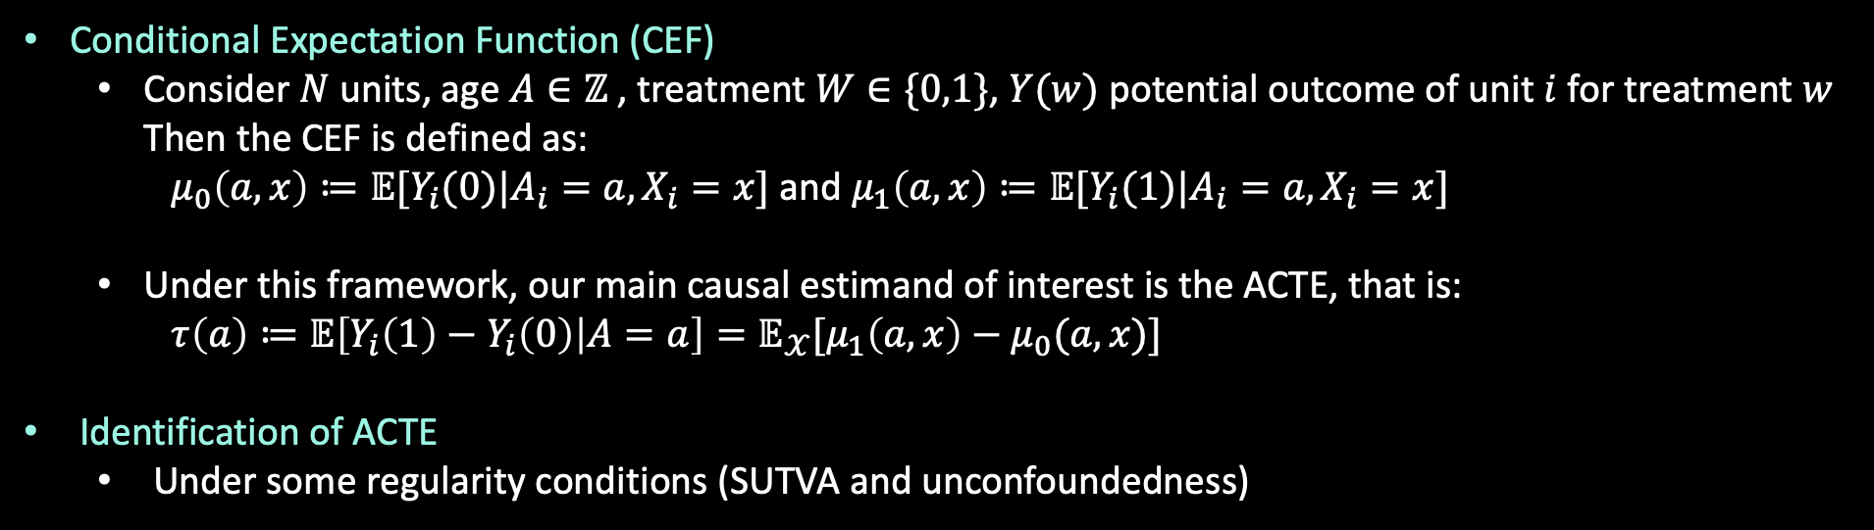
Framework
Conditional Expectation Function (CEF)
Consider $N$ units, age $A∈ℤ$ , treatment $W∈\{0,1\}$, $Y(w)$ potential outcome of unit $i$ for treatment $w$ Then the CEF is defined as:
$μ_{0}\left(a,x\right)≔𝔼[Y_{i}(0)|A_{i}=a, X_{i}=x]$ and $μ_{1}\left(a,x\right)≔𝔼[Y_{i}(1)|A_{i}=a, X_{i}=x]$
Under this framework, our main causal estimand of interest is the ACTE, that is:
$τ\left(a\right)≔𝔼\left[Y_{i}\left(1\right)−Y_{i}\left(0\right) | A=a\right]=𝔼_{𝒳}[μ_{1}\left(a,x\right)−μ_{0}(a,x)]$
Identification of ACTE
Under some regularity conditions (SUTVA and unconfoundedness)
Notes:
Probably remove the identification.

Slide 27
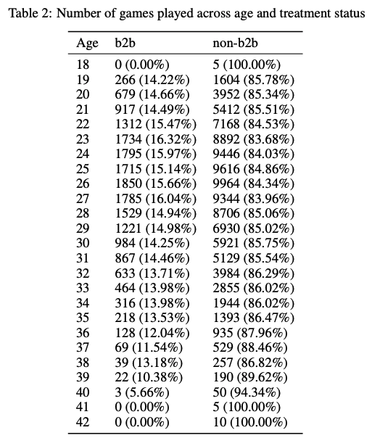
Age-distribution
Notes:
Probably remove the identification.

