Slide 1

Rate My Professor Statistical Analysis
Julia Chong & Ed Haracz

Slide 2
Hypotheses
Alternative Hypotheses | Data Used | Outcome
Private & Public college ratings are statistically different. | 50 most populous public colleges from each state, 45 most populous private colleges | Reject Null.
Professors with a greater quantity of ratings have more extreme ratings. | About 10,000 professors from Pennsylvania State University | Failed to reject.
Professors with longer names have statistically different ratings and rating counts than the population. | Top 50 professors from Pennsylvania State University with the longest names, discluding names that include a dash (-) | Failed to reject rating hypothesis Rejected rating counts hypothesis.
Department ratings are statistically different. | 146 departments from Pennsylvania State University | Reject Null.

Slide 3


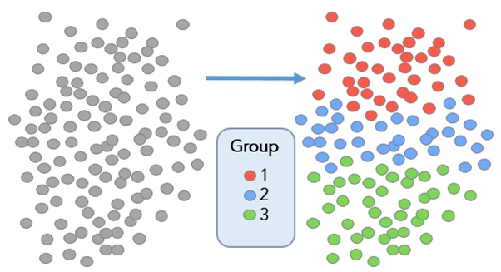



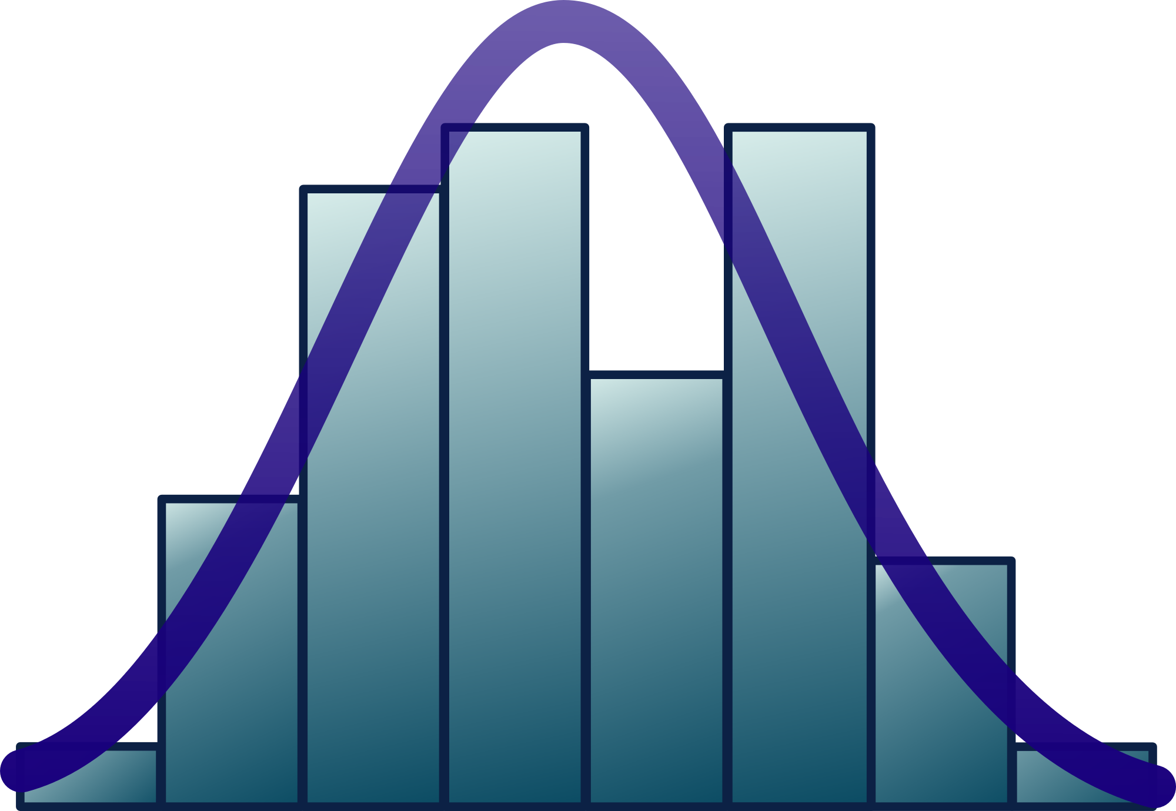
Process
Exploratory Data Analysis
Graphing with Seaborn
College name research
Parsed and grouped data
SQL queries
RateMyProfessor API
Statistical Analysis

Slide 4
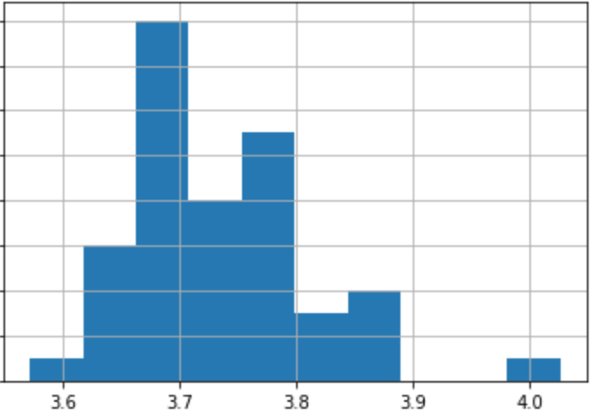
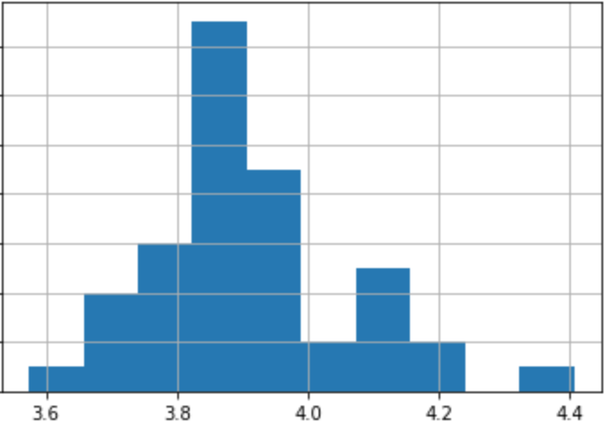
Hypothesis: Public vs. Private
Public Schools Overview:
Mean: 3.734
Standard Dev.: 0.078
Private Schools Overview:
Mean: 3.911
Standard Dev.: 0.151
Rating

Slide 5
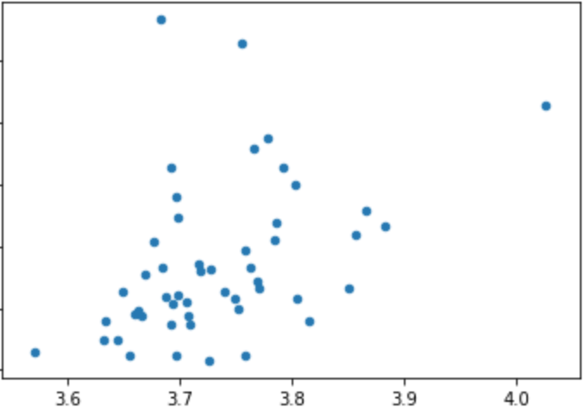
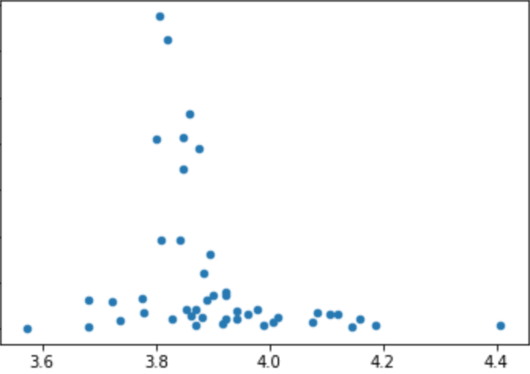
Public vs. Private Scatter
Public
Private
Rating

Slide 6
Public vs. Private
T-test results:
P-value: 1.425e-9
Statistic: -7.061
Effect Size:
Cohen’s D: 1.496
Power: -10.312
Public
Correlation between Rating & Rating Count: 0.422
Private
Correlation between Rating & Rating Count: -0.269

Slide 7
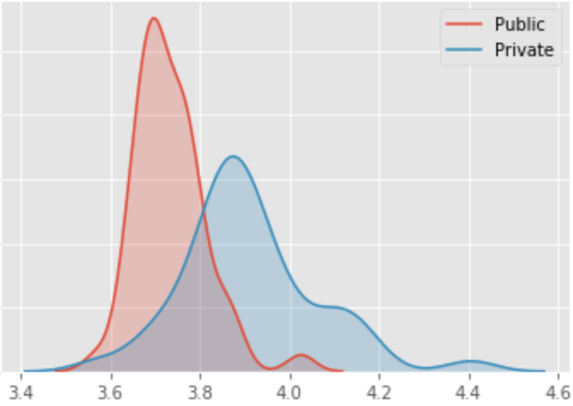
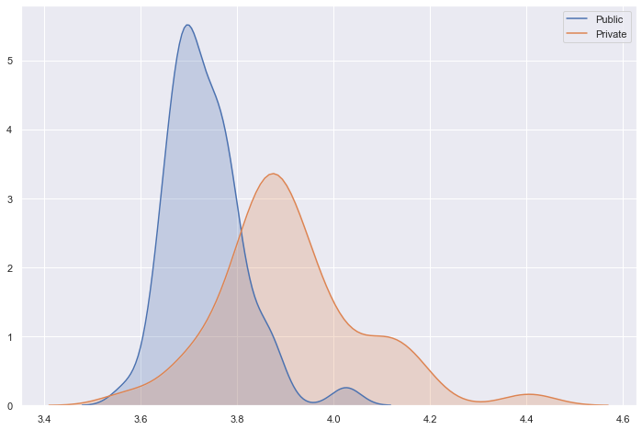
Public vs Private Distributions
Frequency
Rating

Slide 8
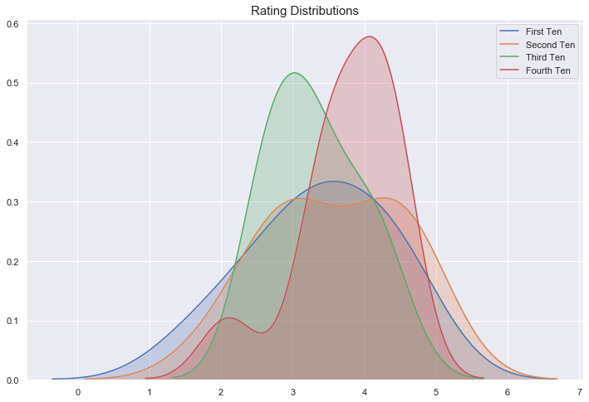
Hypothesis: Rating Count Outliers
At a glance, the first ten category has more outliers than the other categories.
However, after running the t-test, the values failed to reject the null hypothesis and also were not consistent.

Slide 9
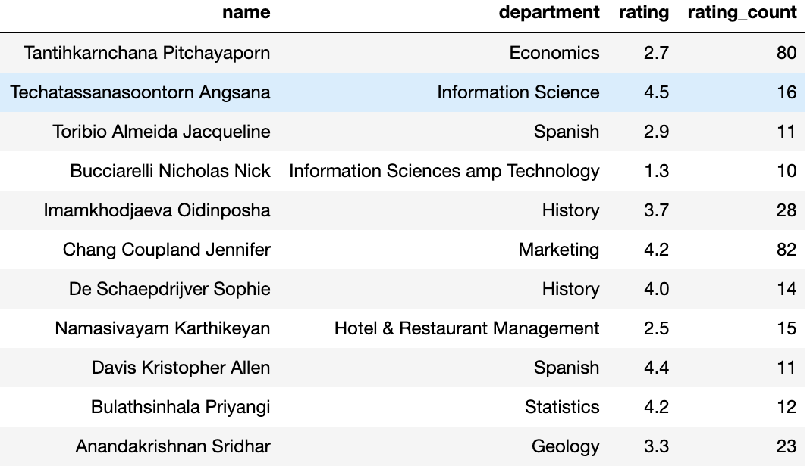
Hypothesis: Foreign Professors, Rating, and Rating Count
Rating t-statistic: -1.451
Rating p-value: .1531
Rating Count t-statistic: 4.245
Rating Count p-value: .000095

Slide 10
Hypothesis: Departments
ANOVA
Prob(F-statistic): 677e-20
Multi-comparison/Tukey
10586 tests
35 Reject
9 were Computer Science
9 were Economics
Population vs. Comp. Science
Pvalue = 4.99e-6
Statistic = -4.83
Population vs. Economics
Pvalue = 1.92e-6
Statistic = -4.99

Slide 11
Hypothesis: Departments
STEM vs Liberal Arts
The majority of the statistic differences were between STEM Departments and Liberal Arts Departments:
Computer Science | German
Computer Science | Music
Computer Science | Philosophy
Computer Science | Theatre
Economics | Communications
Economics | French
Economics | Music
Economics | Theatre

Slide 12
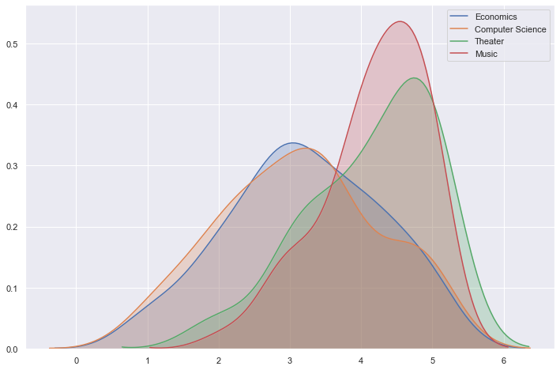
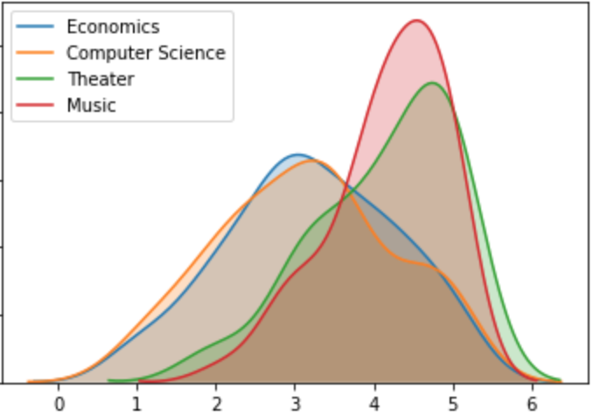
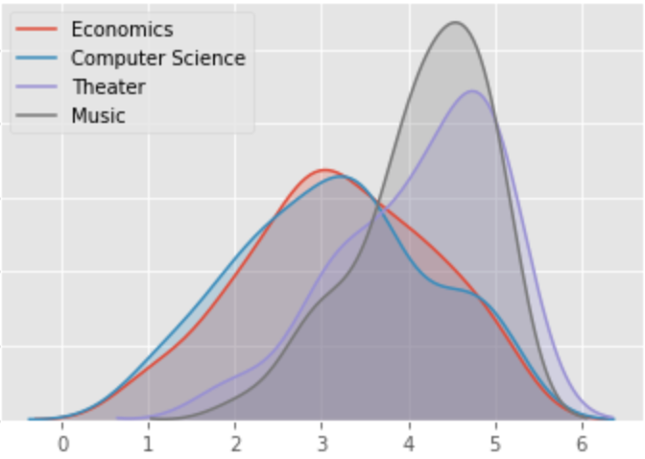
Departments Distributions
Departments are statistically different. Especially between STEM & Liberal Arts.
STEM have lower means and more standard deviation.

Slide 13
Conclusions
A new rating system would be effective that separates/weighs:
Public vs. Private Ratings
STEM vs. Liberal Arts
Ratings follow a similar distribution regardless of quantity.
A complicated name leads to less quantity but doesn’t affect rating itself.

