Slide 1

Stock Analysis/Prediction
Ed Haracz

Slide 2
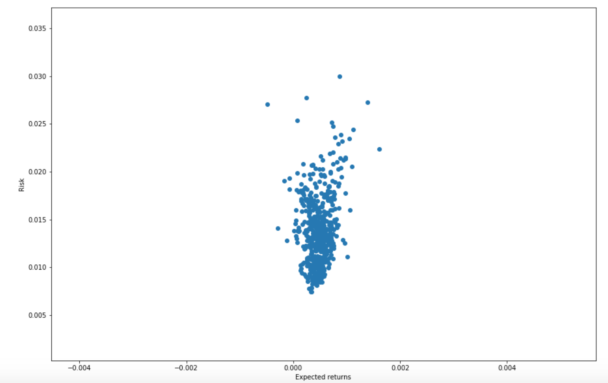
Project Overview
Build models that are able to forecast price of a stock
Data includes daily stock prices from:
All S&P 500 Stocks (505)
1/1/2010 -> 12/31/2019
Weekends and Holidays are forward filled
Models:
ARIMA & Auto-ARIMA
FB Prophet
LSTM
All models were run to predict two years worth of prices then run to predict one year of prices.
Productionalize chosen model to work on any stock input.
S&P 500 Stock Risk vs. Return

Slide 3
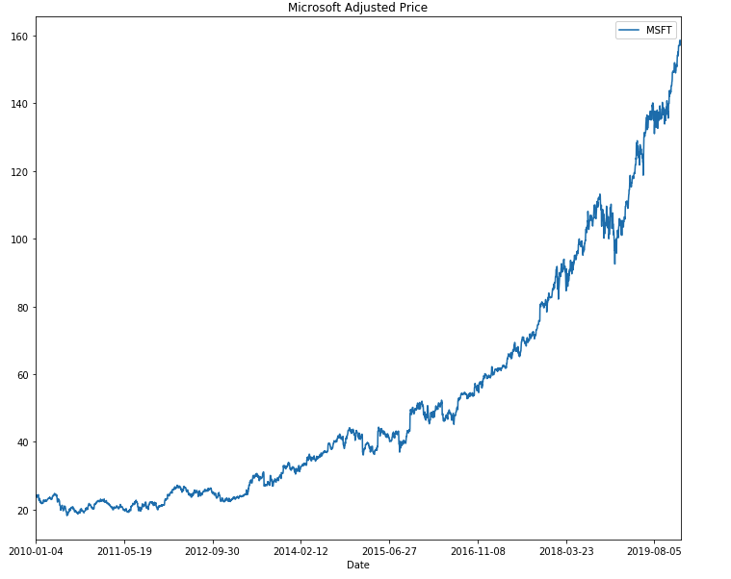
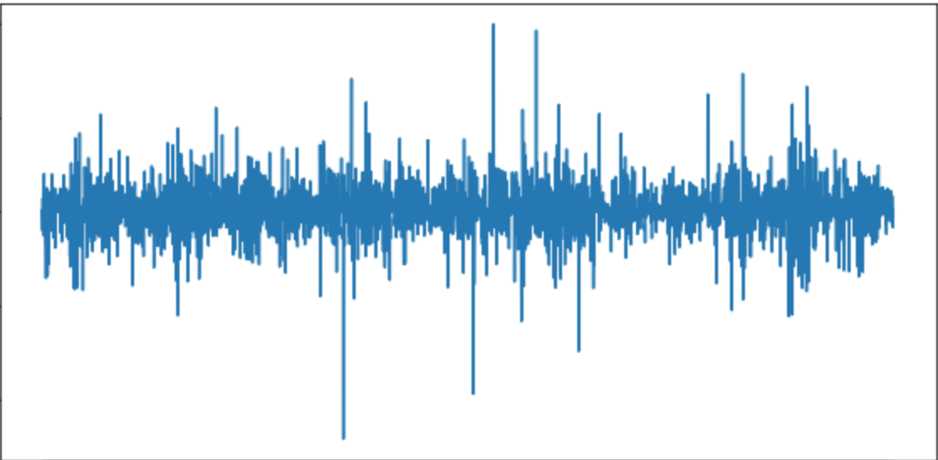
Microsoft
Models are being built and trained on univariate data
Using Microsoft as this variable
Data does not have a constant mean
Differencing
Data does not have a constant standard deviation
Min/Max Scaling
Log Transform

Slide 4
Model Results

Slide 5
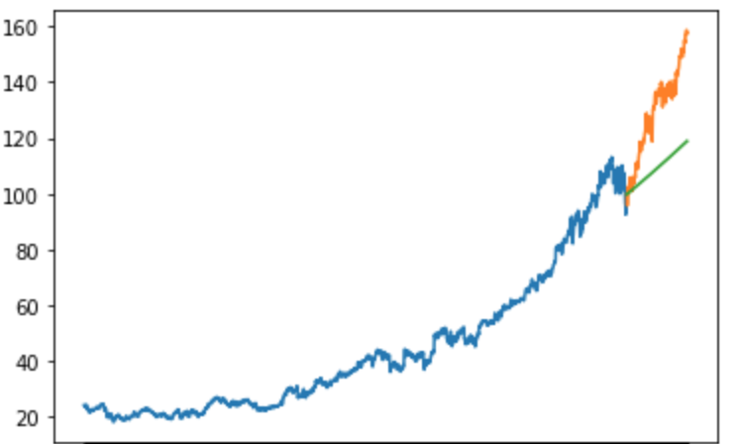
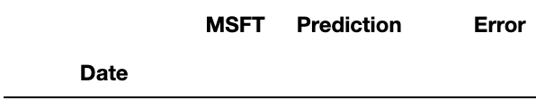
Auto-ARIMA (1-Year Prediction)
ARIMA did not work very well for predicting stock price in this case for two main reasons.
ARIMA is a linear model. It is not very accurate to predict stock price with a straight line.
Shocks either positive or negative are very hard to account for.
This is exactly what made this model inaccurate
Microsoft had an incredible 2019. Stock Price rose 55% which threw off the model.
RMS: 22.5

Slide 6
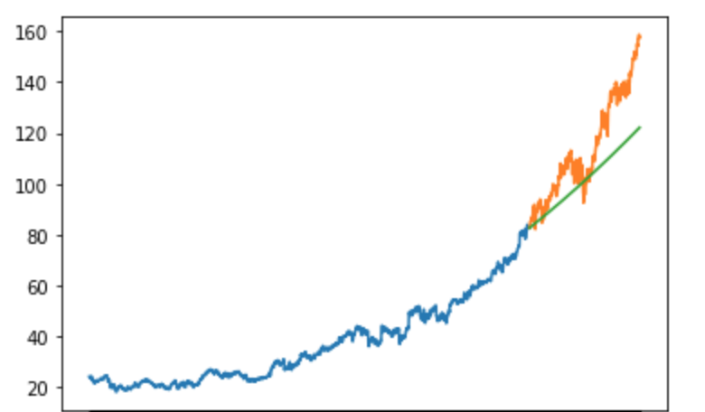


Auto-ARIMA (2-Year Prediction)
Interestingly enough the model performed better when having to predict two years as opposed to one.
This is due to accuracy for 2018. The model struggled with 2019.
RMS: 15.44

Slide 7
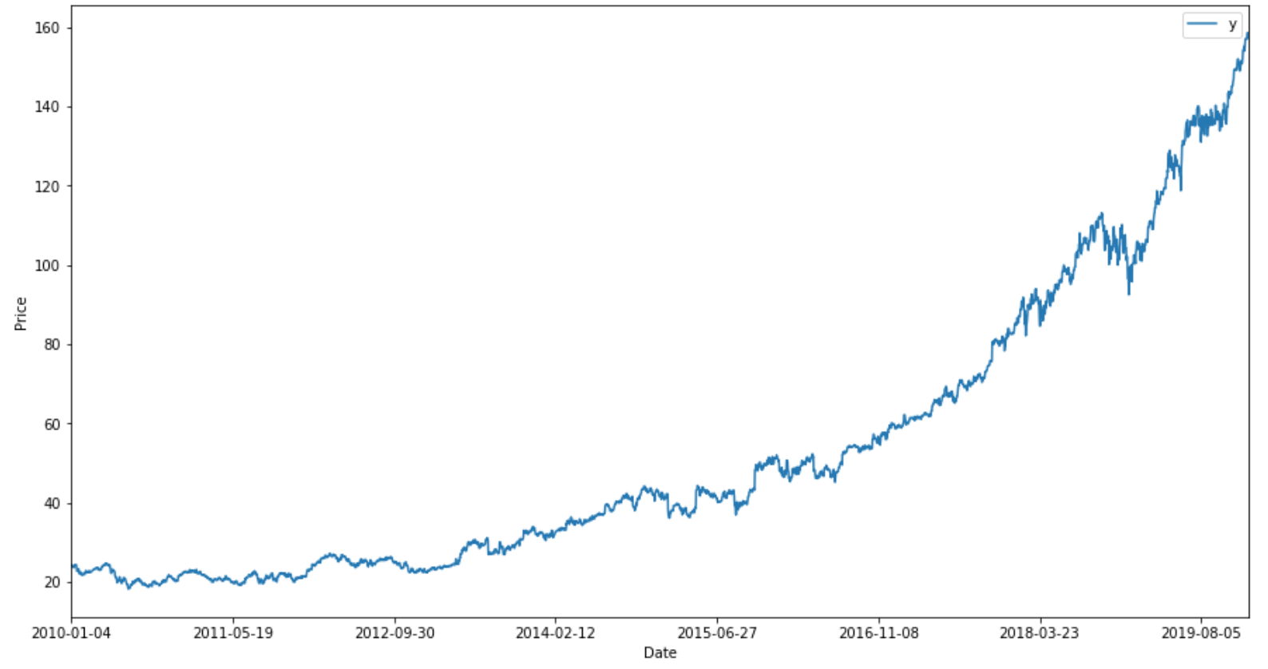
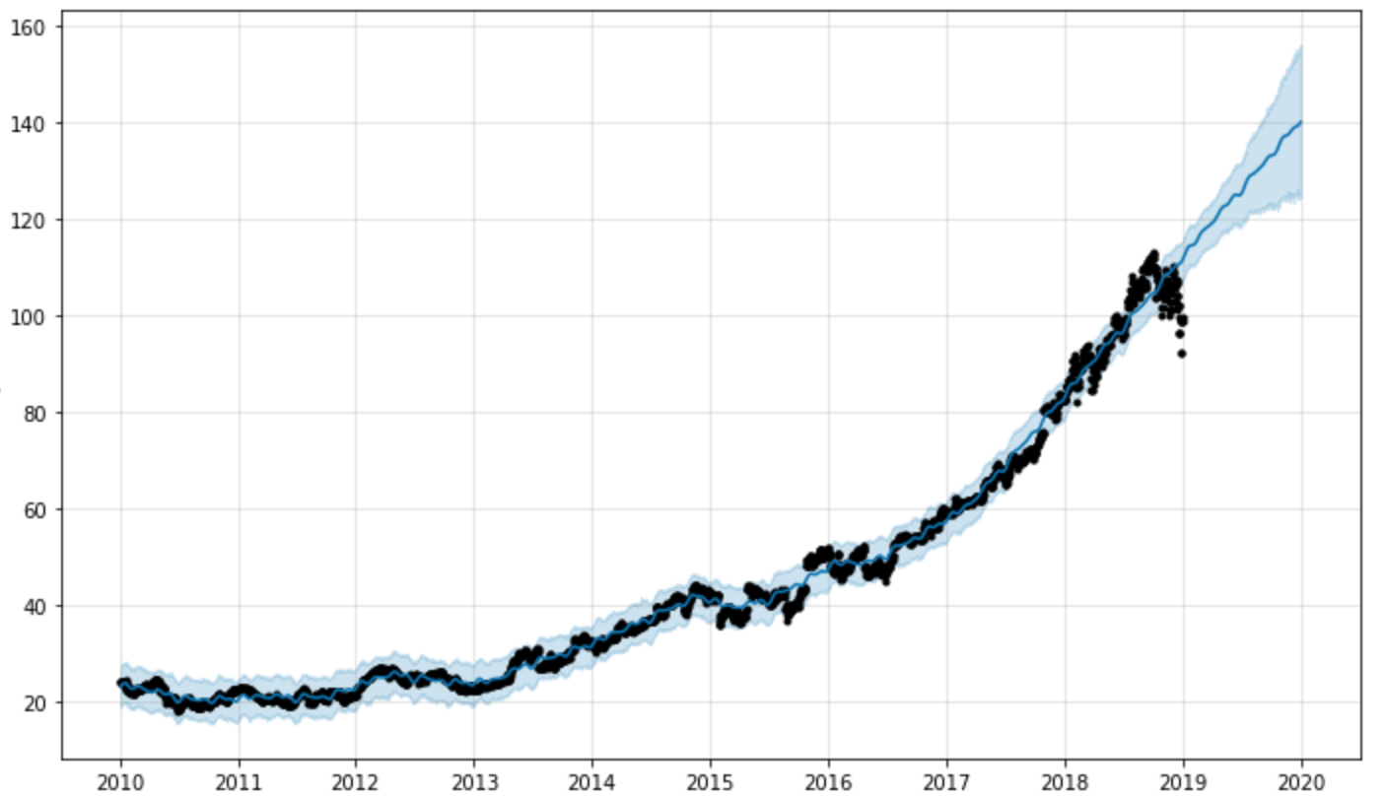
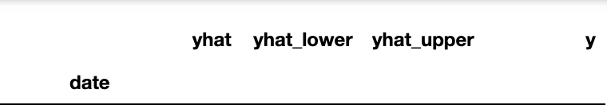
FB Prophet
FB Prophet is a model based on a generalized additive model (GAM).
FB Prophet was the model chosen for front end.
It was effectively accurate and extremely fast
RMS: 8.36

Slide 8
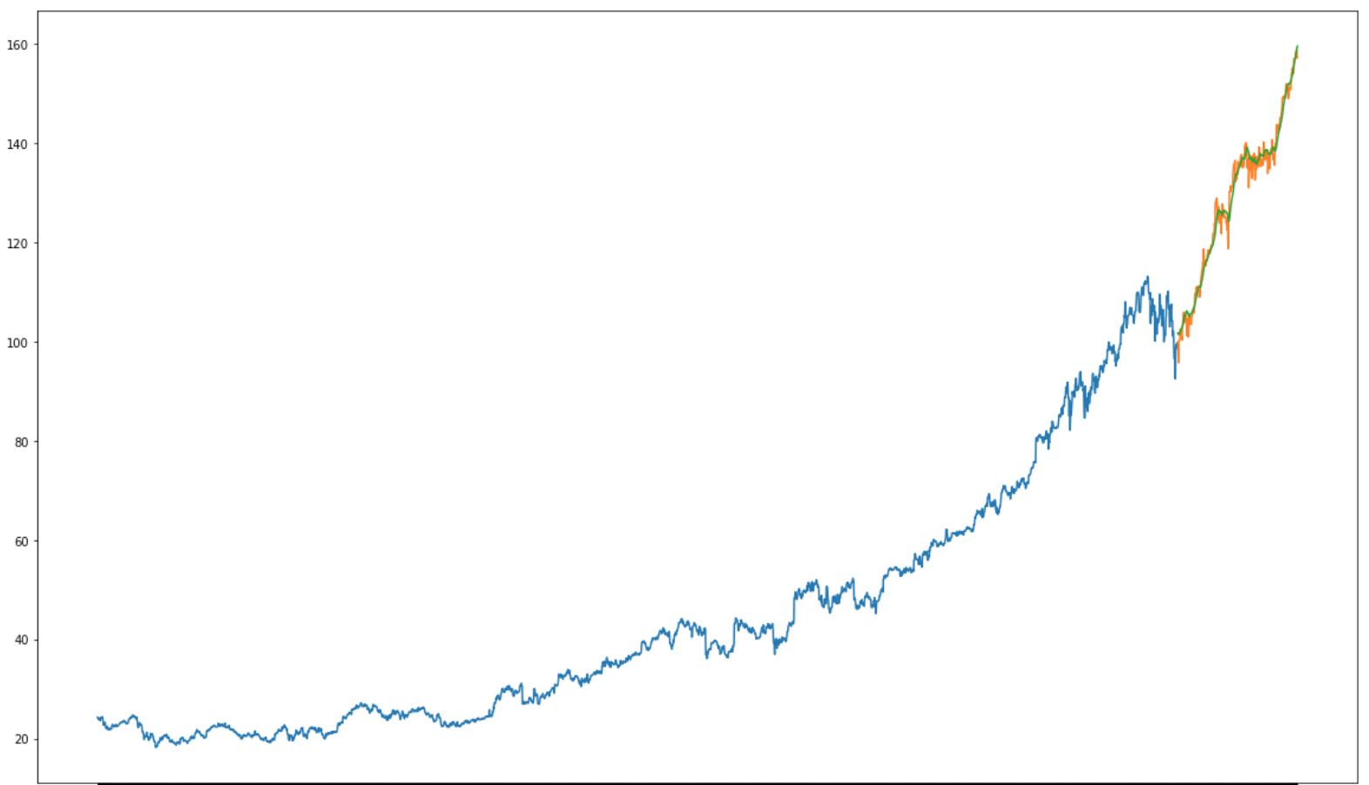
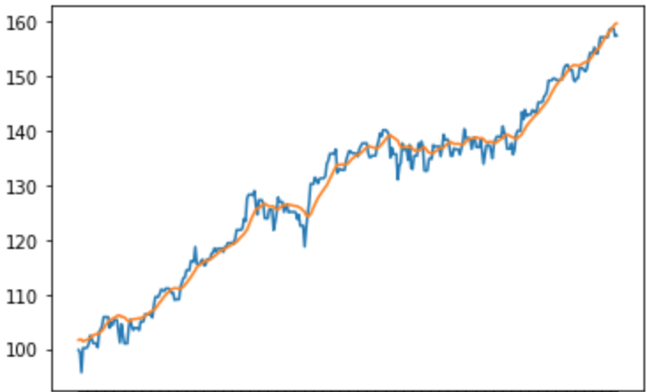





Long Short-Term Memory (LSTM)
LSTM is an evolution of a Recurrent Neural Network
LSTM uses a feedback loop and gates to “remember”. It predicts one step forward then shifts its window and updates its memory.
LSTM was the most effective model at forecasting stock prices but takes about an hour to fit.
MSE: 4.1 (RMSE ~ 2)
Price
Date
Date

Slide 9

Next Steps
Build a sentiment analysis model that can pick up on trends in the market that may cause shocks.
Create fundamental analysis model, such as a Decision Machine, that analyzes critical financial metrics and ratios of companies based on their financial statements.
Pair this forecasting model with the two aforementioned models.

