Slide 1
The Rutba Office showcase
A deck with one of everything, written by PowerPoint on 2026-09-10 01:45
Rutba Office showcase
Notes:
Speaker notes for the title slide: welcome everyone, then move on.

Slide 2

Bullets at three levels
First point
Second point
  A sub-point
    A sub-sub-point
Third point, in colour
Rutba Office showcase
Notes:
Notes on slide two: the picture is generated, not fetched.

Slide 3
Shapes: fills, gradients, outlines, shadows, text, a group, a rotation
Rectangle
Rounded
Oval
Triangle
Star
Arrow
Chevron
Hexagon
Heart
Smile
Process
Callout
Cloud
Up arrow
Diamond
Parallelogram
Rutba Office showcase
Notes:
Sixteen preset shapes, two of them grouped, one rotated, one a hyperlink.

Slide 4
A table with a style
Region | Q1 | Q2 | Total
North | 1,200 | 1,350 | 2,550
South | 980 | 1,120 | 2,100
East | 1,430 | 1,510 | 2,940
All | 3,610 | 3,980 | 7,590
Rutba Office showcase

Slide 5
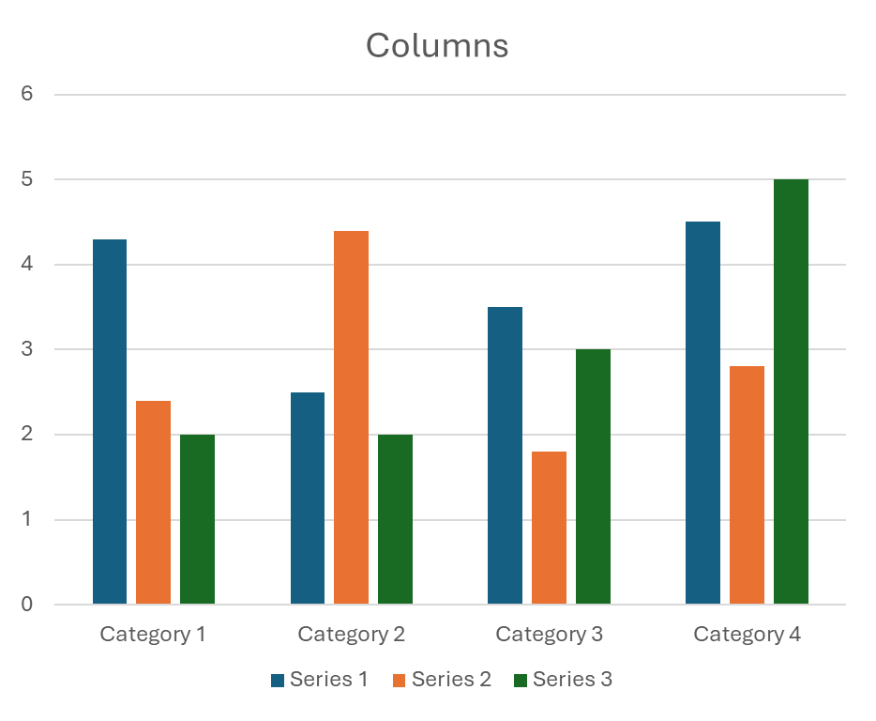
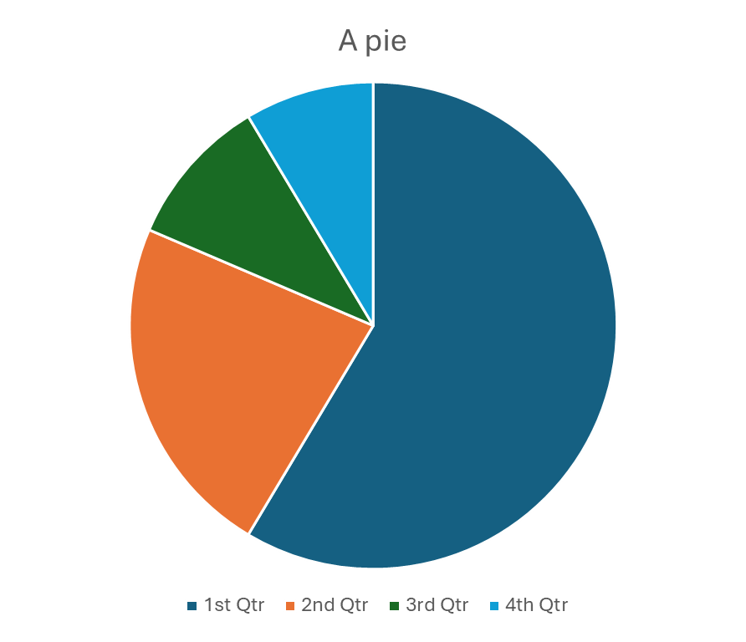
Charts: a column chart and a pie
Rutba Office showcase
Notes:
The chart data is what PowerPoint puts in by default.

Slide 6

A text box with formatted paragraphs.
This one is bold and blue.
This one is italic, larger, and right-aligned.
This one is bulleted.
And this one is bulleted too.
A callout pointing at the text box
Rutba Office showcase

Slide 7
Animated, and hidden from the show
Zooms
Flies in
Fades in
Rutba Office showcase

Slide 8
Thank you
Eight slides, sixteen shapes, two charts, a table, a picture, WordArt, animations, notes, a hidden slide, sections, a footer and slide numbers.
Non-Latin: 日本語 • العربية • Ελληνικά
Rutba Office showcase
Notes:
Closing notes: thank the audience and take questions.

