Slide 1

German Credit Risk Analysis A comprehensive analysis of factors influencing credit risk
By Ethan Hartman

Slide 2
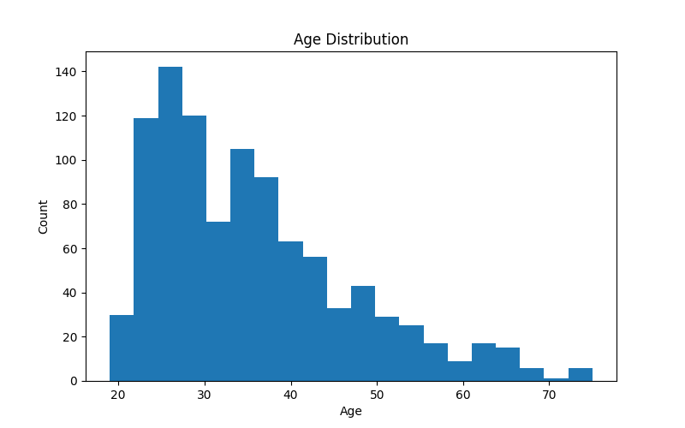

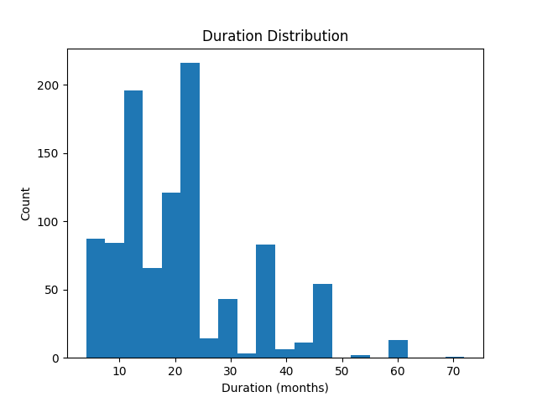
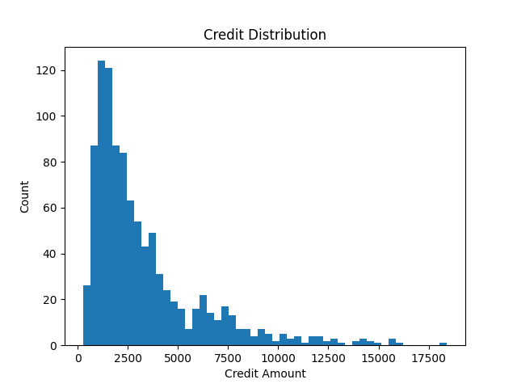
Data Overview
The dataset is of German loan borrowers.
The information contained within the set relates to Individual characteristics (Sex, age, housing), account information (checking and savings account balance level), and loan information (purpose, duration, amount, and risk assessment).
Most of the data is categorical in nature but were converted to numerical identifiers later for correlation analysis.
The Job column is numerical in nature, but information from the source of the dataset informs that it is categorical
0 - unskilled non-resident, 1 - unskilled resident, 2 - skilled, 3 - highly skilled
This will be reflected in visualizations.
Additionally, the only columns which contain null values are Savings and Checking. I These records were not dropped. Instead, I used an imputation method to fill them. This is discussed later.

Slide 3
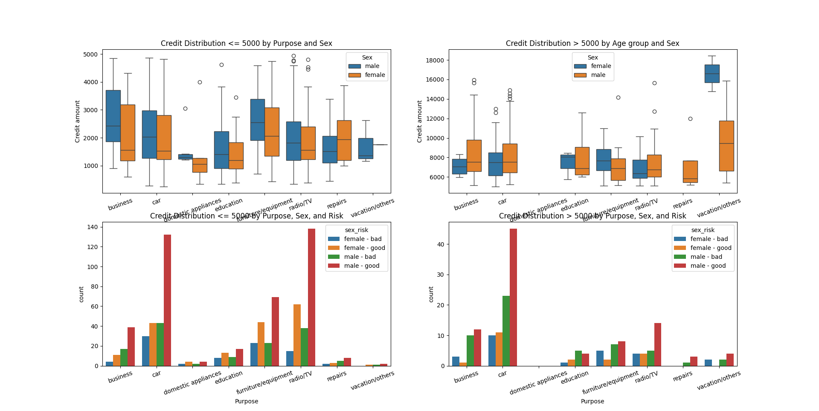
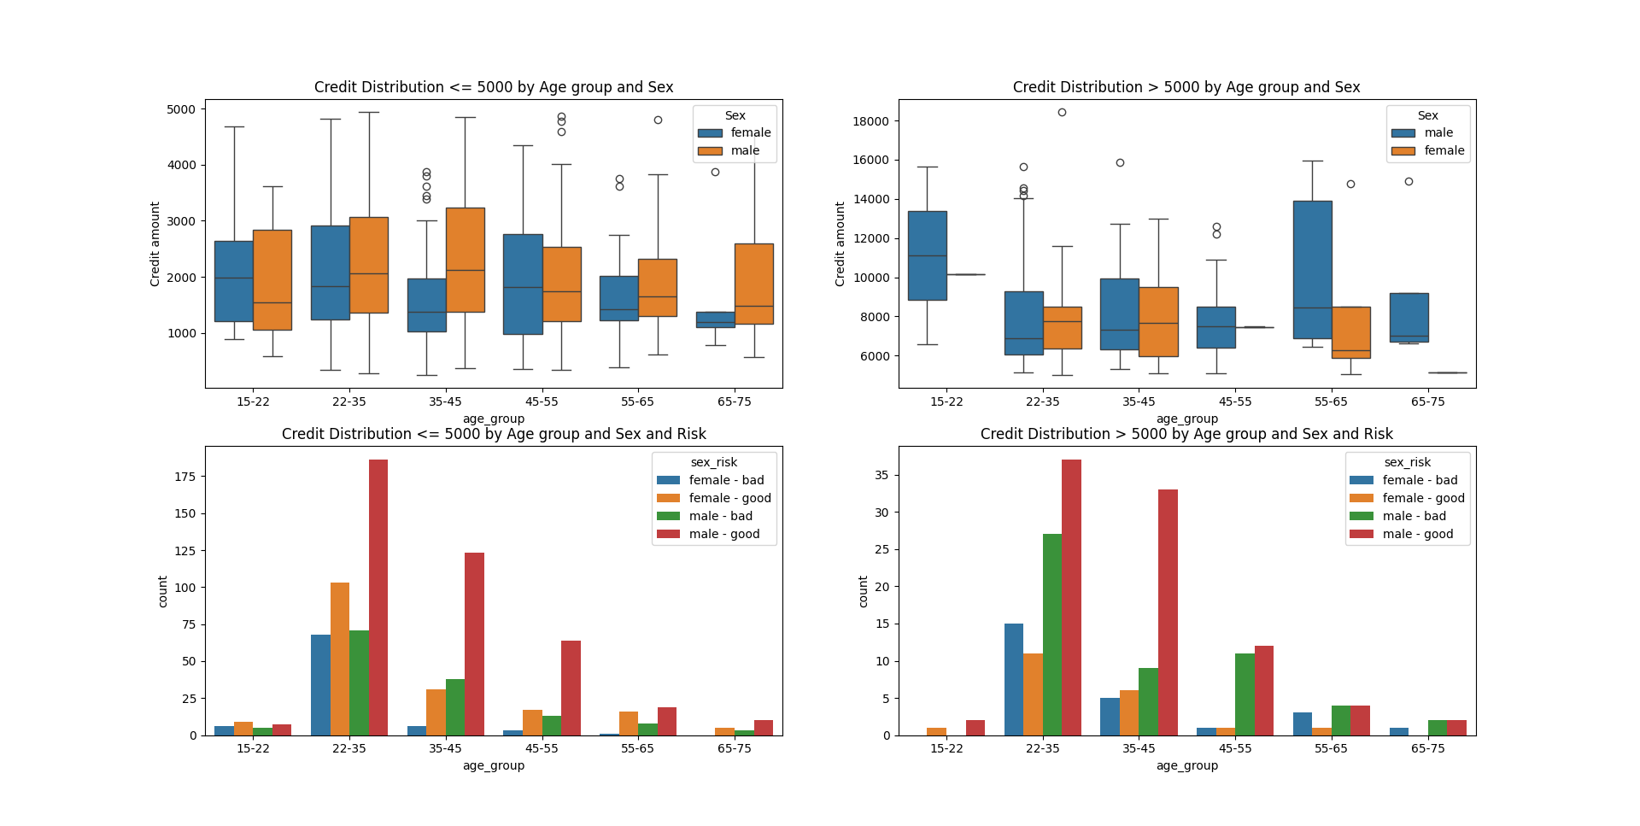

Credit Demographics
Credit distribution by Purpose, Sex, and Risk
Distribution of Age, Credit Amount, and Duration

Slide 4

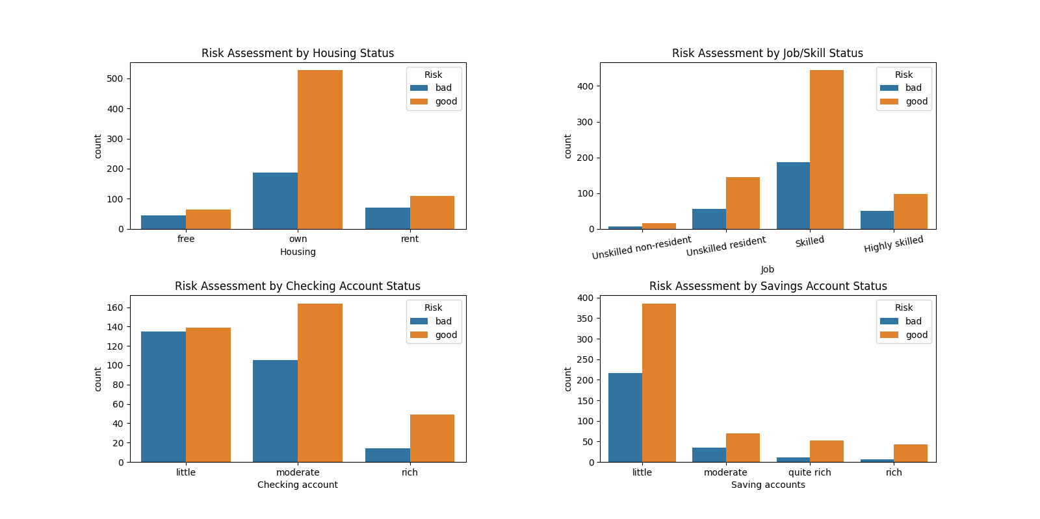
Risk Assessment by Demographics
Risk distribution by Housing, Job, Checking and Saving accounts

Slide 5

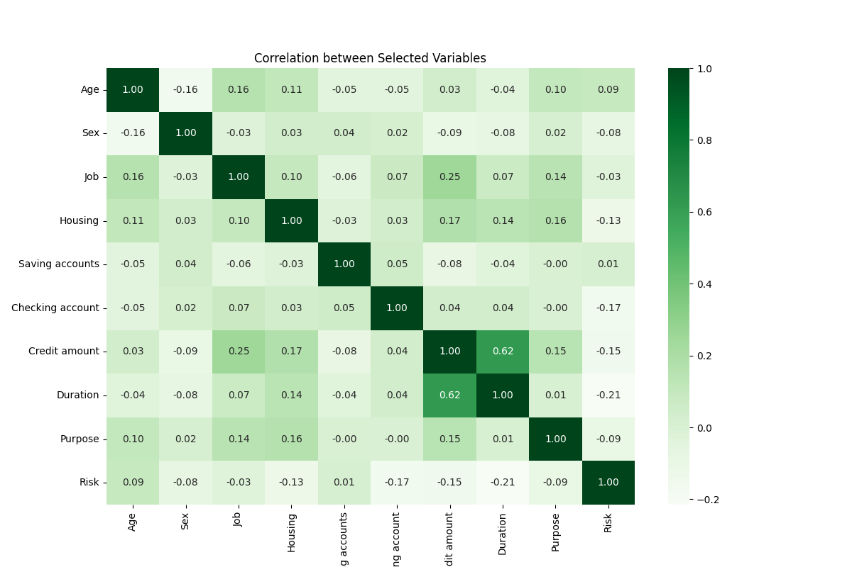
Correlation Analysis
Data Preprocessing and Feature Engineering
Correlation between Selected Variables
NA’d values in the Checking and Saving accounts columns were filled by supplying the average value of the mean, median, and mode of their respective age group for that column.
An upper and lower limit were calculated for numeric columns (Age, Credit, Duration) as follows:
IQR = Q3(75% quartile) - Q1(25% quartile) upper limit = Q3 + 1.5 * IQR , lower limit = Q1 - 1.5 * IQR
Outliers were classified as values existing outside these limits. To maintain the dataset size and robustness, while reducing outlier influence, outlier values were changed to the appropriate limit value and the records were kept.

Slide 6

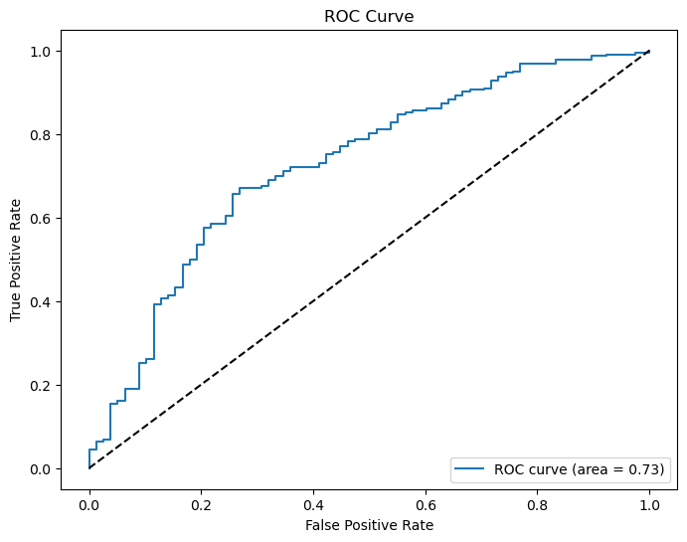
Predictive Modeling
Confusion Matrix and ROC Curve for Logistic Regression Model
 | Predicted Bad Risk | Predicted Good Risk
Actual Bad Risk | 18 | 60
Actual Good Risk | 7 | 215
 | Precision | Recall | F1-Score | Support
Bad Risk | 0.72 | 0.23 | 0.35 | 78
Good Risk | 0.78 | 0.97 | 0.87 | 222
Accuracy |  |  | 0.78 | 300
Macro Avg | 0.75 | 0.60 | 0.61 | 300
Weighted Avg | 0.77 | 0.78 | 0.73 | 300

