Slide 1
EarthFire
A website for exploring MODIS and VIIRS fire detections
NASA FIRMS data • Interactive globe • Daily harmonized grid
Notes:
Project source: https://github.com/ehasanulhaque152/EarthFire. This deck uses stills from the project’s illustrated walkthrough video, not direct browser screenshots.

Slide 2
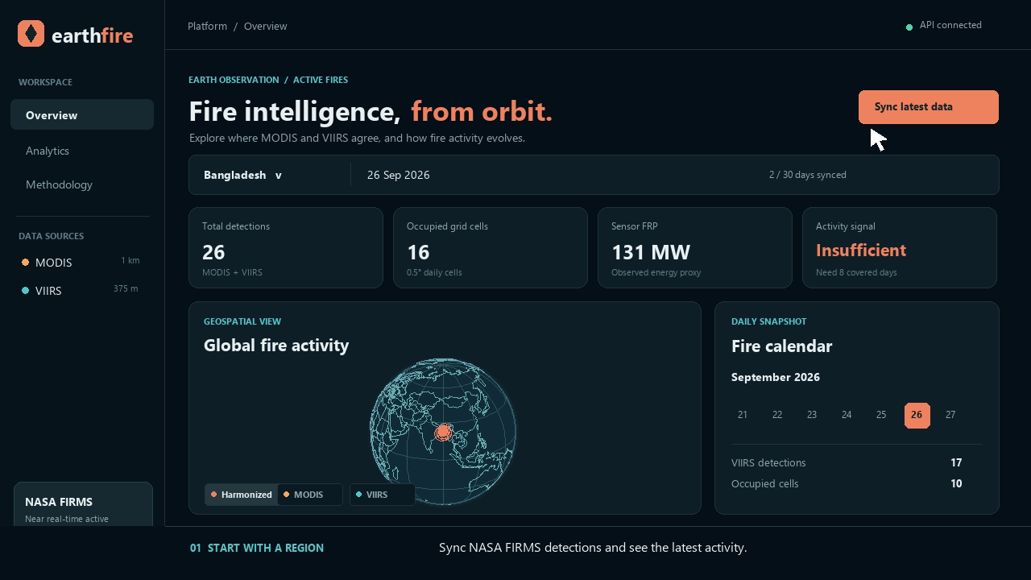
Dashboard overview
Select a region, sync FIRMS observations, and review the latest activity.
Notes:
The displayed Bangladesh data is a saved demonstration snapshot from 26 September 2026. Counts and FRP are observations, not fire perimeters. Source: EarthFire local dashboard and docs/earthfire-walkthrough.mp4.

Slide 3
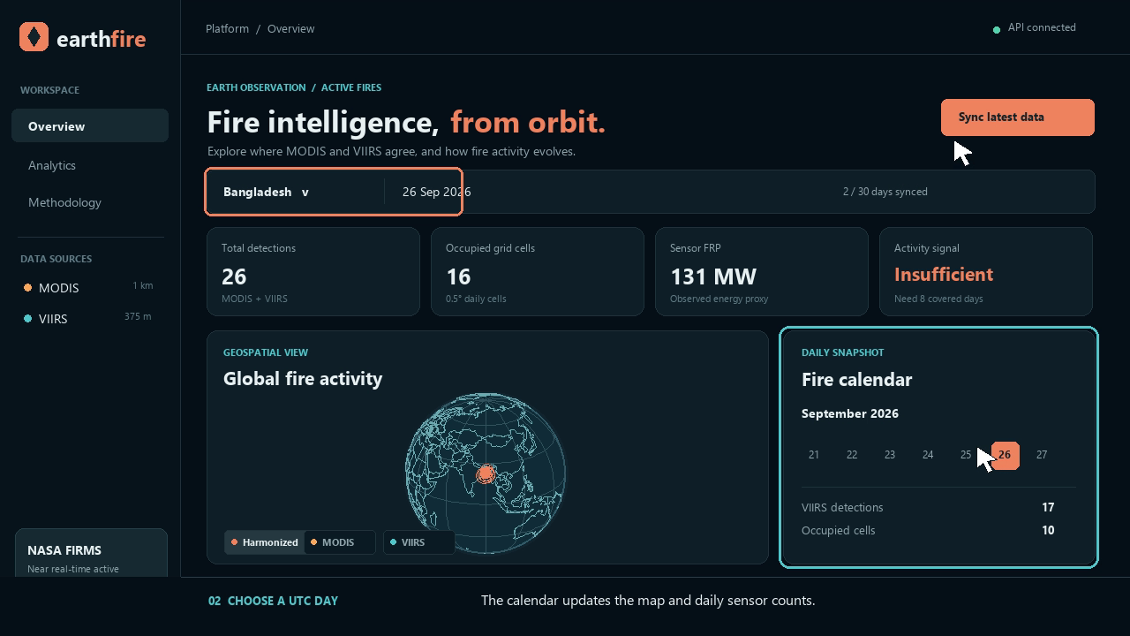
Region and day controls
The calendar changes the UTC day shown on the map and in daily totals.
Notes:
EarthFire groups detections by UTC date. Region selection changes the requested bounding box. Source: EarthFire dashboard and README.

Slide 4
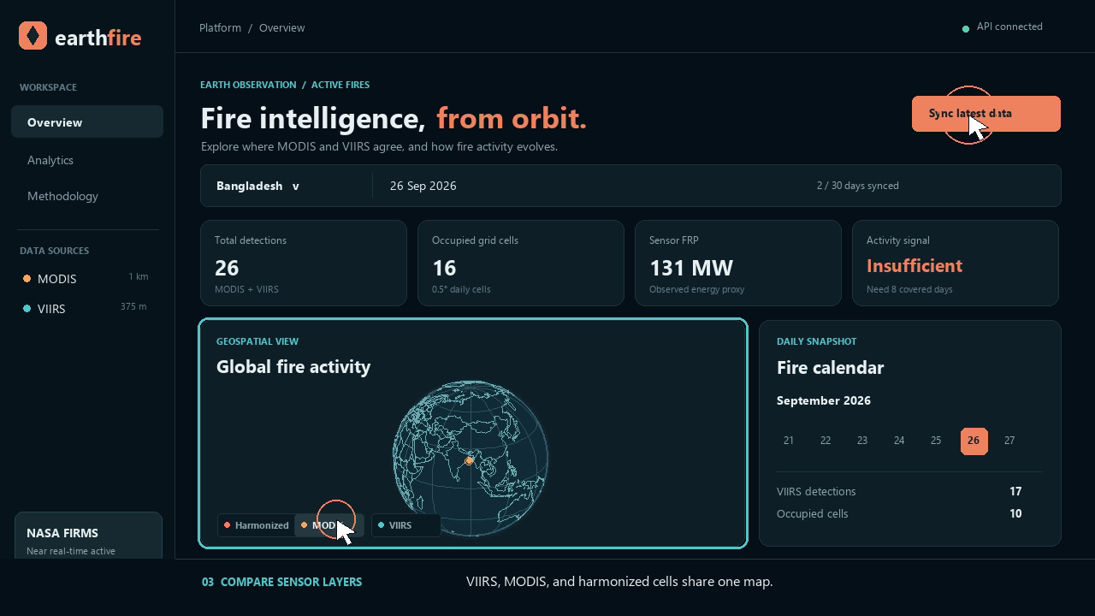
MODIS, VIIRS, and harmonized layers
Layer controls let visitors compare each sensor with the shared grid view.
Notes:
MODIS and VIIRS have different detection footprints. The harmonized layer shows occupied 0.5° daily cells. Source: EarthFire dashboard and README.

Slide 5
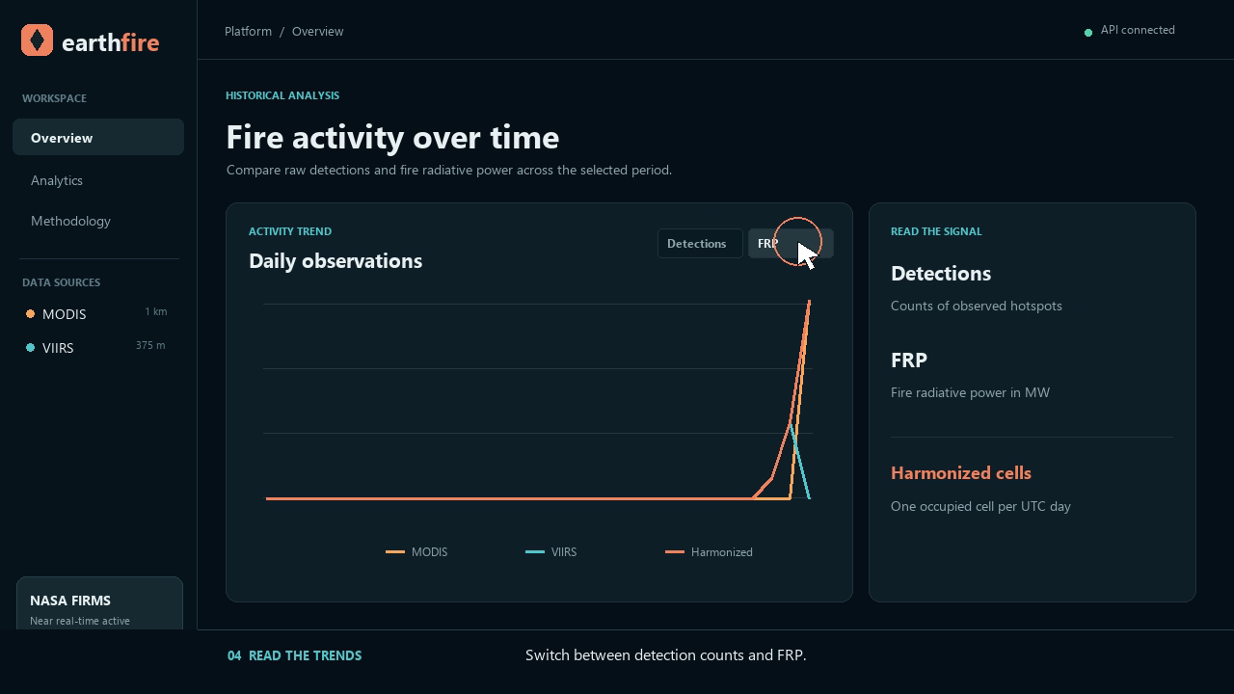
Daily activity and trends
The chart switches between detection counts and fire radiative power.
Notes:
The activity signal is a statistical comparison of recent covered days. It is not a wildfire risk or probability forecast. Source: EarthFire dashboard and README.

Slide 6
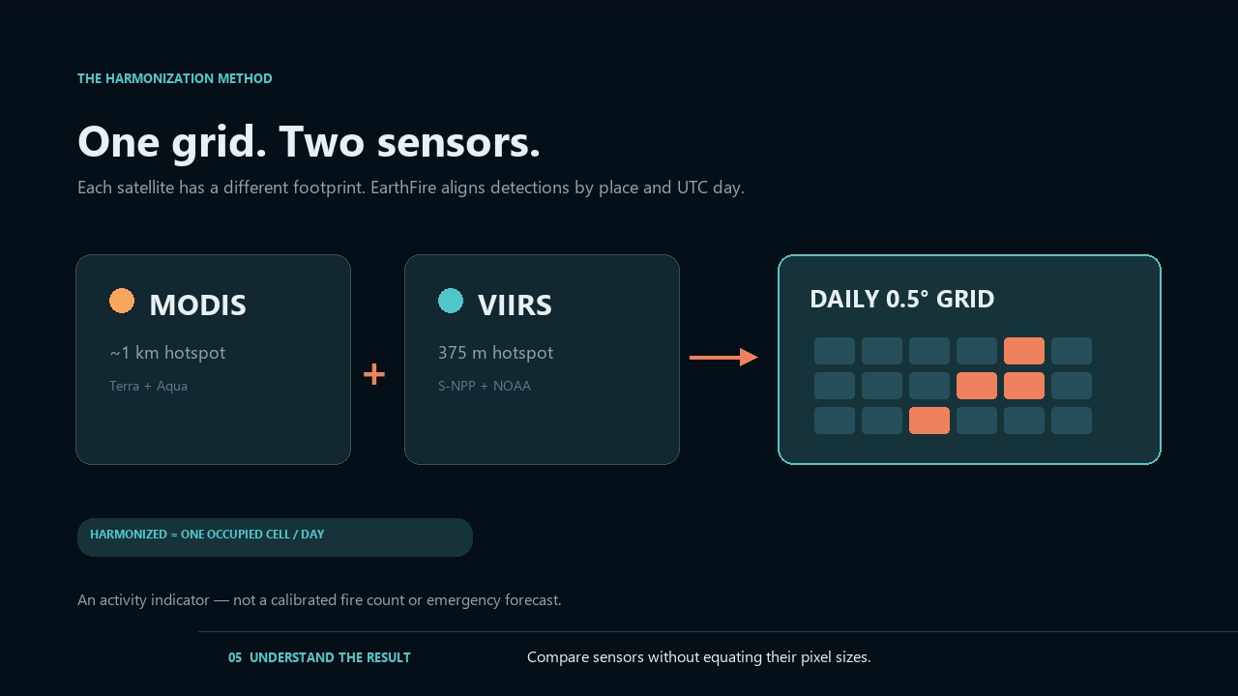
The harmonization method
MODIS and VIIRS observations align by UTC day and 0.5° grid cell.
Notes:
Each sensor retains separate raw counts and FRP. A harmonized count is one occupied cell per UTC day when either sensor detects activity. The optional TensorFlow LSTM predicts next-day occupied cells only after sufficient historical coverage. It is experimental and not an emergency forecast. Source: EarthFire README and backend/train_lstm.py.

