Slide 1

Introduksjon til Git
Eivind Haug-Warberg, konsulent
27.01.2022

Slide 2
Agenda
01
git gud

Slide 3
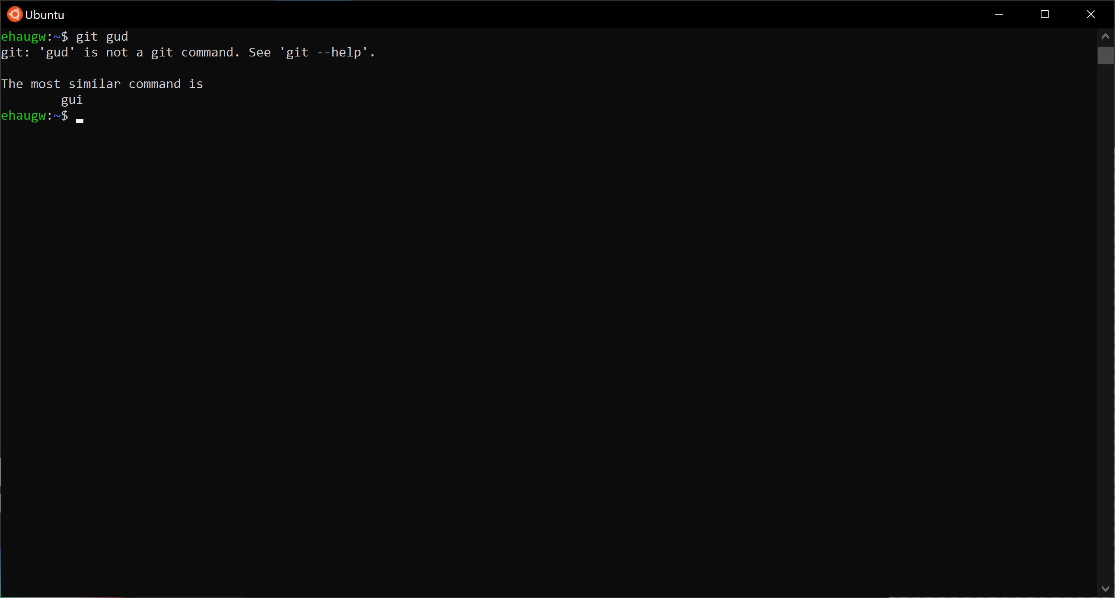

Slide 4
Agenda
01
02
03
04
05
Repository
Commit
Branch
Merge
Rebase

Slide 5
Repository

Slide 6
Some basics of a Git repository
Git init
Working Directory
Index
HEAD

Slide 7
commit
add
Working Directory
Index
HEAD
Notes:
Working directory: current files, index: files to be committed, head: last commit

Slide 8
Commit

Slide 9
master

Slide 10
$ git commit
master
1
Notes:
Remember to mention «git add»

Slide 11
$ git commit
master
1
2
Notes:
Git diff

Slide 12
Branch

Slide 13
master
1
2

Slide 14
$ git branch feature
feature
master
1
2

Slide 15
$ git checkout feature
feature
master
1
2

Slide 16
$ git commit
feature
3
master
1
2

Slide 17
$ git commit
feature
3
4
master
1
2

Slide 18
Merge

Slide 19
feature
3
4
master
1
2

Slide 20
$ git checkout master
feature
3
4
master
1
2

Slide 21
$ git merge feature
feature
3
4
master
1
2

Slide 22
$ git merge feature
feature
3
4
master
1
2
master
1
2
3
4

Slide 23
Merge can be used to synchronize branches

Slide 24
feature
2
master
1

Slide 25
$ git checkout master
feature
2
master
1

Slide 26
$ git commit
feature
2
master
1
3

Slide 27
$ git checkout feature
feature
2
master
1
3

Slide 28
$ git merge master
feature
2
M
master
1
3

Slide 29
$ git commit
feature
2
M
4
master
1
3

Slide 30
$ git checkout master
feature
2
M
4
master
1
3
Notes:
Mention merge conflicts being resolved once

Slide 31
$ git merge feature
feature
2
M
4
master
1
3

Slide 32
feature
2
M
4
master
1
3
M
2
master
1
M
4
3

Slide 33
Rebase

Slide 34
master

Slide 35
$ git commit
master
1

Slide 36
$ git commit
master
1
2

Slide 37
$ git branch feature
feature
master
1
2

Slide 38
$ git checkout feature
feature
master
1
2

Slide 39
$ git commit
feature
3
master
1
2

Slide 40
$ git commit
feature
3
4
master
1
2

Slide 41
$ git checkout master
feature
3
4
master
1
2

Slide 42
$ git commit
feature
3
4
master
1
2
5

Slide 43
$ git checkout feature
feature
3
4
master
1
2
5

Slide 44
$ git rebase master
feature
3
4
master
1
2
5
Notes:
Mention merge conflicts being solved for each commit that conflicts with #5

Slide 45
$ git checkout master
feature
3
4
master
1
2
5

Slide 46
$ git merge feature
feature
3
4
master
1
2
5

Slide 47
feature
master
master
1
2
5
3
4

Slide 48
Rebase
$ git rebase –i <target>
Reorder
Reword
Drop
Squash
Fixup

Slide 49
Git with Others

Slide 50
The Origin/Remote
“origin” and “remote” are just conventions
The truth version of your repository
Shared with others
SSH keys
Interact with fetch, push, pull and reset
Pull requests

Slide 51
Stash

Slide 52
Use Stash to undo and redo changes since the last commit
Git stash
Git stash apply
Git stash drop
Git stash pop
May cause conflicts
Notes:
Pop = apply + drop

Slide 53
Insights you can act on

Slide 54


Slide 55

Note regarding images – REMOVE THIS NOTE PRIOR TO DISTRIBUTION
To update this image, delete the current image and click on the Image icon to change to a new picture located on your computer. Additional images are available in the image library of Brand Source at https://brand.cgi.com/.

