Slide 1
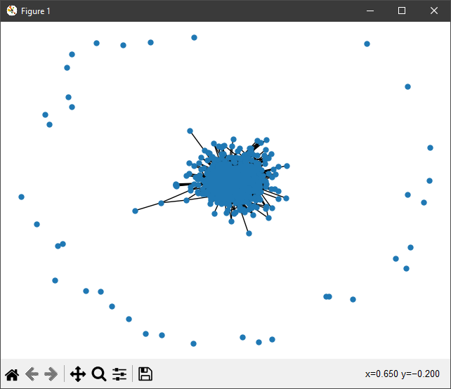
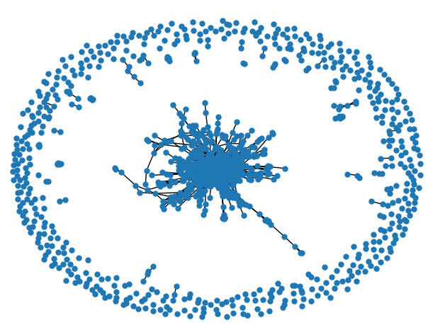
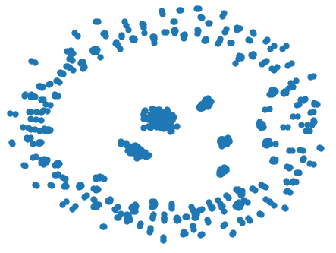
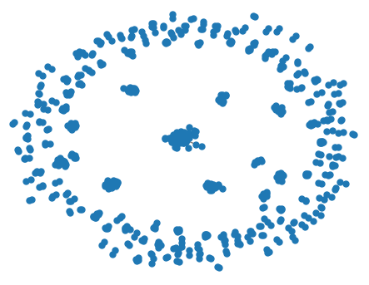
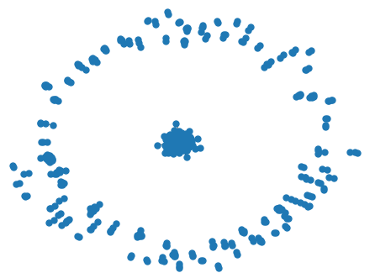
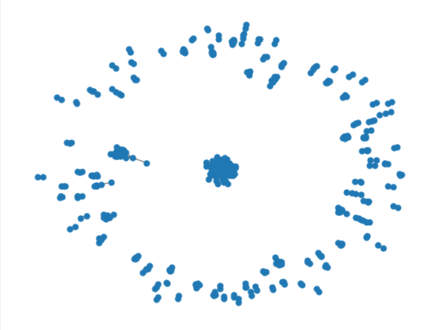
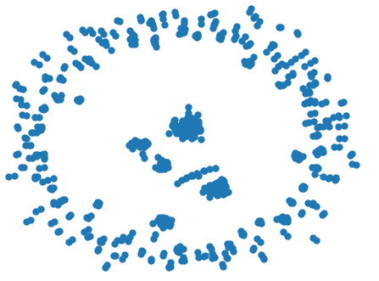
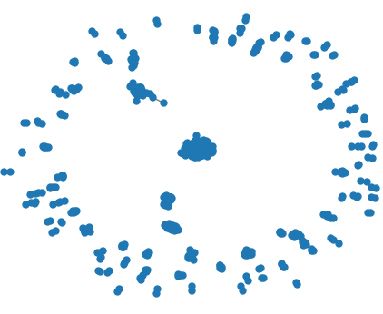
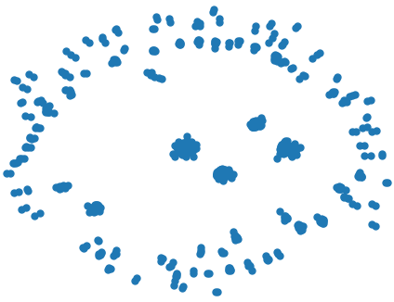
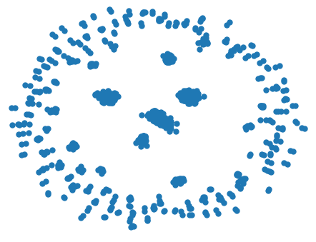
Jaccard 0.1
Jaccard 0.2
Raw
Number of nodes (G_raw): 1277
Number of edges (G_raw): 52854
nodes (G_raw): 1277
edges (G_raw): 3732
Comm
Res 0.1
Number of communities: 195
Number of nodes (G_new): 1163
Number of edges (G_new): 45578
communities: 693
nodes (G_new): 738
edges (G_new): 2273
resolution: 0.2
Number of communities: 207
Number of nodes (G_new): 1152
Number of edges (G_new): 40279
communities: 609
nodes (G_new): 802
edges (G_new): 2631
resolution: 0.4
Number of communities: 215
Number of nodes (G_new): 1153
Number of edges (G_new): 30662
resolution: 0.4
communities: 590
nodes (G_new): 828
edges (G_new): 2588

