Slide 1
Modeling the phenomenon of congestion at Gotthard
A Case Study Eric Hayoz & Janick Zwyssig
15.12.2014
ETH Zürich - GESS
1

Slide 2
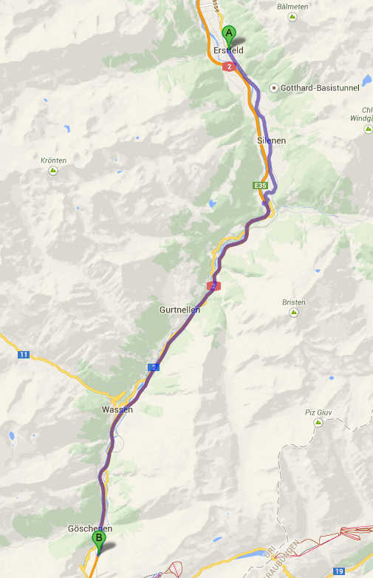
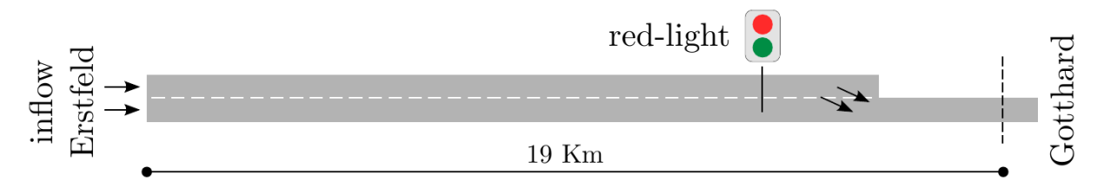
Situation
distance (Erstfeld to Göschenen): 19 km
duration: 13 min
length of tunnel: 16.9 km
speed limit: 80 km/h

Slide 3
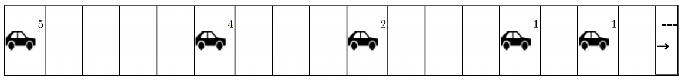
Nagel-Schreckenberg model
Acceleration
Deceleration
Lingering
Moving forward

Slide 4
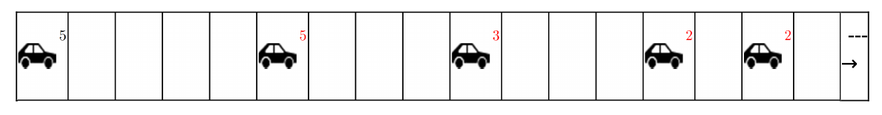
Nagel-Schreckenberg model
Acceleration
Deceleration
Lingering
Moving forward

Slide 5
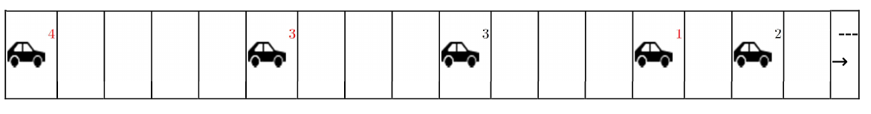
Nagel-Schreckenberg model
Acceleration
Deceleration
Lingering
Moving forward

Slide 6
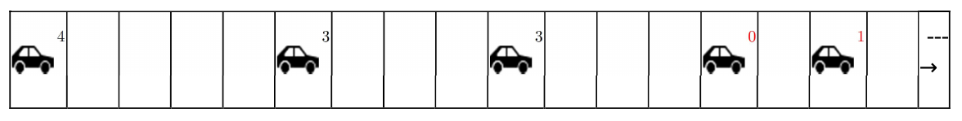
Nagel-Schreckenberg model
Acceleration
Deceleration
Lingering
Moving forward

Slide 7
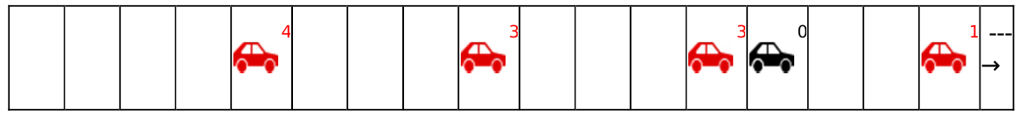
Nagel-Schreckenberg model
Acceleration
Deceleration
Lingering
Moving forward

Slide 8
Implementation
Based on Nagel-Schreckenberg
«move probability»
«move correction»
Extensions:
two lanes
Lane change
Red-light
Congestion measurement

Slide 9
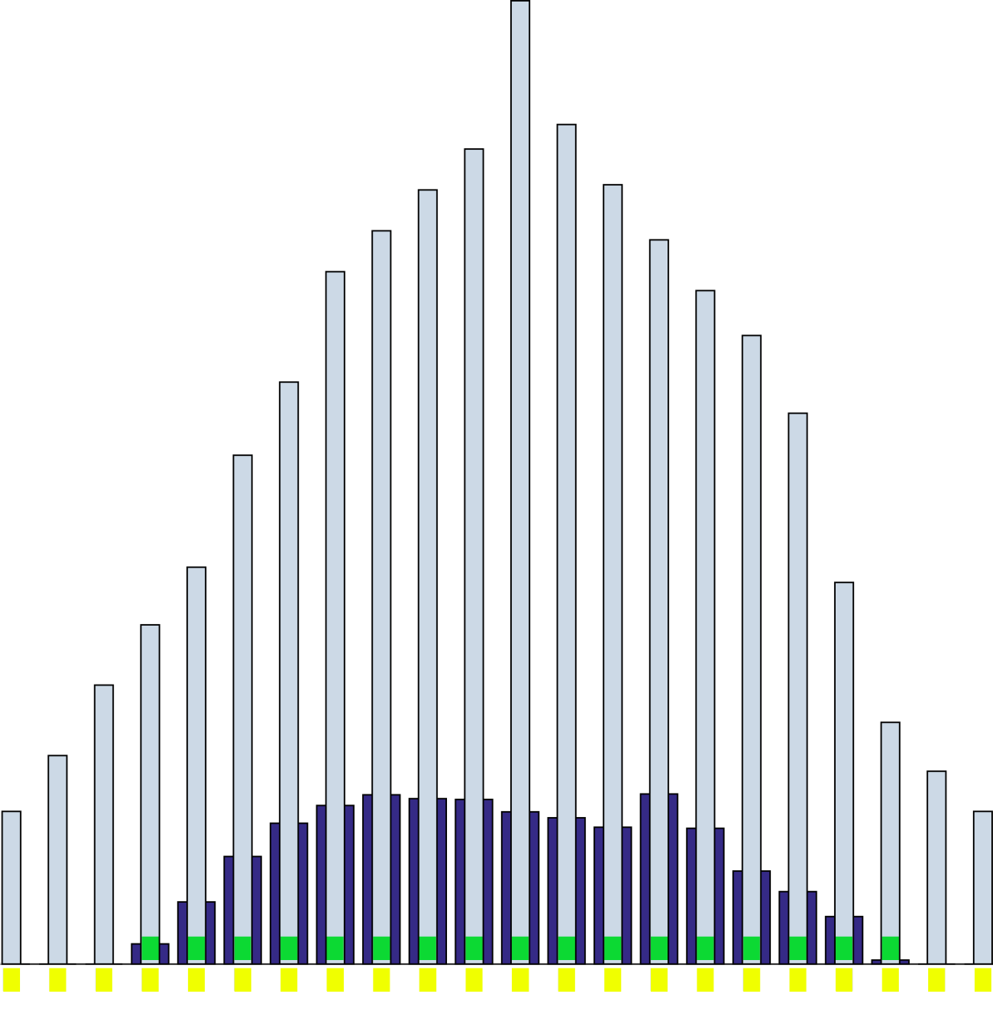
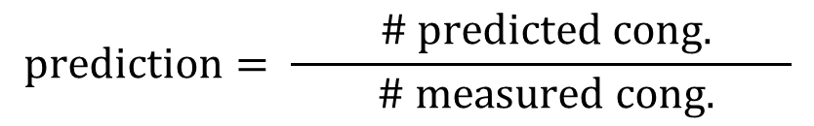
Model-Training: prediction
$$prediction= \frac{ \# predicted cong. }{ \# measured cong.}$$

Slide 10
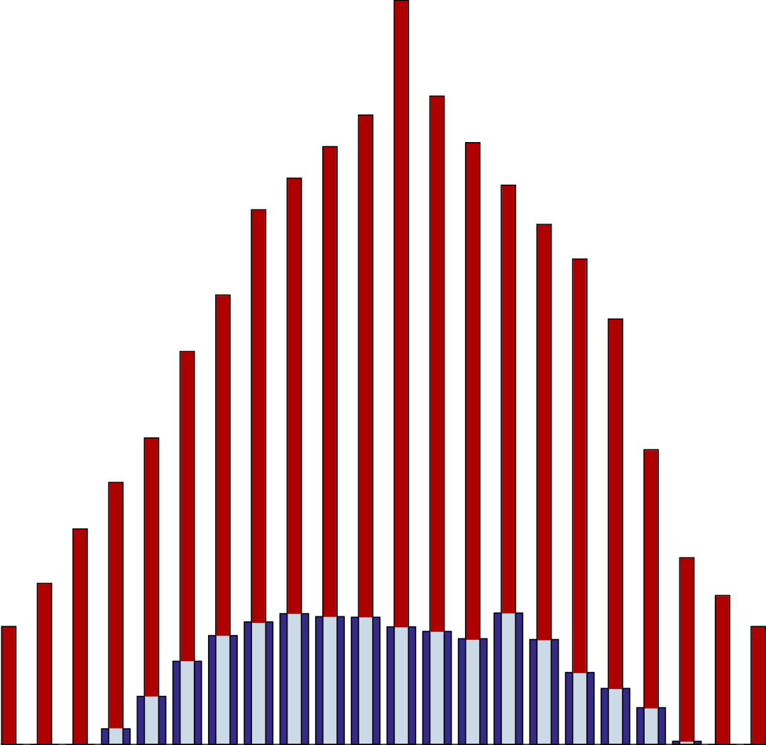
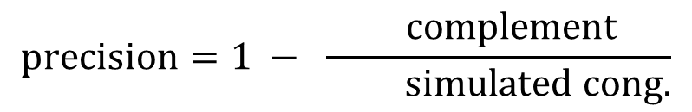
Model-Training: precision
$$precision=1 − \frac{ complement}{ simulated cong.}$$

Slide 11
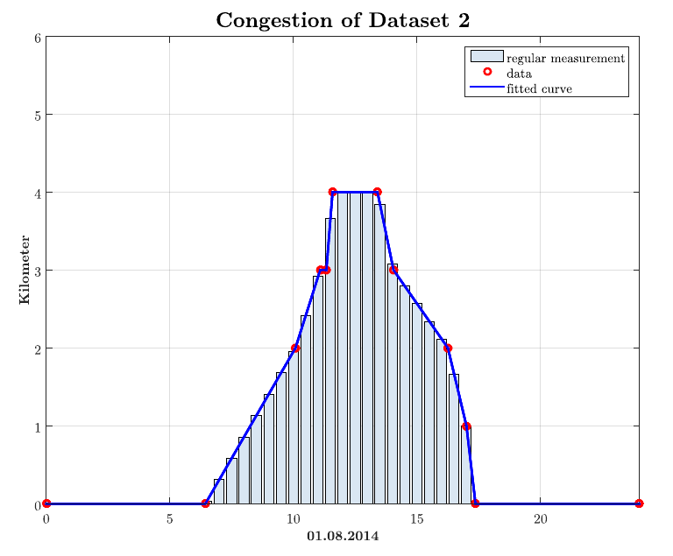
Model-Training: processing Dataset

Slide 12
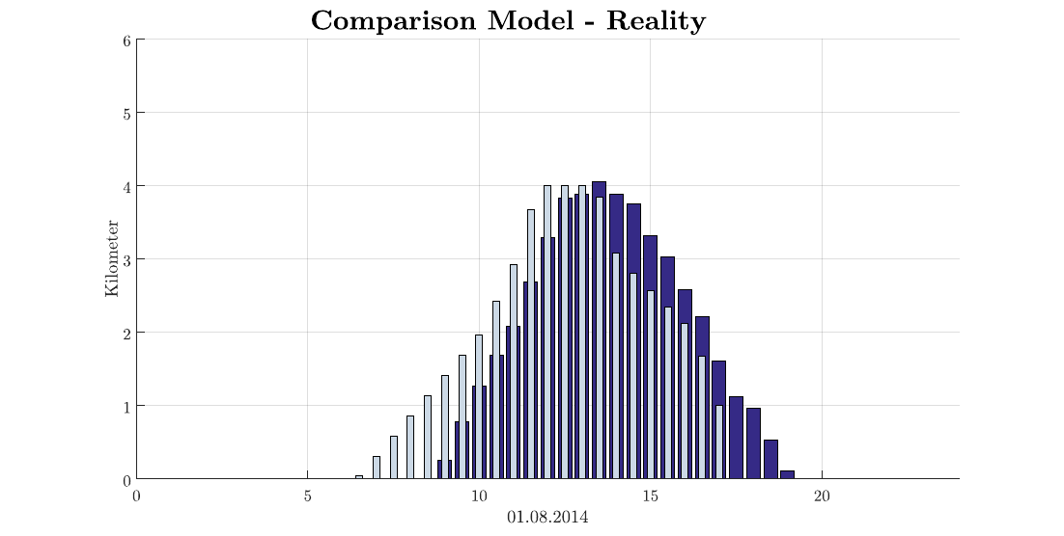
Model-Training: Parameter optimization
precision: 0.65
prediction: 0.77

Slide 13
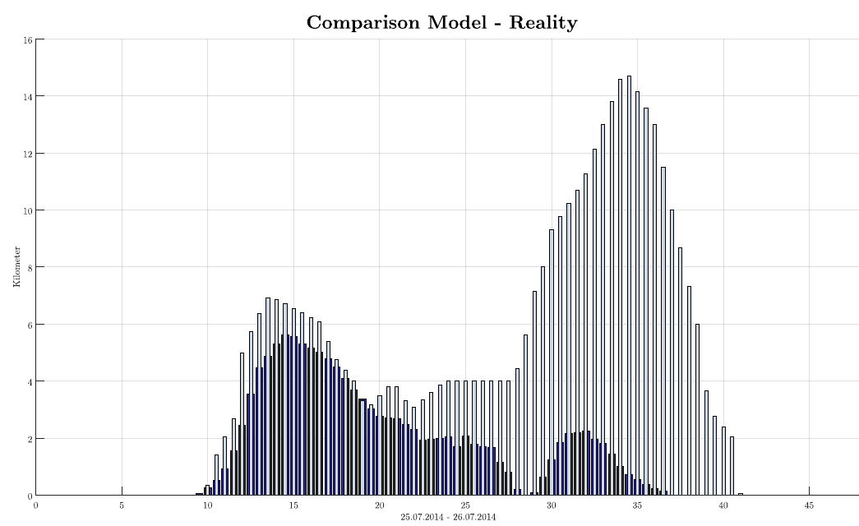
Result: Dataset 3

Slide 14
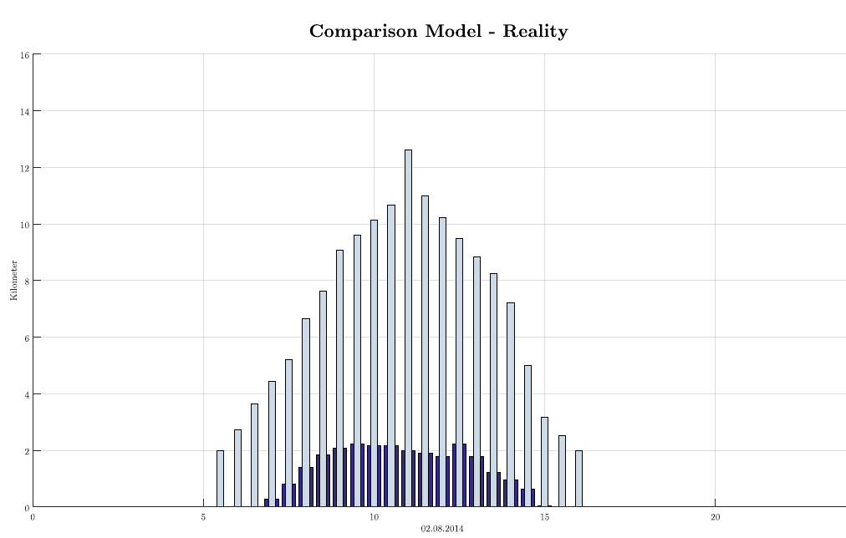
Result: Dataset 4

Slide 15
«Training Dataset» over 24h
precision: 0.65
prediction: 0.77

Slide 16
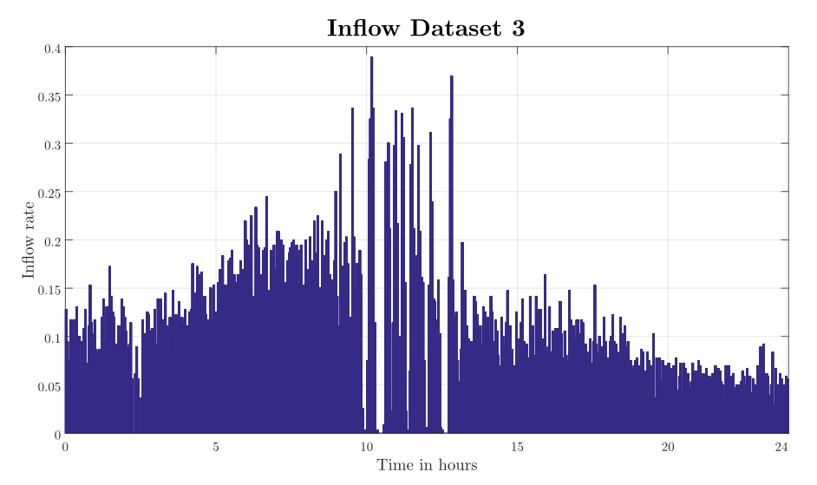
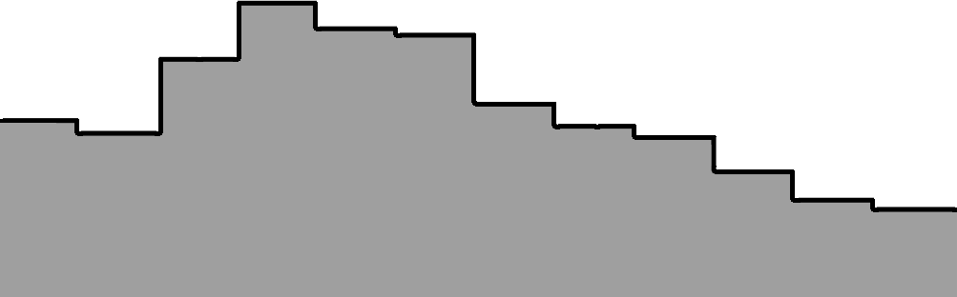
Inflow of dataset 4
Measured Inflow
Mean Inflow (2h)

Slide 17
Conclusion
model training was successful → “training dataset”
big deviations despite of detailed and extensive parameter testing
unpredictable

