Slide 1
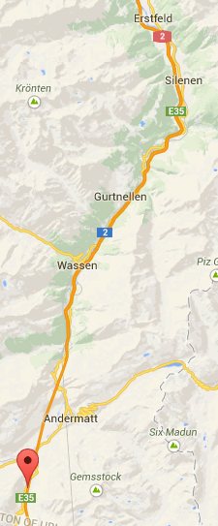
Traffic simulation: Gotthard-Strassentunnel
How accurate can we predict a traffic congestion with its length at the “Gotthard-Strassentunnel” based on traffic data as listed above?
Research Methods
Implement Nagel-Schreckenberg-Modell
Simulation of traffic flow from Erstfeld to Göschenen, including 2-in-1-lane reduction in front of the “Gotthard-Strassentunnel”.
Using Dataset provided by ASTRA Bericht Verkehrsfluss Nationalstrassen 2013
A2 A4
flow-metering in Erstfeld (for trucks only)
drop counting
2  1
Gotthard
20.10.2014
Traffic Jammers Group
Eric Hayoz, Janick Zwyssig

