Slide 1
Benchmark Glacier Project Mass Balance Workflow

Slide 2
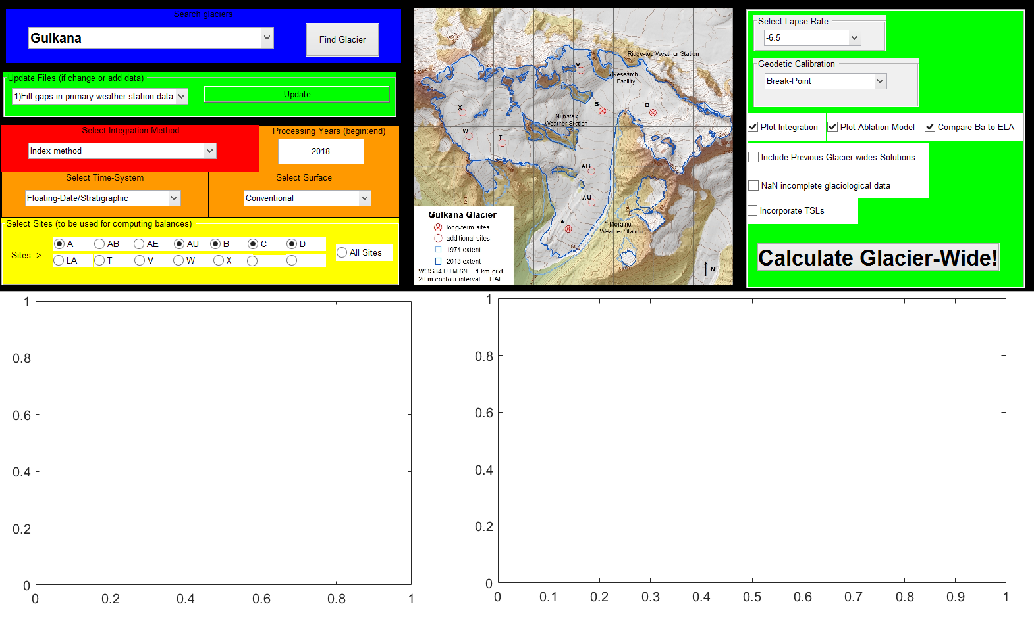
Matlab Guided User Interface (GUI) re-written
10 functions
Reduced from 22 functions
3652 lines of code
Reduced from 5570

Slide 3
Required data
Weather Data: Daily average temperatures and total precipitation are required in order to run the mass balance model within the program. A primary weather station should be determined by the user, based on the proximity to the glacier and the completeness of the record. Secondary weather stations also need to be determined by the users. These data are used to fill and data gaps in the primary weather station file, to generate a continuous record of weather during the period of glaciological record. See data/glacier/Input_Glaciername_Daily_Weather.csv and data/template/Input_Glaciername_Secondary_weather.csv
Glaciological Data: Stratigraphic winter and annual point balance are required to calibrate the mass balance model and calculate glacier-wide mass balance. Data should be collected at fixed locations across the glacier. Point balances must be in meter water equivalent units, and have the date of the measurement listed as well. See data/template/Input_Glaciername_Glaciological_Data.csv
Geodetic Data: Glacier-wide mean volume change, in meters, referencing the total change since the first geodetic measurement. Geodetic measurements should be made from co-registered digital elevation model (DEMs) with full, or near full glacier coverage. The date should reflect the average date of acquisition for each DEM. Finally, the uncertainty reflects the final vertical uncertainty of a DEM after co-registration, determine using the Normalize Median Absolute Deviation (NMAD) statistic. If any altimetry measurements exists, these maybe included as a secondary data file with the same format as the primary geodetics file. See data/template/Input_Glaciername_Geodetics.csv and data/template/Input_Glaciername_Altimetry.csv
Hypsometric Data: A glaciers hypsometry, aka area altitude distribution (AAD), should be derived from each DEM used to calculate the geodetic balance time-series, recording glacier area in 100 m bins. To generate a continuous time-series of AADs from the first year of glaciological record through the last, apply a linear interpolation/extrapolation. See data/template/Input_Glaciername_Area_Altitude_Distribution.csv

Slide 4
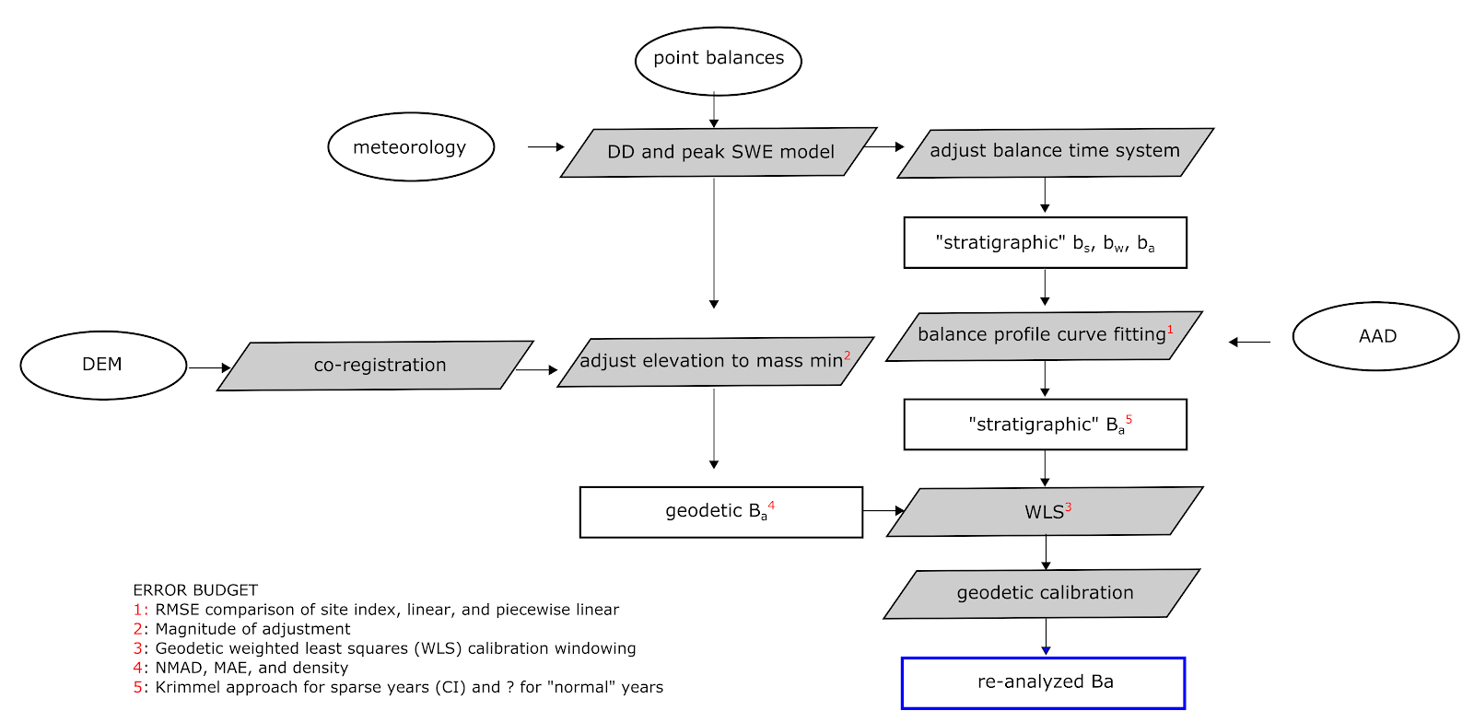

Slide 5
Update Functions
There are three update functions that need to be run when a new glacier dataset is added to the /data directory, or whenever existing data is update. These functions are used to assemble continuous weather data records, calibration the mass balance model using weather data and glaciological measurements, and finally fill and missing glaciological measurements during the period of record

Slide 6
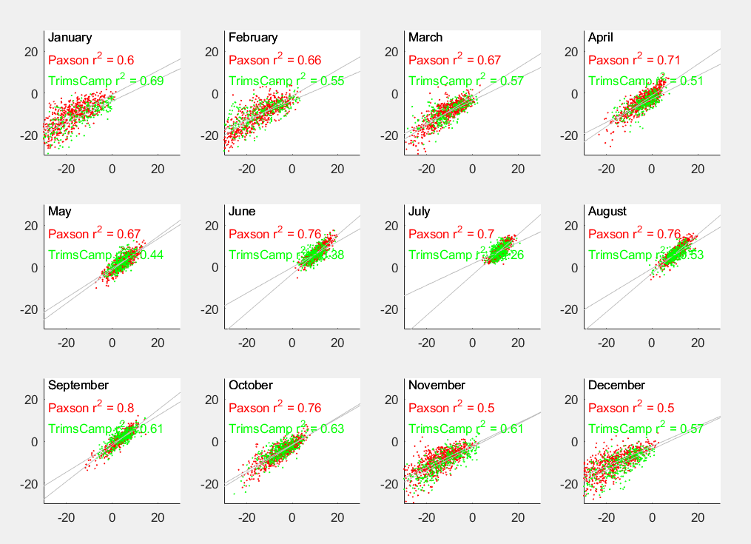
Update Functions: 1) Fill gaps in primary weather data
The first update function fills any gaps in the “Input_Glaciername_Daily_Weather.csv” file. Data from a distal weather station, “Input_Secondary_Weather_data.csv”, is used to develop a statistical relationship between primary and secondary weather stations. A simple linear regression is fit for each month and used to model the temperature and precipitation at the primary weather station if data is missing.
The secondary weather data may have several weather stations, depending on the length, completeness, and location.
The filled primary weather station data is saved to the /data/Intermediate data directory as “GlaciernameFilledWx.csv”

Slide 7
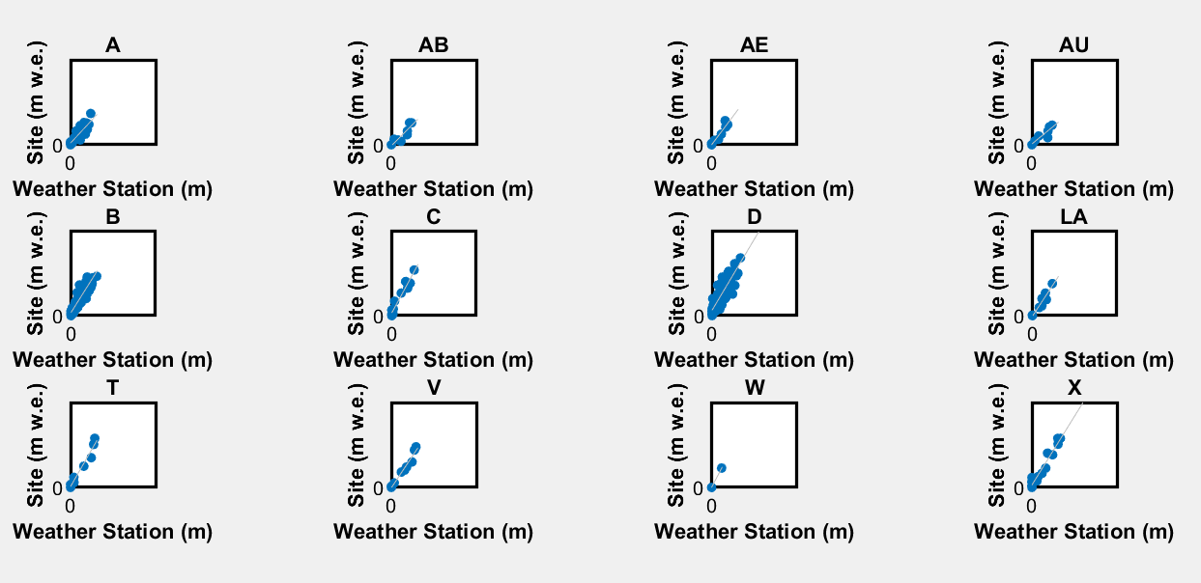
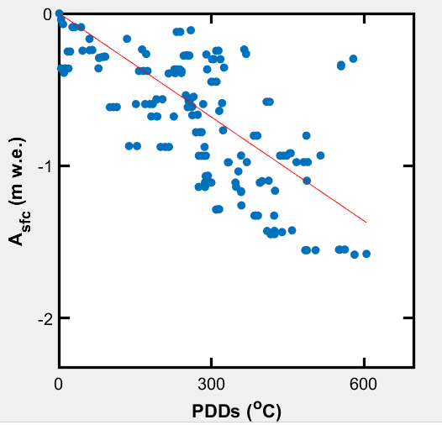
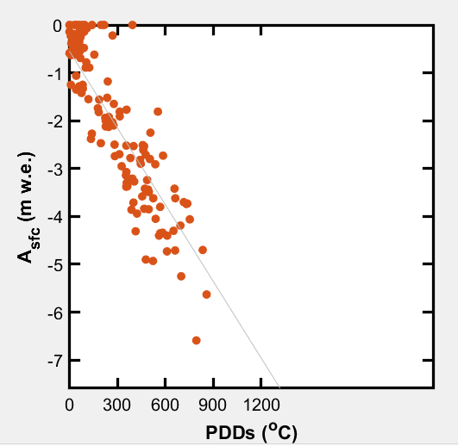
Update Functions: 2) Calibrate Mass Balance Model
The second update function calibrates the mass balance model used in calculating glacier-wide solutions. The calibration occurs in three steps 1) snow accumulation 2) snow ablation 3) ice ablation.
First snow accumulation rates are calibrated on a site-to-site basis using the measured precipitation at the primary weather station and the measured on-glacier site swe in the spring. This occurs first because it requires the least number of assumptions.
Next, glaciological data is sorted for measurements the capture seasonal ablation of only snow in order to calibrate a snow ablation coefficient. This step occurs second, because we need to adjust most spring measurements to the mass maximum using the previously calculated precipitation ratios.
Finally, we calibrate a ice melt coefficient which is highly dependent on the calibrated precipitation ratios and snow ablation coefficients
Because the melt coefficients are solved depending on apriory assumptions, the function runs iteratively until the melt coefficients stop changing by 0.00001 *C/PDD

Slide 8
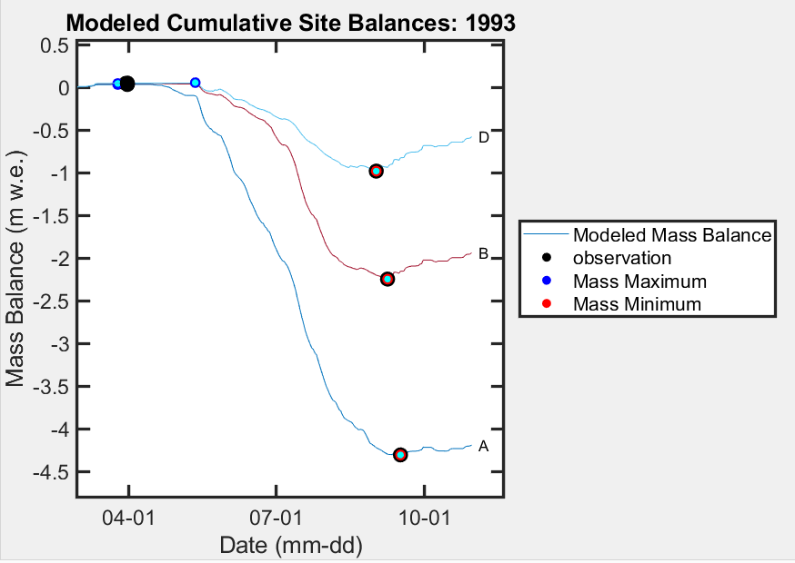
Update Functions: 3) Fill missing glaciological observations
Missing glaciological observations are filled using the mass balance model to provide a consistent number of sites to calculate the glacier-wide mass balance.
First, to identify which sites the user wants to be filled/modeled “Input_GlacierName_Glaciological_Data.csv” should read NaN for missing spring or fall observations. Additionally, the date should be entered as NaN as well for these missing observations. This allows the user to define the appropriate elevation for the site.
Alternatively, the user can define the year and sites in the GUI that they wish to model missing data.
Missing observations are modeled on May 1 for spring measurements and September 30 for fall observations.

Slide 9
Calculate Glacier-Wide!
A GUI is used to allow users to toggle between glaciers, perform processing steps, and calculate the glacier mass balance using several different approaches commonly used in previous studies

Slide 11
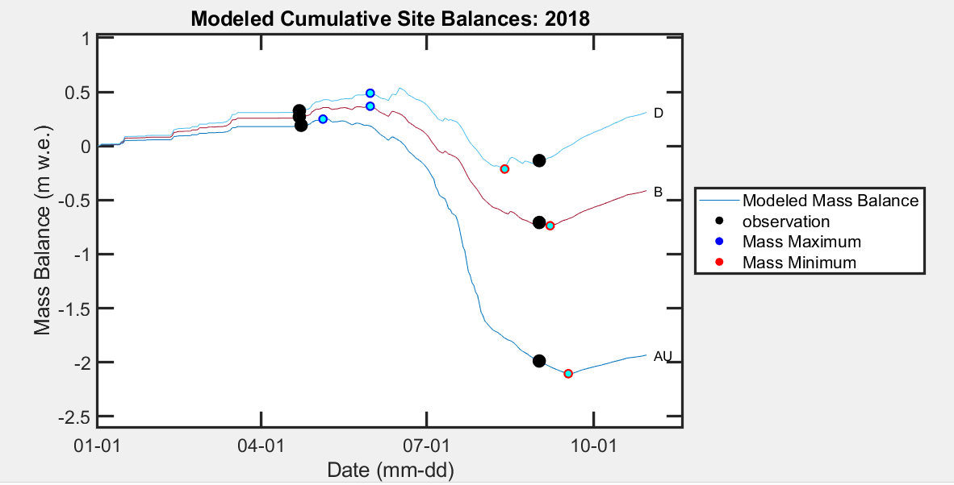

Find site specific stratigraphic extremum

Slide 13
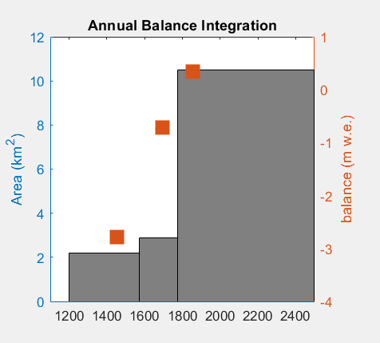
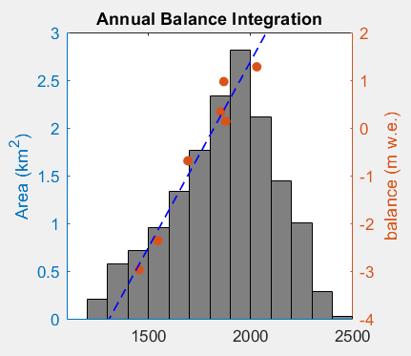
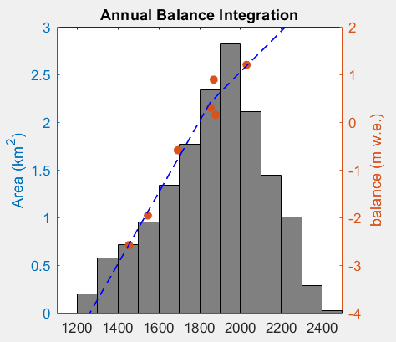
Index Method
Linear Balance Profile
Piecewise Balance Profile

Slide 15
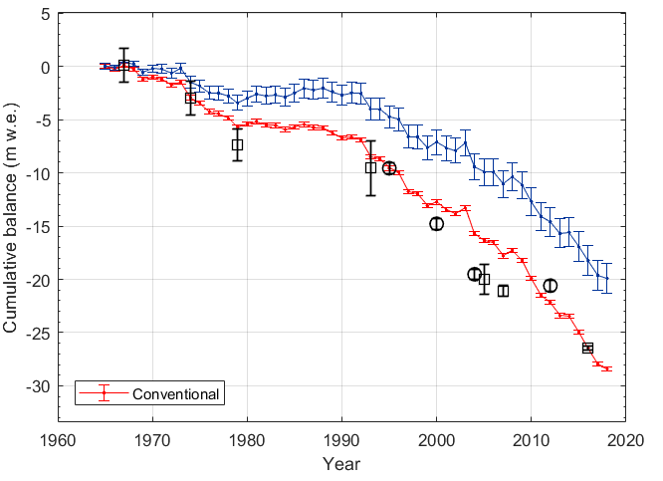
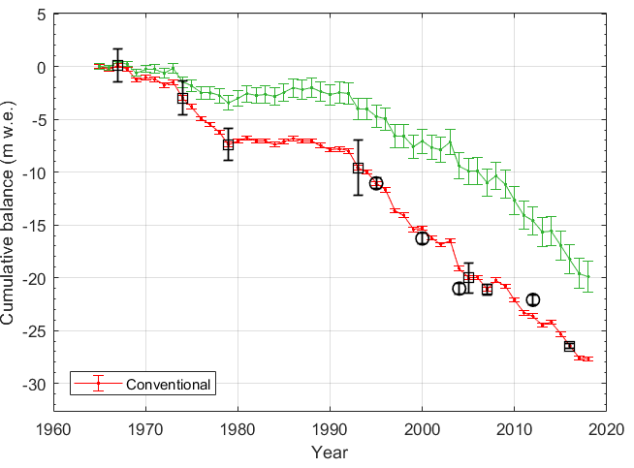
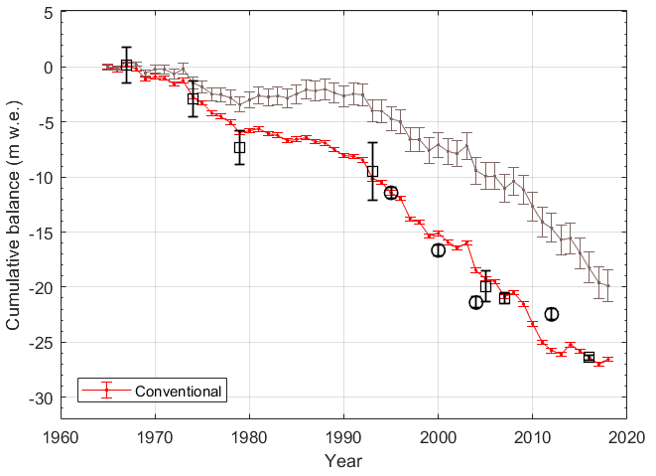
Best-fit
Piecewise
Break Points (user defined)

Slide 17
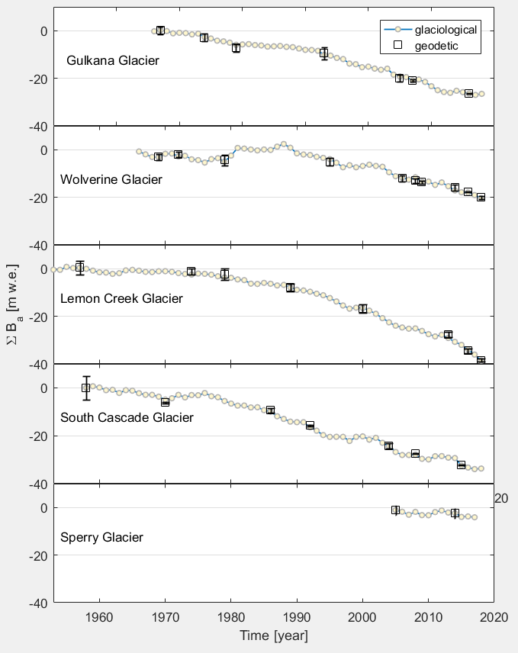

Slide 18
To-Do’s
Bunder check (by others not named Chris)
Filling missing glaciological balances
Mean balance profile approach
Moving window of geodetic calibration
Time-system adjustment to glaciological and not geodetic time-series

