Slide 1
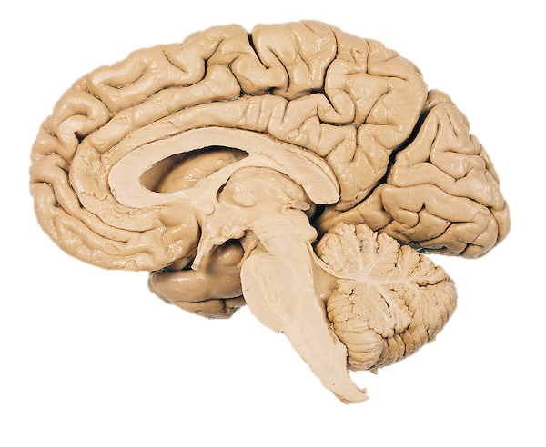

Slide 2
Prefrontal Cortex
Nigrostriatal Pathway
Mesocortical Pathway
Ventral Tegmental Area
Substantia Nigra

