Slide 1

World
Observation
Reward
Action
Agent

Slide 2





World
Observation
Reward
Action
+ 1
Agent

Slide 3
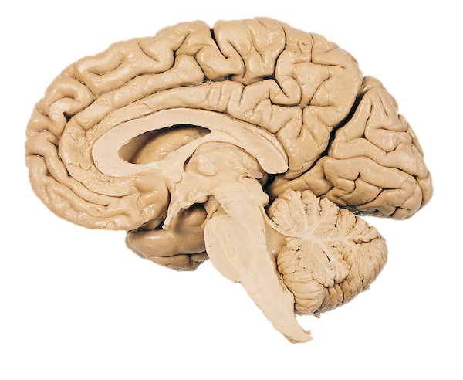
Base System
Dopamine neurons
Stable over time
Meta System
Prefrontal cortex
Flexible & dynamic

