Slide 1
Traditional Image Classification
PIAI, POSTECH

Slide 2
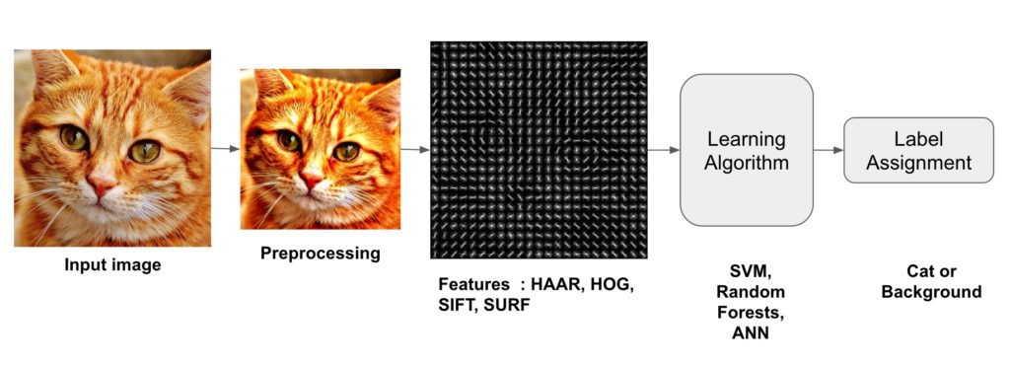
Image Classification A core task in Computer Vision
Notes:
영상 분류
기계 시각

Slide 3
목차
1
2
Preprocessing
OpenCV
Histogram
Image Thresholding
Image Smoothing
Traditional Image
Classification
4
3
Feature descriptor
HOG
Decision Tree
Random Forest

Slide 4
1. OpenCV

Slide 5

OpenCV
1. OpenCV
OpenCV (Open Source Computer Vision) is a programming library aimed at real-time computer vision.
The library is a cross-platform available on Windows, Linux, and so on and is available free of charge under an open source BSD permit.
OpenCV supports deep learning frameworks for TensorFlow , Torch / PyTorch , and Caffe.

Slide 6
OpenCV
1. OpenCV
환경 구축
1. Anaconda 다운로드 및 설치 (https://www.anaconda.com/download/)
$ bash Anaconda3-2020.07-Linux-x86_64.sh
2. 가상환경 생성 및 라이브러리 설치
$ conda env create -f vision_env.yml
3. 환경이름 : vision
파이썬 버전 : 3.7
주요 라이브러리 목록 및 버전:
tensorflow-gpu==2.2.0(cudatoolkit==10.1.243, cudnn==7.6.5), keras==2.4.3, tqdm==4.47.0,
scikit-learn==0.23.1,
scikit-image==0.16.2,
matplotlib==3.2.2,
seaborn==0.10.1,
pandas==1.0.5, opencv==4.3.0

Slide 7
OpenCV
1. OpenCV
실습 진행

Slide 8
2. Preprocessing

Slide 9
2. Preprocessing
Histogram
Image Thresholding
Image Smoothing
Notes:
https://opencv-python.readthedocs.io/
https://opencv-python-tutroals.readthedocs.io/

Slide 10
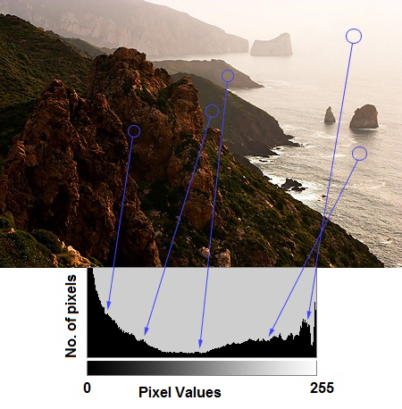
Preprocessing
Histogram
It is a plot with pixel values (ranging from 0 to 255, not always) in X-axis and corresponding number of pixels in the image on Y-axis.
By looking at the histogram of an image, you get intuition about contrast, brightness, intensity distribution etc of that image.
Left region of histogram shows the amount of darker pixels in image and right region shows the amount of brighter pixels.
From the histogram, you can see dark region is more than brighter region, and amount of midtones (pixel values in mid-range, say around 127) are very less.

Slide 11
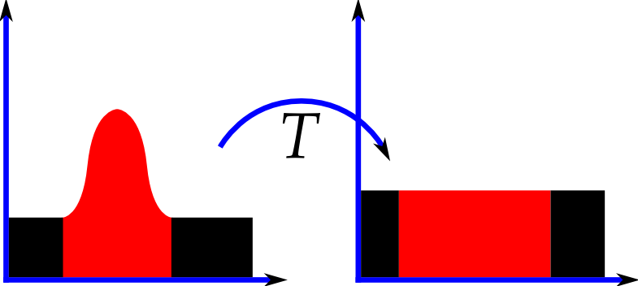
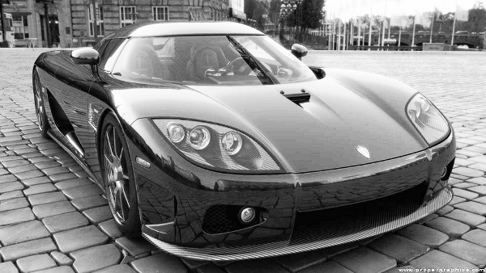
Preprocessing
Histogram
Histogram Equalization (히스토그램 평활화)
Consider an image whose pixel values are confined to some specific range of values only. But a good image will have pixels from all regions of the image.
So you need to stretch this histogram to either ends (as given in below image, from wikipedia) and that is what Histogram Equalization does (in simple words).
This normally improves the contrast of the image.

Slide 12
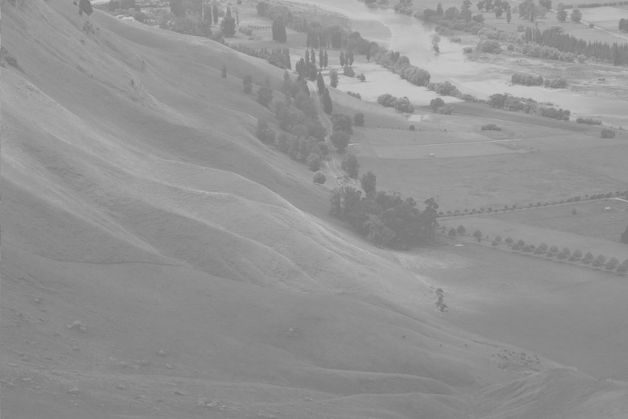
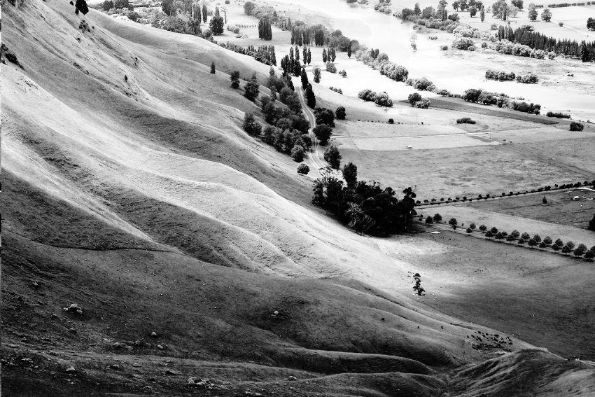
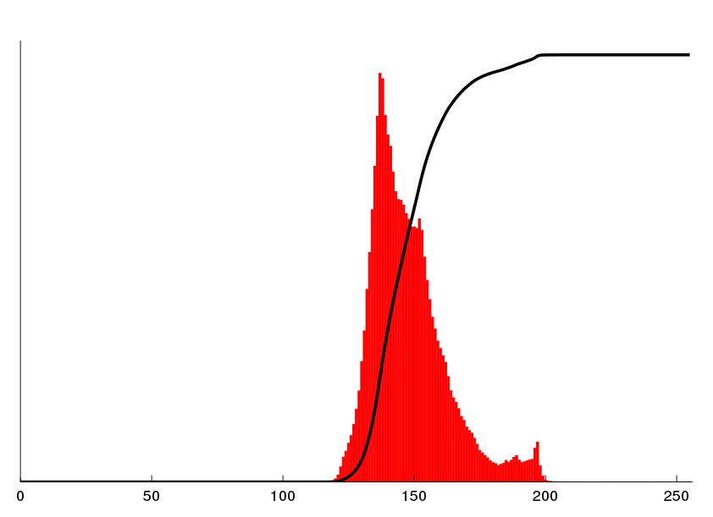
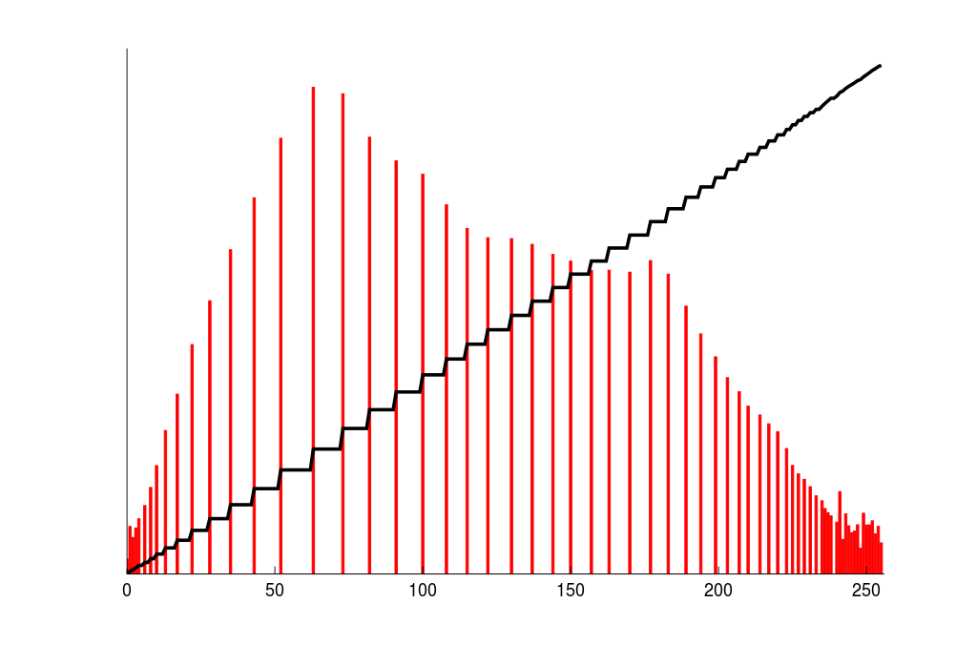
Preprocessing
Histogram
Histogram Equalization (히스토그램 평활화)
Histogram Equalization
명암비 개선
Cumulative distribution
function
Histogram

Slide 13
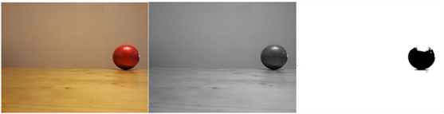
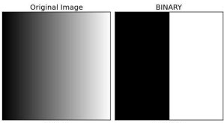
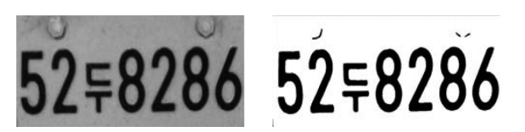
Preprocessing
Image Thresholding
If pixel value is greater than a threshold value, it is assigned one (white), else it is assigned zero (black)
The image should be a grayscale image
Simple Thresholding
- If pixel value is greater than a threshold value(a global value as threshold value),
it is assigned one value (may be white), else it is assigned another value (may be black)
- cv2.threshold()

Slide 14
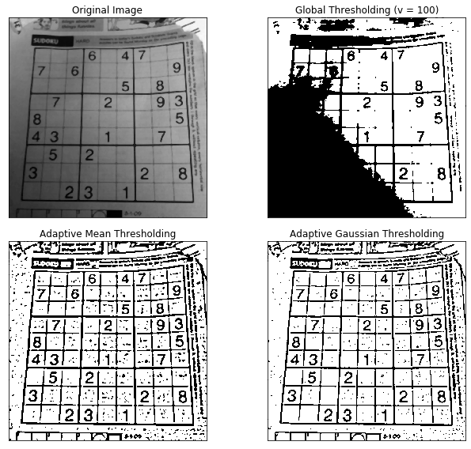
Preprocessing
Image Thresholding
Simple Thresholding
may not be good in all the conditions where image has different lighting conditions in different areas

Slide 15
Preprocessing
Image Thresholding
Adaptive Thresholding
Determines the threshold for a pixel based on a small region around it
Method
Mean : threshold value is the mean of neighborhood area. (cv2.ADAPTIVE_THRESH_MEAN_C)
Gaussian : threshold value is the weighted sum of neighborhood values where weights are a Gaussian window. (cv2.ADAPTIVE_THRESH_GAUSSIAN_C)

Slide 16
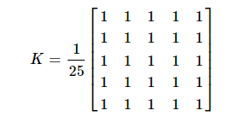
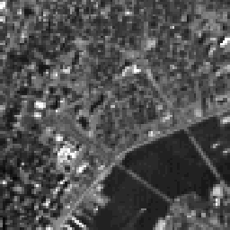
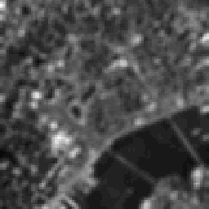
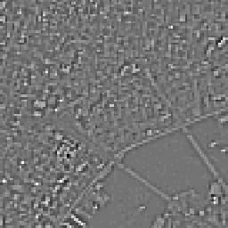
Preprocessing
Image Smoothing
1) Image Filtering
Kernel
- LPF(Low-pass filter) : Removing noises, Blurring
- HPF(High-pass filter) : Edge Detection
- cv2.filter2D() with kernel(filter)
Cropped New York Image
Low Pass Filtered New York Image
High Pass Filtered New York Image

Slide 17
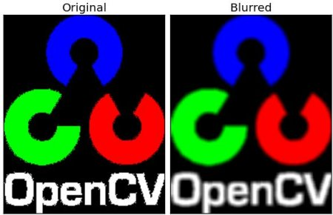
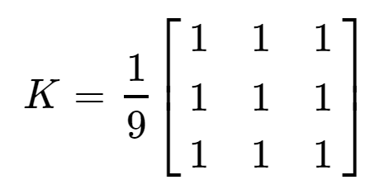
Preprocessing
Image Smoothing
2) Image Blurring
Averaging Blurring
Convolving image with a normalized box filter
It is useful for removing noise
Taking the average of all the pixels under kernel area and replace the central element
cv2.blur, cv2.boxFilter

Slide 18

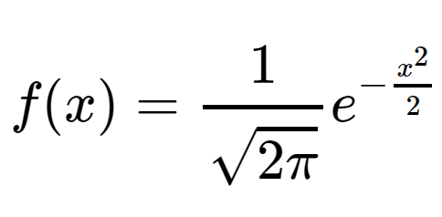
Preprocessing
Image Smoothing
2) Image Blurring
Gaussian Blurring
Gaussian kernel with the function, cv2.getGaussianKernel() is used (kernel > 0 , an odd number greater than one)
Highly effective in removing gaussian noise (Noise with equal overall density, white noise) from the image.
cv2.GaussianBlur()

Slide 19
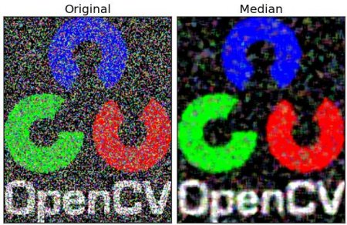
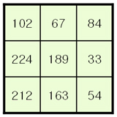
Preprocessing
Image Smoothing
2) Image Blurring
Median Blurring
Takes median of all the pixels
highly effective against salt-and-pepper noise in the images
cv2.medianBlur()
Example) Results of applying kernel window
: After alignment, apply the median of 102 at 33, 54, 67, 84, 102, 163, 189, 212, 224.

Slide 20
2. Preprocessing
실습 진행

Slide 21
3. Feature Descriptor

Slide 22
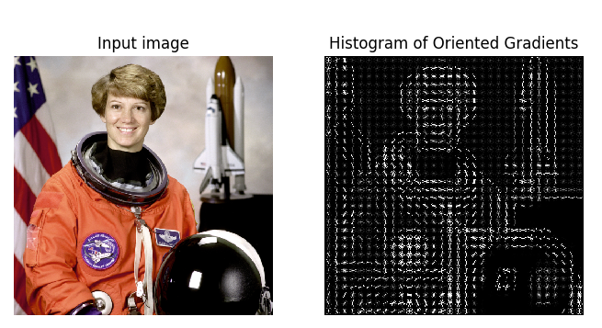
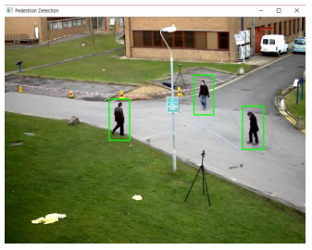
Histogram of Oriented Gradients (HOG)
Feature descriptor
Methods for extracting histogram-type features by considering the direction and magnitude of pixel variation
Generally used for human or pedestrian awareness
HOG로 표현한 이미지
보행자 인식

Slide 23
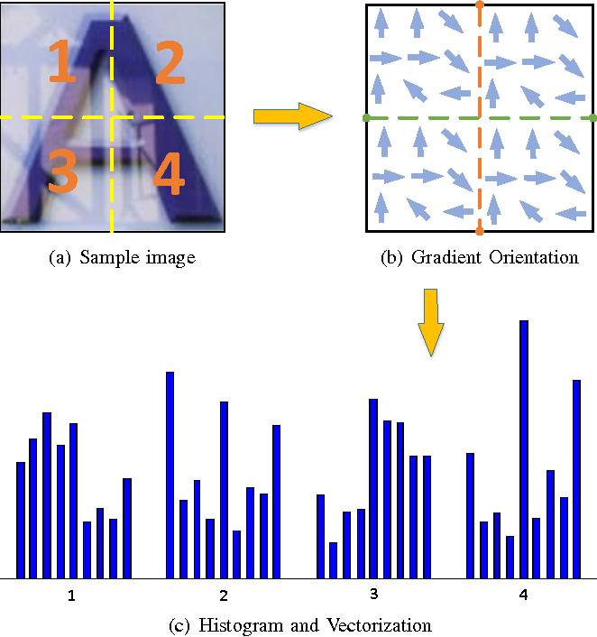
Histogram of Oriented Gradients (HOG)
Feature descriptor
Process of calculating the HOG feature descriptor
Preprocessing
Calculate the Gradient of Images
Calculate Histogram of Gradients in 8×8 cells
16×16 Block Normalization
Calculate the HOG feature vector

Slide 24
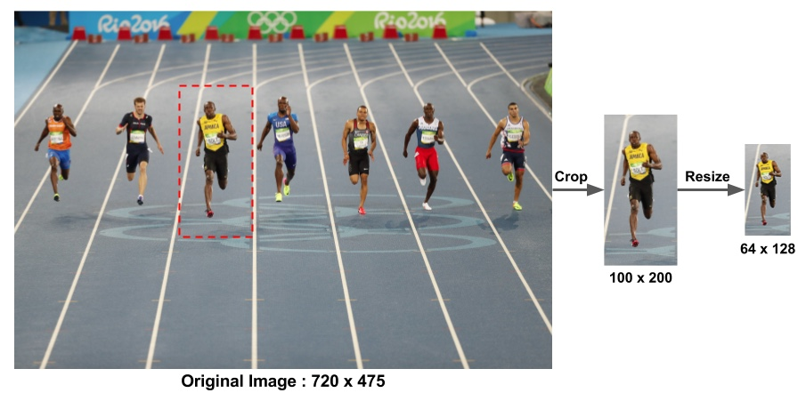
Histogram of Oriented Gradients (HOG)
Feature descriptor
Step 1 : Preprocessing
HOG feature descriptor used for pedestrian detection is calculated on a 64×128 patch of an image.
Select a patch of size 100×200 for calculating our HOG feature descriptor. This patch is cropped out of an image and resized to 64×128
Notes:
https://www.learnopencv.com/histogram-of-oriented-gradients/

Slide 25
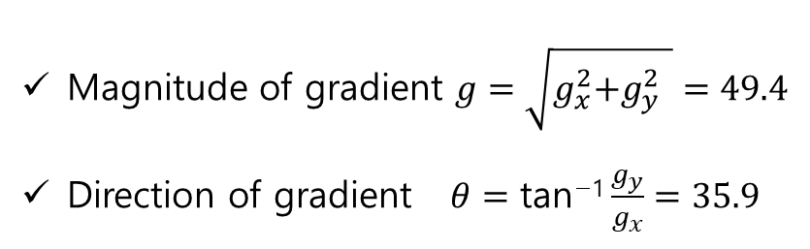
Histogram of Oriented Gradients (HOG)
Feature descriptor
Step 2 : Calculate the Gradient of Images
- Calculate the horizontal and the vertical gradient images, $g_{x}$ and $g_{y}$
Input data
Basic filter
75 | 95 | 22
35 | 82 | 64
23 | 55 | 42
1
0
-1
$g_{x}$= 29
$g_{y}$= 40
-1 | 0 | 1
Magnitude of gradient $g=\sqrt{g_{x}^{2}\text{+}g_{y}^{2} }=49.4$
Direction of gradient $θ=\text{tan}\text{−1}\frac{g_{y}}{g_{x}}=35.9$

Slide 26
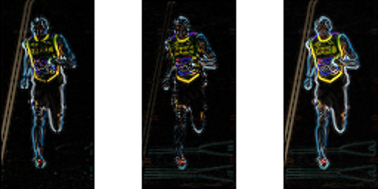
Histogram of Oriented Gradients (HOG)
Feature descriptor
Step 2 : Calculate the Gradient of Images
x-gradient
y-gradient
Magnitude of gradient
The gradient image removed a lot of non-essential information (e.g. constant colored background), but highlighted outlines.
At every pixel, the gradient has a magnitude and a direction.
For color images, The magnitude of gradient at a pixel is the maximum of the magnitude of gradients of the three channels, and the direction is the direction corresponding to the maximum gradient.

Slide 27
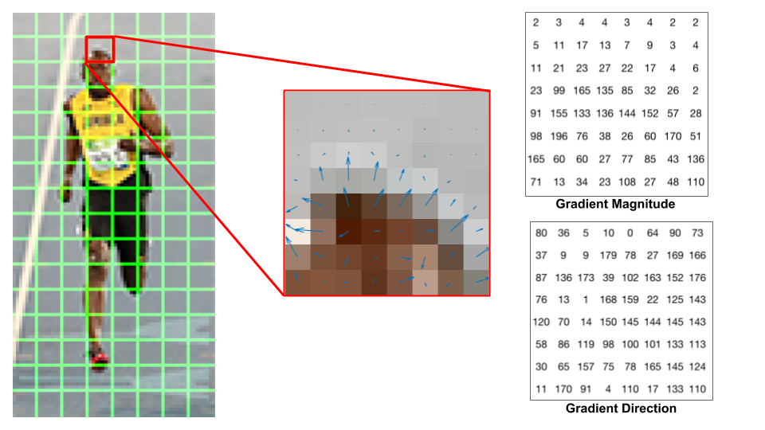
Histogram of Oriented Gradients (HOG)
Feature descriptor
Step 3 : Calculate Histogram of Gradients in 8×8 cells
1 cell (8x8)
For 8x8 cell size (1 cell 당 가로 8 픽셀, 세로 8 픽셀)
8x8x3 = 192 pixel values (color 3 channel, RGB) : 연산 횟수
8x8x2 = 128 numbers (magnitude and direction) : 출력

Slide 28
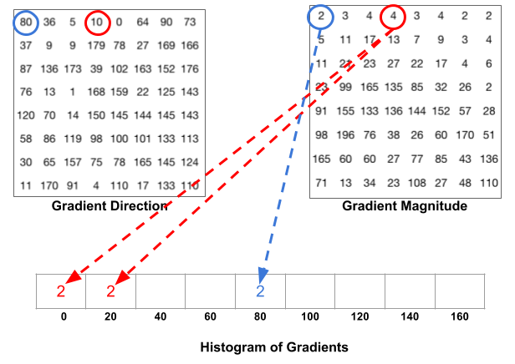
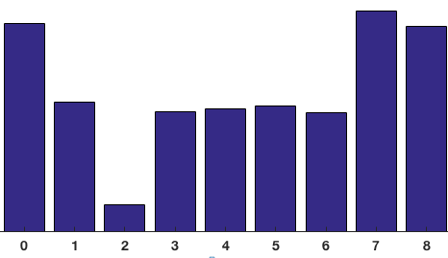
Histogram of Oriented Gradients (HOG)
Feature descriptor
Step 3 : Calculate Histogram of Gradients in 8×8 cells
9-bin histogram
Create a histogram of gradients in these 8×8 cells. The histogram contains 9 bins corresponding to angles 0, 20, 40 … 160.
A bin is selected based on the direction, and the vote ( the value that goes into the bin ) is selected based on the magnitude.

Slide 29
Histogram of Oriented Gradients (HOG)
Feature descriptor
Step 4 : 16×16 Block Normalization
Gradients of an image are sensitive to overall lighting.
If the lighting of the image, changes, the direction of the gradient does not change, but the magnitude may change.
To be independent of lighting variations, we would like to “normalize” the histogram so they are not affected by lighting variations.

Slide 30





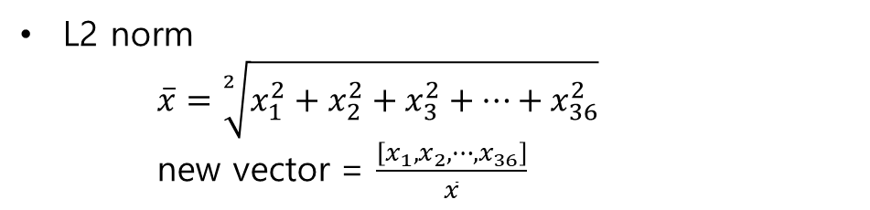
Histogram of Oriented Gradients (HOG)
Feature descriptor
A 16×16 block has 4 histograms(4개의 cell로 부터 나옴) which can be concatenated to form a 1 x 36 element vector
each cell represents one 1x9 histogram
$$\left[x_{1}, x_{2}, ⋯, x_{9}\right]$$
$$\left[x_{10}, x_{11}, ⋯, x_{18}\right]$$
$$\left[x_{18}, x_{19}, ⋯, x_{27}\right]$$
$$\left[x_{26}, x_{27}, ⋯, x_{36}\right]$$
concatenate
$\left[x_{1}, x_{2}, ⋯, x_{36}\right]$ - 1x36 vector
L2 norm
$\overline{x}=\sqrt[2]{x_{1}^{2}+x_{2}^{2}+x_{3}^{2}+⋯+x_{36}^{2}}$
new vector = $\frac{\left[x_{1}, x_{2}, ⋯, x_{36}\right]}{\overline{x}}$

Slide 31
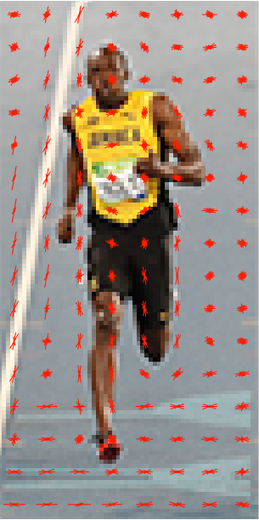
Histogram of Oriented Gradients (HOG)
Feature descriptor
Step 5 : Calculate the HOG feature vector
In 64x128 patches,
One 16x16 block → 1x36 L2 norm vector
Sliding 16x16 block: 7x15 = 105
Final HOG feature vector is (36x105 = 3780) 1x3780 dimensional vector

Slide 32
3. Feature Descriptor
실습 진행

Slide 33
4. Traditional Image Classification

Slide 34
Traditional Image Classification
4. Traditional Image Classification
Image classification using Feature Descriptor and Learning Algorithm
Use HOG as feature Descriptor, Random Forest as Learning Algorithm

Slide 35
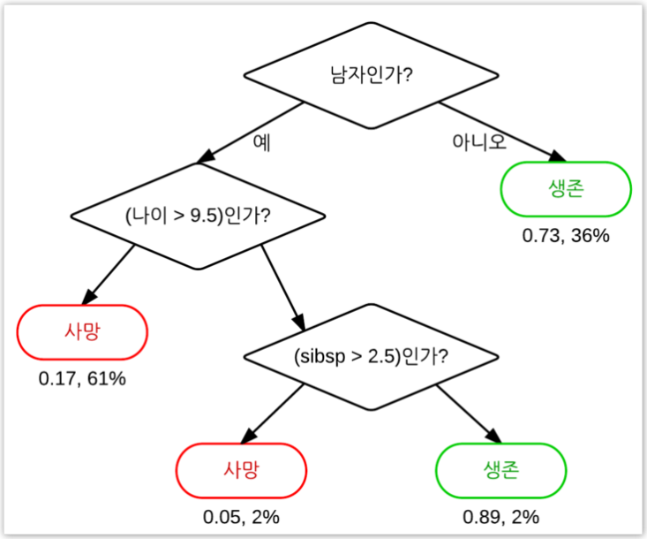
Traditional Image Classification
Decision Tree
<tree>
Available for both Classification and Regression
스무고개하듯 예/아니오 질문을 이어가며 학습
Process
데이터를 가장 잘 구분할 수 있는 질문을 기준으로 나눔
나뉜 범주에서 또 다시 데이터를 가장 잘 구분할 수 있는 질문을 기준으로 나눔
②단계 k번 반복 -> k가 커지면 overfitting 발생

Slide 36
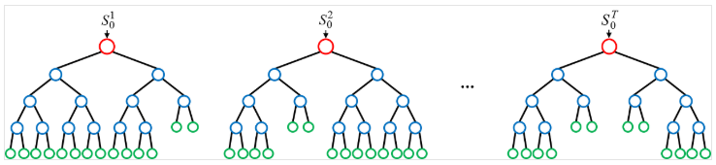
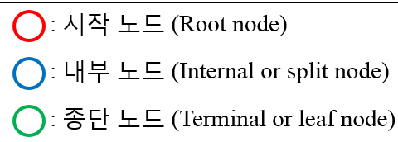
Traditional Image Classification
Random Forest
The random forest is a algorithm consisting of many decisions trees.
Available for both Classification and Regression.
Easy to handle Missing values.
Effective for large data processing
Random decision forests correct for decision trees' habit of overfitting to their training set.
Random forests can be used to rank the importance of variables.

Slide 37
Traditional Image Classification
Random Forest
Process
주어진 training dataset에서 중복을 허용하여 n개 선택 -> bootstrap
n개의 dataset에서 변수를 중복 허용없이 d개 선택
이를 이용해 의사결정 나무를 학습하고 생성
①~③ 단계 k번 반복 -> k개의 의사결정나무 생성/k가 커지면 예측 결과의 품질을 더 좋게 해주지만 컴퓨터의 성능 문제를 일으킬 수 있음
①~④ 단계를 통해 생성된 k개의 의사결정나무를 이용해 예측
예측된 결과의 평균이나 가장 빈도수가 높은 예측 결과 선택 -> 앙상블 기법

Slide 38
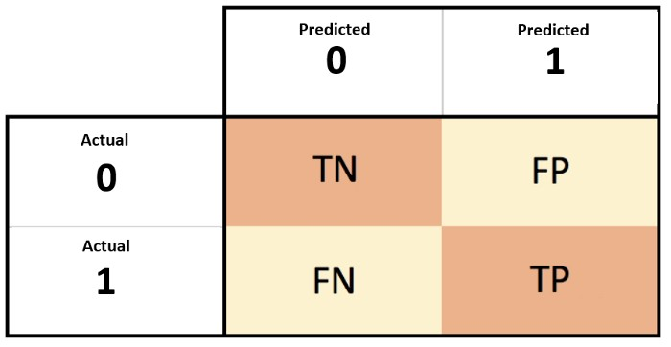
Traditional Image Classification
모델 평가
레이블 0,1(관심 범주)을 가진 데이터를 분류할 때,
TP(True Positives) : 관심 범주를 정확하게 분류
FN(False Negatives) : 관심 범주가 아닌 것으로 잘못 분류
FP(False Positives) : 관심 범주라고 잘못 분류
TN(True Negatives) : 관심 범주가 아닌 것을 정확하게 분류
Accuracy (정확도) | 정확하게 예측해낸 것을 의미. 모델이 얼마나 정확한지 평가하는 척도 공식 : (TP + TN) / (TP + TN + FP + FN)
Precision (정밀도) | 모델을 통해 1이라고 분류해낸 그룹 A가 있을 때, 모델이 얼마나 믿을만한 정도로 A를 만들어 냈는지 평가 공식 : TP / (TP + FP)
Recall (재현도) | 정밀도와 비교되는 척도로써, 관심 영역만을 얼마나 추출해냈는지 평가 공식 : TP / (TP + FN)

Slide 39
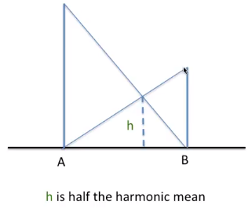
모델 평가
레이블 0,1(관심 범주)을 가진 데이터를 분류할 때,
TP(True Positives) : 관심 범주를 정확하게 분류
FN(False Negatives) : 관심 범주가 아닌 것으로 잘못 분류
FP(False Positives) : 관심 범주라고 잘못 분류
TN(True Negatives) : 관심 범주가 아닌 것을 정확하게 분류
F1-Score (조화 평균) | Recall과 precision을 이용한 조화 평균. 단순하게 평균을 구하는 것이 아니라 큰 값이 있다면 penalty를 주어서 작은 값 위주로 평균을 구함. Imbalanced data에 대해서 큰 값을 가진 클래스가 있더라도 조화를 이루는 평균을 구할 수 있음. 공식 : 2 x {(precision x recall) / (precision + recall)}

Slide 40
Traditional Image Classification
4. Traditional Image Classification
실습 진행

