Slide 1
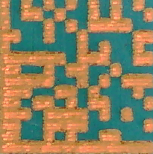

DOWN
SETTING
DAILY
RIGHT
EXIT
INITIALIZE
LEFT
INITIALIZE
RESET
START
START
STOP
STOP
Teaching
Auto
UP
Teaching
ReMark PCB
Simulation Mode
Buzzer Stop
Buzzer Stop
Cycle STOP
12
1
All Pos
Vision
2D Scan

