Slide 1
HEALTHCARE TECHNOLOGY • PITCH DECK
eHealthwares
Connect healthcare data for meaningful use.
Connecting healthcare organizations, professionals, patients and information through intelligent healthcare technology.
eHealthwares Informatics Limited
John • CTO & Founder

Slide 2
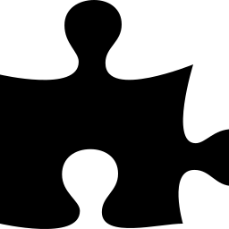



THE PROBLEM
Healthcare information is disconnected
Fragmented records
Poor coordination
Patient information is scattered across facilities and systems that don't talk to each other.
Healthcare professionals and organizations struggle to coordinate around a shared picture of the patient.
Access barriers
Data hard to use
Patients face location and communication barriers that stand between them and the right care.
Valuable health data is difficult to collect, retrieve and meaningfully use at the point of decision.
Result: inefficient care, delayed decisions and poor healthcare experiences.
eHealthwares
02

Slide 3
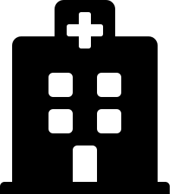
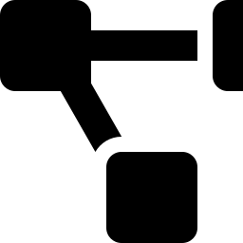

OUR SOLUTION
A connected healthcare information ecosystem
Health Information Management Suites
We build Health Information Management suites for healthcare facilities — the operational backbone for hospitals, labs and pharmacies.
Free Omnichannel Exchange
We enable free, omnichannel, communication-driven health information exchange — so information moves wherever it's needed.
Breaking location
and channel barriers
Connecting the right people, information and workflows.
We break location and channel barriers, connecting the right people, information and workflows — wherever care happens.
eHealthwares
03

Slide 4
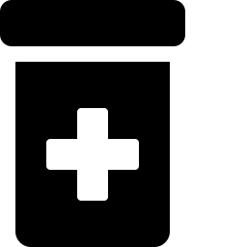

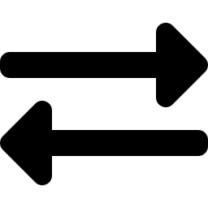
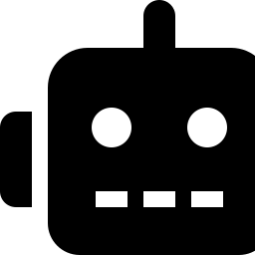
WHAT WE BUILD
Healthcare systems + intelligent information exchange
Hospital
Pharmacy
Laboratory
EMR
PMS
Order & Workflow
Electronic medical records and facility management.
Pharmacy management for dispensing and inventory.
Laboratory order and workflow management.
Exchange
Omnichannel
AI Assistant
HIE
Engine
MyAIha
Health Information Exchange across organizations.
Communication engine spanning web, SMS, WhatsApp.
AI-powered health assistant for patients and staff.
eHealthwares
04

Slide 5


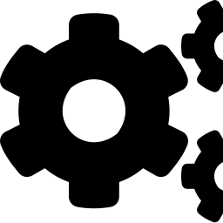



HOW IT WORKS
From information collection to meaningful action
1
2
3
4
5
6
Collect
Connect
Process
Route
Retrieve
Act
Our workflow-driven communication connects patients and healthcare stakeholders through appropriate channels, and routes information to the right person, at the right level, at the right time.
eHealthwares
05

Slide 6

OUR DIFFERENTIATION
More than an EMR. More than communication.
Omnichannel questionnaires
Workflow-driven communication
Healthcare Information Management
Stakeholder connection
AI-enabled information exchange
Connecting the full care team
Doctors
Nurses
Pharmacists
Patients
Hospitals
Laboratories
Pharmaceutical Stores
eHealthwares
06

Slide 7


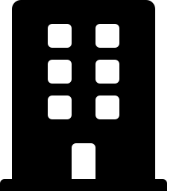

CUSTOMERS
Who we serve
Patients
Independent Practitioners
Healthcare Organizations
Hospitals
Laboratories
Pharmacies
Payers / HMOs
These customers can use and pay for our products and services.
eHealthwares
07

Slide 8


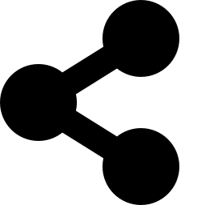


PAYER OPPORTUNITY
Making healthcare resources work where they matter most
We enable efficient use of time, skills, knowledge and healthcare resources by connecting members to the right information, stakeholder and level of specialist — exactly where applicable.
Member Navigation
Care Coordination
Referral Routing
Utilization Efficiency
Improved Member Experience
eHealthwares
08

Slide 9
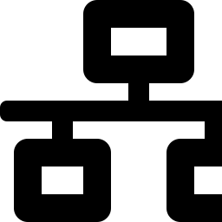

AI & HEALTHCARE INFORMATION EXCHANGE
Turning healthcare data into meaningful use
Efficient personnel connection
Intelligent data collection
Seamless information retrieval
Domain expertise
+ Software + AI
Communication across multiple channels
Better-informed healthcare decisions
The right information. The right person. The right time.
eHealthwares
09

Slide 10
TRACTION
Already operating in real healthcare environments
5
3,000+
Healthcare workflows already in active, daily use
Hospitals
deployed
Patients
reached
Building toward a broader connected healthcare ecosystem
eHealthwares
10

Slide 11

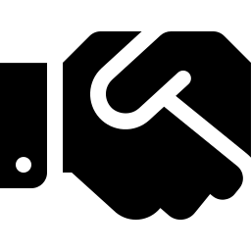
MARKET
Built for Africa
Our initial focus is the African healthcare market, where fragmented healthcare information and access barriers create significant opportunities for digital transformation.
How we scale
Replicating facility implementations
Partnering with EMR and healthcare technology providers
Connecting healthcare organizations and professionals
Expanding across ECOWAS and other African markets
eHealthwares
11

Slide 12



BUSINESS MODEL
B2B2C Healthcare Technology
Healthcare facility software
Practitioner solutions
Healthcare information exchange
Contractual technology services
SaaS solutions
Patient-facing services
Our ecosystem serves both healthcare organizations and individual practitioners — while ultimately improving patient access and outcomes.
eHealthwares
12

Slide 13


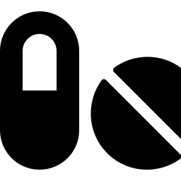

WHY US
Healthcare expertise + Software + AI
Medical
Diagnostics
Healthcare
Pharmaceutical
Software Development
Applied AI
Building reliable, scalable healthcare systems.
AI grounded in real clinical and operational context.
We understand both the healthcare workflows and the technology required to connect them.
eHealthwares
13

Slide 14
IMPACT
Improving access, experience and outcomes
Break location and channel barriers
Improve access to healthcare personnel
Improve access to healthcare information
Enable more coordinated care
Support underserved populations
Make healthcare data actionable
Improve healthcare outcomes
eHealthwares
14

Slide 15
VISION
A healthcare system where information moves with the patient.
Patients
↔
Professionals
↔
Organizations
↔
Information
Making healthcare data accessible, connected and meaningfully usable — wherever it is needed.
eHealthwares
15

Slide 16

WHAT WE ARE LOOKING FOR
Partners to accelerate scale
Healthcare Organizations
Payers / HMOs
Strategic Technology Partners
EMR Partners
Investors
Healthcare Ecosystem Partners
To help us expand adoption, integrate healthcare ecosystems and scale across Africa.
eHealthwares
16

Slide 17
eHealthwares
Connect healthcare data for meaningful use.
Connecting healthcare data, people and workflows to improve healthcare outcomes.
John
CTO & Founder • eHealthwares Informatics Limited

