Slide 1
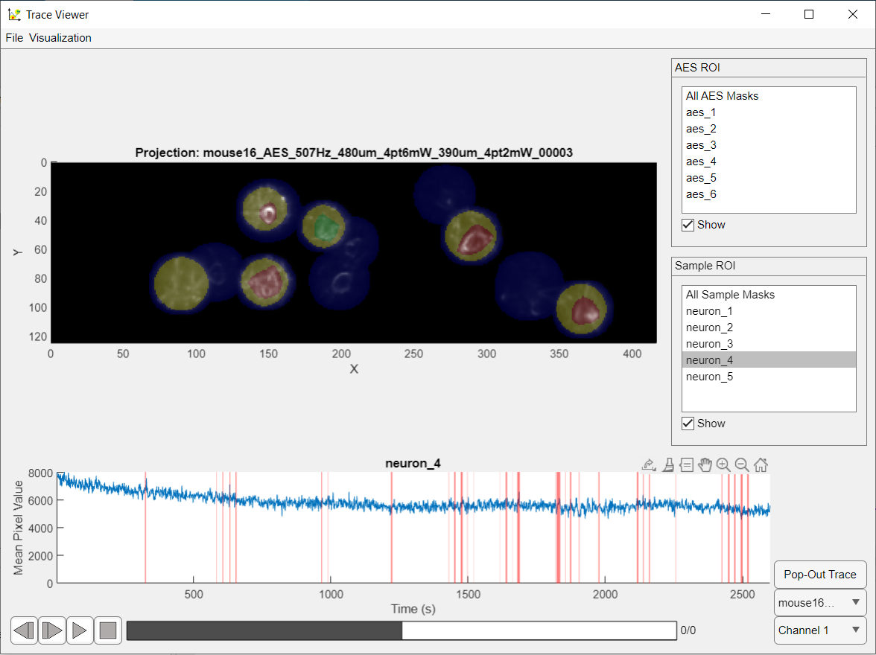


3
1
2
4
10.1
5
10.2
10.3
7
10.4
8
6
9

