Slide 1

PURE Midterm Report
Mimicking Black Box Sentence Level Text Classification Models
Presentation By: Eryk Helenowski
PURE Mentor: Vincent Bindschaedler

Slide 2

Overview
Artificial Intelligence- perform tasks that normally require human intelligence such as visual perception, speech recognition, etc.
Machine Learning- type of AI the provides computers with the ability to learn without being explicitly programmed.
Focuses on programs that change when exposed to new data
Deep Learning- class of Machine Learning algorithms
Natural Language Processing (NLP)- the ability of a computer program to understand human speech
Machine Learning as a Service- companies offer ML services in the form of REST APIs.
Determine susceptibility of MLaaS services to be copied by machine learning techniques

Slide 3
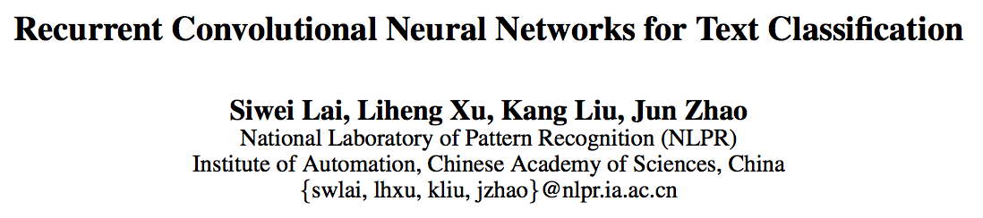
Text Classification is a foundation of many NLP applications
Typically for Text Classifications, a Recursive Neural Network is used
Proven efficient for constructing sentence structure representations
Constructing textual tree is at least O(n²) and tree-like structure is unsuitable for modeling long sentences or documents
Recurrent Neural Network has runtime complexity of O(n) analyzes text word by word and stores the semantics of all previous text in a fixed sized hidden layer
Biased model, later words are more dominant than earlier words
Convolutional Neural Network (CNN) unbiased model, which can fairly determine discriminative phrases in text, also O(n) runtime complexity
“Window size” problem, smaller windows -> loss of info, larger window -> huge parameter space
Suggest use of Recurrent Convolutional Neural Network
Represent words using numbers and a left and right context
Softmax function on output layer
Improvements when accounting for context with recurrent structure, and constructs the representation of text using a convolutional neural net

Slide 4
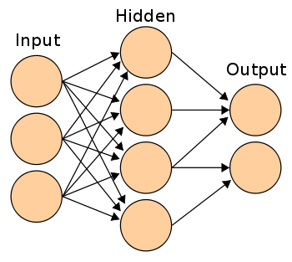
Convolutional Neural Network (CNN)

Slide 5
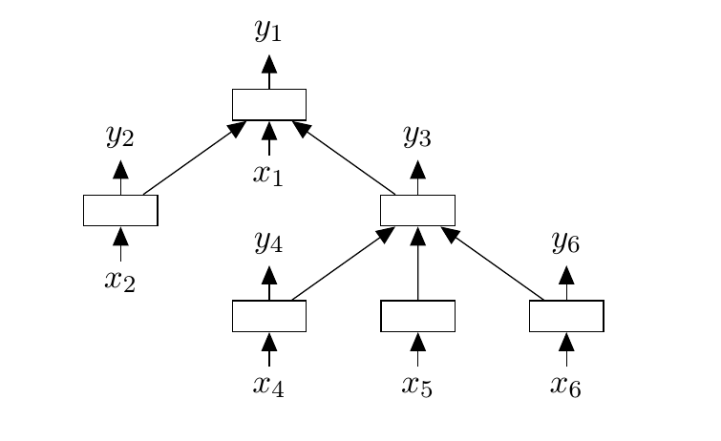
Recursive Neural Tensor Network (RNTN)

Slide 6
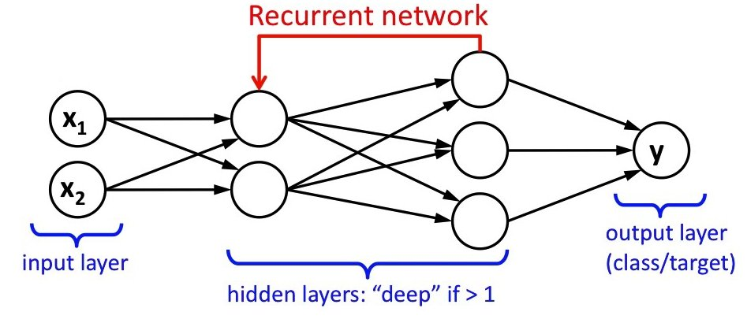
Recurrent Network (RNN)

Slide 7
Techniques
Recurrent Neural Network- contains cycles, often times used for time series data
A more natural fit than convolution neural networks, which are more widely used in image processing
LTSM- Long Short Term Memory network
Type of RNN capable of learning long term dependencies, something RNNs struggle with
Label the training data using some text classification API, then use this to train my model, and then test how effectively my model mimics the behavior of theirs

Slide 8
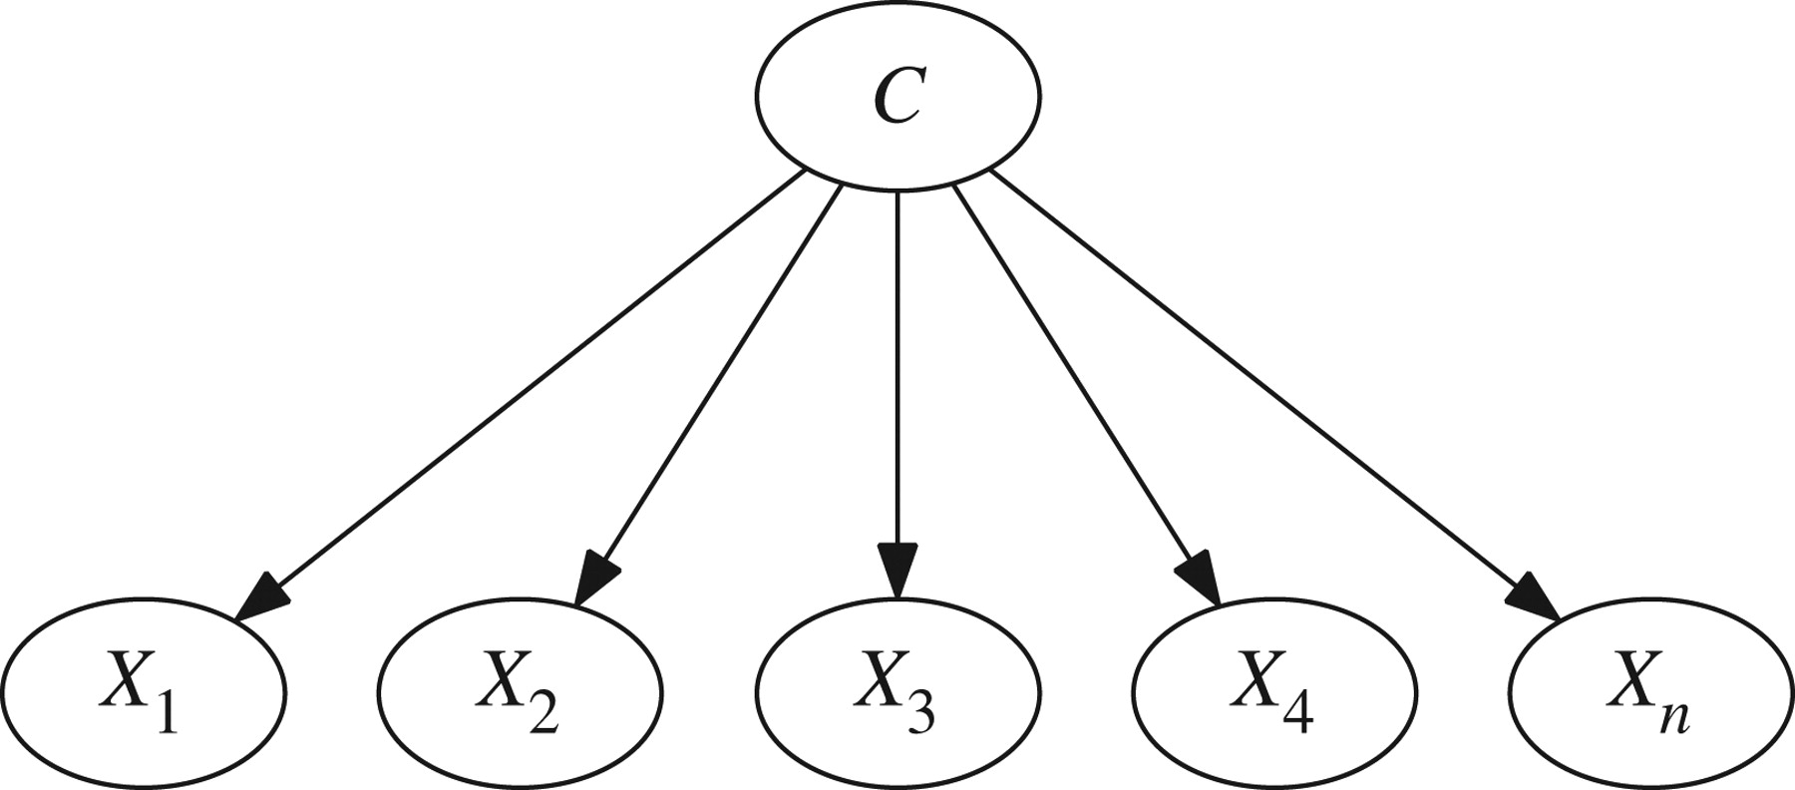


Progress
Native Bayes Classifier
DATA
PREPROCESSING
TRAINING DATA

Slide 9
Goals
Implement a more heavily involved data preprocessing step that allows me to move from a naïve Bayes classifier to a LTSM Recurrent Network
One to one mapping vocabulary?
Vectorized representation of words?
Determine various performance metrics to determine how well I am mimicking the Aylien API
Extend upon a simple LTSM network to explore the effects of different architectures

