Slide 1

Actually Using Your Trained Model
Deploying your model to Google Cloud, Azure, and HTML
Evan Hennis
Google Developer Expert in Machine Learning
Senior Software Engineer at Microsoft
@TheNurl
https://eckronsoftware.wordpress.com
https://github.com/ehennis
YouTube: Evan Hennis

Slide 2



Bio
BS from Iowa State 2004
MS from Georgia Tech 2018
C# developer since 2004
GDE in Machine Learning 2019

Slide 3
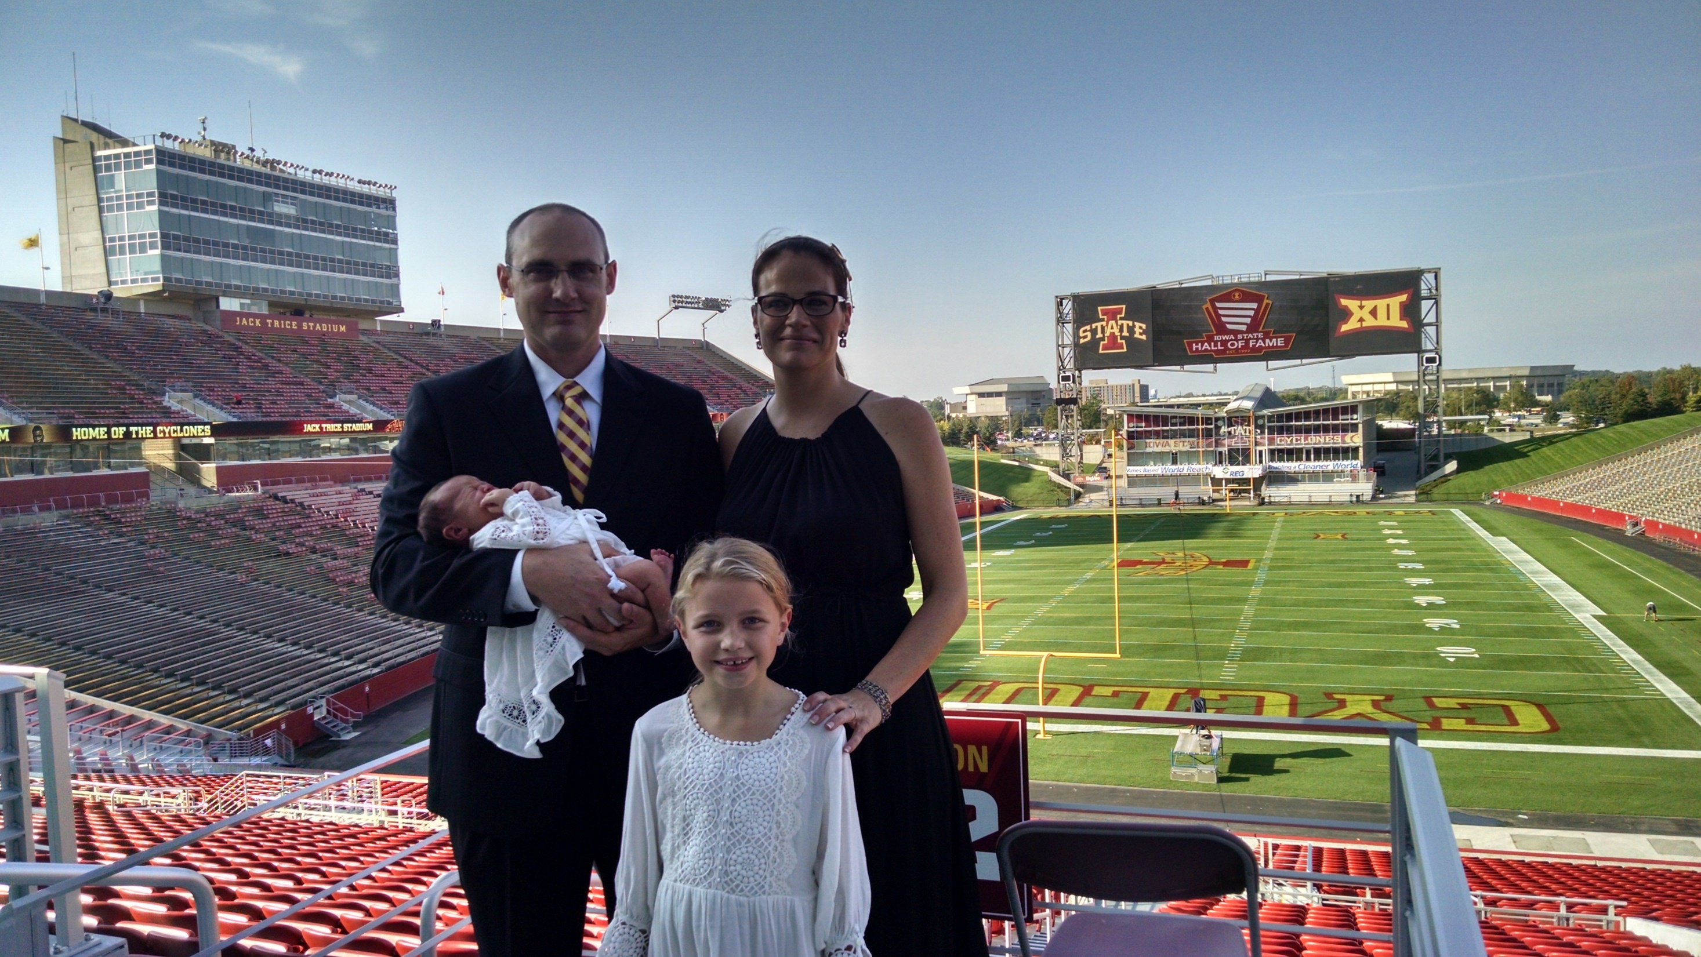

Slide 4





Deep Learning for Basketball Scores Prediction
https://www.manning.com/liveprojectseries/deep-learning-for-basketball-scores-prediction-ser
35% discount code (all products): ctwkcdc22
http://mng.bz/WMa4

Slide 5
Overview
Project Introduction
Model Creation
Web Deployment using TensorFlow.JS
Android Deployment using TensorFlow Lite
Google Cloud Deployment
Microsoft Azure Deployment

Slide 6
Project Introduction
Idea: We have plenty of demos covering creating a model but not very many that actually get the model in the hands of your users.
Technologies:
TensorFlow/Keras
Google Colab Notebook
Something for the web
Something for Android
Google Cloud
Microsoft Azure

Slide 7
Model Creation
Using a neural network to convert Celsius to Fahrenheit
https://github.com/ehennis/Blog/blob/master/UsingYourModels/KCDC/CtoF.ipynb

Slide 8
Web Deployment using TensorFlow.JS
Convert to TensorFlow.js model
Wrap html around JS files
Demo: UsingYourModels/KCDC/CreateTFJS.ipynb
Web Site: UsingYourModels/KCDC/Web Site/include/LoadModel.js

Slide 9
Android Deployment using TensorFlow Lite
Convert to TensorFlow Lite model
Demo: UsingYourModels/KCDC/CreateTFLite.ipynb

Slide 10
Android Deployment cont.
Add CtoF_Model.tflite as Asset
app -> New -> Folder -> Assets folder
Copy ‘CtoF_Model.tflite’ to Assets
Don’t compress the model
app -> build.gradle
Add “aaptOptions”
noCompress “tflite”
Add tensorflow-lite dependency
implementation 'org.tensorflow:tensorflow-tflite'

Slide 11
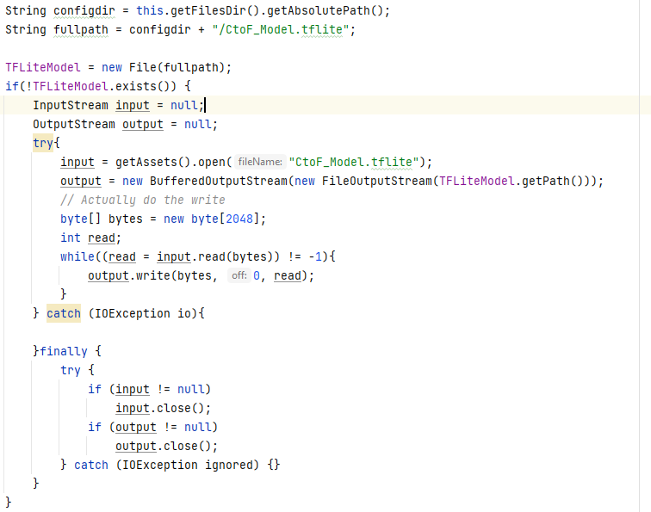
Android Deployment cont.
Create File

Slide 12
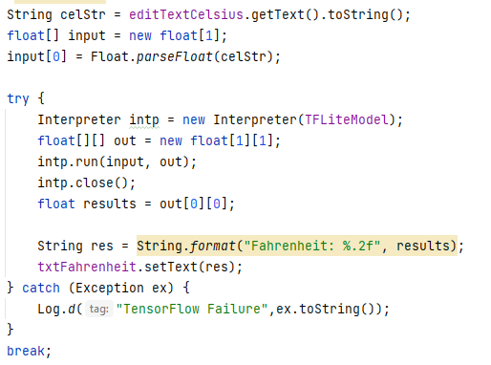
Android Deployment cont.
Run Interpreter

Slide 13
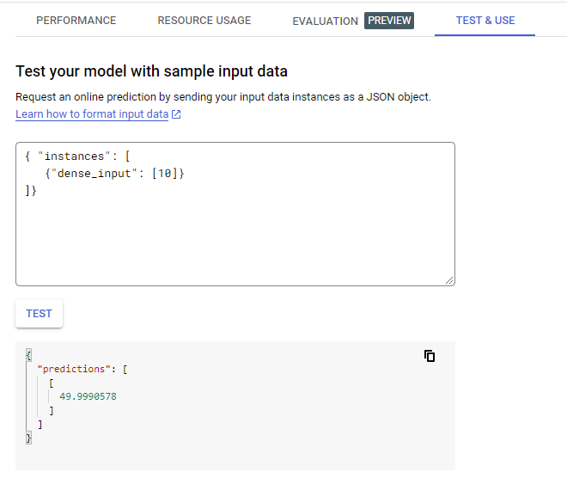
Google Cloud Deployment
Create Project
Create Cloud Storage Bucket
Upload SavedModel files
Create model in AI Platform
This takes a while
Test & Use

Slide 14
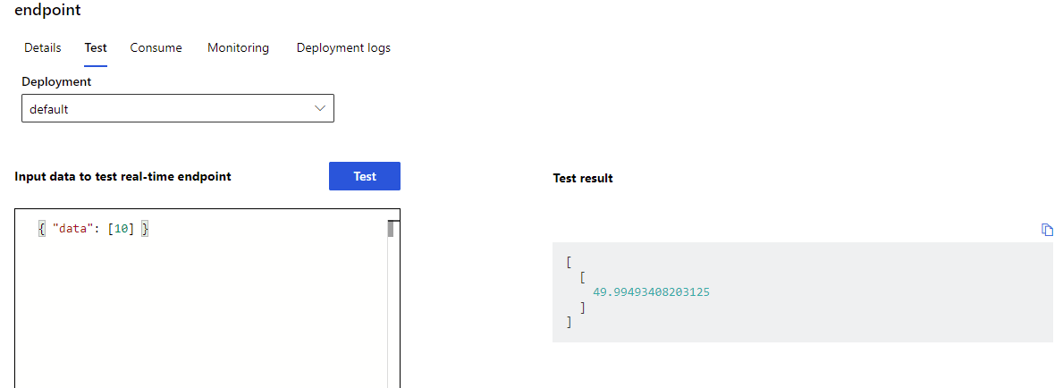
Microsoft Azure Deployment
Create “Azure Machine Learning”
Launch “Azure Machine Learning Studio”
Register Model
Deploy to real time endpoint
Attach score.py

Slide 15
Conclusion
Create your pretrained model
Convert your model to valid formats (TF.JS and TF Lite)
Deploy full model to the clouds (Azure and Google)

Slide 16
Links
Code Repository: https://github.com/ehennis/Blog/tree/master/UsingYourModels

Slide 17
My Information
Twitter: @TheNurl
GitHub: https://github.com/ehennis
YouTube: Evan Hennis
Blog: http://blog.eckronsoftware.com
Email: EvanHennis@gmail.com

