Slide 1

Azure Machine Learning
Train a data science model at scale
Evan Hennis
Google Developer Expert in Machine Learning
Software Developer, Microsoft
@TheNurl
https://eckronsoftware.wordpress.com
https://github.com/ehennis
YouTube: Evan Hennis

Slide 2



Bio
BS from Iowa State 2004
MS from Georgia Tech 2018
C# developer since 2004
GDE in Machine Learning 2019

Slide 3
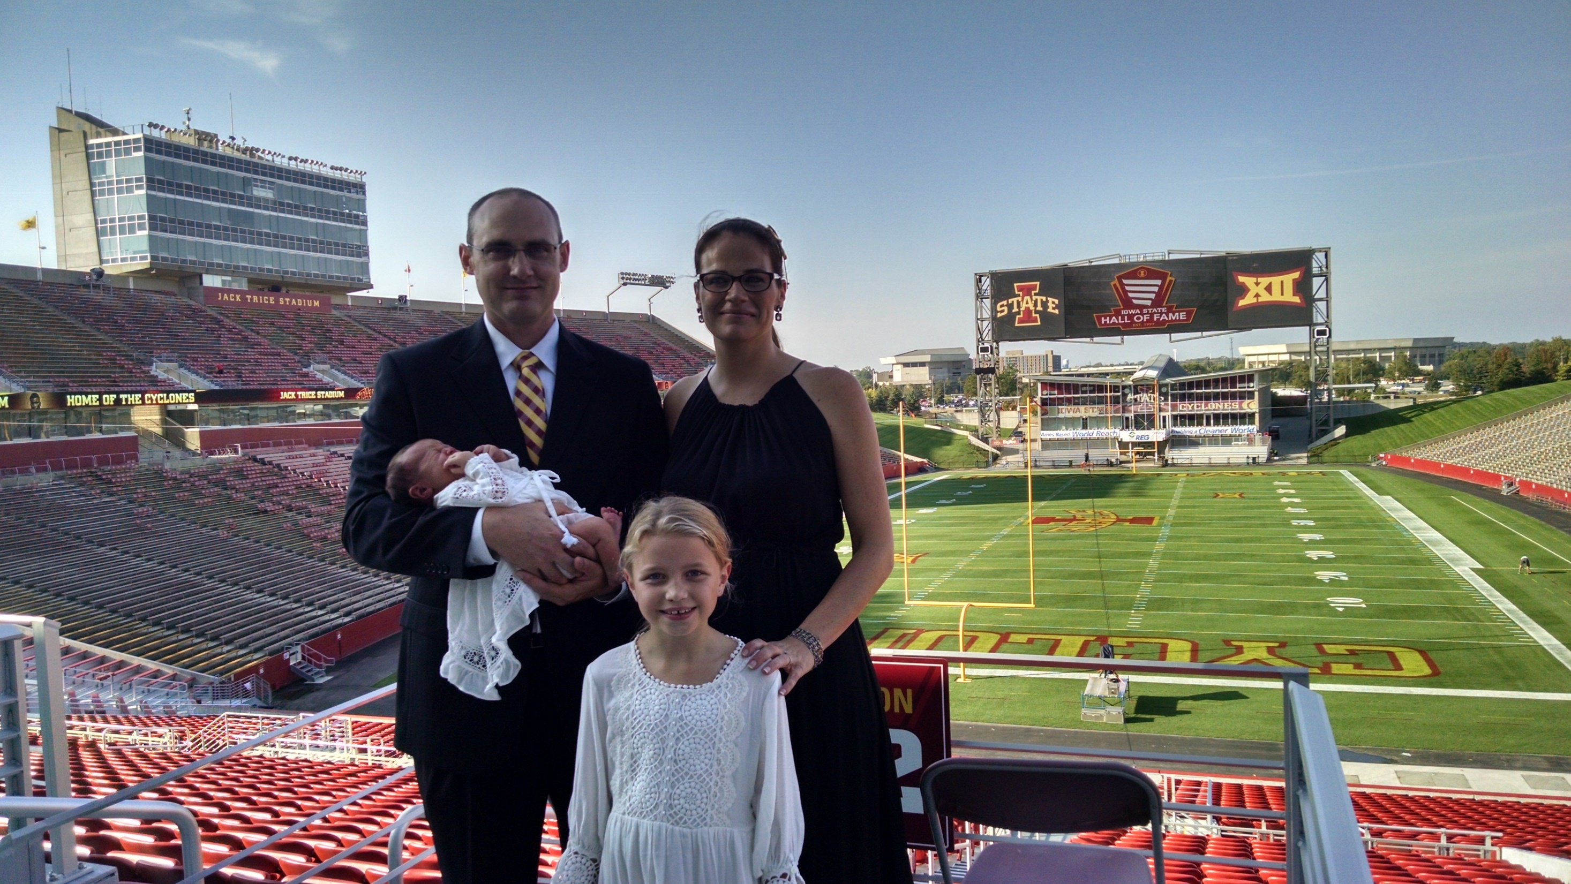

Slide 4
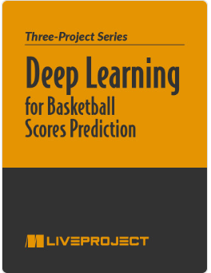
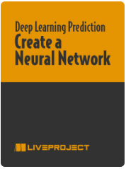

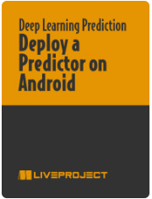

Deep Learning for Basketball Scores Prediction
https://www.manning.com/liveprojectseries/deep-learning-for-basketball-scores-prediction-ser

Slide 5
Overview
Introduction
Setting up a job
Connecting a workspace
Submit for training
Validation
Deployment
Conclusion

Slide 6
Conclusion
Simple-ish
Enables end to end testing in Visual Studio
Allows debugging
Don’t have to start VS and then run your test software

Slide 7
Links
WebApplicationFactory: https://docs.microsoft.com/en-us/dotnet/api/microsoft.aspnetcore.mvc.testing.webapplicationfactory-1?view=aspnetcore-5.0
IClassFixture: https://xunit.net/docs/shared-context
Code Repository: https://github.com/ehennis/Blog/tree/master/WebApplicationFactory/NCode

Slide 8
My Information
Twitter: @TheNurl
GitHub: https://github.com/ehennis
YouTube: Evan Hennis
Blog: http://blog.eckronsoftware.com
Email: EvanHennis@gmail.com

