Slide 1

Advanced .NET Testing
with in-memory EF and Hosted API
Evan Hennis
Google Developer Expert in Machine Learning
Senior Software Developer, Microsoft
@TheNurl
https://eckronsoftware.wordpress.com
https://github.com/ehennis
YouTube: Evan Hennis

Slide 2




Bio
BS from Iowa State 2004
MS from Georgia Tech 2018
C# developer since 2004
GDE in Machine Learning 2019

Slide 3


Slide 4
Overview
API Introduction
EF and DbContext
Testing Strategy 1: Fakes and Mocks
Testing Strategy 2: Custom DbContext
Testing Strategy 3: WebApplicationFactory
Testing Strategy 4: IClassFixture<T>
Testing Strategy 5: Custom Class
Conclusion

Slide 5
API Introduction
.NET Framework 8
Visual Studio 2022
Default Template Project
Added Service
Added DataStore
Added Repository
Added “model”

Slide 6

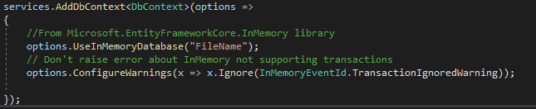
EF and DataContext

Slide 7
xUnit Test Project
xUnit (Microsoft Test also works)
.NET 8

Slide 8
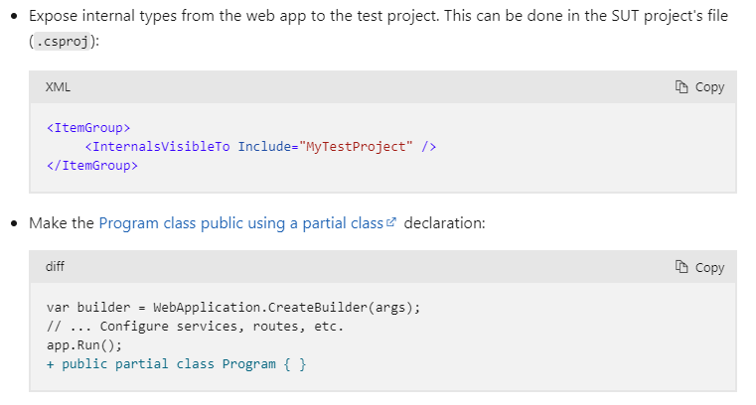
>= .NET 6.0 Change
Startup and Program => Program.cs
No longer have a Program Class
Link

Slide 9
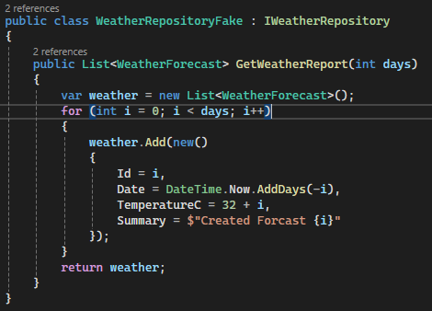
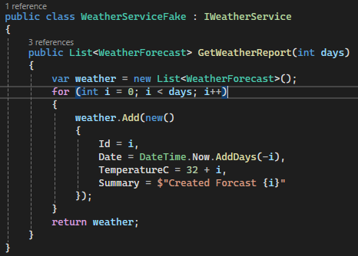
Testing Strategy 1: Fakes and Mocks
Create a “fake” class to simulate the actual code

Slide 10
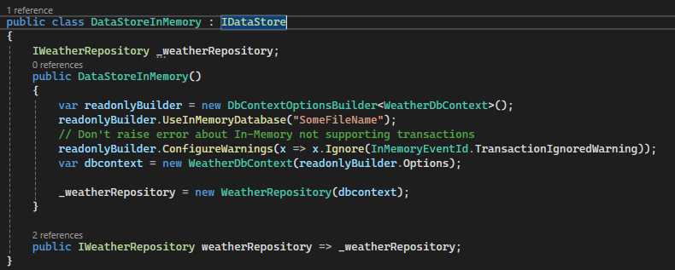
Testing Strategy 2: Custom DbContext
Implement your in-memory store that references your repository

Slide 11
IClassFixture<T>
To share a single context across all tests in the class
Will initialize T at the start of the first test

Slide 12
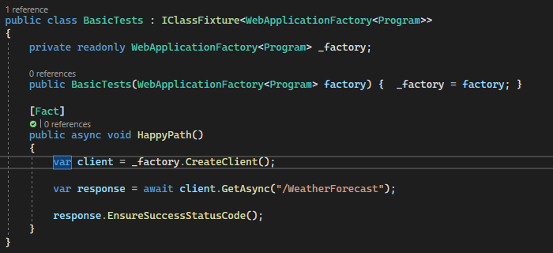
Testing Strategy 3: WebApplicationFactory
Test with no changes

Slide 13
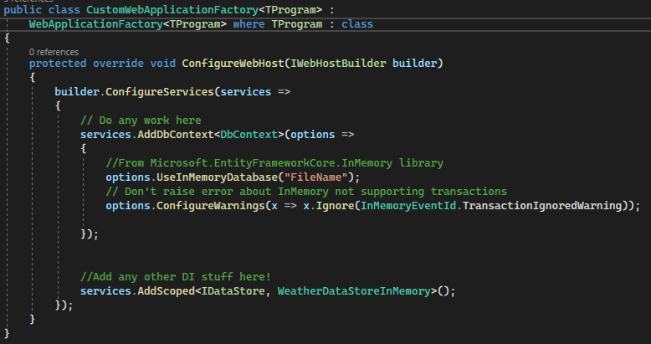
Testing Strategy 4: IClassFixture
Override WebApplicationFactory

Slide 14
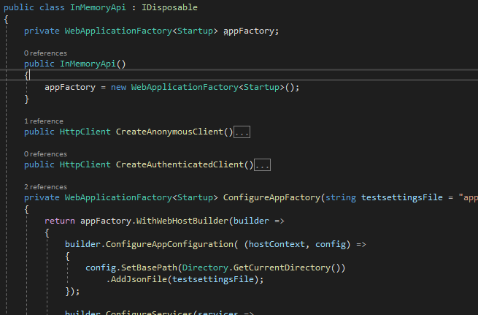
Testing Strategy 5: Custom Class
Create a class that will contain the WebApplicationFactory object

Slide 15
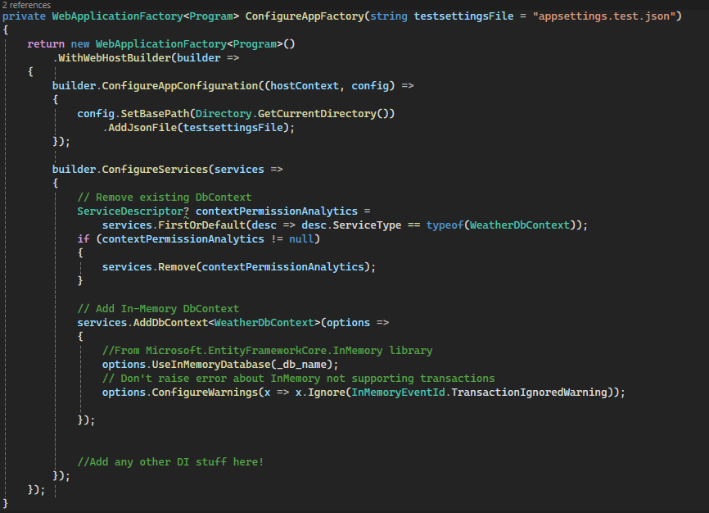
TS5: Startup
Add in anything you need to “setup” for testing

Slide 16
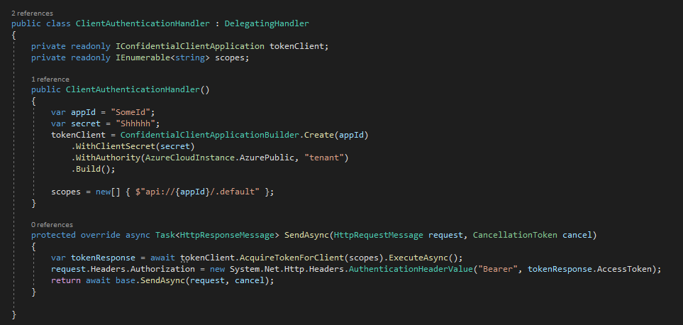
TS5: Authorization
Create a custom Authorization client

Slide 17
Conclusion
Simple-ish
Enables end to end testing in Visual Studio
Allows debugging
Don’t have to start VS and then run your test software

Slide 18
Links
WebApplicationFactory: https://docs.microsoft.com/en-us/dotnet/api/microsoft.aspnetcore.mvc.testing.webapplicationfactory-1?view=aspnetcore-5.0
IClassFixture: https://xunit.net/docs/shared-context
Code Repository: https://github.com/ehennis/Blog/tree/master/WebApplicationFactory/ICC

Slide 19
My Information
Twitter: @TheNurl
GitHub: https://github.com/ehennis
YouTube: Evan Hennis
Blog: http://blog.eckronsoftware.com
Email: EvanHennis@gmail.com

