Slide 1
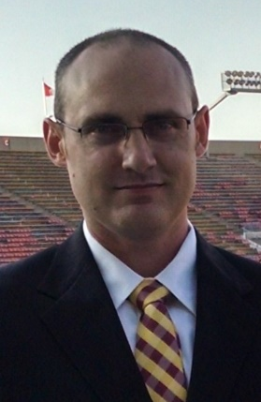
Deep Learning for Basketball
Using Deep Learning to Predict Game Outcomes
Evan Hennis
Google Developer Expert in Machine Learning
@TheNurl
https://eckronsoftware.wordpress.com
https://github.com/ehennis
YouTube: Evan Hennis

Slide 2



Bio
BS from Iowa State 2004
MS from Georgia Tech 2018
C# developer since 2004
GDE in Machine Learning 2019

Slide 3
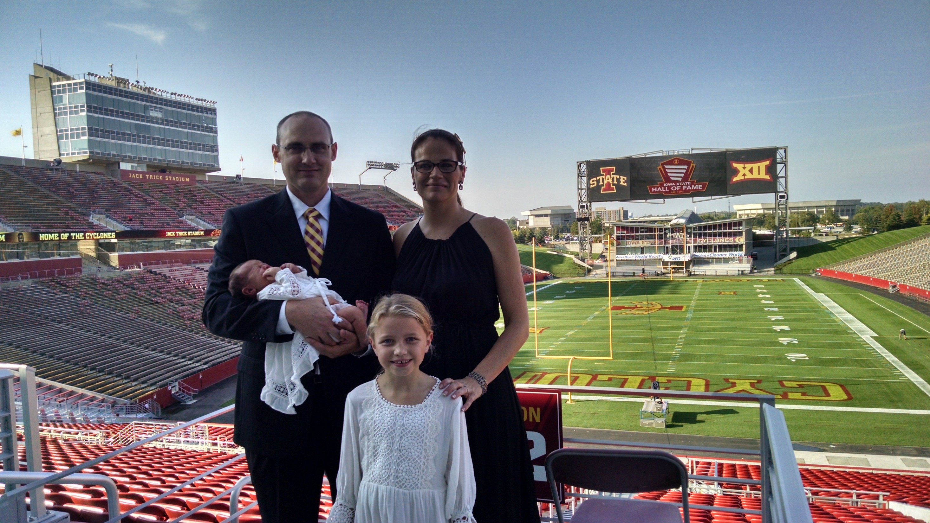

Slide 4
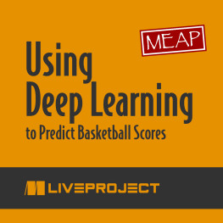
Using Deep Learning to Predict Basketball Scores
https://www.manning.com/liveproject/using-deep-learning-to-predict-basketball-scores
$25 for early release and $50 normally

Slide 5
Overview
Project Introduction
Facebook’s Guide to Machine Learning
Goal Definition
Data Gathering
Data Parsing
Model Creation
Accuracy Testing
Web Deployment (TensorFlow.JS)
Android Deployment (TensorFlow Lite)

Slide 6
Project Introduction
Idea: Wanted to put my master’s degree to use on a real project and gambling became legal in Iowa and I wanted to lose money slower
Technologies:
TensorFlow v2
Google Colab Notebook
Something for the web
Something for Android

Slide 7
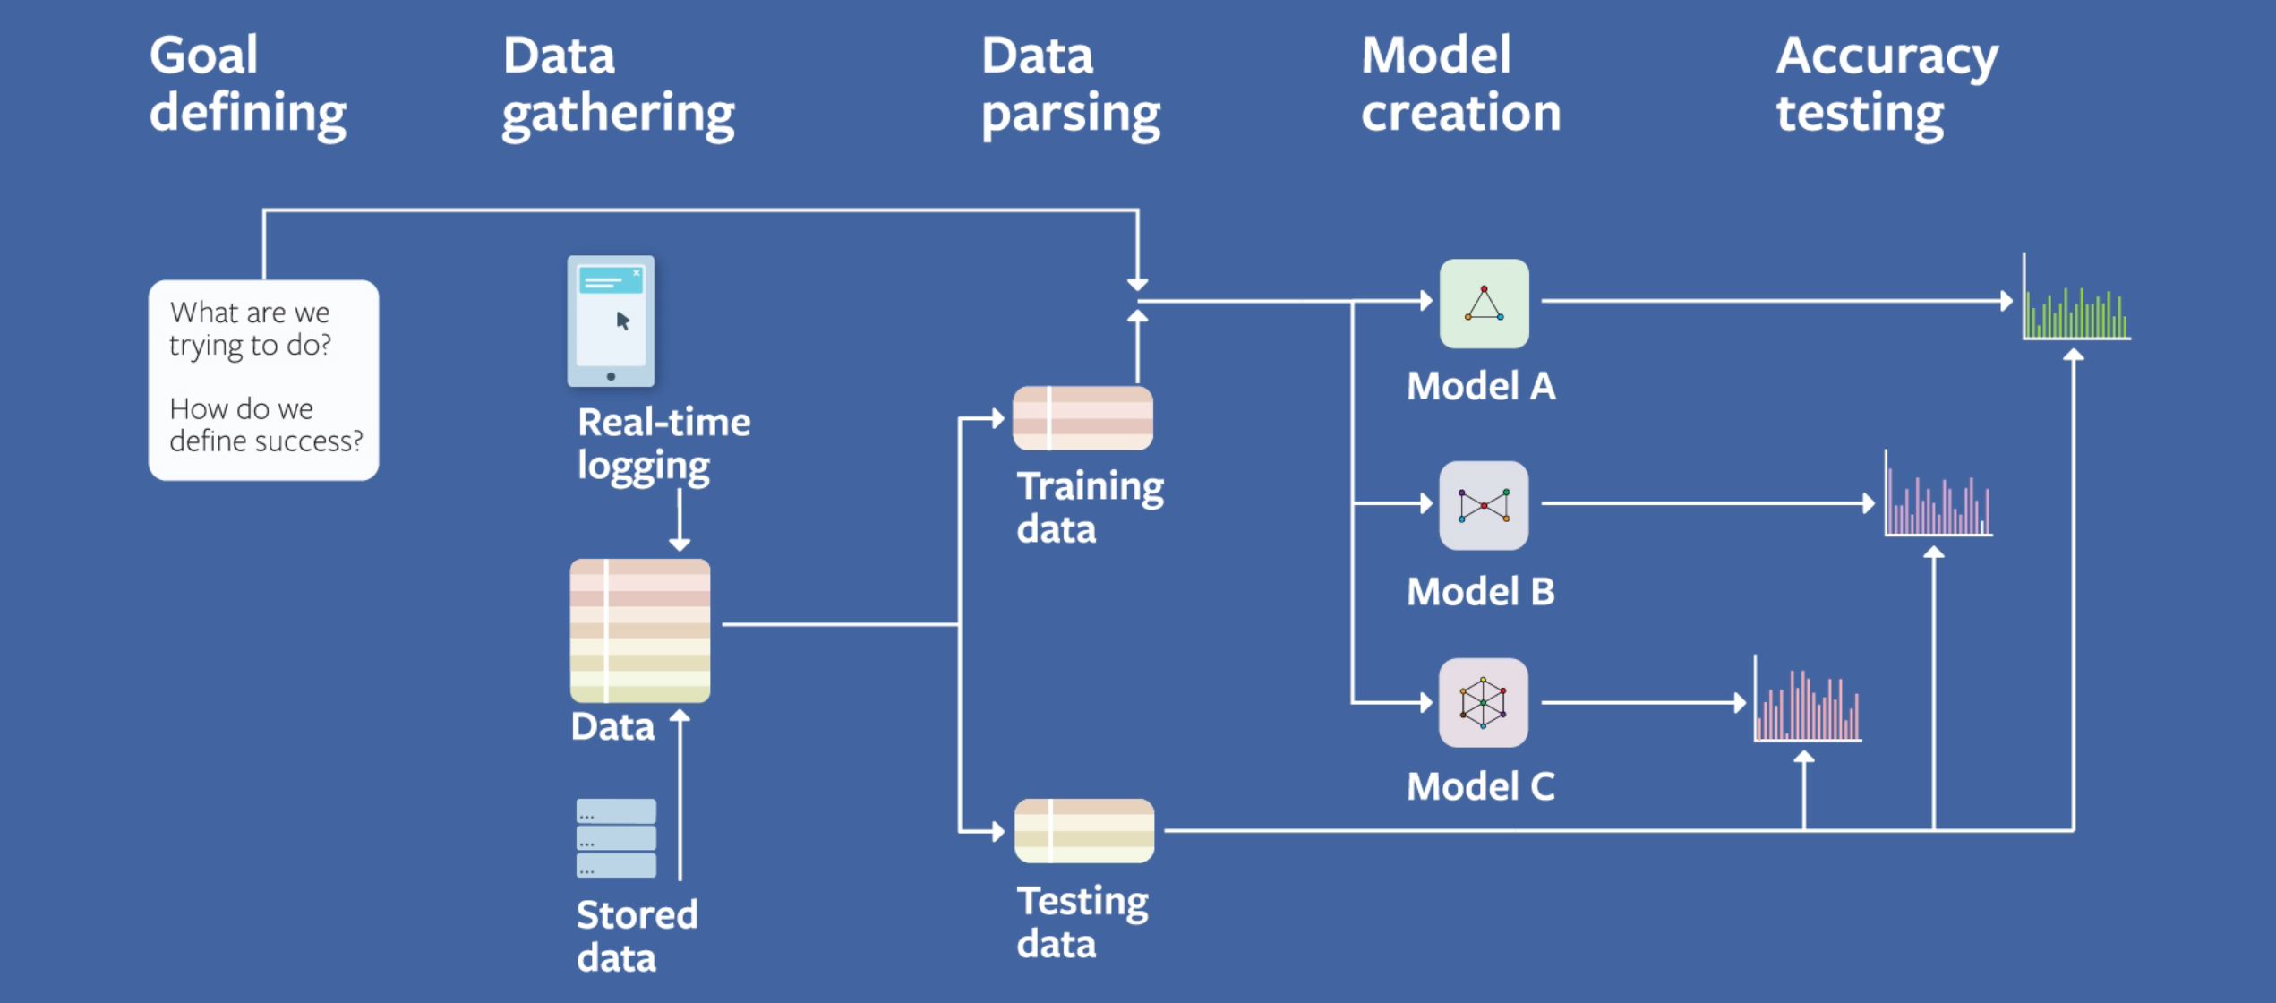
Facebook Field Guide to Machine Learning
https://research.fb.com/blog/2018/05/the-facebook-field-guide-to-machine-learning-video-series/

Slide 8
Goal Defining
What are we trying to do?
Predict the outcome of a college basketball game
How do we define success?
>60% against the spread
+- 5 points

Slide 9
Data Gathering
Scrape the internet
Game results
Teams
Conferences
Spreads
Source
ESPN.com
NCAA.com
Note: Originally done in .NET but have a current year scrape in Python

Slide 10
Data Parsing
Clean the data
Nobody keeps the team’s names consistent!
Remove non-D1 teams
Remove canceled games (Battle for Atlantis had wet floors)
Normalize the data
Keeps the score from over powering the standard deviations
Demo: Milestone2_Answers.ipynb

Slide 11
Model Creation
Typically, should start with something simple (Home vs Away) and build out
Decided on a neural network (shiny new toy)
NNs need lots of data so limited the number of layers and neurons
Iterate through hyper parameters
Layers, Nodes/Neurons, Optimizers, etc.
Demo: Milestone3, Milestone4, and Milestone5_Answers.ipynb

Slide 12
Accuracy Testing
Compare expected versus actual
We have an easy model to test with an easy answer
Harder models to test require measuring the AUC (area under the curve):
Clicking on an ad where just saying ‘No’ will work better than most models.
Demo: BasketballScoutInterface.ipynb and Bet website

Slide 13
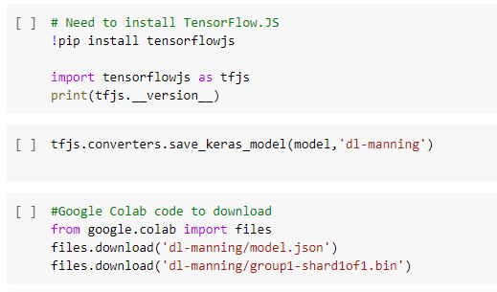
Web Deployment
Convert to TensorFlow.js model
Wrap html around JS files
Demo: LoadModel.js

Slide 14
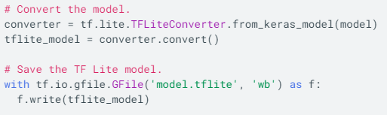
Android Deployment
Convert to TensorFlow Lite model
Import TensorFlow Lite Interpreter ONLY
build.gradle
Don’t compress tflite
Add tensorflow-lite dependency
Demo: ModelManager.java

Slide 15
Future Projects
Finish up the Android application
Implement other models (gradient boosted decision trees aka XGBoost)
Test, Test, Test.

Slide 16
Conclusion
Goal Definition: Beat Vegas
Data Gathering: Internet scraping
Data Parsing: Cleaned games and teams
Model Creation: Neural Network w/ TensorFlow and Keras
Accuracy Testing: Compared expected score vs actual score

Slide 17
Links
Code Repository: https://github.com/ehennis/Blog/tree/master/DeepLearningBasketball

Slide 18
My Information
Twitter: @TheNurl
GitHub: https://github.com/ehennis
YouTube: Evan Hennis
Blog: http://blog.eckronsoftware.com
Email: EvanHennis@gmail.com
Manning liveProject: https://www.manning.com/liveproject/using-deep-learning-to-predict-basketball-scores

