Slide 1
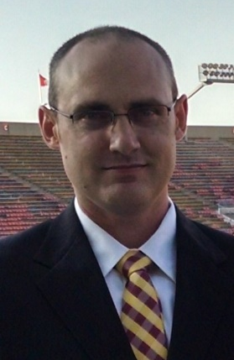
Azure Machine Learning
Train a data science model at scale
Evan Hennis
Google Developer Expert in Machine Learning
Software Developer, Microsoft
@TheNurl
https://eckronsoftware.wordpress.com
https://github.com/ehennis
YouTube: Evan Hennis

Slide 2



Bio
BS from Iowa State 2004
MS from Georgia Tech 2018
C# developer since 2004
GDE in Machine Learning 2019

Slide 3
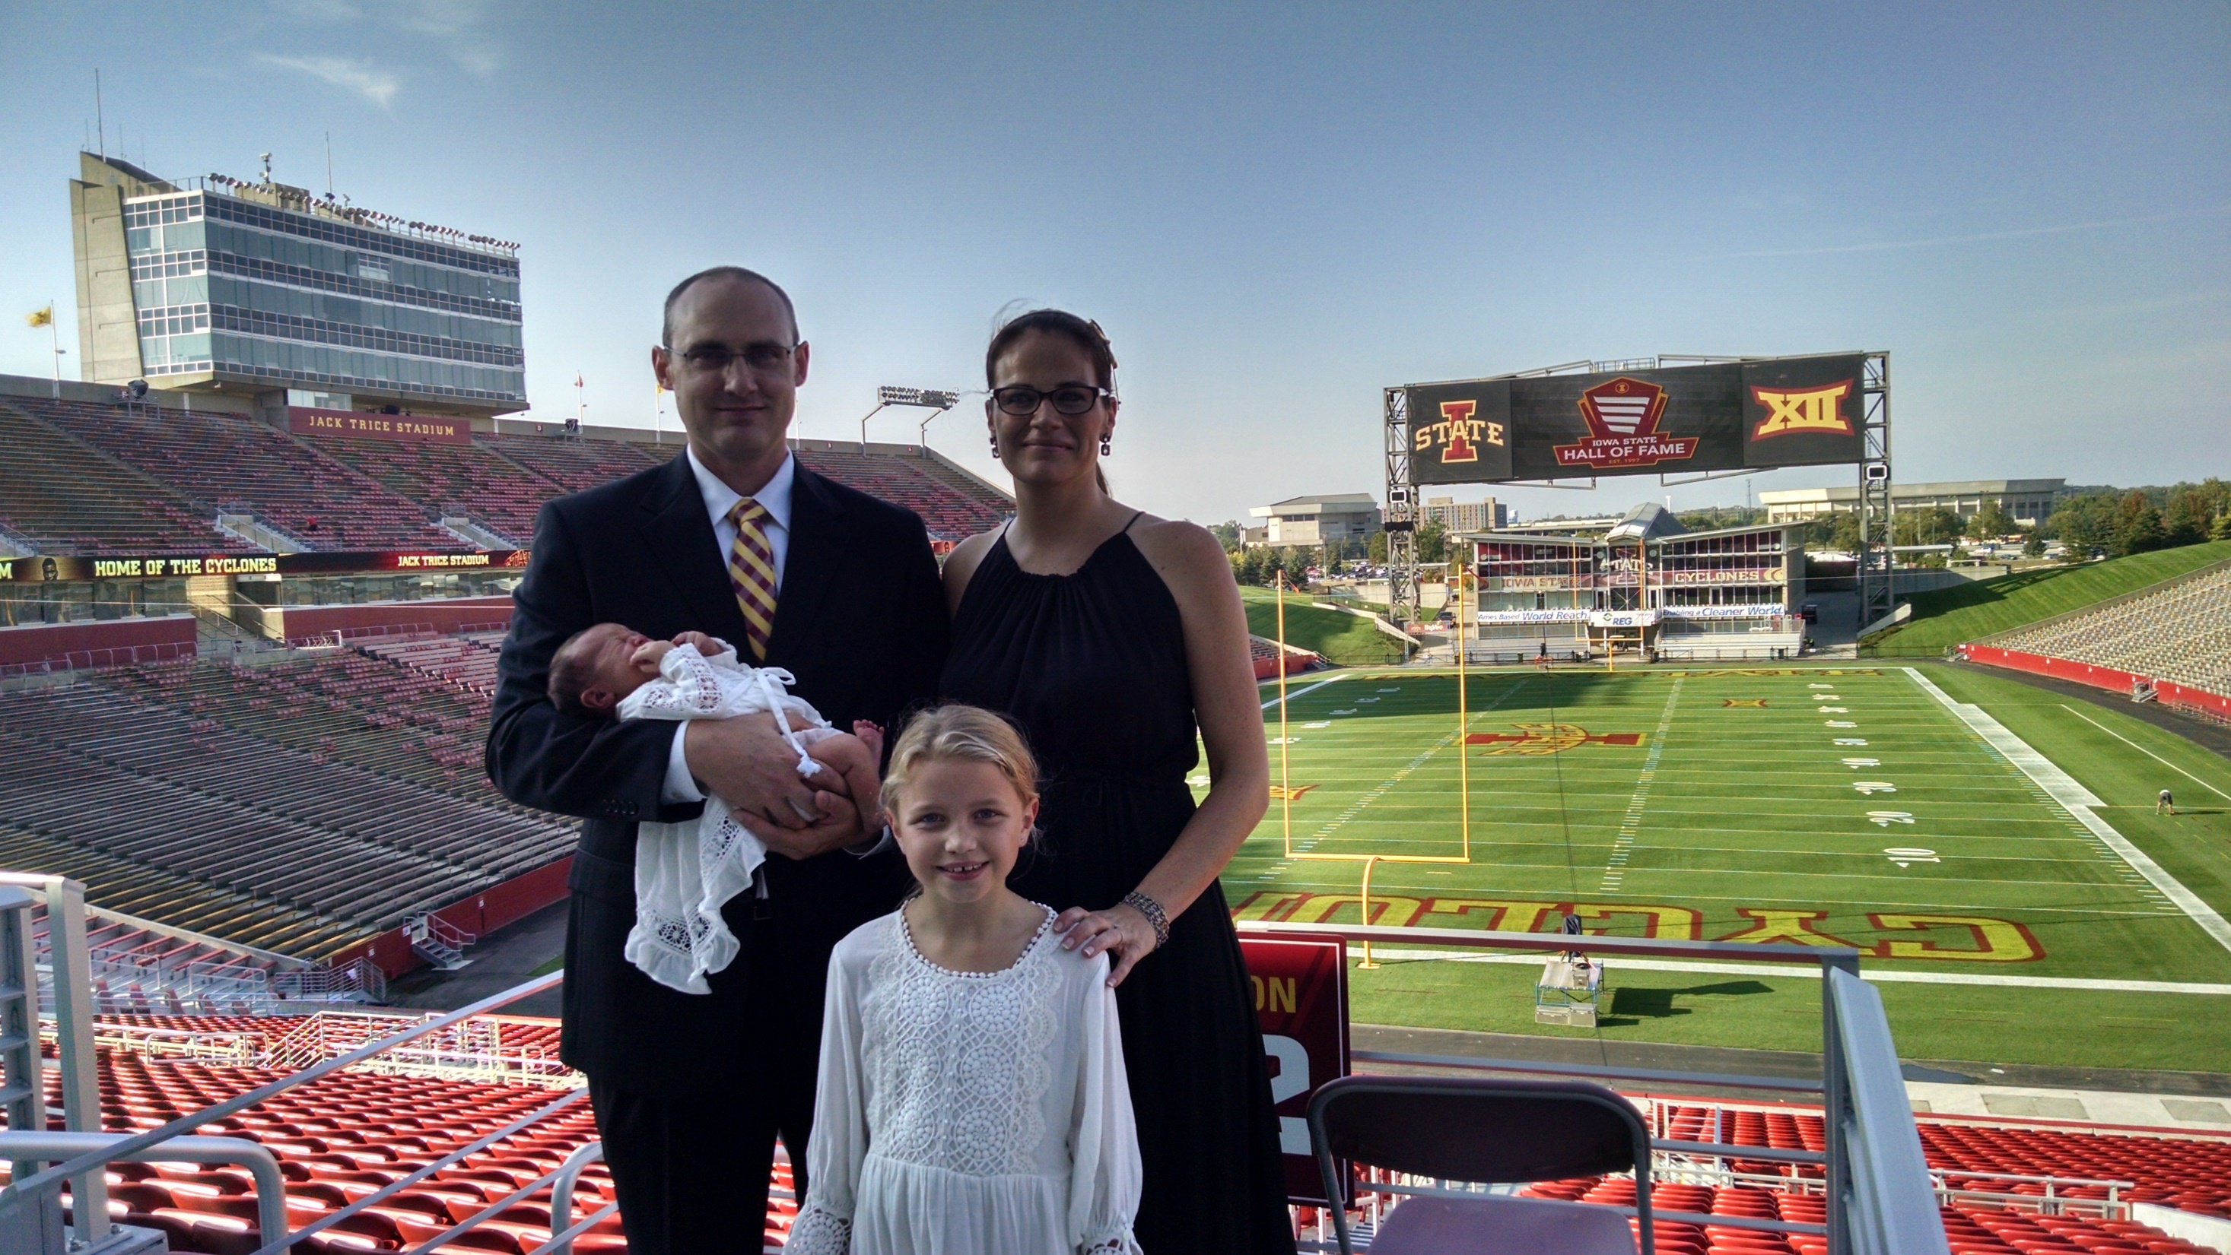

Slide 4
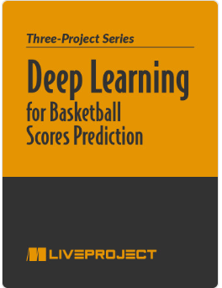
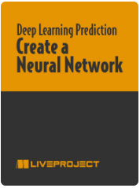
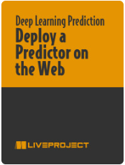
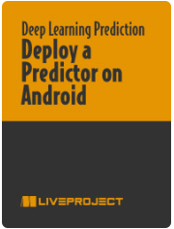

Deep Learning for Basketball Scores Prediction
https://www.manning.com/liveprojectseries/deep-learning-for-basketball-scores-prediction-ser

Slide 5
Overview
Introduction
Create Workspace and Compute Instance
Manually Trained Model
Create a notebook
Build the training set
Train the model
Deploy the model
AzureML Trained Model
Create a compute resource
Create an environment
Build a job
Run the job
Deploy the best model
Create an online endpoint
Test the model
Conclusion

Slide 6
Introduction
Setting up Azure Machine Learning: https://ml.azure.com/
Run a hosted notebook to create our own model
Utilize Azure Machine Learning to run our machine learning tasks

Slide 7
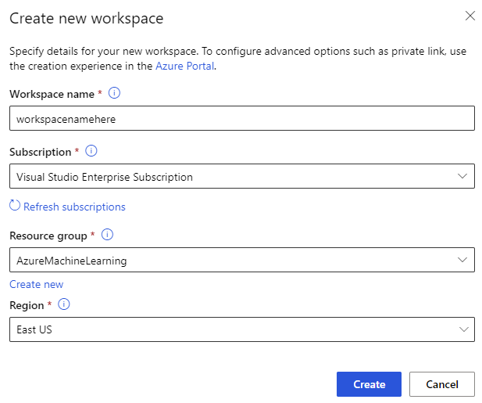
Create Workspace and Compute Instance
Create Workspace
Create Compute Instance
Set computer name
Set VM Type
Quotas…..
Set VM Size

Slide 8
Manually Trained Model
Convert Celsius to Fahrenheit
TempConversion.ipynb

Slide 9
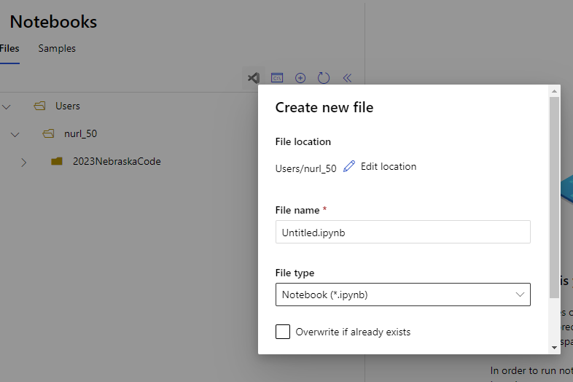
Manual Model: Create Notebook
Notebooks -> + -> New File
Ensure Kernal is “Python 3.8 – Pytorch and Tensorflow””

Slide 10
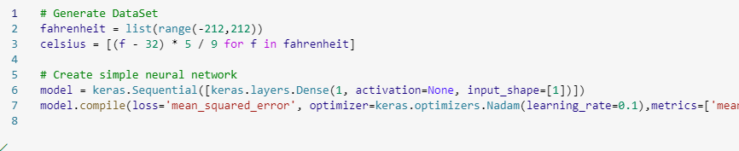
Manual Model: Build Training Set
Generate the test data

Slide 11

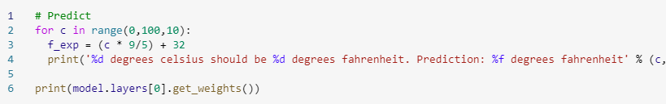

Manual Model: Train The Model
Fit the training data
Test
Save

Slide 12
Manual Model: Switch Kernels
Create a new notebook
Ensure Kernal is “Python 3.10 – SDK v2”

Slide 13
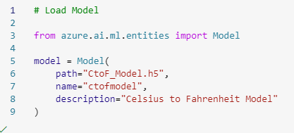
Manual Model: Load The Model
Load the saved model

Slide 14

Manual Model: Load The Model
Load the saved model
Register the model

Slide 15
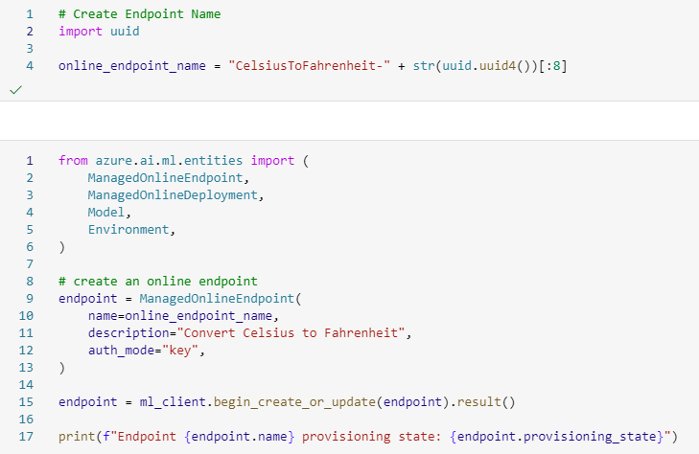
Manual Model: Create Endpoint
Create the endpoint

Slide 16
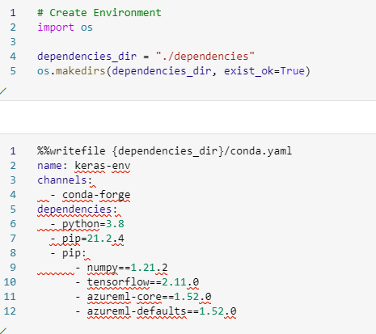
Manual Model: Create Environment
Create Conda file

Slide 17
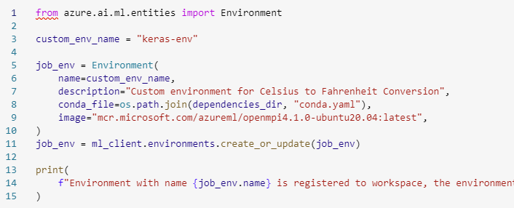
Manual Model: Create Environment (cont)
Create the environment

Slide 18
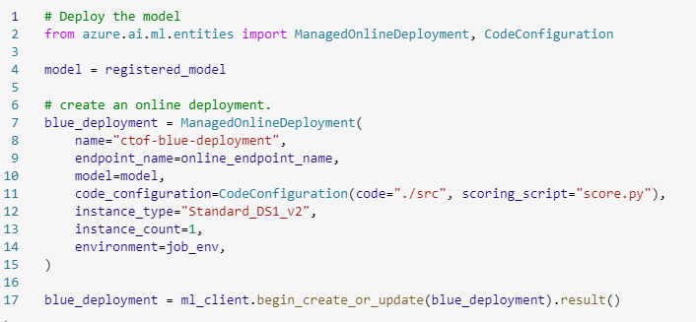
Manual Model: Create Deployment
Create the deployment

Slide 19
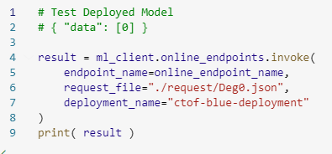
Manual Model: Test
Test the endpoint

Slide 20
AzureML Trained Model
Start with a sample
Notebooks -> Samples -> v2 > sdk > python > jobs > single-step > tensorflow > train-hyperparameter-tune-deploy-with-tensorflow
Clone Notebook
Set Compute to your created compute instance
Ensure Kernal is “Python 3.10 – SDK v2”

Slide 21
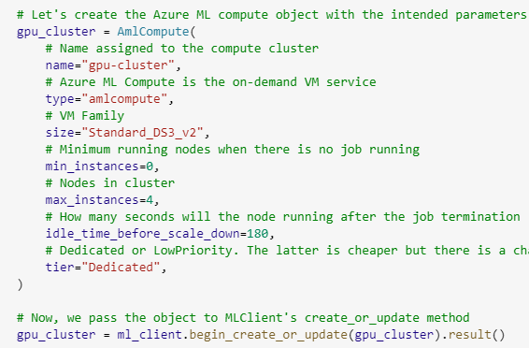
AzureML: Create A Compute Resource
Create a compute instance
Standard GPUs are getting removed 7/31/2023 (this was a nightmare)
Using “Standard_DS3” CPU
I am cheap

Slide 22
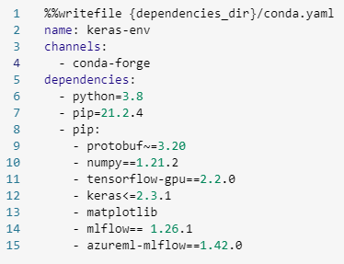
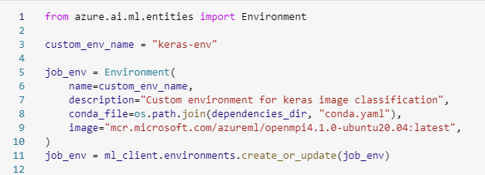
AzureML: Create An Environment
Existing environment or custom environment using Docker or Conda
Keras Example:

Slide 23
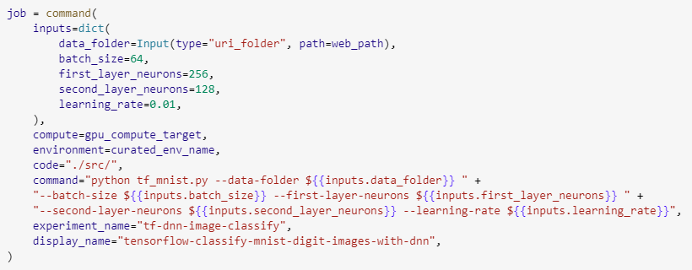
AzureML: Build A Job
Command Job with all the details needed
Using provided training script (tf_mnist.py)

Slide 24
AzureML: Run A Job
Submit Job
Registers the job
Job:
Preparing: Docker image created and uploaded to the workspace
Scaling: The cluster attempts to scale up if it requires more nodes
Running: All the scripts in ‘src’ are uploaded and run

Slide 25
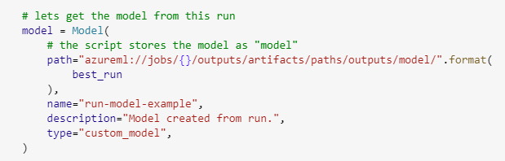
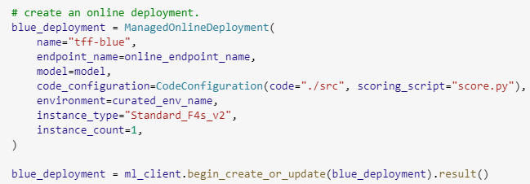
AzureML: Deploy The Model
Create the model
Register the model
Deploy the model

Slide 26
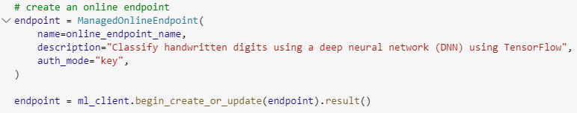
AzureML: Create Online Endpoint
Create the endpoint
Retrieve the endpoint

Slide 27
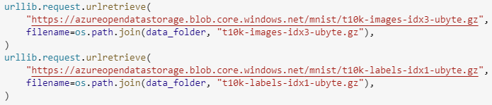
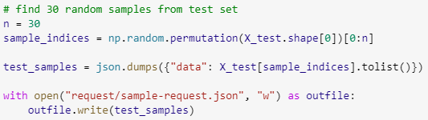
AzureML: Test The Model
Download data (we download it from a public repo)
Create test data set

Slide 28
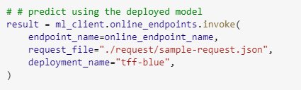
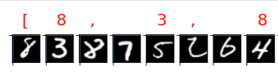
AzureML: Test The Model (cont)
Invoke the endpoint
Plot the results

Slide 29
Conclusion
Easy to follow sample code
Offloads all of your expensive computer to the cloud
Easily access your model

Slide 30
Links
Presentation Repository: https://github.com/ehennis/Blog/tree/master/AzureML
Completed Notebook: v2 > sdk > python > jobs > single-step > tensorflow > train-hyperparameter-tune-deploy-with-tensorflow.

Slide 31
My Information
Twitter: @TheNurl
GitHub: https://github.com/ehennis
YouTube: Evan Hennis
Blog: http://blog.eckronsoftware.com
Email: EvanHennis@gmail.com

