Slide 1
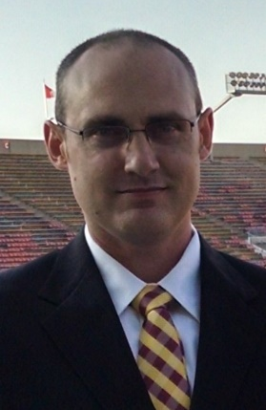
Deep Learning for Basketball
Creating a deep learning model to predict college basketball scores
Evan Hennis
Google Developer Expert in Machine Learning
Software Engineer at Microsoft
@TheNurl
https://eckronsoftware.wordpress.com
https://github.com/ehennis
YouTube: Evan Hennis

Slide 2



Bio
BS from Iowa State 2004
MS from Georgia Tech 2018
C# developer since 2004
GDE in Machine Learning 2019

Slide 3
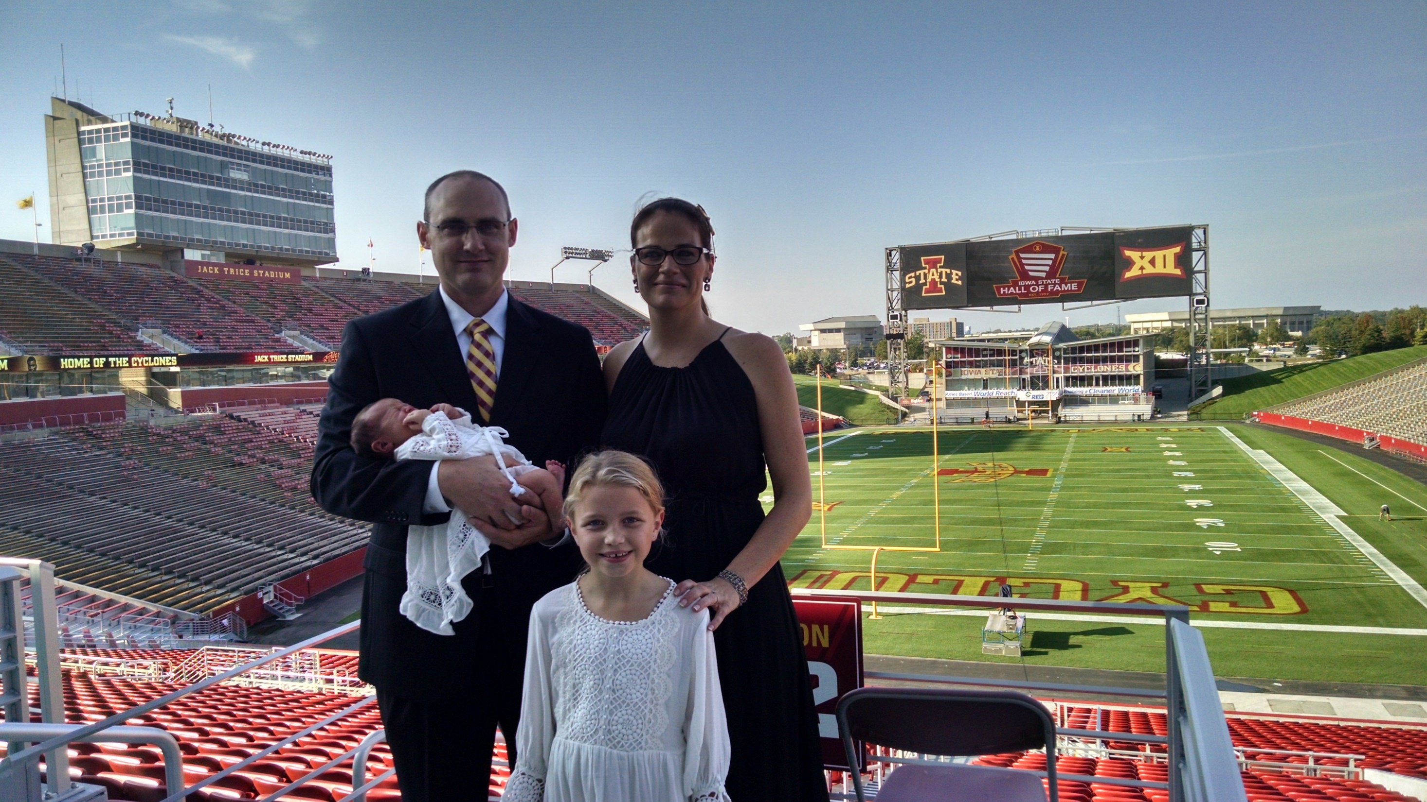

Slide 4
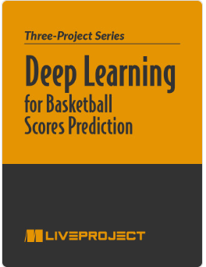
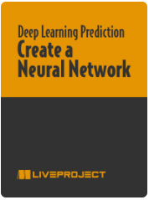
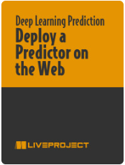
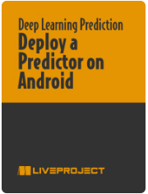
Deep Learning for Basketball Scores Prediction
https://www.manning.com/liveprojectseries/deep-learning-for-basketball-scores-prediction-ser
35% discount code (all products): ctwnecode22
http://mng.bz/PnRP

Slide 5
This is NOT a sales pitch!

Slide 6
Overview
Deep Learning Introduction
Project Introduction
Facebook’s Guide to Machine Learning
Goal Definition
Data Gathering
Data Parsing
Model Creation
Accuracy Testing
Web Deployment (TensorFlow.JS)
Android Deployment (TensorFlow Lite)

Slide 7
Deep Learning Introduction
Using a neural network to convert Celsius to Fahrenheit
https://github.com/ehennis/Blog/blob/master/DeepLearningBasketball/GDGSuncoast/CtoF.ipynb

Slide 8
Project Introduction
Idea: Wanted to put my master’s degree to use on a real project and gambling became legal in Iowa and I wanted to lose money slower
Technologies:
TensorFlow v2
Google Colab Notebook
Something for the web
Something for Android

Slide 9
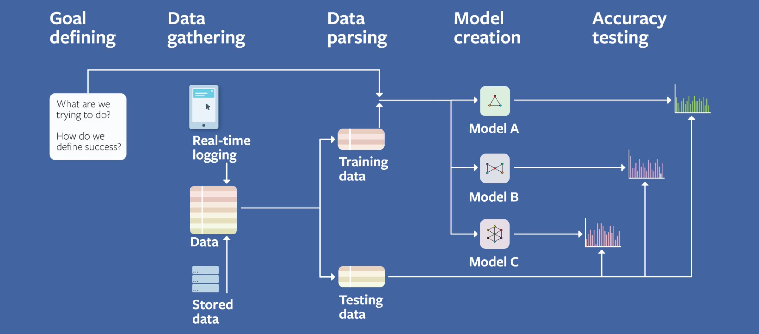
Facebook Field Guide to Machine Learning
https://research.fb.com/blog/2018/05/the-facebook-field-guide-to-machine-learning-video-series/

Slide 10
Goal Defining
What are we trying to do?
Predict the outcome of a college basketball game
How do we define success?
>60% against the spread
+- 5 points

Slide 11
Data Gathering
Scrape the internet
Game results
Teams
Conferences
Spreads
Source
ESPN.com
NCAA.com
Note: Originally done in .NET but have a current year scrape in Python

Slide 12
Data Parsing
Clean the data
Nobody keeps the team’s names consistent!
Remove non-D1 teams
Remove canceled games (Battle for Atlantis had wet floors)
Normalize the data
Keeps the score from over powering the standard deviations
Demo: DeepLearningBasketball/GDGSuncoast/DataCleaning.ipynb

Slide 13
Model Creation
Typically, should start with something simple (Home vs Away) and build out
Decided on a neural network (shiny new toy)
NNs need lots of data so limited the number of layers and neurons
Iterate through hyper parameters
Layers, Nodes/Neurons, Optimizers, etc.
Demo: DeepLearningBasketball/GDGSuncoast/ModelCreation.ipynb

Slide 14
Accuracy Testing
Compare expected versus actual
We have an easy model to test with an easy answer
Harder models to test require measuring the AUC (area under the curve):
Clicking on an ad where just saying ‘No’ will work better than most models.

Slide 15
Web Deployment
Convert to TensorFlow.js model
Wrap html around JS files
Demo: DeepLearningBasketball/GDGSuncoast/CreateTFLite.ipynb
Web Site: DeepLearningBasketball/GDGSuncoast/Web Site/include/LoadModel.js

Slide 16
Android Deployment
Convert to TensorFlow Lite model
Demo: DeepLearningBasketball/GDGSuncoast/CreateTFLite.ipynb
Import TensorFlow Lite Interpreter ONLY
build.gradle
Don’t compress tflite
Add tensorflow-lite dependency
Demo: DeepLearningBasketball/GDGSuncoast/Android build.gradle MainActivity.java

Slide 17
Future Projects
Finish up the Android application
Implement other models (gradient boosted decision trees aka XGBoost)
Test, Test, Test.

Slide 18
Conclusion
Goal Definition: Beat Vegas
Data Gathering: Internet scraping
Data Parsing: Cleaned games and teams
Model Creation: Neural Network w/ TensorFlow and Keras
Accuracy Testing: Compared expected score vs actual score

Slide 19
Links
Code Repository: https://github.com/ehennis/Blog/tree/master/DeepLearningBasketball

Slide 20
My Information
Twitter: @TheNurl
GitHub: https://github.com/ehennis
YouTube: Evan Hennis
Blog: http://blog.eckronsoftware.com
Email: EvanHennis@gmail.com

