Slide 1

Advanced .NET Testing
with in-memory EF and Hosted API
Evan Hennis
Google Developer Expert in Machine Learning
Senior Software Developer, Microsoft
@TheNurl
https://eckronsoftware.wordpress.com
https://github.com/ehennis
YouTube: Evan Hennis

Slide 2




Bio
BS from Iowa State 2004
MS from Georgia Tech 2018
C# developer since 2004
GDE in Machine Learning 2019

Slide 3


Slide 4





Deep Learning for Basketball Scores Prediction
https://www.manning.com/liveprojectseries/deep-learning-for-basketball-scores-prediction-ser

Slide 5
Overview
API Introduction
DbContext
Testing Custom Classes
xUnit IClassFixture
WebApplicationFactory
Conclusion

Slide 6
API Introduction
.NET Framework 8
Visual Studio 2022
Default Template Project
Added Service
Added DataStore
Added Repository
Added “model”

Slide 7

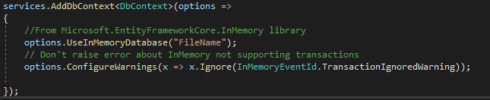
EF and DataContext

Slide 8
xUnit Test Project
xUnit (Microsoft Test also works)
.NET 8
In Memory Repository and Store
Create a new repository in your test project that implements the same interface
Create a new data store in your test project that uses the in memory repository

Slide 9
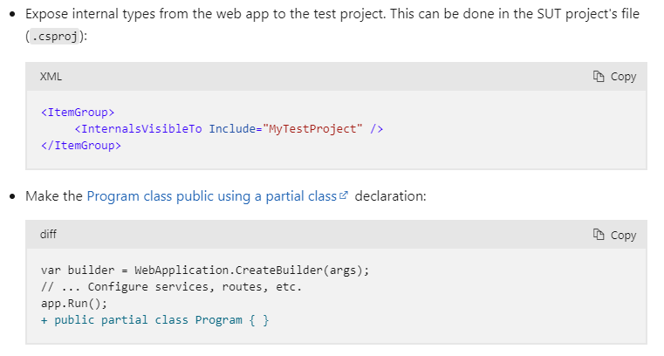
>= .NET 6.0 Change
Startup and Program => Program.cs
No longer have a Program Class
Link

Slide 10
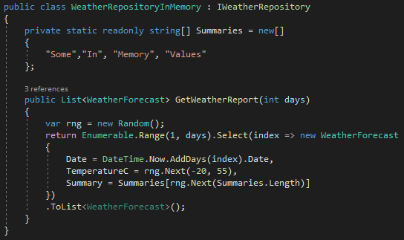
xUnit Test Project: Repository
Implement your “fake” class

Slide 11
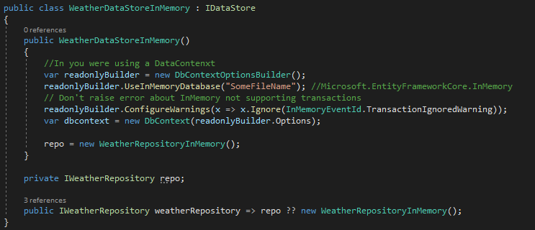
xUnit Test Project: DataStore
Implement your in memory store that references your repository

Slide 12
WebApplicationFactory
“Factory for bootstrapping an application in memory for functional end to end tests”
Microsoft.AspNetCore.Mvc.Testing
NOTE: With minimal APIs in .NET 6 we have add code to access the former startup class.

Slide 13
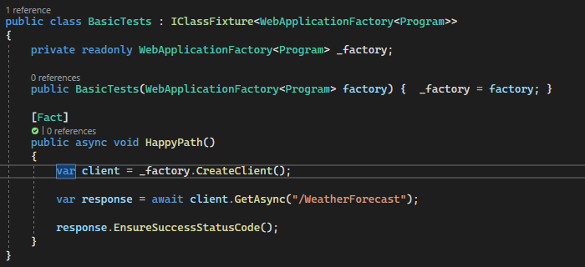
WebApplicationFactory: Basic Test
Test with no changes

Slide 14
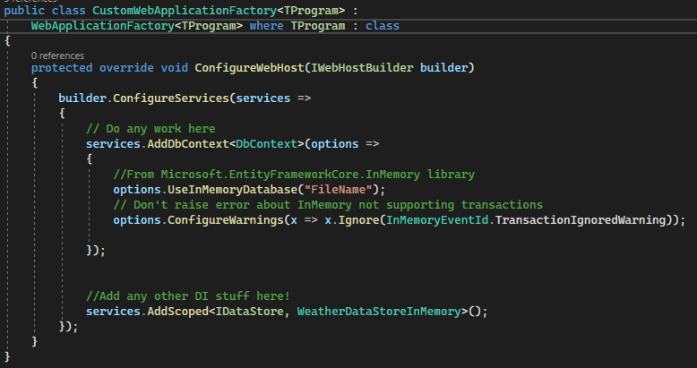
WebApplicationFactory: Override
Override WebApplicationFactory

Slide 15
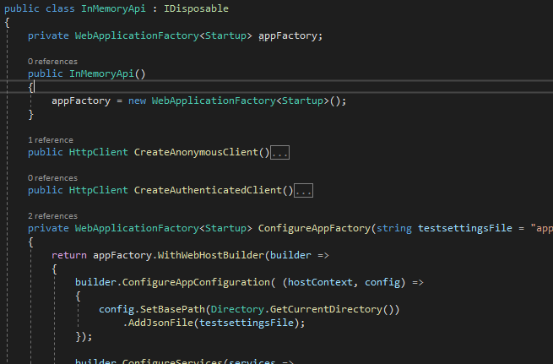
WebApplicationFactory: Custom Class
Create a class that will contain the WebApplicationFactory object

Slide 16
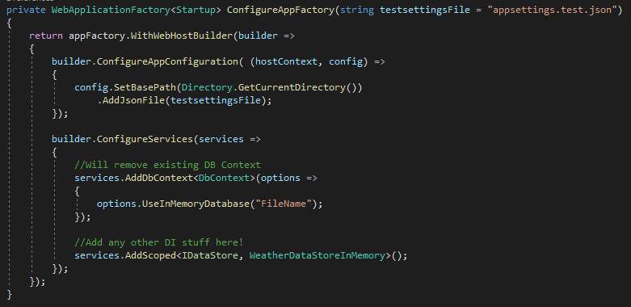
WebApplicationFactory: Startup
Add in anything you need to “setup” for testing

Slide 17
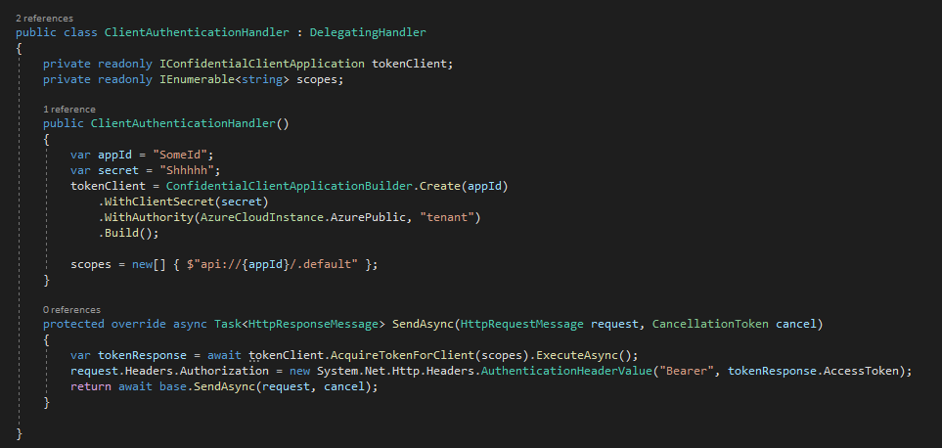
WebApplicationFactory: Authorization
Create a custom Authorization client

Slide 18
IClassFixture<T>
To share a single context across all tests in the class
Will initialize T at the start of the first test

Slide 19
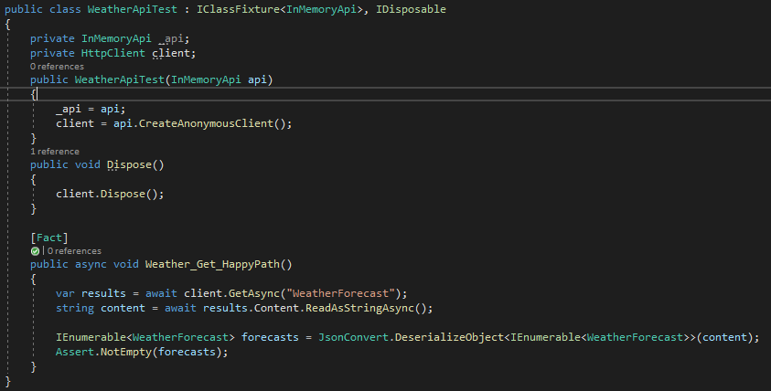
IClassFixture: Test Class
Using the WebApplicationFactory (InMemoryApi)

Slide 20
Conclusion
Simple-ish
Enables end to end testing in Visual Studio
Allows debugging
Don’t have to start VS and then run your test software

Slide 21
Links
WebApplicationFactory: https://docs.microsoft.com/en-us/dotnet/api/microsoft.aspnetcore.mvc.testing.webapplicationfactory-1?view=aspnetcore-5.0
IClassFixture: https://xunit.net/docs/shared-context
Code Repository: https://github.com/ehennis/Blog/tree/master/WebApplicationFactory/NCode

Slide 22
My Information
Twitter: @TheNurl
GitHub: https://github.com/ehennis
YouTube: Evan Hennis
Blog: http://blog.eckronsoftware.com
Email: EvanHennis@gmail.com

