Slide 1

Intro to C# REST API
Evan Hennis
Google Developer Expert in Machine Learning
@TheNurl
https://eckronsoftware.wordpress.com
https://github.com/ehennis
YouTube: Evan Hennis

Slide 2



Bio
BS from Iowa State 2004
MS from Georgia Tech 2018
C# developer since 2004
GDE in Machine Learning 2019

Slide 3


Slide 4
Overview
REST API Introduction
Visual Studio 2019 Instruction
Controller Overview
Dependency Injection
Swagger

Slide 5
REST API Introduction
REST – A set of architectural constraints
Client-server architecture with requests managed through HTTP
JSON (Javascript Object Notation), HTML, XLT, Python, PHP, or Text
Stateless client-server communication (Nothing is stored between calls)
Cacheable data that streamlines client-server interactions
A uniform interface between components
A layered system that organizes each type of server involved
Code-on-demand (optional): Send executable code from server to client
Example: https://http.cat/100)

Slide 6
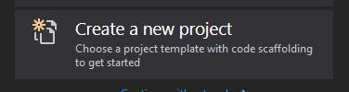
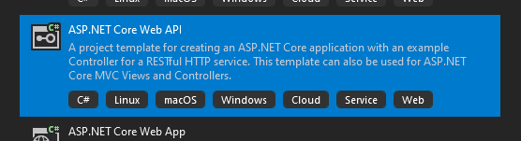
Visual Studio 2019: Create New App
Download: https://visualstudio.microsoft.com/vs/
Create a new project
Select ‘ASP.NET Core Web API
Default location and settings

Slide 7

Visual Studio 2019: Running App
Hit F5 or Debug -> Start Debugging
This will execute the default REST API Project
A Swagger (will learn later) page will start with a list of ALL of your endpoints

Slide 8
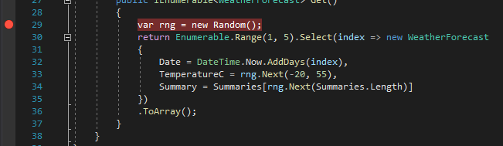
Visual Studio 2019: Debugging App
Click in the LEFT column to create a ‘Break Point’
When executing the ‘Get’ process the application will ‘break’ when it hits line #29.

Slide 9
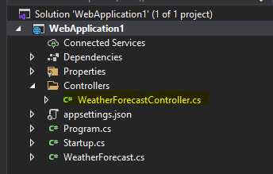
Controller Overview
Class called “[ClassName]Controller”
The application will automatically create the endpoint
Ex: https://localhost:44304/WeatherForecast
Attribute tags
Surrounded by ‘[‘ and ‘]’
[ApiController]
[Route(“[controller]”)
[HttpGet]

Slide 10
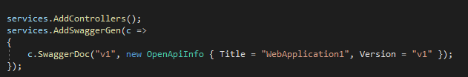
Dependency Injection
Design pattern for Inversion of Control (IoC)
Registers the class with a Service Provider to be used later
Class is “injected” into the constructor of the class

Slide 11

Swagger
Swashbuckle.AspNetCore.Swagger
An easy to use UI for describing an API

Slide 12
Full Demo

