Slide 1
CIS 174: Advanced C# Programming
Week 4: 2024-09-12 to 09-18
Chapters NULL

Slide 2
Assignments (Module 4)
GitHub and SourceTree (Topic 1)
Final Project Team submission (Topic 2)
Course Survey

Slide 3
Topics (Module 4)
GitHub
SourceTree (Git UI)
Final Project Teams

Slide 4
GitHub (Mod 4 Topic 1)
Git
2005 by Linus Torvalds (creator of Linux)
Distributed version tracking system
GitHub: Internet hosting for Git
GitLab and Azure DevOps are also hosting solutions

Slide 5
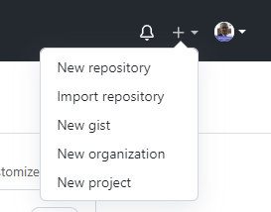
GitHub: Creating a repository
+ -> New Repository
Repository Name: Unique name for your project
Public/Private
Initialize with:
Readme.md: Used to describe your project and displayed on the homepage
.gitignore: Determines what files are NOT included in source
License: Determine how your project is licensed

Slide 6
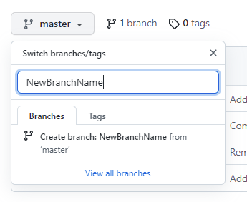
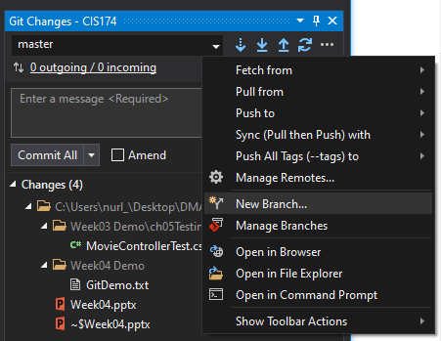
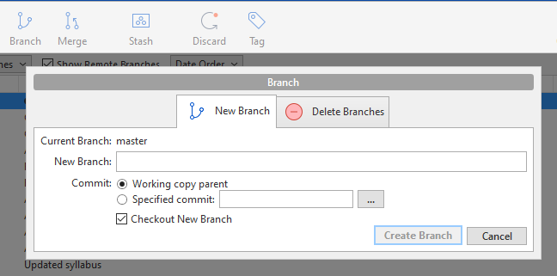
GitHub: Create Branches
Main/Root/Trunk branch: master
Rename: https://github.com/github/renaming
Creating a branch
Git Bash: git branch NewBranchName
GitHub: master -> NewBranchName
Visual Studio: Git Changes -> … -> New Branch
SourceTree: Branch

Slide 7
GitHub: Change Branches
When working locally change to your branch to keep master/main from getting messy
Creating a branch
Git Bash: git checkout NewBranchName
Visual Studio: Git Changes -> … -> Manage Branches
SourceTree: Branches -> Select branch
Notes:
You will need to pull down the branch if you created it in GitHub
Make sure that you actually change branches and not just created a new one

Slide 8
GitHub: Pull
Pull: Update the local repository with the code from the remote repo
When starting make sure to pull down all recent changes from the source branch
Git Bash: git pull
SourceTree: Pull
Visual Studio:

Slide 9
GitHub: Commit
Commit: Submit your changes to the current branch
NOTE: This does NOT push the changes to the remote branch
After making changes (typically finishing your task) commit your code
Git Bash: git commit [file list or –a] -m “Commit Message”
SourceTree: Commit
Visual Studio: Commit All (I have a rant against VS here)

Slide 10
GitHub: Push
Push: Commit your changes back to the remote repository
After committing code push back to the remote repository
Git Bash: git push [--all]
SourceTree: Push
Visual Studio:

Slide 11
GitHub: Merge
Merge: Moving your code from your branch back to the main branch
After pushing your code you need to merge with the main branch
Git Bash: git merge NewBranchName [Done within main branch]
SourceTree: Merge
Visual Studio: Git Changes -> … -> Manage Branches -> Merge ‘NewBranchName’ into ‘master’
Note:
If you do this locally you will need to do another Push to update GitHub

Slide 12
GitHub: Pull Request
Pull Requests (PR) let the team know you have a change that you want put into the main branch.
PRs allow the entire team to review the code and vote to merge into the main branch
After pushing your code to your new branch you need to create a Pull Request.
GitHub: Pull Request -> New pull request
SourceTree: Repository -> Create Pull Request
Visual Studio: Git Changes -> … -> Manage Branches -> Create Pull Request

Slide 13
GitHub: Merge Issues
Merge issues happen when multiple people commit code to the same place and Git doesn’t know how to merge the changes.
These are a pain but fairly common with a large team or small project.
Typically, while trying to merge you will get an error and be placed in a temp branch to fix the changes

Slide 14
SourceTree (Mod 4 Topic 1)
https://www.sourcetreeapp.com/
Alternatives
Visual Studio
GitHub Desktop
GitHub Bash
“Must” create a Bitbucket Account (I was able to skip this part)
Remote -> + Add an account… -> Select GitHub -> Refresh OAuth Token

Slide 15
SourceTree: Install
https://www.sourcetreeapp.com/
“Must” create a Bitbucket Account (I was able to skip this part)
Remote -> + Add an account… -> Select GitHub -> Refresh OAuth Token -> Fill out your Github information
Hit ‘Refresh’ to load all of your repositories
Hit ‘Clone’ to download your version

Slide 16
SourceTree: Cloning Repository
Hit ‘Refresh’ to load all of your repositories
Hit ‘Clone’ to download your version
Select your local folder and hit ‘Clone’

Slide 17
Final Project (Mod 4 Topic 2)
Teams of 3 people
Use the ‘Final Project Team Formation’ message board to form teams
Post your ideas and see if anyone has something similar

