Slide 1
CIS 174: Advanced C# Programming
Week 2: 2024-05-29 to 06-04
Chapter 4
Module 2

Slide 2
Assignments (Module 2)
Verify Azure Setup (Topic 1)
EF Core Web App Lab (Topic 2)
Murach Chapter 4 Quiz (Topic 3)
Multipage WebApp w/ DB (Topic 3)
Final Project Brainstorming (Topic 4)

Slide 3
Topics
Set Up Azure
Database Connectivity
Multi-page Web App
Final Project

Slide 4
Azure (Mod 2 Topic 1)
Readings
Microsoft: https://azure.microsoft.com/en-us/
Acronis: https://www.acronis.com/en-us/articles/what-is-microsoft-azure/
How-To Geek: https://www.howtogeek.com/337961/what-is-microsoft-azure/
Sign up using your DMACC email address
Free
Will get $100 credit
Portal: https://portal.azure.com/

Slide 5
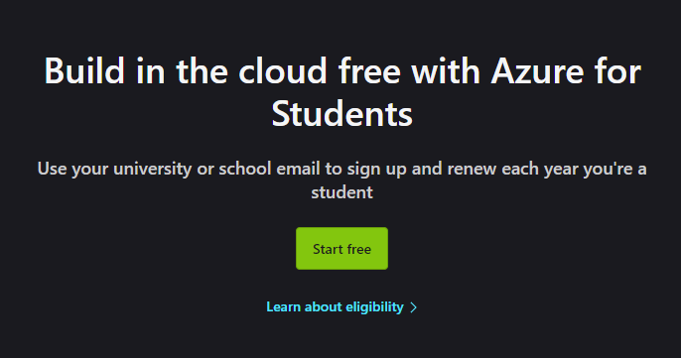
Azure Account Creation
Free Student Account: https://azure.microsoft.com/en-us/free/students/

Slide 6
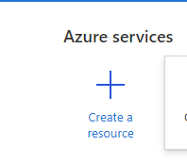
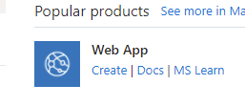
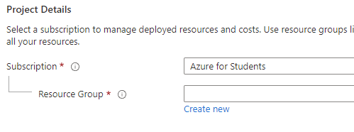
Azure: Creating a new App Service
Create a resource
Web App -> Create
Create new Resource Group named ‘cis174dmacc

Slide 7
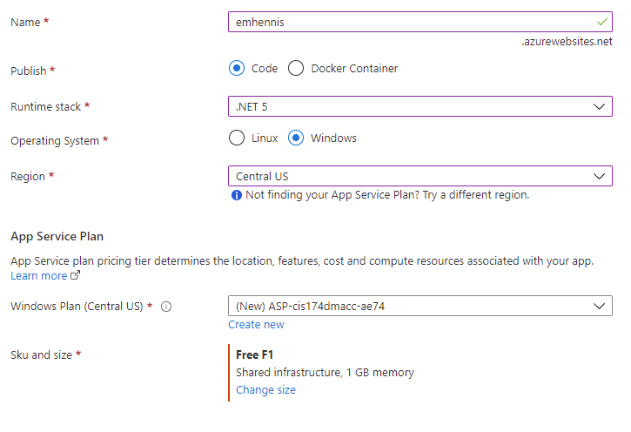
Azure: Create Web App
Name: Something unique (emhennis)
Runtime Stack: .NET 6 (or 7 or 8)
Operating System: Windows
Region: Central US
Windows Plan: [Default]
Sku and size: Free F1 (Can do bigger but $$)
Review + create

Slide 8
Deploy from Visual Studio
Create a new project (or use an existing one)
Right click on the project and select publish
Target: Azure
Specific Target: Azure App Service (Windows)
Select your created Azure Web App
Deployment Type: Publish (generates pubxml file)
Hit ‘Publish’

Slide 9
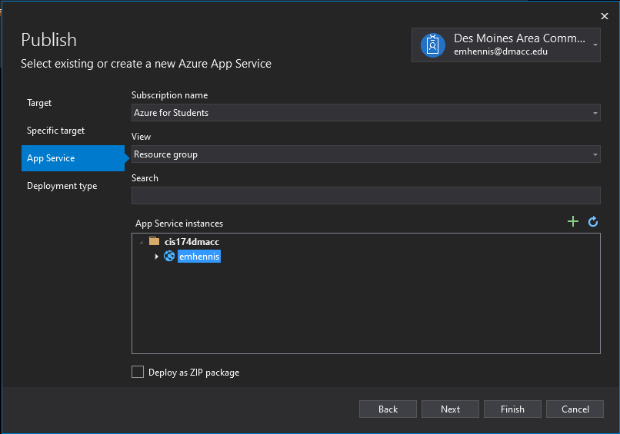
Visual Studio Publish

Slide 10
Entity Framework (EF) Core (Mod 2 Topic 2)
EF YouTube Videos
http://www.youtube.com/watch?v=PpqdsJDvcxY
http://www.youtube.com/watch?v=-sftSA9_X-k
http://www.youtube.com/watch?v=-FCzoUL47ds
http://www.youtube.com/watch?v=gV_XvdgYwyU
http://www.youtube.com/watch?v=G1Ip4pNbpcE

Slide 11
EF Core Install
Tools -> Nuget Package Manager -> Manage NuGet Packages
Or Right click on Dependencies -> Manage NuGet Packages
Browse -> ‘Microsoft.EntityFrameworkCore.SqlServer’
Make sure you include ‘.SqlServer’
Install
VS2022 .NET 6.0: 6.0.*+
.NET 7.0: 7.0.*+
.NET 8.0: 8.0.*+
Accept License
Browse -> ‘Microsoft.EntityFrameworkCore.Tools’
VS2022 .NET 6.0: 6.0. *+
.NET 7.0: 7.0.*+
.NET 8.0: 8.0.*+
Accept License

Slide 12
EF Database Classes
DbContext: The primary class for communicating with a database
DbContextOptions: Stores configuration options for DbContext
DbSet<Entity>: A collection of objects created from the specified entity

Slide 13
EF: DbContext
Primary class for communicating with the database
Uses your existing Models
DbSet<Model> represents a table in the database
Can use Linq to query/access the database table
OnModelCreating(ModelBuilder)
Called by the framework when context is created
Use “HasData” to seed data
Startup.cs: Add DI object to create the DbContext

Slide 14
EF: Database Migrations
Package Manager Console
Tools -> NuGetPackage Manager -> Package Manager Console
Up(): Upgrades your database
Down(): Downgrades your database
Add-Migration Initial
Creates your initial database snapshot
Creates MovieContextModelSnapshot.cs
Can only have one
Update-Database
Uses your models to create actual SQL tables
__EFMigrationsHistory table shows migration history

Slide 15
EF: Linq Commands
Language-Integrated Query
Where(lambda expression): Filters the entities
OrderBy(lambda expression): Orders the entities
FirstOrDefault(lambda express): Returns the first element or null
ToList(): Converts the results to a list
Executes the command at this point
Find(id): Finds the first element or null
Must be the primary key of the entity

Slide 16
EF: Linq Commands cont
IQueryable is the query expression
IQueryable stay as an expression until they are executed
IQueryable<Movie> query = context.Movies.OrderBy(m => m.Name);
Execute a query express
query.ToList()
Find(id)

Slide 17
EF: Insert, Update, and Delete
Add(entity): Adds the entity to the database
Update(entity): Updates any changed data on the entity
Remove(entity): Delete the entity in the databse

Slide 18
EF: Related Data
Create new model
Create reference on existing model
Add new model, relational data, and seed data to DbContext
Create migration
Add-Migration Genre
Update-Database

Slide 19
EF: User Friendly URLs and Slugs
User friendly URLs
Set lowercase URLs and trailing slash in Startup.ConfigureServices
Slugs
Add {slug?} to the MapControllerRoute.pattern in Startup
Add readonly Slug property to ‘Movie’

Slide 20
Azure Database (Mod 2 Topic 2)
Watch the video in Topic 2 titled ‘Azure SQL Database’
The version are different but the process is similar
This is for the final project
You can use your local SQL Express for any assignment that IS NOT deployed to Azure

Slide 21
Multi-Page Web App w/DB (Mod 2 Topic 3)
Create a multi-page app with:
A working database
Pages that:
List Contacts
Add Contact
Delete Contact
Deployed to Azure
You will need to make a new web page for this
Can use the existing resource

Slide 22
Final Project (Mod 2 Topic 4)
Final project will include all of the topics covered in this class
Submit 3 potential final projects

