Slide 1
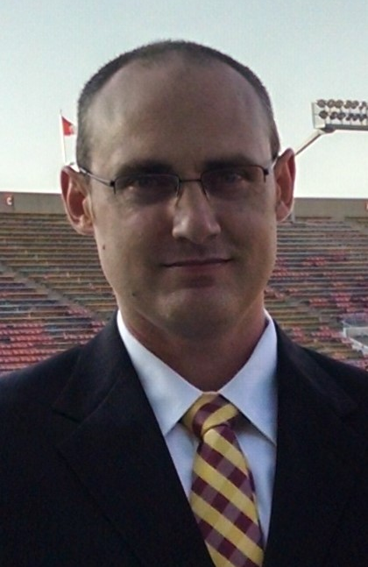
Reinforcement Learning
Exploring Reinforcement Learning through the evolution of the Q-Learner
Evan Hennis
@TheNurl
https://eckronsoftware.wordpress.com
https://github.com/ehennis
Notes:
Hello, my name is Evan Hennis and this video will cover a project I created that demonstrates Linear Programming using the game Rock, Paper, Scissors as an example.

Slide 2


Bio
BS from Iowa State 2004
MS from Georgia Tech 2018
C# developer since 2004

Slide 3
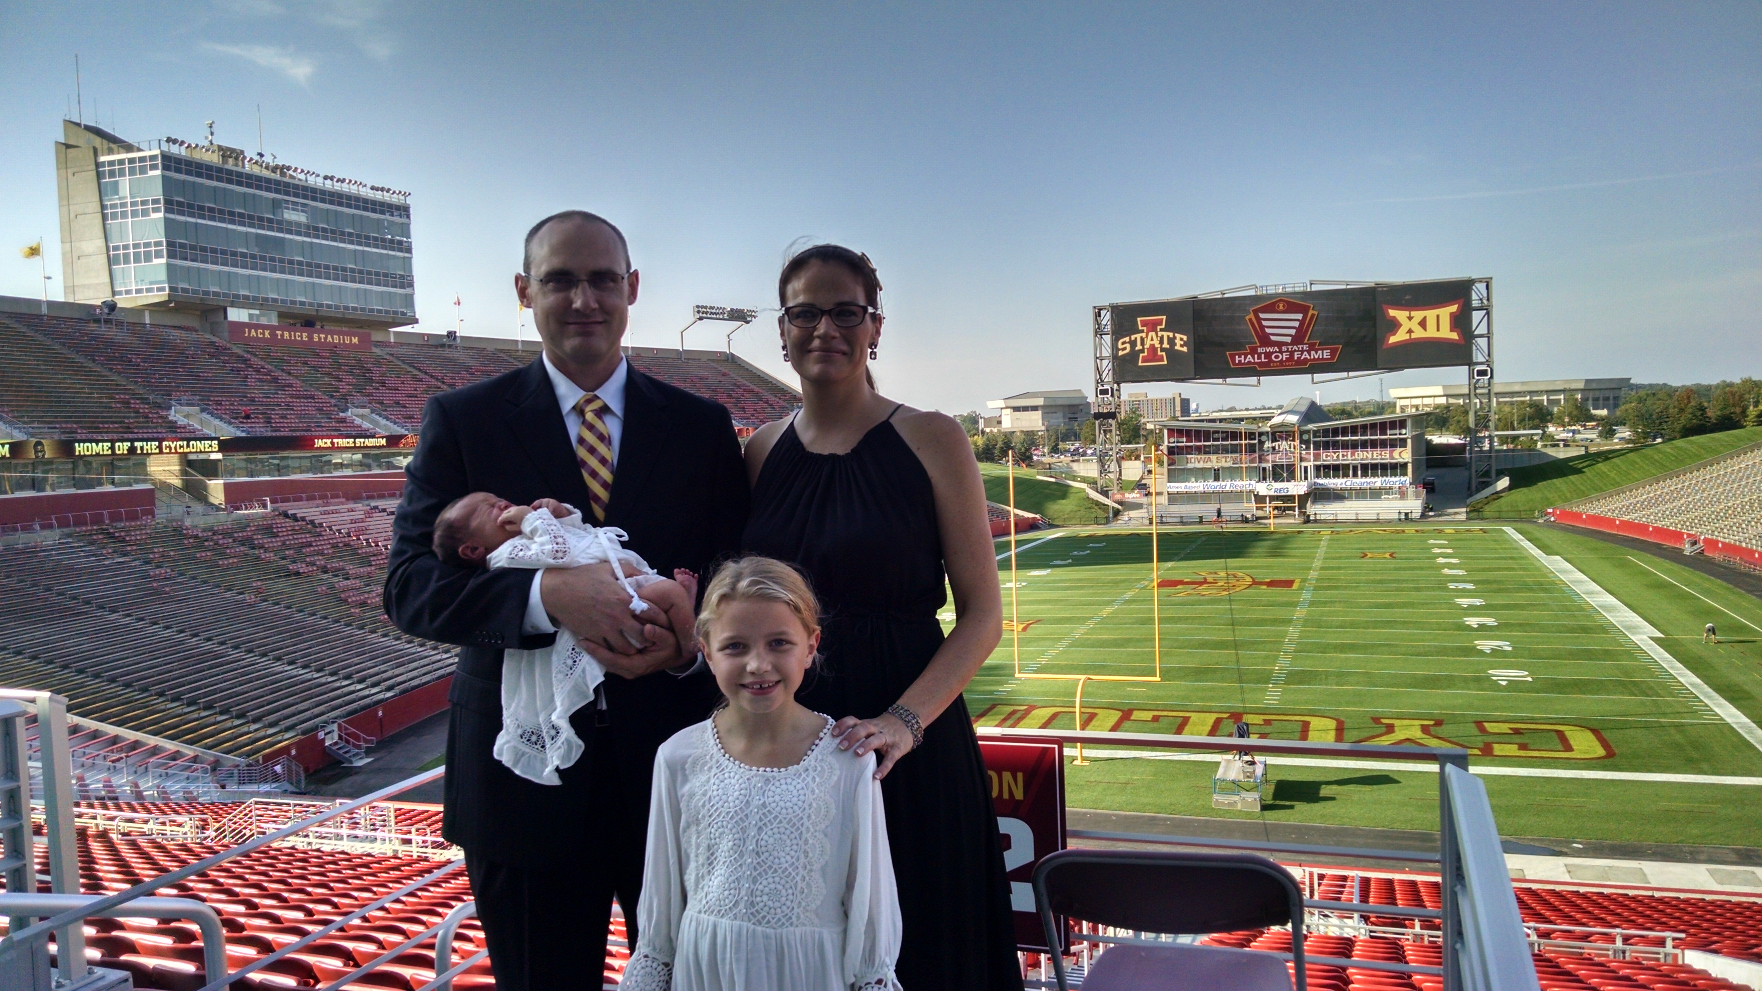

Slide 4
Overview
Environment Variables
Introduce Reinforcement Learning and Q-Learning
Markov Decision Process, Value Iteration, and Policy Iteration
Q-Learner
Double Q-Learner
DQN
Double DQN
Notes:
This video will have a quick introduction of a binary classification. I will then go on to talk about the creation of a neural network and finally show how I put them all together to help predict a football play based on a set of input parameters

Slide 5
Environment Setup
Windows 10
Python 3.6.1
Anaconda3 4.4.0
TensorFlow 1.2.0 (<- TFv2 coming this spring)
Keras 2.0.5
Gym (OpenAI) 0.9.1
NumPy 1.12.1
MatPlotLib 2.0.2

Slide 6
Jupyter Notebooks
TIP: To get to the root of your drive start from a command line
jupyter notebook
Open-source web application
Markdown and Code (40+ languages)
Interactive Output

Slide 7
Reinforcement Learning Basics
Rooted in the psychology of learning
Do an action, get a reward, learn, rinse & repeat
Richard Sutton and Andrew Barto
Reinforcement Learning: An Introduction (1998)

Slide 8
Q-Learning Milestones
Q-Learning (1989 Chris Watkins)
Double Q-Learning (2010 Hado van Hasselt)
DQN (2015 Google DeepMind)
DDQN (2016 Google DeepMind)

Slide 9
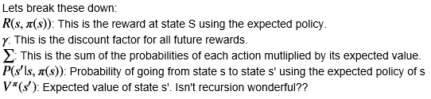


Markov Decision Process (MDP)
Mathematical framework for modeling decision-making
Discrete in time
4 main parts
S: Finite set of states
A: Finite set of actions
P_{a}(s,s’): Probability that action a in state s at time t will lead to s’ at time t’
R_{a} (s,s’): Immediate reward of taking action a in state s and moving to state s’
Bellman’s Equation
Optimal Policy:

Slide 10
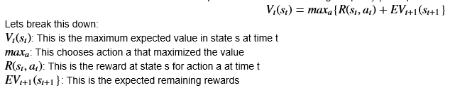
Value Iteration
Instead of the optimal policy we find the maximum value
Value Function
Policy Iteration
Update the policy directly instead of trying to find the value
Ex: Using linear equations find the infinite reward for each state using current policy. Change first action and repeat.

Slide 11
Q-Learning
Created by Chris Watkins (1989) based off of what Richard Sutton was doing with RL
Reinforcement learning technique using a Q table to learn the optimal policy
Model Free
To The Notebook!

Slide 12
Double Q-Learning
Created by Hado van Hasselt (2010)
Q-Learning uses max and it has a tendency to overestimate values
Introducing a second Q table solved this issue by grabbing the action with the max value in the second table and using that in the first table
To The Notebook!

Slide 13
Neural Network
Based on how our brains work in processing data using interconnected neurons
Function Approximation: Selecting a function instead of a discrete value
To The Notebook!

Slide 14
Deep Q Network
Created by Google DeepMind (2015) to demonstrate the power of function approximation while trying to master Atari games
Replaced the Q table with a Neural Network to allow a continuous environment
To The Notebook!

Slide 15
Double Deep Q Network
Created by Google DeepMind (2016) by using the concepts in Double Q-Learning and adding a second Neural Network.
To The Notebook!

