Slide 1
TODO:
Add RL-Agent Stuff
Update to use TF v2
Get some topics from Google I/O, DeepMind, OpenAI

Slide 2
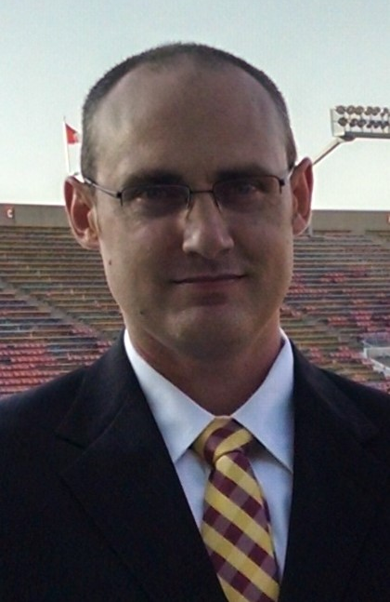
Reinforcement Learning
Exploring Reinforcement Learning through the evolution of the Q-Learner
Evan Hennis
Google Developer Expert in Machine Learning
@TheNurl
https://eckronsoftware.wordpress.com
https://github.com/ehennis
YouTube: Evan Hennis

Slide 3



Bio
BS from Iowa State 2004
MS from Georgia Tech 2018
C# developer since 2004
GDE in Machine Learning 2019

Slide 4
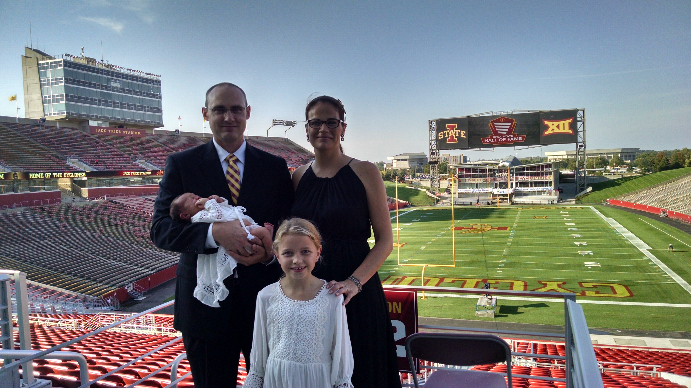

Slide 5
Overview
My Environment
Introduce RL
Markov Decision Process, Value Iteration, and Policy Iteration
Q-Learner
Double Q-Learner
DQN
Double DQN
Notes:
First, I am going to show how MY system is set up. In the future I want to move this completely online with Google Colab so it won’t be as much of an issue.
Second, I will introduce RL
Third, I will quickly cover MDPs, Value Iteration, Policy Iteration
Finally, I will work through the 4 stages of the Q-Learning evolution. The original Q-Learner from 1989, Double Q-Learner from 2010, Deep Q-Network from 2015, and finally the Double DQN from 2016

Slide 6
Environment Setup
Windows 10
Python 3.6.1
Anaconda3 4.4.0
TensorFlow 1.2.0 (<- TFv2 alpha released)
Keras 2.0.5
Gym (OpenAI) 0.9.1
NumPy 1.12.1
MatPlotLib 2.0.2

Slide 7
Jupyter Notebooks
TIP: To get to the root of your drive start from a command line
jupyter notebook
Open-source web application
Markdown and Code (40+ languages)
Interactive Output

Slide 8
Reinforcement Learning Basics
Psychology of learning!
Action -> Reward -> Learn!
Richard Sutton and Andrew Barto
Reinforcement Learning: An Introduction (1998)
Notes:
In psychology decision-making is regarded as the cognitive process resulting in the selection of a belief. Meaning, we take in our environment, or inputs, do some processing on them, and output a decision.
In Reinforcement Learning, we do an ACTION in a certain STATE in the environment. The environment then returns our NEXT STATE and our REWARD. This continues until the POLICY is learned.

Slide 9
Markov Decision Process (MDP)
Mathematical framework for modeling decision-making
Discrete in time
4 main parts
S: Finite set of states
A: Finite set of actions
P_{a}(s,s’): Probability that action a in state s at time t will lead to s’ at time t’
R_{a} (s,s’): Immediate reward of taking action a in state s and moving to state s’

Slide 10

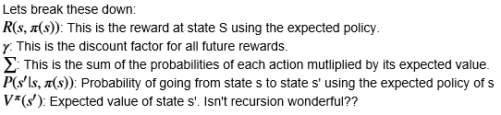

Bellman’s Equation
Optimal Policy:
Notes:
The Bellman’s Equation is THE equation in machine learning.
~~Walkthrough each symbol~~

Slide 11




Discount Factor ($γ$)
Gamma: 0.8
Gamma: 0.9
Notes:
Here are 2 examples of the Discount Factor/Gamma
First, this is what it looks like when you have a reward 4 states away. It demonstrates how the value propagates back to your current state
Second, this is how the reward would propagate after a single run of the Value Iteration

Slide 12
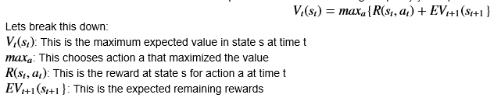
Value Iteration
Instead of the optimal policy we find the maximum value
Value Function
Policy Iteration
Update the policy directly instead of trying to find the value
Ex: Using linear equations find the infinite reward for each state using current policy. Change first action and repeat.

Slide 13
Q-Learning Milestones
Q-Learning (1989 Chris Watkins)
Double Q-Learning (2010 Hado van Hasselt)
DQN (2015 Google DeepMind)
DDQN (2016 Google DeepMind)

Slide 14
Q-Learning
Created by Chris Watkins (1989) based off of what Richard Sutton was doing with RL
Reinforcement learning technique using a Q table to learn the optimal policy
Model Free
To The Notebook!

Slide 15
Double Q-Learning
Created by Hado van Hasselt (2010)
Q-Learning uses max and it has a tendency to overestimate values
Introducing a second Q table solved this issue by grabbing the action with the max value in the second table and using that in the first table
To The Notebook!

Slide 16
Neural Network
Based on how our brains work in processing data using interconnected neurons
Function Approximation: Selecting a function instead of a discrete value
To The Notebook!

Slide 17
Deep Q Network
Created by Google DeepMind (2015) to demonstrate the power of function approximation while trying to master Atari games
Replaced the Q table with a Neural Network to allow a continuous environment
To The Notebook!

Slide 18
Double Deep Q Network
Created by Google DeepMind (2016) by using the concepts in Double Q-Learning and adding a second Neural Network.
To The Notebook!

Slide 19
TF-Agents
Currently in “pre-release”
Hosted on Github at tensorflow/agents
2 Core Responsibilities
Defining a Policy
Learn/Train that Policy

Slide 20
TF-Agents DQN
Create Q Network from ‘tf_agents.networks’
Pass in Observation and Actions
Create DQN Agent from ‘tf_agents.agents.dqn’
Pass in Q Network
Create Eval Policy and Data Collection Policy
Create Replay Buffer from ‘tf_agents.replay_buffers’
DQN Example: https://colab.research.google.com/github/tensorflow/agents/blob/master/tf_agents/colabs/1_dqn_tutorial.ipynb

Slide 21
My Information
Twitter: @TheNurl
GitHub: https://github.com/ehennis
YouTube: Evan Hennis
Blog: https://eckronsoftware.wordpress.com

