Slide 1
CARE Principles for Indigenous Data Governance
ES 292
Fall 2025
Prof. Erin Hestir
University of California Merced

Slide 2
Announcements
What’s up?

Slide 3
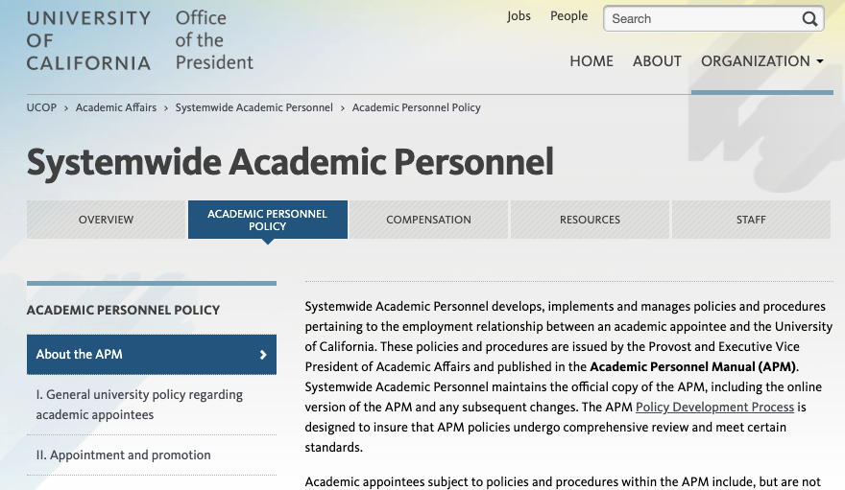
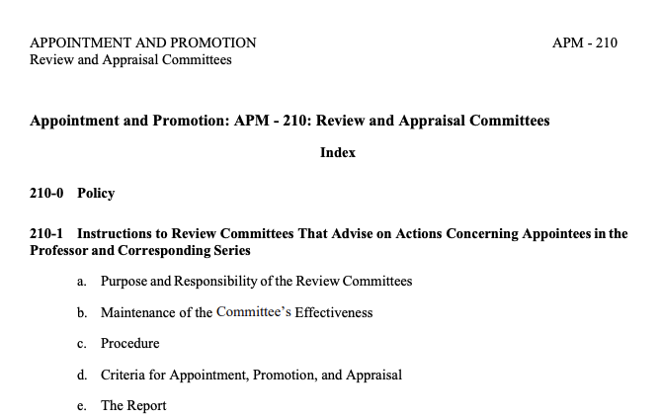
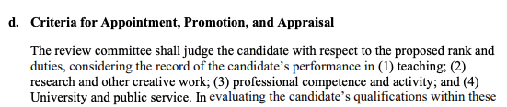

Slide 4
CARE & FAIR Data Principles

Slide 5
Why CARE Matters for Environmental Systems (and your research…)
Research intersects indigenous lands, waters, histories, communities
Environmental data = power + governance
FAIR ≠ sufficient
CARE ensures justice, sovereignty, and reciprocity

Slide 6
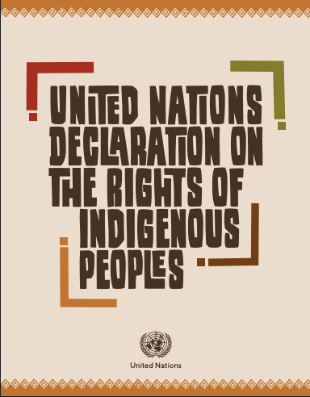
UNDRIP: The Foundation
Article 18
“Indigenous peoples have the right to participate in decision-making in matters which would affect 16 their rights, through representatives chosen by themselves in accordance with their own procedures, as well as to maintain and develop their own indigenous decision-making institutions.”
Notes:
United Nations Declaration on the Rights of Indigenous Peoples (UNDRIP) establishes:
Self-determination
Control over cultural heritage, knowledge, and intellectual property
Rights to maintain and protect traditional knowledge, sciences, and technology
Free, Prior, and Informed Consent (FPIC) for activities affecting lands, resources, or knowledge
Key takeaway:
UNDRIP establishes Indigenous rights in principle; data sovereignty operationalizes those rights in practice.
Transition sentence:
“If UNDRIP tells us what rights Indigenous Peoples hold, Indigenous data governance asks how we uphold those rights in our research workflows—especially in open science.”

Slide 7
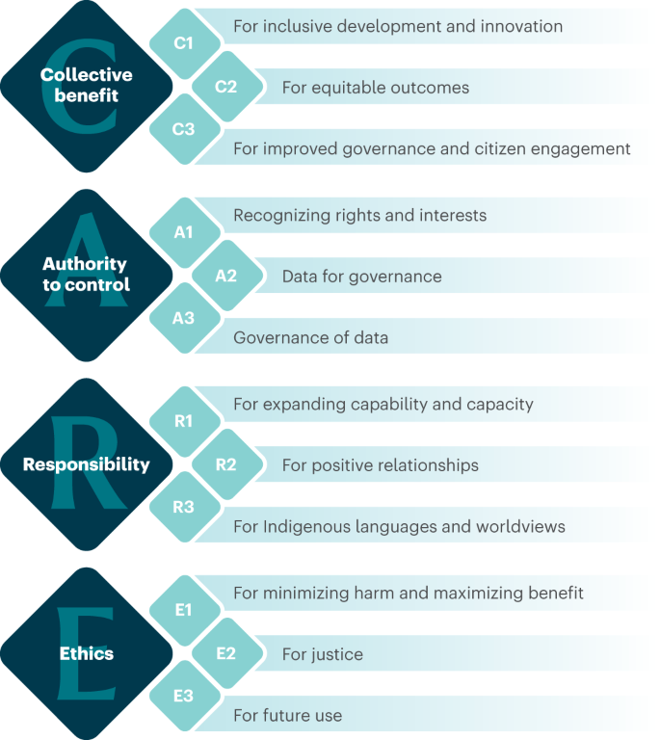
Indigenous Data Sovereignty: CARE Principles
Jennings, L., Anderson, T., Martinez, A. et al. Applying the ‘CARE Principles for Indigenous Data Governance’ to ecology and biodiversity research. Nat Ecol Evol 7, 1547–1551 (2023). https://doi.org/10.1038/s41559-023-02161-2
Notes:
The global Indigenous data sovereignty movement argues that Indigenous nations must govern how data about their lands, people, and knowledge are collected, accessed, used, and shared.
This led to the CARE Principles:
Collective Benefit – Data should enhance Indigenous wellbeing and self-determination.
Authority to Control – Indigenous nations decide who collects, accesses, and uses data.
Responsibility – Researchers must minimize harm and steward data transparently and respectfully.
Ethics – Beyond IRB: relational accountability, reciprocity, and context-specific norms.
Key point: CARE centers power, relationships, and sovereignty, not just data management.

Slide 8
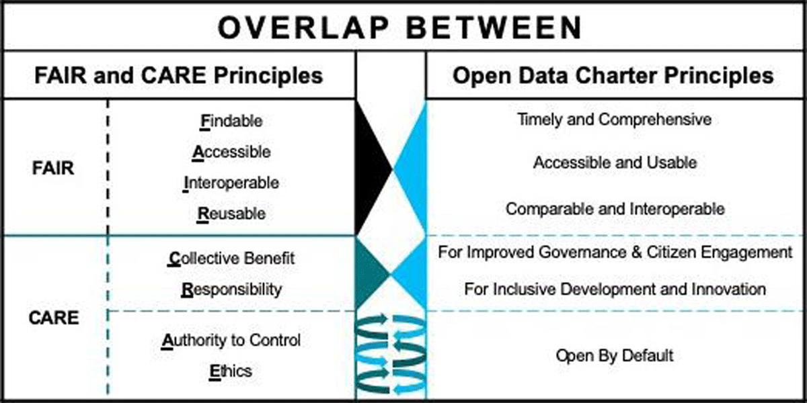
CARE & FAIR Data Principles
Carroll, S.R., Garba, I., Figueroa-Rodríguez, O.L., Holbrook, J., Lovett, R., Materechera, S., Parsons, M., Raseroka, K., Rodriguez-Lonebear, D., Rowe, R., Sara, R., Walker, J.D., Anderson, J. and Hudson, M. (2020) ‘The CARE Principles for Indigenous Data Governance’, Data Science Journal, 19(1), p. 43.
Notes:
FAIR: Findable, Accessible, Interoperable, Reusable
Developed to support open science, transparency, and machine-readable data infrastructure.
FAIR is critical for reproducibility, environmental modeling, machine learning, and remote sensing.
But:
FAIR does not address who owns the data, who benefits, or who might be harmed.
FAIR can unintentionally enable extraction or misuse of Indigenous data when applied without CARE.
Transition sentence:
“FAIR makes data usable; CARE makes data just.”

Slide 9
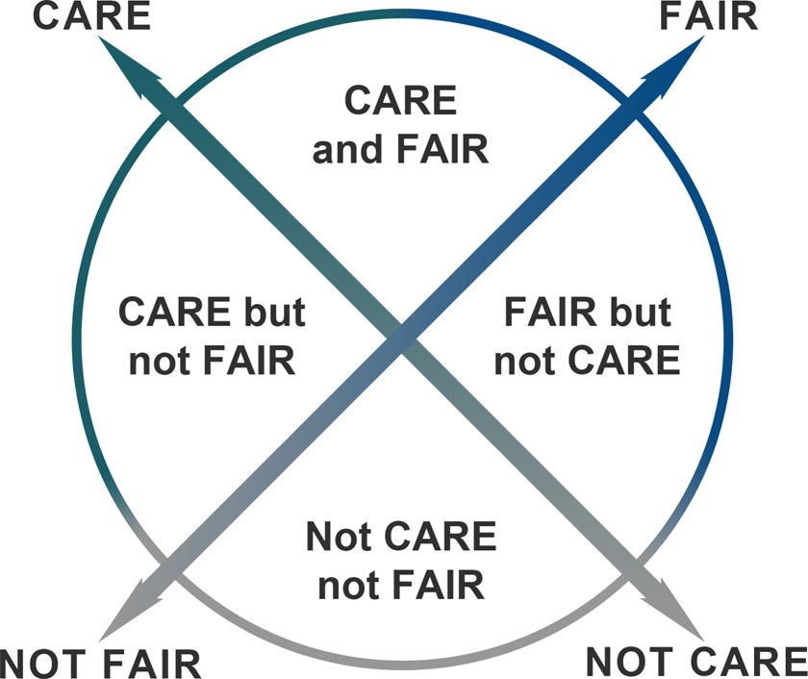
CARE vs FAIR Data Principles
Carroll, S.R., Herczog, E., Hudson, M. et al. Operationalizing the CARE and FAIR Principles for Indigenous data futures. Sci Data 8, 108 (2021). https://doi.org/10.1038/s41597-021-00892-0
Notes:
Environmental and geospatial research must integrate both:
FAIR ensures scientific quality → good metadata, accessible code, reproducible workflows.
CARE ensures justice and sovereignty → community authority, FPIC, benefit-sharing, controlled access.
Together, they form an ethical–technical framework for open science.

