Slide 1
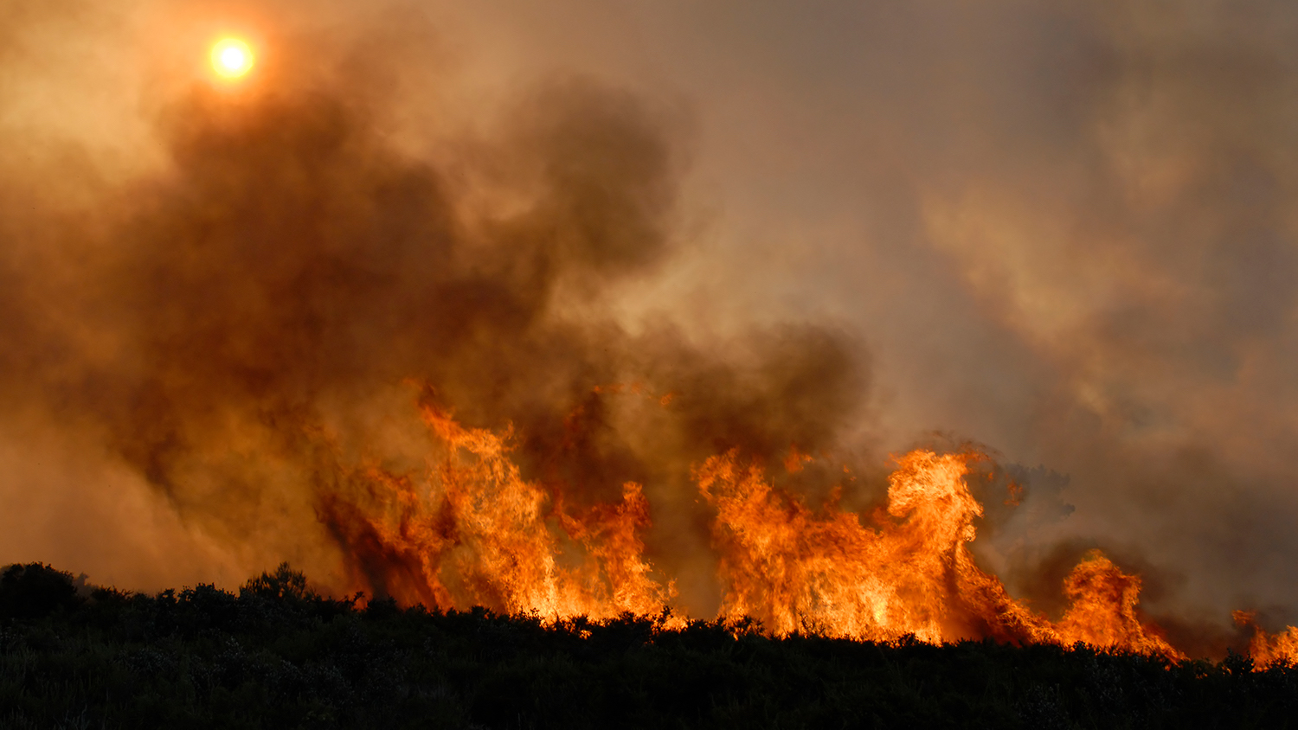
https://cnr.ncsu.edu/news/2021/07/how-dangerous-wildfire-smoke/

Slide 2
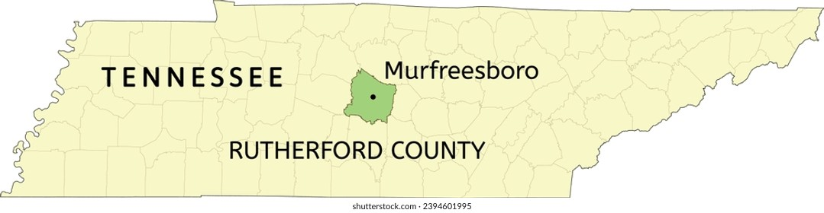
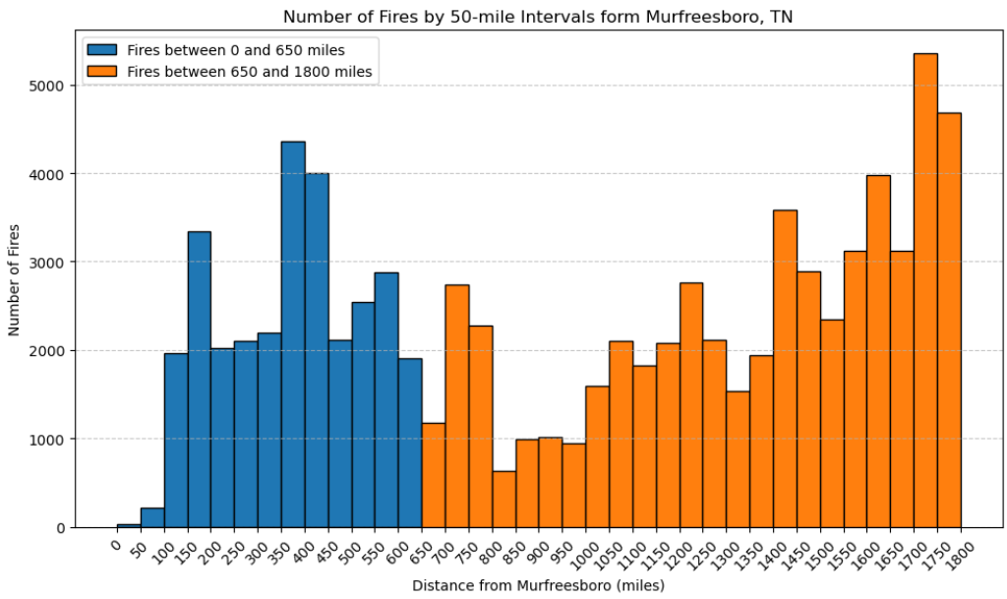
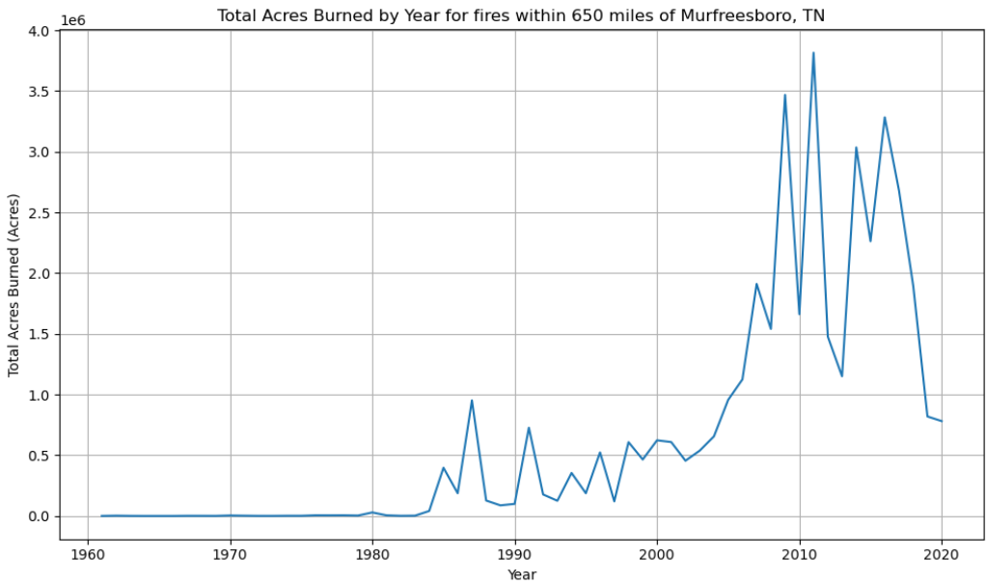
Murfreesboro, Tennessee
https://www.shutterstock.com/search/murfreesboro-tennessee?image_type=vector

Slide 3

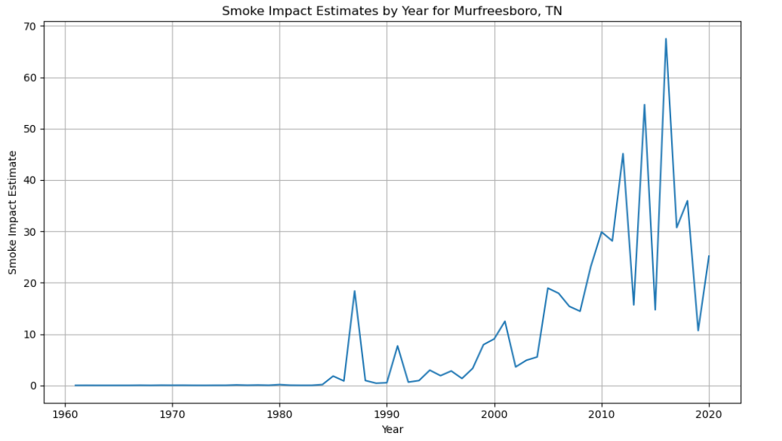
Smoke impact of a fire =

Slide 4
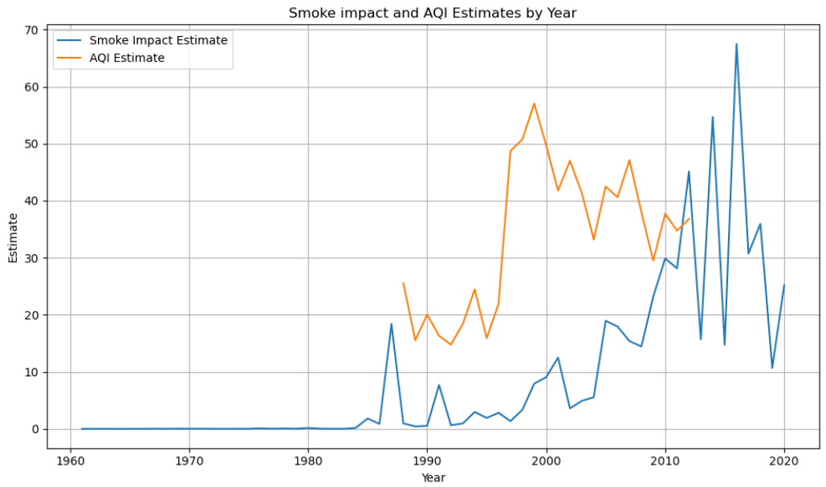

Slide 5
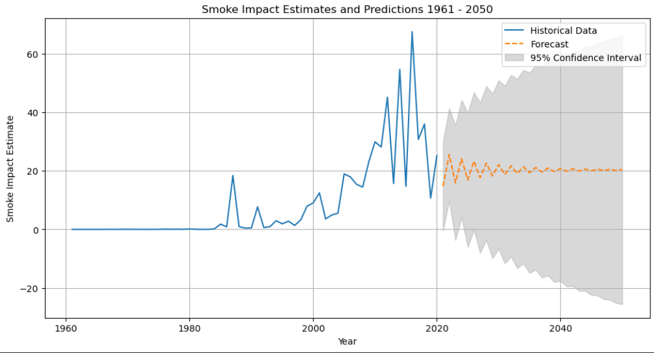

Slide 6
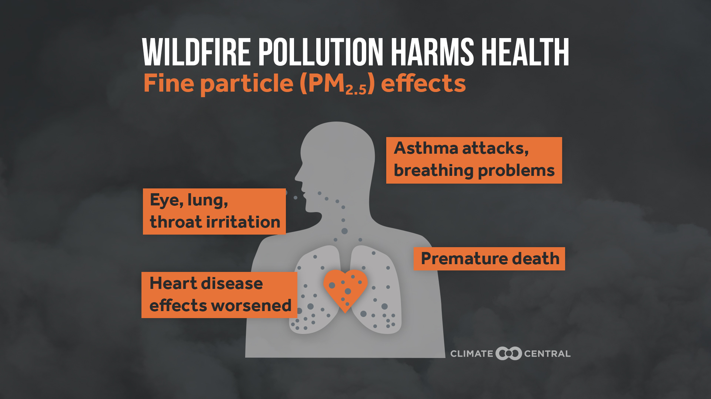
https://www.climatecentral.org/climate-matters/wildfire-smoke-nationwide-health-risk-2023

Slide 7
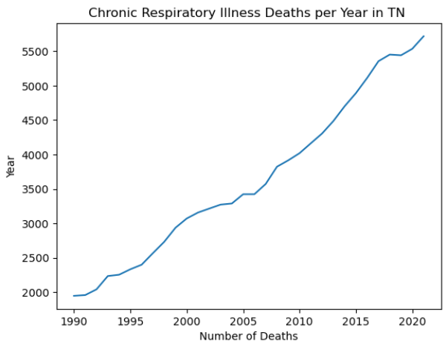
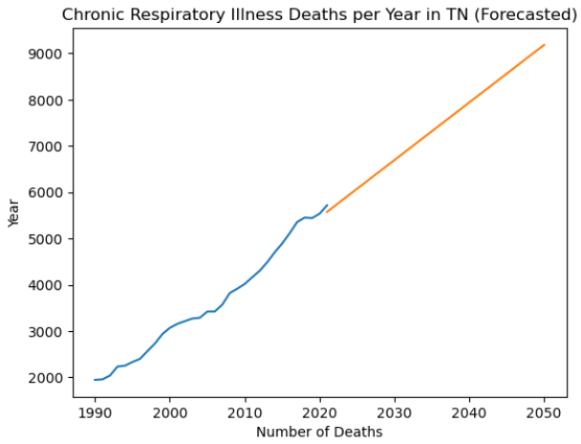

Slide 8
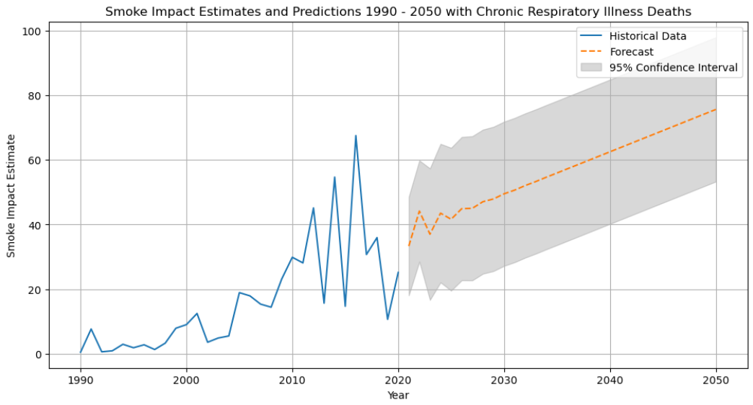

Slide 9

https://cebma.org/resources/frequently-asked-questions/what-are-the-limitations-of-evidence-based-practice/

Slide 10

https://www.istockphoto.com/photos/health-warning

