Slide 1



Edo_2020_Governorship_Election
View in Power BI
Last data refresh:
9/25/2020 2:43:30 PM UTC
Downloaded at:
9/25/2020 2:51:56 PM UTC

Slide 2
OVERVIEW
Edo state is a state in Southern Nigeria. Its capital is Benin City. The 2014 estimated population of the Edo state is 5 million people. It is made up of 4 major ethnic groups; namely the Bini, Esan, Owan, and the Etsako.
Edo was formed from the defunct Bendel State on August 27, 1991.
The Bini speaking people who occupy seven out of the 18 Local Government Areas of the state constitute 57.14%; while others are as follow: Esan(17.14%), Etsako(12.19%, with ), Owan(7.43%), and Akoko Edo (5.70%).
Edo state can be grouped into three regions; south (which comprises of the Binis speaking people), central (comprises of the Esan speaking people) and north (which comprises of the Owan, the Etsako and the Akoko Edo people).
The tables in the next slide show the number of votes APC and PDP had in various LGAs, the regions the LGAs belongs and their total votes in each regions.

Slide 3
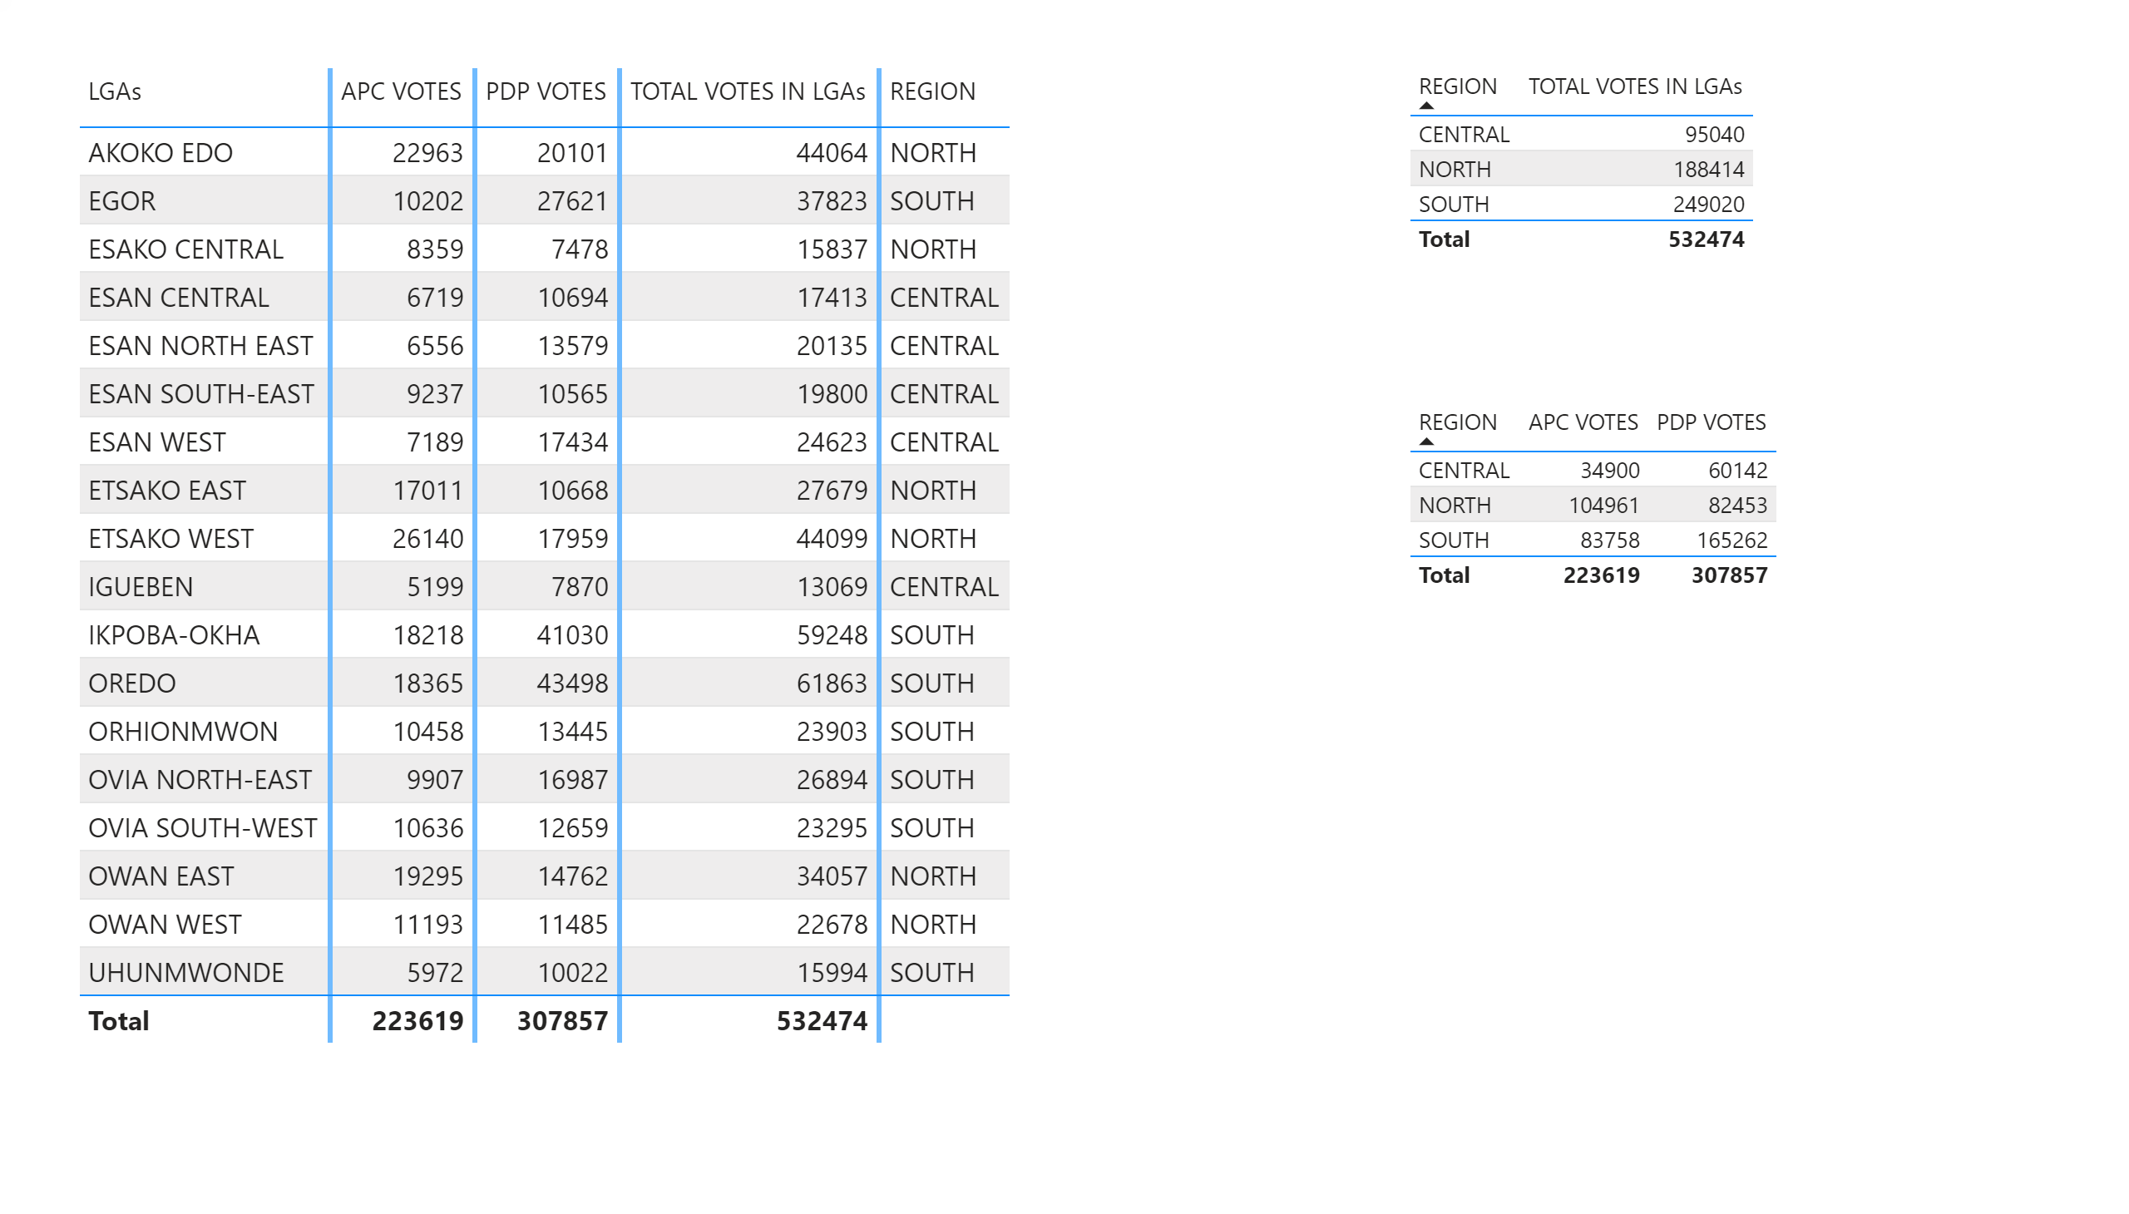

Slide 4
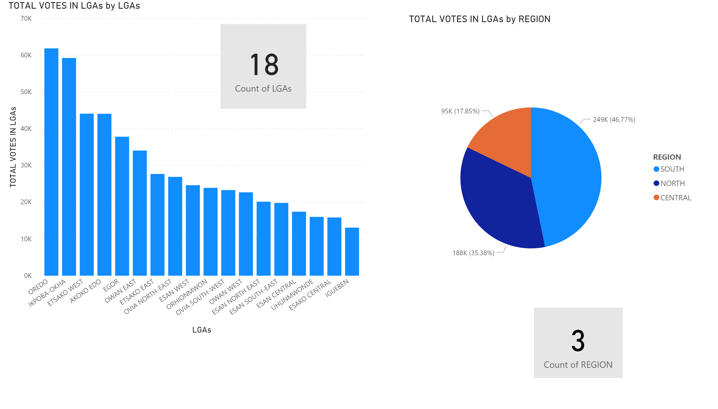

Slide 5
The bar chart shows that:
The highest number of votes was casted in Oredo followed by Ikpoba Okha.
The lowest number of votes was casted in Igueben followed by Etsako Central.
From the pie chart:
The highest number of votes was seen in the south and the lowest in central.
The number of votes in the south represents approximately 50% of all votes.
The total votes in the north is approximately twice the votes in the central.
The south and north’s votes represent 82% of all the votes.

Slide 6
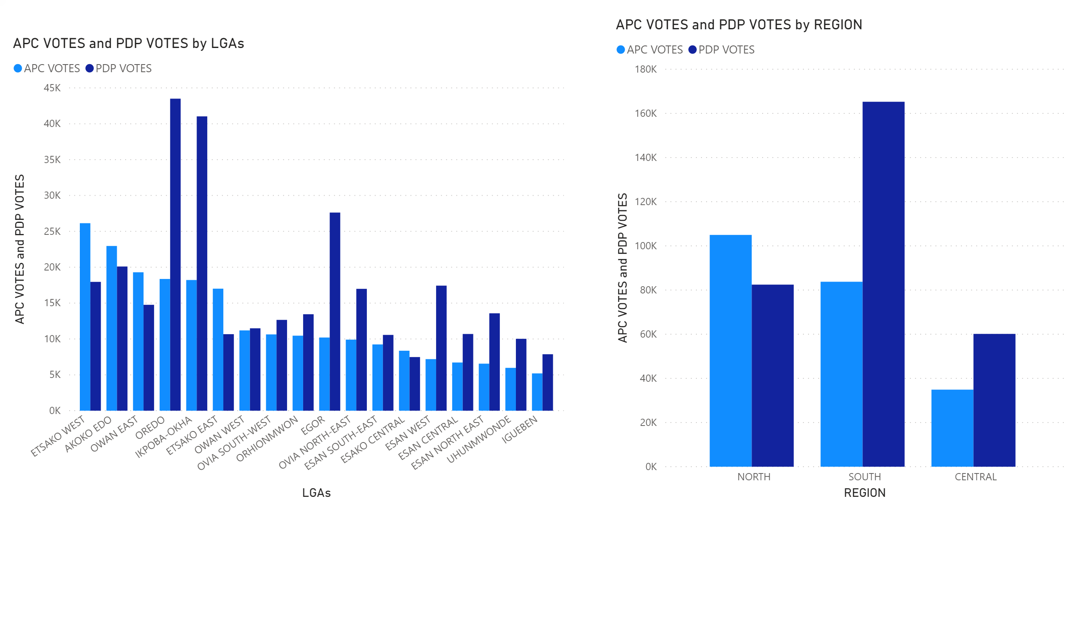

Slide 7
From the left clustered bar chart:
PDP had their highest votes in Oredo and Ikpoba Oka.
APC had their highest votes in Etsako West and Akoko Edo.
PDP won 13 out of the 18 LGAs.
From the right clustered bar chart:
PDP won the south and central region of Edo state while APC won the north.

Slide 8
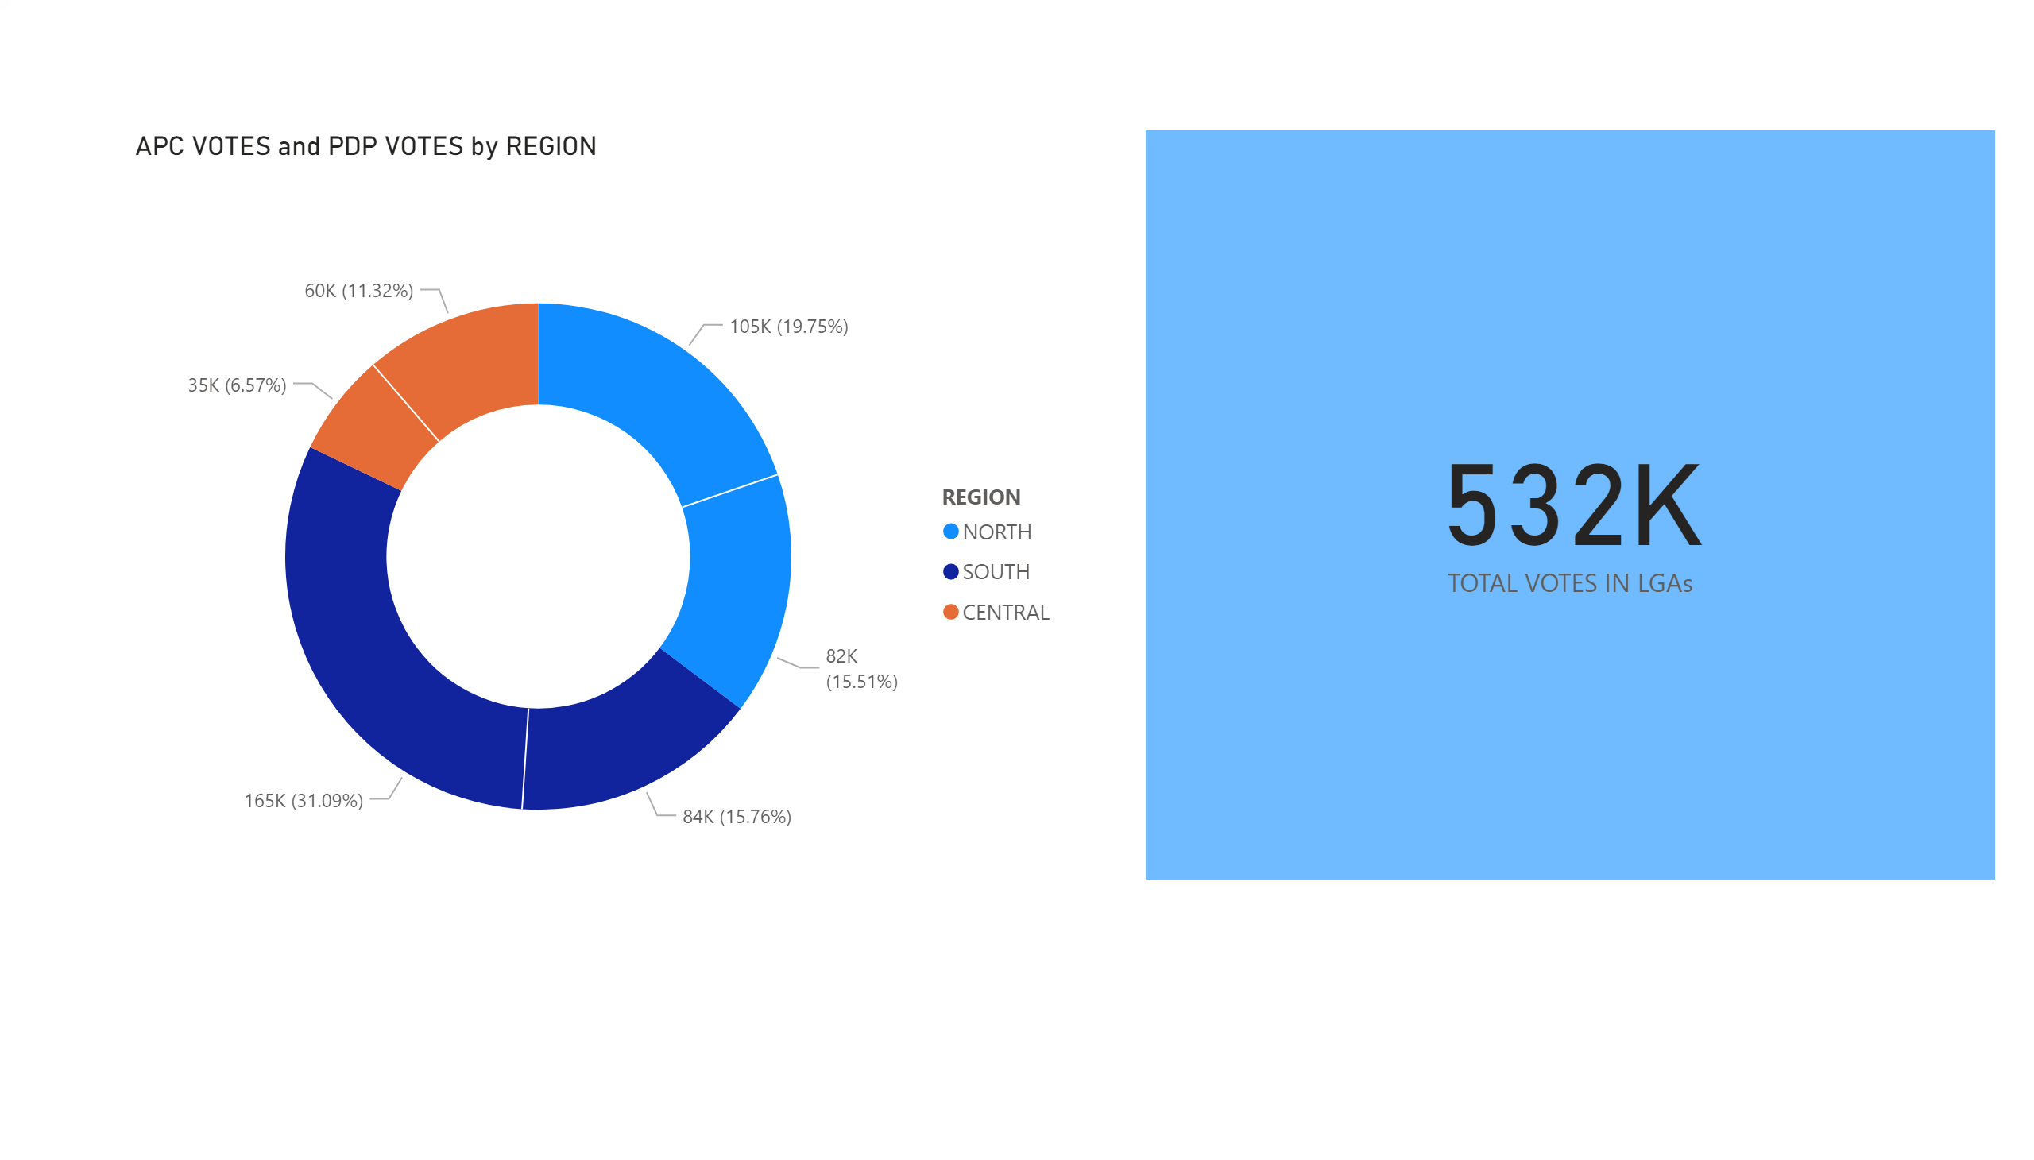

Slide 9
From the donut chart:
PDP had roughly twice the votes of APC in the central and southern regions.
APC had won PDP in the north by 4.28% of the votes in the north.

Slide 10
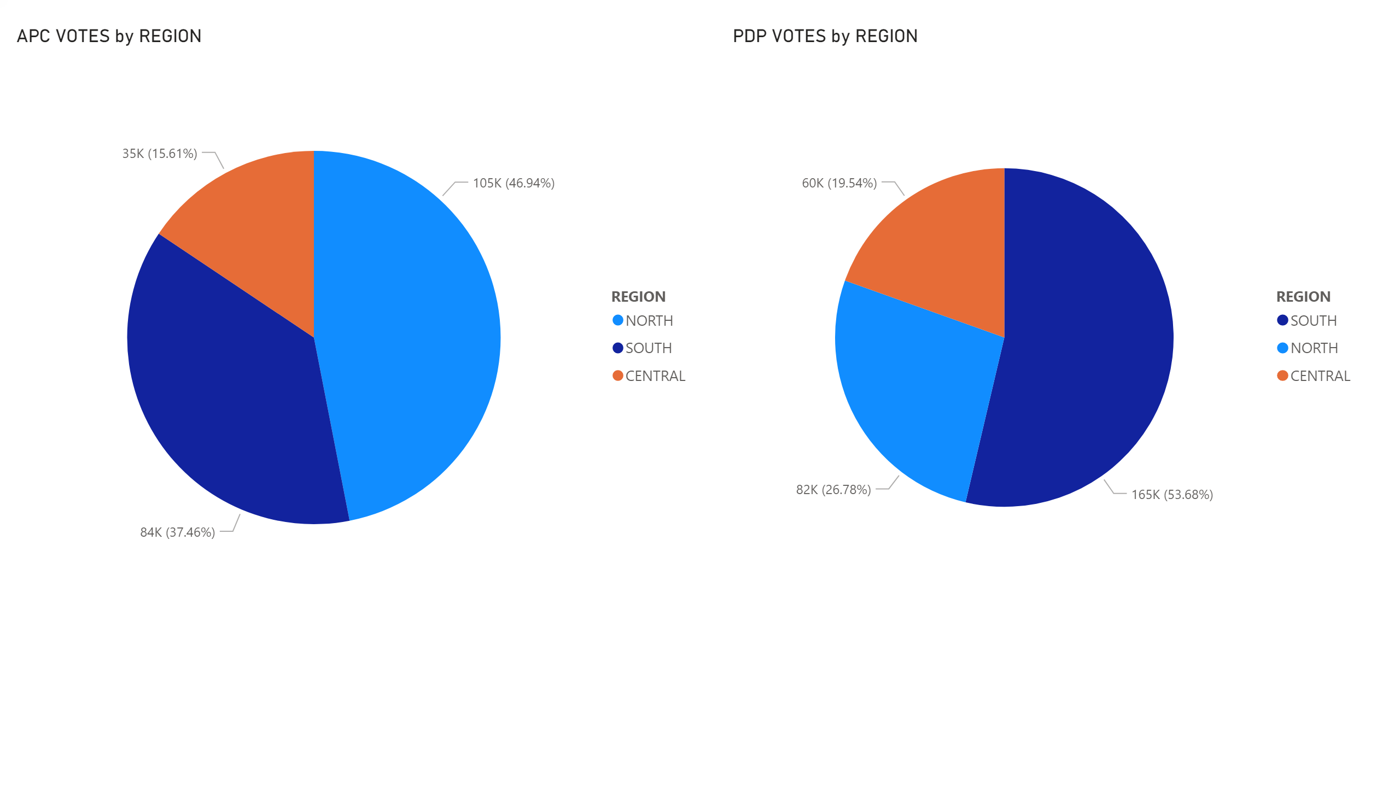

Slide 11
The pie chart reveals that:
APC had their largest votes from the north while PDP had theirs from the south.
The total number of votes for APC in the north represents approximately half of their total votes.
The total number of votes for PDP in the south represents half of their total votes.
Other inferences:
The turnout for the central region was poor as compare to that of the north.
Parties might consider focusing their campaign in the southern and northern regions.

