Slide 1

Training Evaluation
SU IST652
Scripting for Data Analysis
Elia Kostyrka

Slide 2
Topic of Investigation
Training assessment results for an audience of over 5,000 employees that conduct monthly mandatory training of various topics. Results of this analysis can be used to show how effective training was on an unspecified topic.
2

Slide 3
Business Questions
What subgroup was most familiar with the topic based on the assessment results by region, job title, and years of experience?
What subgroup requires remediation based on assessment results by region, job title, and years of experience?
What was overall compliance by region?
What was overall satisfaction by region, job title, and years of experience?
How can training be improved according to participant comments?
3

Slide 4
Data
The data included structured data in a .csv file with over 5,000 observations and over 30 variables.
Select critical variables were examined and included:
Scores
Assessment status (complete/incomplete)
Overall satisfaction level
Region
Job title
Years of experience on the job
Comments on how to improve training
4

Slide 5
Analysis Plan
Descriptive statistics
Subgrouping using Pandas and other libraries
Output in the form of descriptions and data visualizations (Matplotlib and seaborn).
Logistic Regression (statsmodels library)
Text mining (nltk, TextBlob)
Other libraries were incorporated as needed to improve analysis.
5

Slide 6
Cleaning and Transforming
Score data was categorized into discrete data for modeling, ScorePerfect (100 = Yes, <100 = No)
Years data was categorized into more bins, Experience = Not Much (< 5 years), Much (>5 years)
Blank scores were deleted for some calculations, including tabulating distribution
Text mining – lowercase, removed punctuation and stopwords, including some additional common words (like “improve”),conducted n-gram vectorization (bigrams) to identify the most frequent themes
6

Slide 7
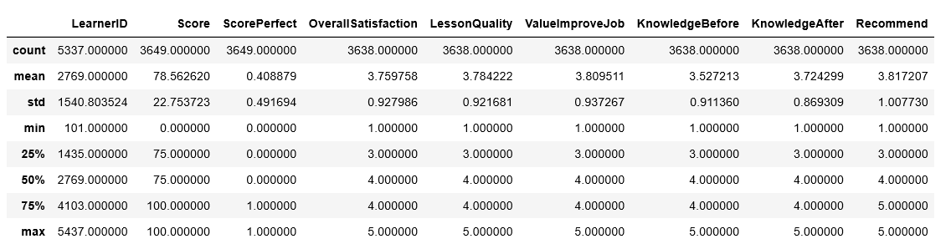
Exploratory Data Analysis, Descriptive Statistics
There were 5,337 learners assigned the assessment
The average score was 78.56%, the minimum score was 0% and maximum score was 100%
Learner average satisfaction scores for training using a 5-point Likert scale were the following:
3.82 for Likely to recommend to peers
3.81 for Value to improve their job
3.78 for Lesson quality
3.76 for Overall satisfaction
7
Notes:
Python .describe function

Slide 8
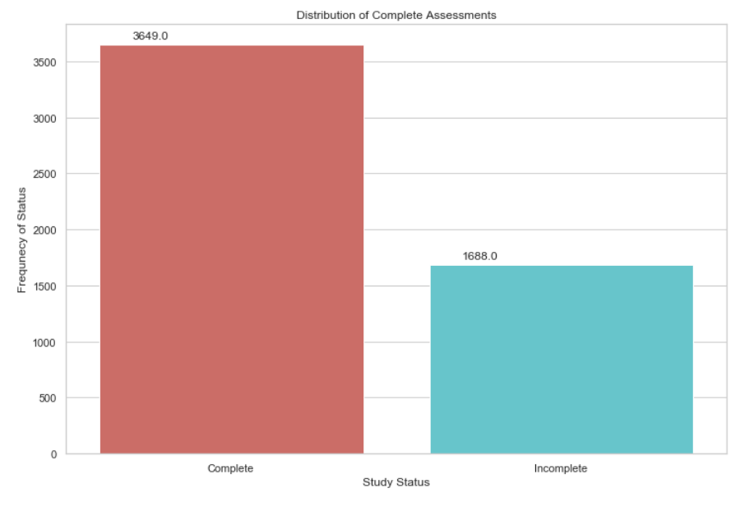
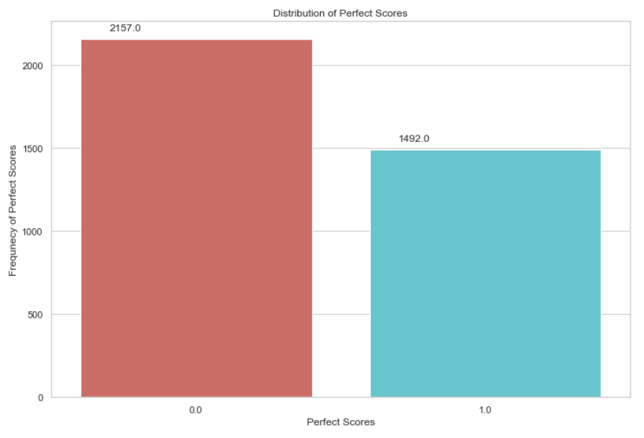
Exploratory Data Analysis, Descriptive Statistics
3,649 of the 5,337 (68%) learners completed the assessment
1,492 of the 3,649 (41%) received a perfect score of 100%
8
Notes:
sns countplot

Slide 9
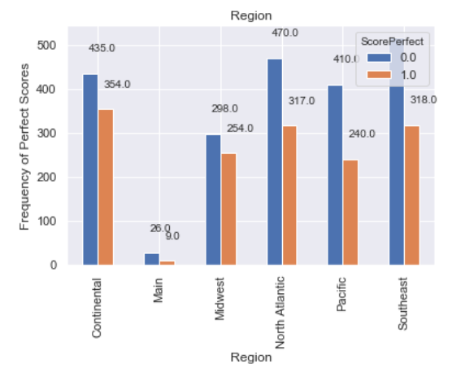
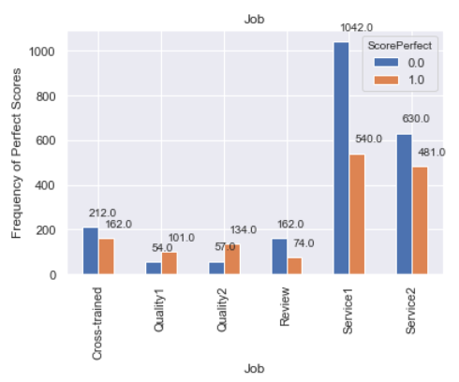
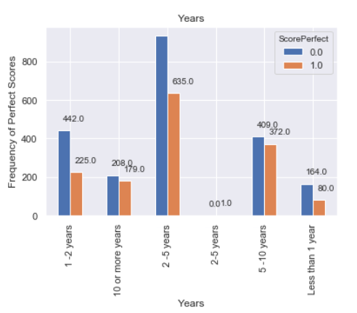
What subgroup was most familiar with the topic based on the assessment results by region, job title, and years of experience? Percentage Perfect Score
Region: 46% of learners in the Midwest Region got a perfect score, followed by 44% of Continental Region; the Main, Pacific, and Southeast Regions had the fewest number of staff that scored a perfect score (26%, 37% , and 38% respectively)
Job Title: 70% of Quality 2 staff got a perfect score, followed by 65% of the Quality1 staff
Years of Experience: 48% of personnel with 5-10 years of experience got a perfect score, followed by 46% with 10 or more years of experience
9

Slide 10
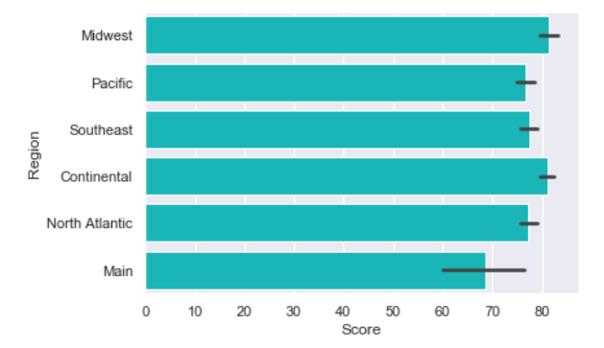
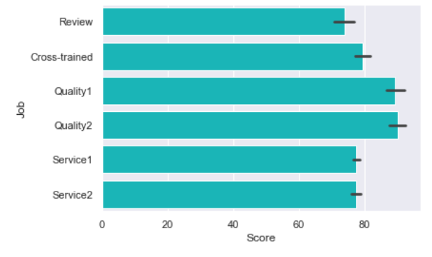
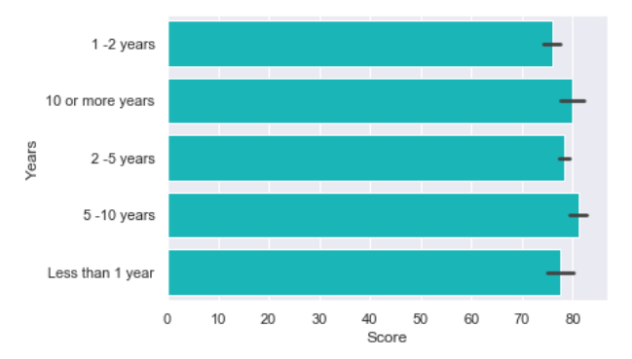
What subgroup requires remediation based on assessment results by region, job title, and years of experience? Score Averages
Region: Staff from the Main Region had the lowest score average, 69%
Job Title: Staff from the Review job title had the lowest score average, 73%
Years: Staff with 1-2 years of experience had the lowest score average, 76%
10

Slide 11
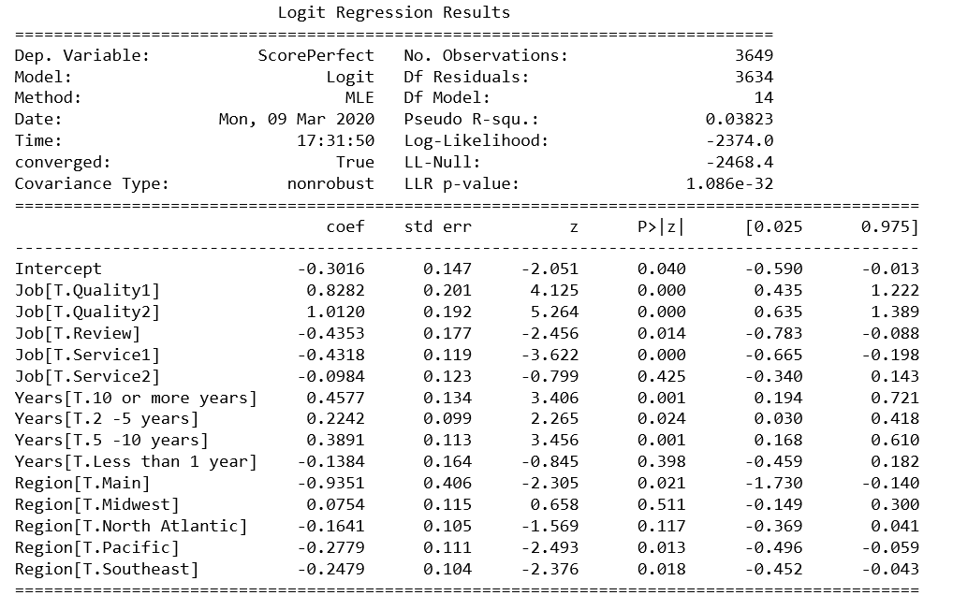
What subgroup requires remediation based on assessment results by region, job title, and years of experience? Logistic Regression
Logit measures how well variables of the model explain the dependent variable (perfect score)
 | Positive Perfect Score Correlation |  | Negative Perfect Score Correlation
 | Highly Significant (p-value < .001) | Significant (p-value < .05) | Highly Significant (p-value < .001) | Significant (p-value < .05)
Region |  |  |  | Main Pacific Southeast
Job | Quality1 Quality2 |  | Service1 | Review
Years | 5-10 years 10 or more
11
Notes:
Pseudo R-squared ranging from 0.2 to 0.4 indicates very good model fit

Slide 12
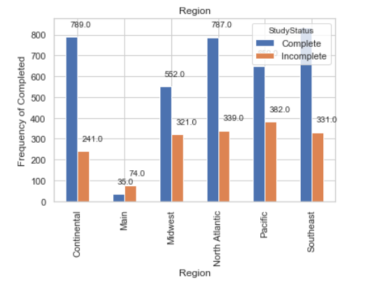
What was overall compliance by Region?
Main 68%
Midwest 37%
Pacific 37%
North Atlantic 30%
Southeast 28%
Continental 23%
12

Slide 13
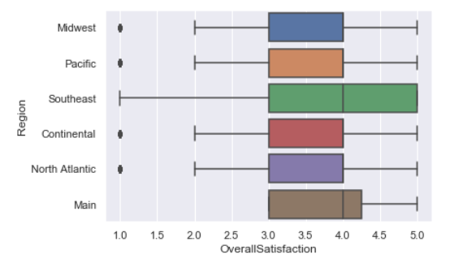
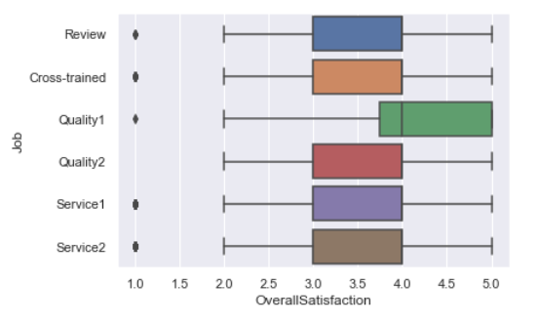
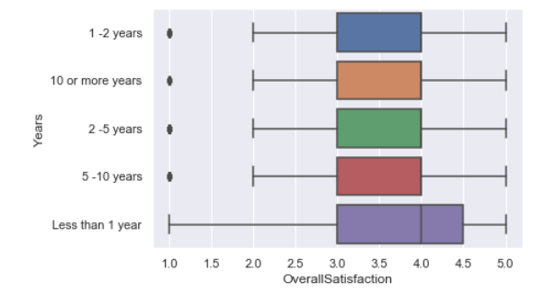
What was overall satisfaction by region, job title, and years of experience?
In general, the average overall satisfaction rating for the assessment was 3.76
Staff in the Southeast Region had higher overall satisfaction ratings than all other groups
Staff Quality1 job had higher overall satisfaction ratings than all other groups
Staff with Less than 1-year experience had higher overall satisfaction ratings than all other groups
13

Slide 14
Conclusion
Overall, compliance and score average were below the benchmarks
Compliance was below 70% (68%)
Score average was below 80% (78.56% )
Less than half (41%) that completed the training scored 100% on the assessment
Overall satisfaction ratings for lesson quality, value to improve participant’s job, and whether they would recommend the training ranged from 3.78 to 3.82 with overall satisfaction at 3.76 (between neutral and satisfied)
Participants most familiar with the training topic included staff from the Midwest Region, Quality1 and Quality2 job titles, and more experienced staff (5+ years)
Participants that require immediate remediation include the following groups:
Staff from the Main Region and Pacific Regions
Staff belonging to the Service1 and Review jobs
Staff with 1-2 years of experience
14

Slide 15
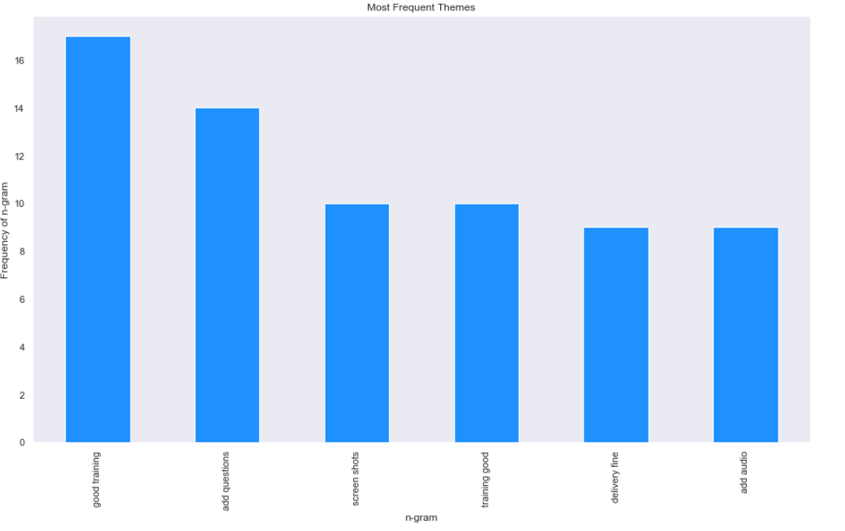
How can training be improved according to participant comments?
Add more questions
Use screen shots
Add audio
15

