Slide 1
Chapter 4: Paths in graphs
Key concepts and algorithms:
- Breadth-first search (BFS)
- Dijkstra’s algorithm
- Priority queue implementations for
Dijkstra’s algorithm
- Shortest paths in the presence of negative
edges (Bellman-Ford algorithm)
- Shortest paths in directed acyclic graphs (DAGs)

Slide 2
Breadth-first Search
Uses a queue
procedure bfs(G,s)
for all u in V:
dist[u] = infinity
prev[u] = nil
dist[s] = 0
Q = [s] (queue containing only s)
while Q is not empty
u = eject(Q)
for all edges (u,v):
if dist[v] = infinity
dist[v] = dist[u] + 1
prev[v] = u
inject(Q,v)
Runtime:
O(|V| + |E|)

Slide 3
Dijkstra’s shortest path algorithm
Uses a priority queue.
Assumes non-negative edge lengths.
procedure dijkstra(G,len,s)
for all u in V:
dist[u] = infinity
prev[u] = nil
dist[s] = 0
H = makequeue(V) (lower dist-values mean higher priorities)
while H is not empty:
u = deletemin(H)
for all edges (u,v):
if dist[v] > dist[u] + len(u,v)
dist[v] = dist[u] + len(u,v)
prev[v] = u
decreasekey(H,v)

Slide 4
Correctness Proof (by mathematical induction)
Let the yellow set be the nodes that have already been dequeued.
Key to proof: when v is added to yellow set, it has the correct distance.
Induction hypothesis: For each dequeued node u, dist[u] is the shortest distance from the source node s to node v. Also, for each node v still in the queue, dist[v] is the shortest distance using dequeued nodes only between s and v.
y
x
s
u
v

Slide 5
Proof of induction step
Let P_{v} be the path of length dist[v], that stays in the yellow set until it uses the edge (u,v)
Let P be some other path to v. Suppose P first leaves the yellow set on the edge (x, y).
  P = P_{sx} ◦ (x,y) ◦ P_{yv}
  Len(P_{sx}) + len(x,y) >= dist[y]
  Len(P_{yv}) >= 0
  Len(P) = Len(P_{sx}) + len(x,y) + Len(P_{yv})
  >= dist[y] + 0 >= dist[v]
  Bottom line: There is no shorter path to v. dist(v) is correct.
y
x
s
u
v

Slide 6
Dijkstra’s algorithm runtime
The runtime of Dijkstra’s algorithm depends on how the priority queue is implemented.
Dijkstra’s performs exactly one insert for each vertex.
It also performs deletemin exactly once for each vertex.
It performs O(|E|) decreasekey operations.
So runtime is:
O(|V| ∙ (insert + deletemin) + |E| ∙ decreasekey)
= O(|V| ∙ insert + |V| ∙ deletemin + |E| ∙ decreasekey)
= O(|V| ∙ deletemin + (|V| + |E|) ∙ insert) since insert and
decreasekey have the same time complexity for all common
implementations of the priority queue
See “Which heap is best?” chart on page 114
(may be page 125 in electronic copy)

Slide 7
Sect. 4.6 Shortest paths in the presence of negative edges
Dijkstra’s algorithm doesn’t generally work in the presence of negative edges because the “shortest” path may involve travelling to a more distant intermediate node.
Example:
5
A
C
3
S
-2
4
B
What would Dijkstra’s algorithm compute as the distance from S to C?
8, but the correct distance is 7

Slide 8
Sect. 4.6 Shortest paths in the presence of negative edges
The algorithm that we will use is called the Bellman-Ford algorithm. It correctly finds the shortest paths provided that the graph does not have any “reachable negative weight cycles”.
Under this assumption, we can assume that a shortest path exists that has no more than |V| - 1 edges.
Bellman-Ford is based on the following subroutine (which which was also part of Dijkstra’s algorithm):
procedure update((u,v) in E):
dist[v] = min(dist[v], dist[u] + len(u,v))
The essential difference between Dijkstra’s algorithm and the Bellman-Ford algorithm is that Bellman-Ford will need to invoke the update operation more times.

Slide 9
Bellman-Ford Algorithm
procedure shortest-paths(G,len,s)
for all u in V:
dist[u] = infinity
prev[u] = nil
dist[s] = 0
repeat |V| - 1 times:
for all e in E:
update(e)
Runtime:
O(|V| ∙ |E|)

Slide 10
20
BellmanFord(V,E,len;s)
B
10
−7
3
6
A
D
E
4
2
8
C
for all u in V:
dist[u] = ∞
prev[u] = nil
dist[s] = 0
repeat |V| −1 times:
for all (e₁,e₂)in E:
if dist[e₁] + len(e₁,e₂) < dist[e₂]
dist[e₂] = dist[e₁] + len(e₁,e₂)
prev[e₂ ]= e₁
dist[e₁]
e₁
len(e₁,e₂)
s
e₂
dist[e₂]

Slide 11
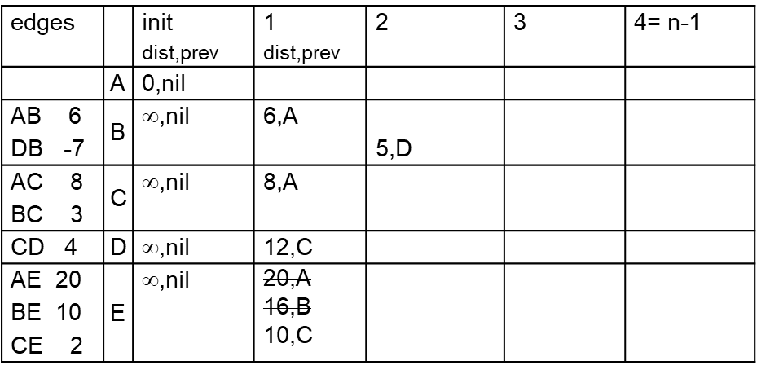
20
for all u in V:
dist[u] = ∞
prev[u] = nil
dist[s] = 0
repeat |V| −1 times:
for all (e₁,e₂)in E:
if dist[e₁] + len(e₁,e₂) < dist[e₂]
dist[e₂] = dist[e₁] + len(e₁,e₂)
prev[e₂ ]= e₁
B
10
3
−7
A
6
D
E
4
2
8
C
Each pass through the inner loop iterates through all the edges.
If we work through them downward in order by destination edge, it's easy to keep this in a table
where we can store dist[] and prev[] in columns, updating them each step.
|V|
|E|

Slide 12
20
BellmanFord(V,E,len;s)
?
B
−106
10
−7
3
6
A
D
E
4
2
8
C
for all u in V:
dist[u] = ∞
prev[u] = nil
dist[s] = 0
repeat |V| −1 times:
for all (e₁,e₂)in E:
if dist[e₁] + len(e₁,e₂) < dist[e₂]
dist[e₂] = dist[e₁] + len(e₁,e₂)
prev[e₂ ]= e₁
dist[e₁]
e₁
len(e₁,e₂)
s
e₂
dist[e₂]

Slide 13
Sect. 4.6.2 Negative cycles
Bellman-Ford does not work in the case where a graph has reachable negative cycles.
In fact, the shortest paths problem doesn’t even make sense in that case:
There would be vertices with distance -∞

Slide 14
Correctness of Bellman-Ford
Let s be the start node, and u any vertex.
By mathematical induction, after the i-th iteration of the main loop, dist(u) = the weight of the cheapest path from s to u that uses no more than i edges.
Since we assume no reachable negative cycles, the ultimate shortest path must use no more than |V| - 1 edges.

Slide 15
Sect. 4.6.2 Negative cycles
How to check whether reachable negative cycles exist?
- Run one extra iteration of the repeat loop in the Bellman-Ford algorithm. A reachable negative cycle exists if and only any of the dist values get updated.

Slide 16
Sect. 4.7 Shortest paths in dags
Bellman-Ford has a fairly high runtime: O(|V| ∙ |E|)
Are there any special cases under which we can handle the shortest paths problem more efficiently, even in the presence of negative weight edges?
Yes! – if the graph is a dag.

Slide 17
Sect. 4.7 Shortest paths in dags
Can we efficiently check whether a directed graph is indeed a dag?
Yes! (How?)
Run dfs on the graph and check whether it produces any backedges.
- The graph is cyclic iff it has a backedge.
Page 89 in Section 3.3.1 provides an easy criterion for checking whether an edge (u,v) is a backedge:
- It is a backedge iff pre(v) < pre(u) < post(u) < post(v)
- I.e. iff v was a parent of u in the dfs
v
backedge (u,v):
pre(v) < pre(u) < post(u) < post(v)
w
u

Slide 18
Sect. 4.7 Shortest paths in dags
procedure dag-shortest-paths(G,len,s) // Find shortest paths from s
for all u in V:
dist[u] = infinity
prev[u] = nil
dist[s] = 0
linearize G (i.e. topologically sort it – can use dfs as in Chapt 3)
for each u in V, in linearized order, starting from s:
for all edges (u,v) in E:
update(u,v)
Runtime:
O(|V| + |E|)
Even better than Dijkstra’s!

Slide 19
Summary: Finding shortest paths in directed graphs (single source)
if the graph is acyclic
run dag-shortest-paths – O(|V| + |E|)
else if all edges are non-negative
run Dijkstra’s algorithm – O((|V| + |E|) log|V|) (or better*)
else
run Bellman-Ford algorithm – O(|V| · |E|)
*depending on graph density and the priority queue implementation (as discussed in “Which heap is best?” on page 114/125)

