Slide 1
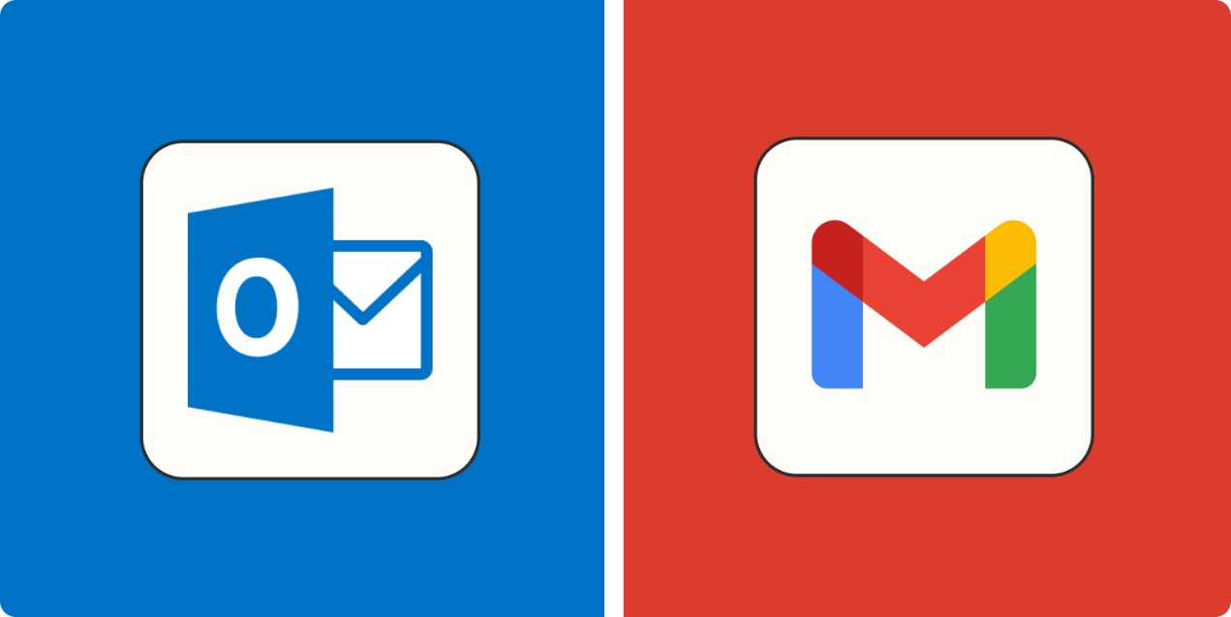
Configuring outlook live email on gmail via POP3. Here all the emails will be fetched by gmail from the outlook email address and will be displayed in the gmail inbox

Slide 2
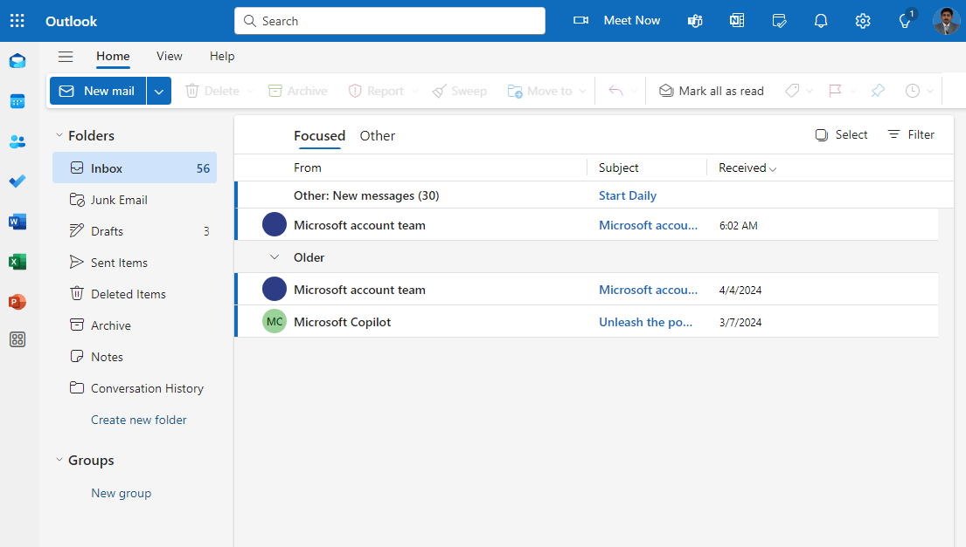
Log in to your Outlook Live account

Slide 3
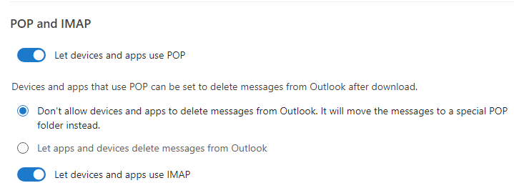
Go to Settings > Mail > Forwarding and IMAP
Enable “Let devices and apps use POP”

Slide 4
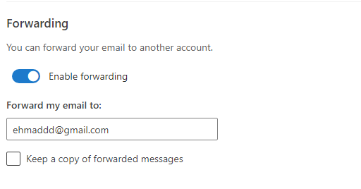
Go to Settings > Mail > Forwarding and IMAP
Enter email address to forward email

Slide 5
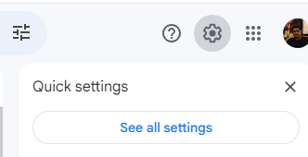
In gmail, Settings -> See all settings

Slide 6

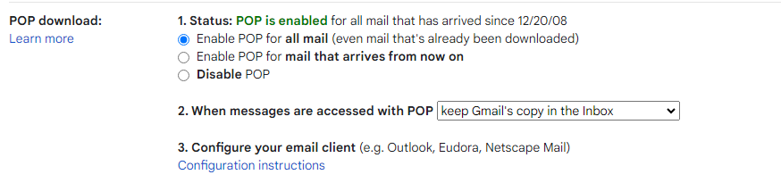

“Enable POP for all mail”
“Forwarding and POP/IMAP” tab

Slide 7


“Accounts and Import” tab
“Check mail from other accounts”

Slide 8
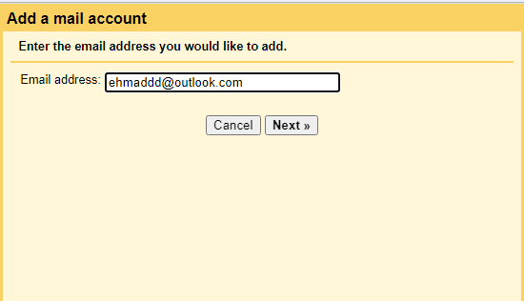
Enter e-mail address to fetch e-mails from

Slide 9
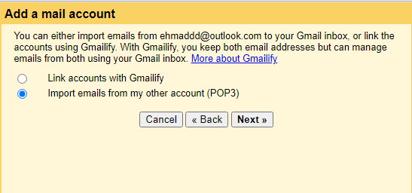
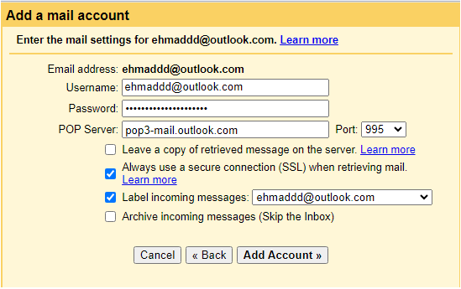
Select “Import emails from my other account (POP3)
POP Server
pop-mail.outlook.com
Port
995
Check
Always use a secure connection (SSL) when retrieving mail
Label incoming messages

Slide 10
Verify success

Slide 11
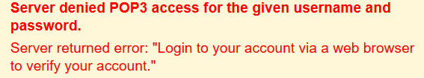
Go to the Outlook website and log in with your email and password
Click on your profile icon or name in the top right corner
Select View account or Account settings from the dropdown menu
Look for a section called Recent Activity or Security
Click on it to view recent login attempts and security challenges
This entry represents Gmail trying to access your Outlook account
Look for recent activity entries. You should find one with a location that isn’t your usual one (like the United States) and an IP address similar to 205.85.xxx.xxx (which is from Google’s server)

Slide 12
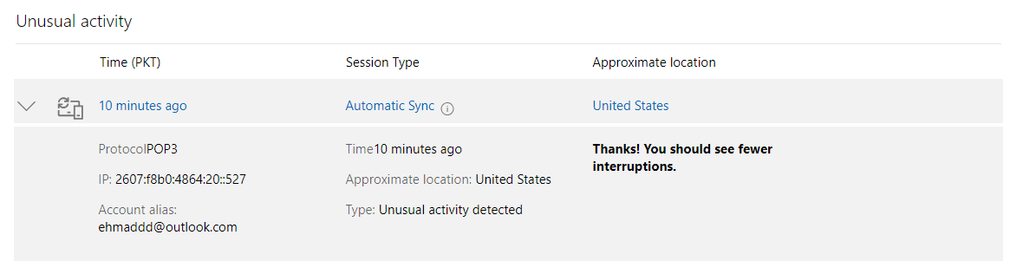
Click on the entry to expand it
Click "This was me" to approve the access attempt from Gmail
Try to add your Outlook account again or re-save the POP3 settings

