Slide 1
Exploring absences due to illness at Company X between 2017 - 2019
Dan, Mary, Erwin, Stef, Akash

Slide 2
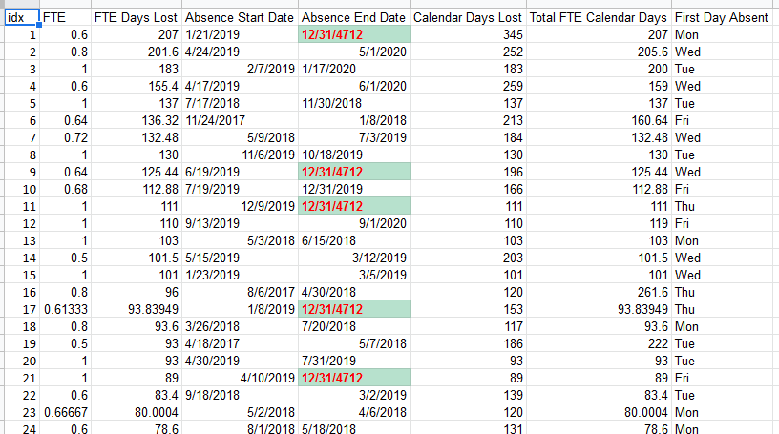

Slide 3
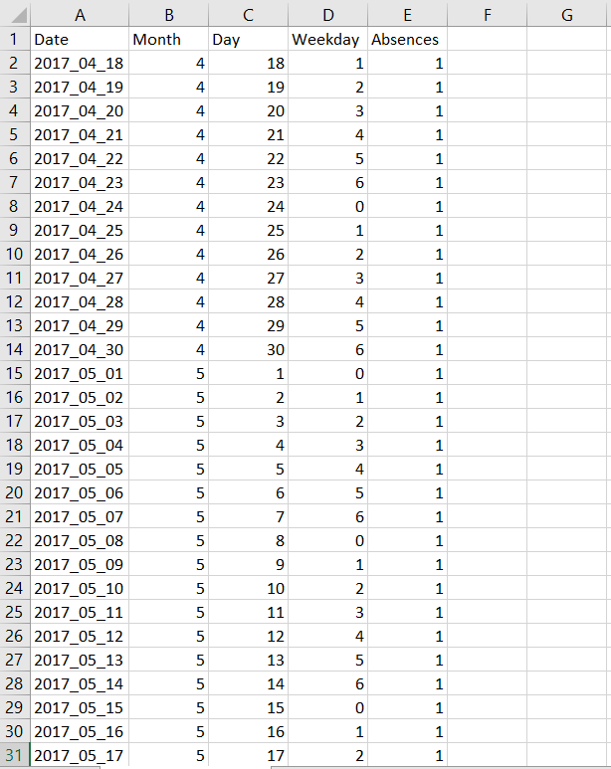

Slide 4
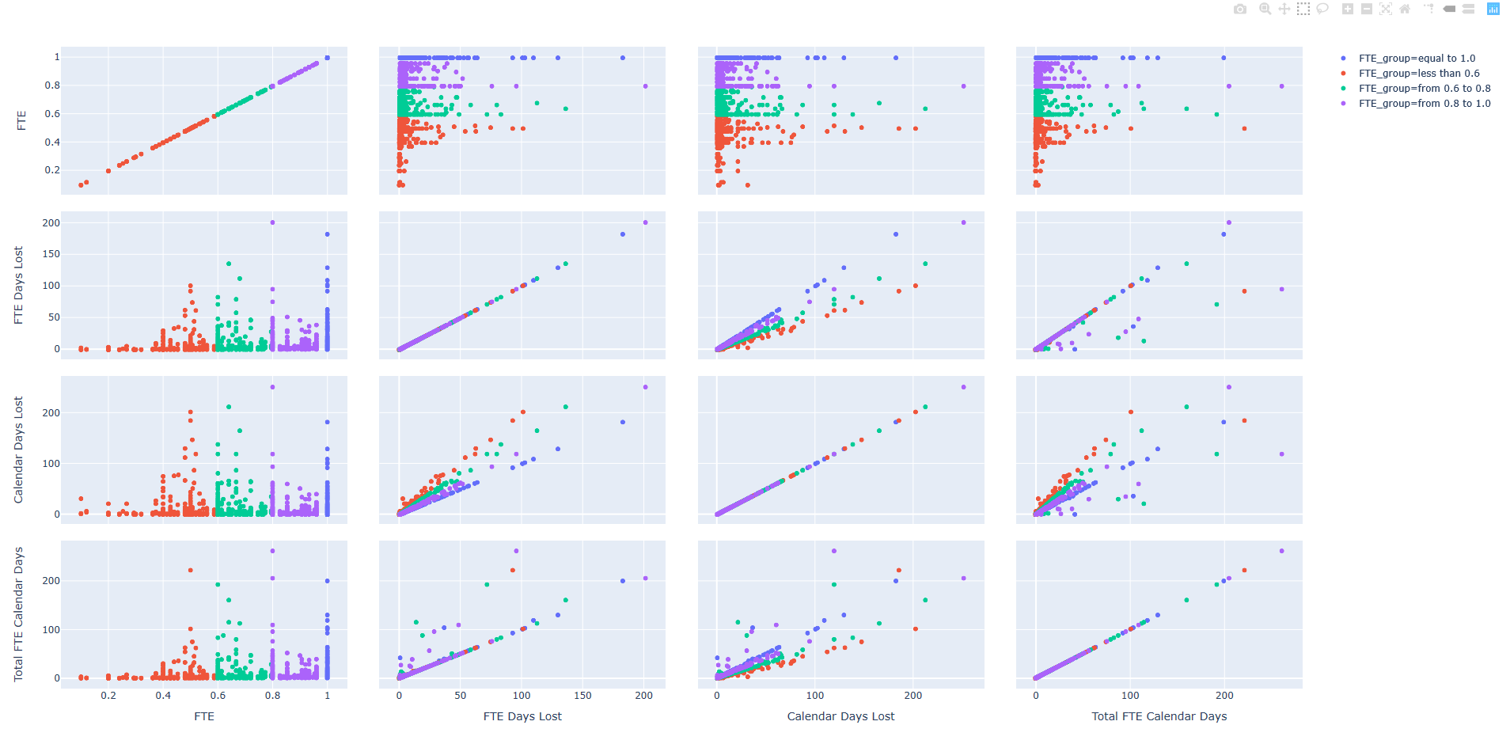

Slide 5
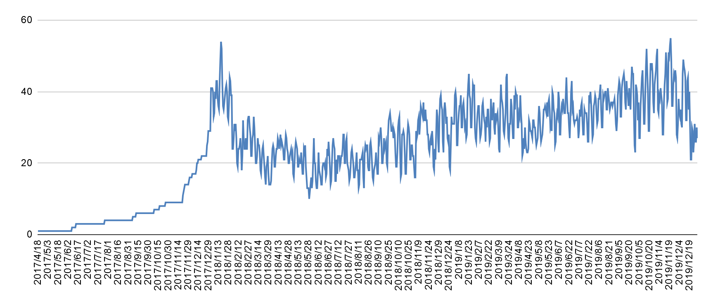
Notes:
Across 989 days, 1 to 55 people off sick
Avg 25 ppl sick per day
Max number of people off sick is 55, happened on 21 Nov 2019
NEWS ~ an NHS nurse stress suicide

Slide 6
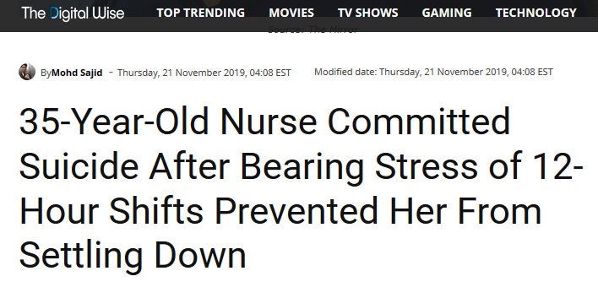

Slide 7
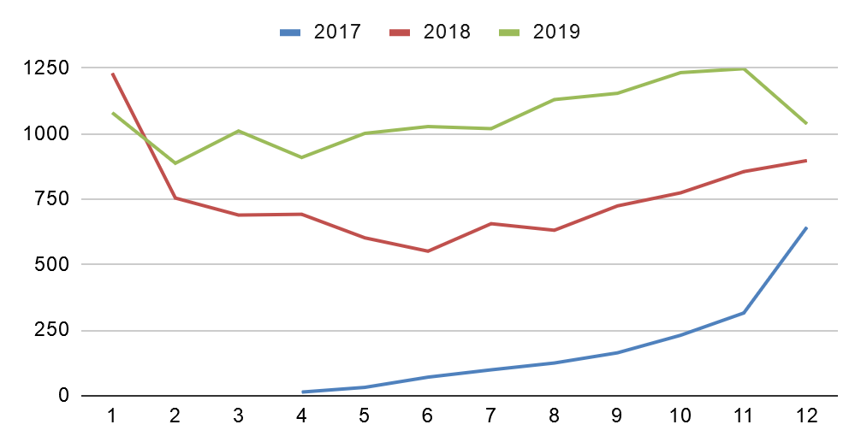
Notes:
Seasonality of people being off sick?

Slide 8
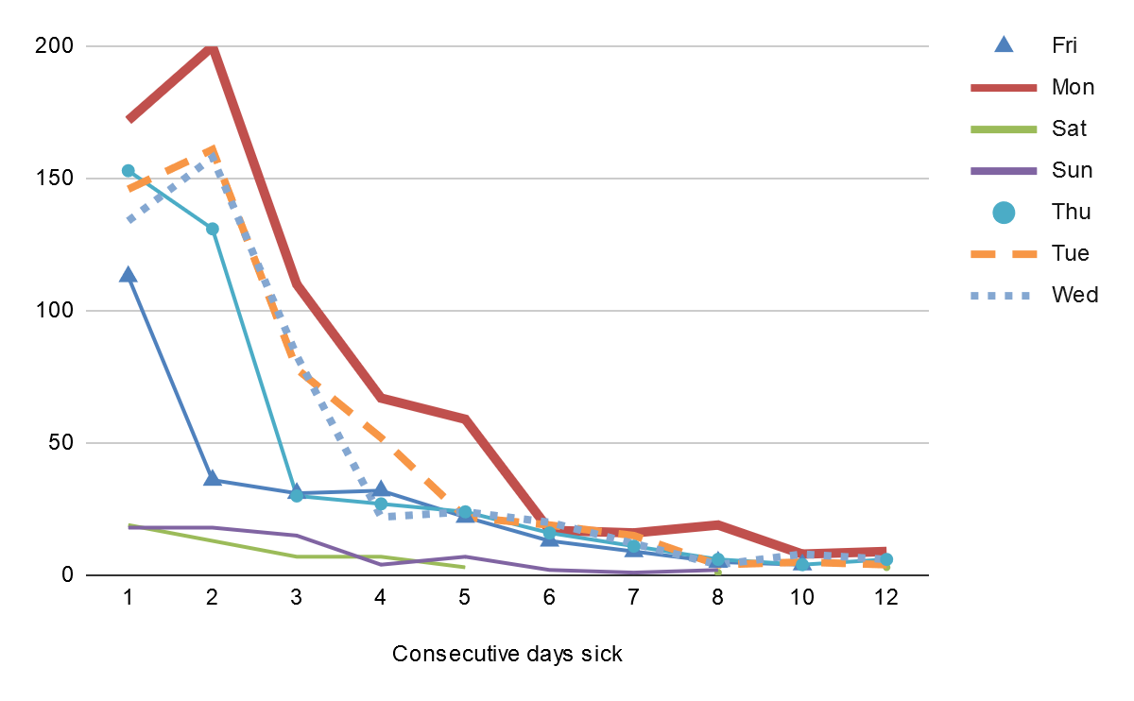
Notes:
Most people start being sick on Mondays
If start absence on Mon / Tues / Weds, most people take 2 days off.

Slide 9
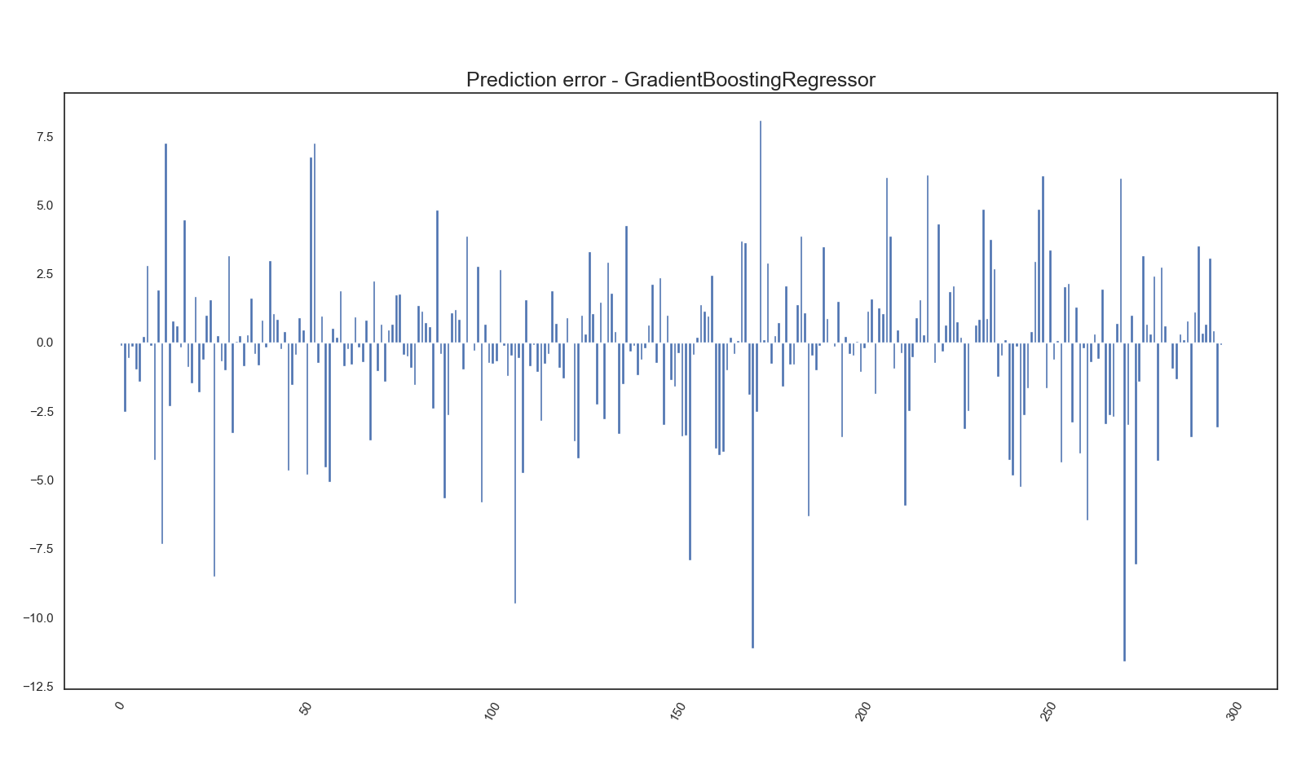

Slide 10
Things to investigate in the future
Any correlations between weather variables and number of absences on any given day
Introduce new parameters: annual leave, reason/classification, staff per patient ratio,
Illness absences correlation to sentiment analysis based on local/popular tweets of a day
Refinement of model selection

