Slide 1

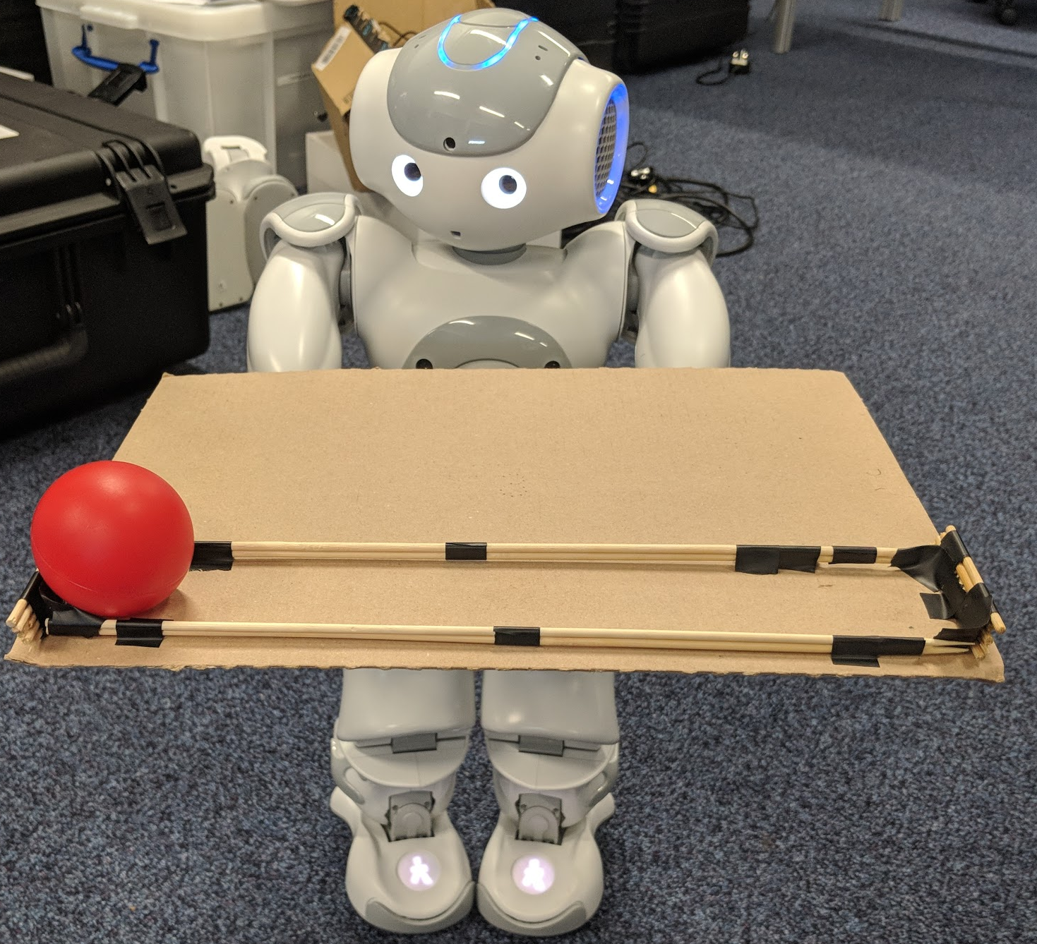

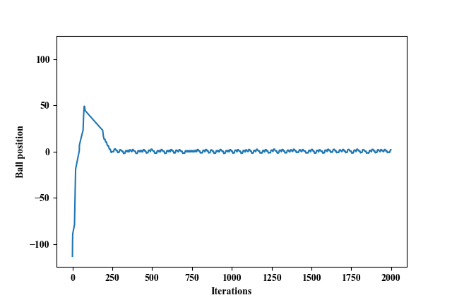
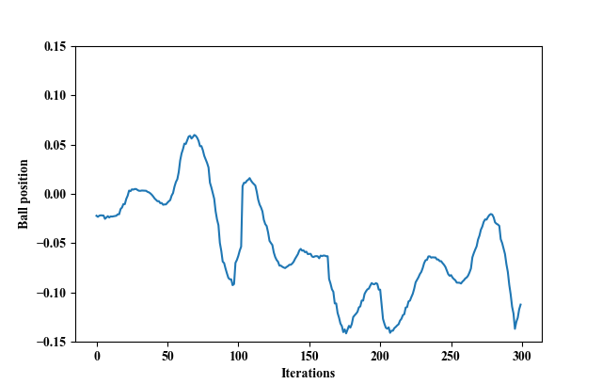
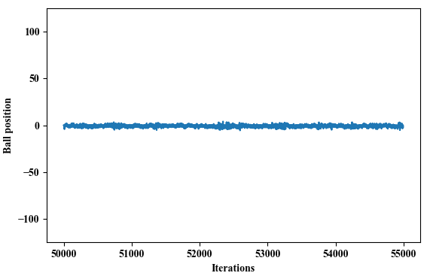
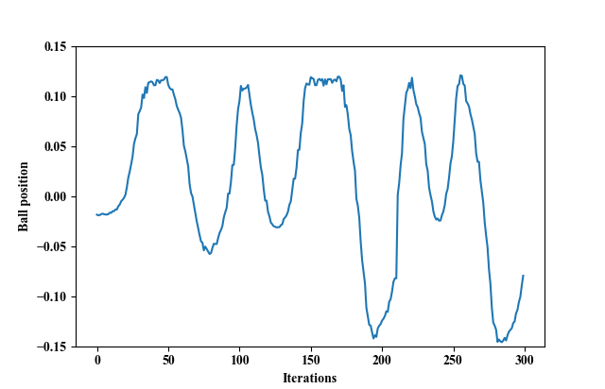
Investigation of Machine Learning Techniques for a Ball Balancing Task
Student: Edward Hockedy
Supervisor: Magnus Bordewich
BACKGROUND
Context
A difficult aspect of creating a robot is programming behaviour. Machine learning allows robots to learn behaviour without it needing to be explicitly programmed. However, training in this way can take a long time. Simulation can speed up this process.
The Task
The task is for a robot to learnt to balance a ball on a tray. The robot rotates the tray, moving the ball left or right.
Aims
Compare and evaluate different methods of machine learning as a way to complete the task
Analyse the suitability of using a simple simulation to learn behaviour that can be used by the robot
Explore techniques to improve performance on the robot
2. MACHINE LEARNING METHODS
Q-learning
A form of reinforcement learning, Q-learning makes learning agents interact with the environment, using the trial-and-error method to gather experience and train the action (decision) policy^{[1]}. Here, the agent chooses an action (tilt left or right) based off the current state it is in. It then gets a reward depending on how good the new state is.
Neural Network
A type of supervised learning, a neural network is a massively parallel combination of simple processing unit which can acquire knowledge from environment through a learning process and store the knowledge in its connections^{[2]}. The training data is generated by a user manipulating the tray and recording which actions were taken for each state.
3. TASK SETUP
The simulation is s simple 2D recreation of the setup with the robot. Figure 1 shows this. The robot in figure 2 is a Nao robot. It holds the tray with its arms. It can track the ball with the camera in its head.
5. Conclusion
In conclusion, both Q-learning and a neural network are good at learning to balance a ball. The simulated behaviour was not perfectly recreated with the robot. Out of the two, the neural network performed better as it was better at interpolating unseen states.
Figure 2. The robot with tray
Figure 1. The simulation
4. RESULTS
Q-learning
Results in the simulation were very good. Unfortunately, the performance on the robot was less good, but the general behaviour was still present.
Neural Network
Results in the simulation were also very good. Once again, performance was less good with the robot.
In an attempt to improve performance on the robot, delay was added to the simulation to mimic the robot’s slow response. This did not improve results. Experience replay was also explored. This uses state transition data from the robot, not the simulation. This also didn’t help.
Figure 4. Ball position over time after training with neural network in simulation left, on robot right.
Figure 3. Ball position over time after Q-learning in simulation left, on robot right.
6. REFERENCES
[1] Jin-Ling, L. & Kao-Shing, H. (2017), ‘Balancing and reconstruction of segmented postures for humanoid robots in imitation of motion’, IEEE Access (5), 17534–17542.
[2] Guresen, E. & Kayakutlu, G. (2011), ‘Definition of artificial neural networks with comparison to other networks’, Procedia Computer Science 3, 426 – 433. World Conference on Information Technology.

Slide 2
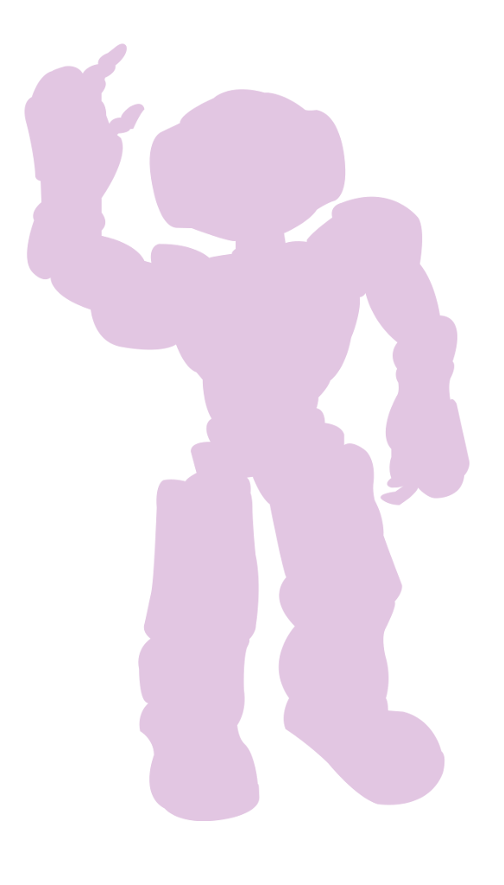
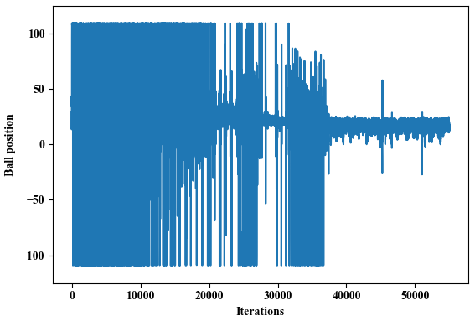
Investigation of Machine Learning Techniques for a Ball Balancing Task
Student: Edward Hockedy
Supervisor: Magnus Bordewich
BACKGROUND
Context
A difficult aspect of creating a robot is programming behaviour. Machine learning allows robots to learn behaviour without being explicitly programmed. However, training in this way can take a long time. Simulation can speed up this process.
Aims
Compare and evaluate different methods of machine learning for learning to balance a ball on a tray
Analyse the suitability of using a simple simulation to learn behaviour that can be used by the robot
Investigate techniques to improve performance with robot
4. Q-LEARNING RESULTS
Results in the simulation were very good. Unfortunately, the performance on the robot was less good, but the general behaviour was still present.
Figure 3. On the left is the ball position over time throughout training as it eventually converges. The right is performance on the robot.
2. THE TASK
The task is to balance a ball on a tray. To save time, training is done in simulation. The learnt behaviour model can then be used by the robot to make decisions about how to act when the given a state (ball position, ball velocity and tray angle). The simulation (figure 2) is a simple 2D recreation of the robot in figure 1. The robot holds the tray with its arms. It can track the ball with the camera in its head.
5. NEURAL NETWORK RESULTS
Results in the simulation were also very good. Once again, performance was less good with the robot.
In an attempt to improve performance on the robot, delay was added to the simulation to mimic the robot’s slow response. This did not improve results. Experience replay was also explored. This uses state transition data from the robot, not the simulation. This also didn’t help.
Figure 1. The robot with tray
Figure 4. Ball position over time after training with neural network in simulation left, on robot right.
Figure 2. The simulation
3. MACHINE LEARNING METHODS
Q-learning
A form of reinforcement learning, Q-learning makes learning agents interact with the environment, using the trial-and-error method to gather experience and train the action (decision) policy^{[1]}. Here, the agent chooses an action (tilt left or right) based off the current state it is in. It then gets a reward depending on how good the new state is.
Neural Network
A type of supervised learning, a neural network is a massively parallel combination of simple processing unit which can acquire knowledge from environment through a learning process and store the knowledge in its connections^{[2]}. The training data is generated by a user manipulating the tray and recording which actions were taken for each state.
6. CONCLUSION
In conclusion, both Q-learning and a neural network are good for learning to balance a ball. The simulated behaviour was not perfectly recreated with the robot, however it was very useful at speeding up the training process. Factors such as the capabilities of the robot and number of available actions were the cause of bad performance. Out of the two, the neural network performed better as it was better at interpolating unseen states.
7. REFERENCES
[1] Jin-Ling, L. & Kao-Shing, H. (2017), ‘Balancing and reconstruction of segmented postures for humanoid robots in imitation of motion’, IEEE Access (5), 17534–17542.
[2] Guresen, E. & Kayakutlu, G. (2011), ‘Definition of artificial neural networks with comparison to other networks’, Procedia Computer Science 3, 426 – 433. World Conference on Information Technology.

