Slide 1

Snowflake: new warehouse implementation
Fantastic 4: Ethan Hodys, Nitheesha Daka, Bhuwaneshwari Iyer, Siddharth Menon, Sreejith Sreekumaran Nair

Slide 2






Technologies

Slide 3

Business Case
Implement Modern Data Warehouse solution for 365 Retail Markets (https://365retailmarkets.com/)
Legacy siosks use Microsoft Stack with Sql Server and SSAS
Current Gen kiosks use Java and MariaDB (MySql clone)
Challenge is migration of data from two different types of date repositories (Sql Server / MySql)
Snowflake was chosen for Data Warehouse Solutoin
Consultant implemented migration of MySql data unacceptable
8 hours long snapshot replication using HADOOP running only once daily

Slide 4
Process flow
Web Apps
ADM
DBs
MariaDb
SnowFlake
SHQ
Sql Server
Data
Warhouse

Slide 5
Data flow: project implementation
Stitch
MariaDb Instance in AWS Lightsail
Data Connection
Snowflake Database
"BANA7034"
Tableau Snowflake Connector
Snowflake Warehouse
"BANA7034_WH"
Tableau Reports

Slide 6
Our implementation
Create 5 tables identical to 365 Retail Markets current MariaDB Schema
ORG / LOCATION /SALESHEADER / SALESITEM /
SALESPAYMENT
Extract existing April sales to CSV for all 5 tables
Import into our AWS Lightsail MariaDB instance via “CSV Connector” in Dbeaver
Stitch Integration setup to replicate data every 1 min into Snowflake Data Warehouse
Duplicate table implementation in Snowflake
Setup and Configure new Datawarehouse for project in Snowflake

Slide 7
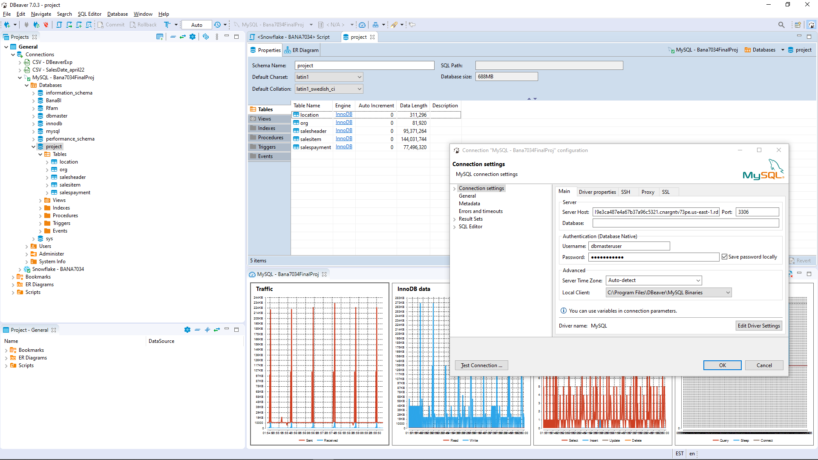
Aws lightsail implementation
Dbeaver screenshot showing connections to MariaDb instance (Bana7034FinalProj) and Snowflake (BANA7034)

Slide 8
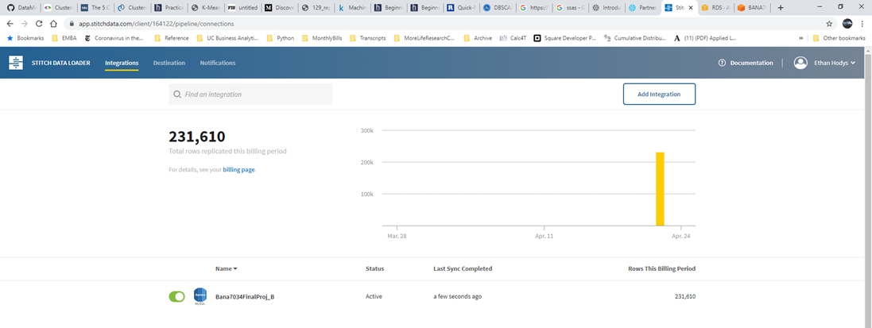
Stitch data implementation
Total records we migrated from MariaDB

Slide 9
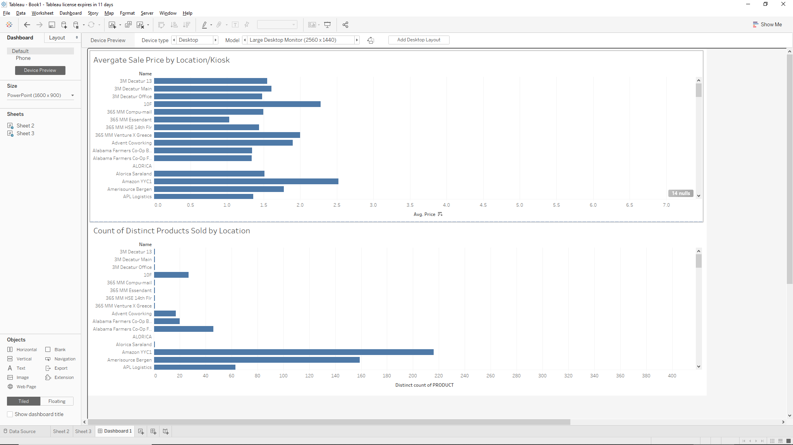
Tableau dashboard: Snowflake connector
Average Sale Price by Location
Distinct Product Count by Location

