Slide 1

Minimum wage sentiment analysis
Ethan Hodys / Vincent chiang

Slide 2
Sociological Metrics
Educational Attainment¹: The data is based on the responses to the American Community Survey. The percentage represents the number of individuals that have earned a bachelor's degree or higher. Sourced from Wikipedia (2009).
Peace Index¹: The US state index is based on an analysis of homicide violent crime policing incarceration rates and the availability of small arms. The data is inverted and refactored for percentages instead of a numerical score. The higher the percentage the more peaceful a state is considered. Sourced from Vision of Humanity (2010).
Above Poverty Rate¹: The percentages represent the number of households per state that are living above the poverty rate (by household income). Sourced from Wikipedia (2008) and originally from the United States Census Bureau.

Slide 3
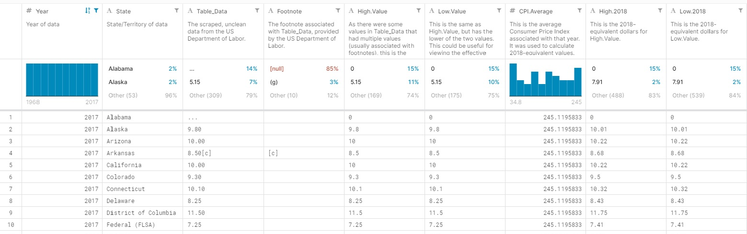
Minimum wage data

Slide 4
Final DatASET
[Percent_Above_Poverty_Rate]
[Percent_Educational_Attainment]
[Percent_Peace_Index]
[StateName]
[StateCode]
[MinWageTable_Data]
[MinWageFootnote]
[MinWageHigh_Value]
[MinWageLow_Value]
[MinWageCPI_Average]
[MinWageHigh_2018]
[MinWageLow_2018]
[DiabetesRATE]
[DiabetesDEATHS]
[HypertensionRATE]
[HypertensionDEATHS]
[KidneyRATE]
[KidneyDEATHS]
[TeenBirthsRATE]
[SunPercentage]
[Suntotal]
[SunClearDays]

Slide 5
Methodology
Regression Tree
GAM
Repeat with Sunshine replacing Wage
Response variables
Educational Attainment
Peace Index
Above Poverty Line

Slide 6
Methodology - Continued

Slide 7
Conclusion and future work

