Slide 1
Statistics for Computational Biology Projects
Erica Holdmore
DFCI Department of Data Sciences
March 27, 2024 – 10am-12pm
Notes:
Talk + Q&A: 50 minutes
Activities: 1 hour
Break: 10 minutes

Slide 2
Introduction to Stats and Computational Biology

Slide 3
Computational Biology and Its Applications
Seeks to understand biological systems and their relationships through data analysis, mathematical modeling, and other quantitative tools.
Often applied to understand:
Population genomics
Evolutionary genomics & proteomics
Regulatory & metabolic networks
Gene-disease associations
Biomedical imaging analysis
Infectious disease dynamics
Many more!

Slide 4
Statistics in Computational Biology
Computational biology approaches typically generate large amounts of data.
Purpose of data analysis is to identify patterns and trends in biological data.
Allows us to rigorously test hypotheses about biological processes and their relationships.
Helps estimate parameters, fit models, and validate models and simulations.
Provides guidance on appropriate experimental design.
Can be used to make predictions and guide future research directions.

Slide 5
Beginning a Project with Statistics in Mind
Can provide advice about aspects of experimental design.
Sample size
Replication
Randomization & Controls
Batch effects
Important to plan appropriate analyses before an experiment begins.
Increase power of analyses
Reduce likelihood of Type II error (”false negatives”)

Slide 6
Beginning a Project with Statistics in Mind
Important to plan appropriate analyses before an experiment begins.
A Priori Analysis
Post hoc Analysis
“Prospective”, “planned”
Hypothesis-driven
Increased power against Type II error
More thoughtful research design
Not always possible
“Posteriori”, “unplanned”
Exploratory
Provides insight and generates ideas
Need to adjust significance value for multiple comparisons
Interpret with caution
Not advised for estimating treatment effect in randomized clinical trials
Notes:
Helpful: https://typeset.io/questions/what-are-the-advantages-and-disadvantages-of-each-post-hoc-2y0f3tm72p
Refer to https://eric.ed.gov/?id=ED364597 for a demonstration of advantages of planned comparisons

Slide 7
Workshop Outline
Experimental Design
Probability Distributions & Data Cleaning
Statistical Inference
Statistical Methods for Genomics
Interpretation & Data Visualization
Ethical Considerations & Challenges
Wrap-up and Q&A
Notes:
My intent is to provide a practical overview, so I will not get into nitty gritty theory, derivations, or equations. See Works Cited and Further Reading if you want to know more!

Slide 8
Experimental Design

Slide 9
General Considerations for Experimental Design
Appropriate controls
Sample size
Replication strategy
Batch Effects

Slide 10
Appropriate Controls
Control minimize the effects of all variables other than the one(s) being tested.
How do we design an experiment with good controls?
Make observations
Know your study system
Have a clear hypothesis
Select a specific, measurable independent variable
Decide on appropriate control groups
Include randomization where appropriate
Monitor controls throughout experiment
Notes:
Control group should be as similar as possible to experimental group in every way other than the independent variable being tested

Slide 11
Experimental Replication & Pseudoreplication

Slide 12
Record keeping

Slide 13
Sample Size
Notes:
Cover sample size, then elude to power analysis/effect size and note we’ll talk about it later in the workshop.

Slide 14
Power & Effects size
Power = the probability that a statistical test will reject a false null hypothesis
A larger sample size provides more power, meaning your statistical test is more likely to detect an effect.
Effect size = the absolute difference between groups + variability
Cohen (1988) provides cutoffs for effects sizes as:
small ≥ 0.02,
medium ≥ 0.15
large ≥ 0.35
Notes:
May want to move this after statistical methods section?? After we talk about null hypotheses and each of these tests?
Helpful: https://www.bioinformatics.babraham.ac.uk/training/R_Statistics/Power%20Analysis%20with%20R.pdf

Slide 15
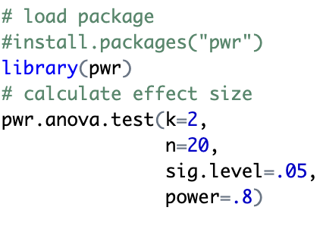
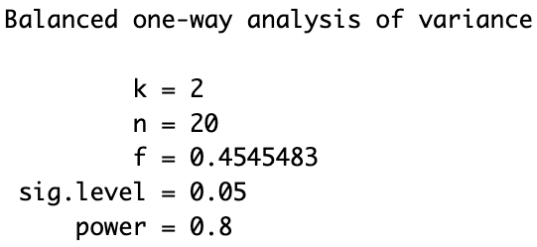
Activity 1: Power Analysis in R
Input:
The ‘pwr’ package (Champley 2020) can perform power analyses for a variety of common statistical test.
Enter three of the four parameters (effect size, sample size, significance level, power) as well as your number of groups and the fourth is calculated.
On the right is an example power analysis for ANOVA.
Note that sample size is per group!
Output:

Slide 16
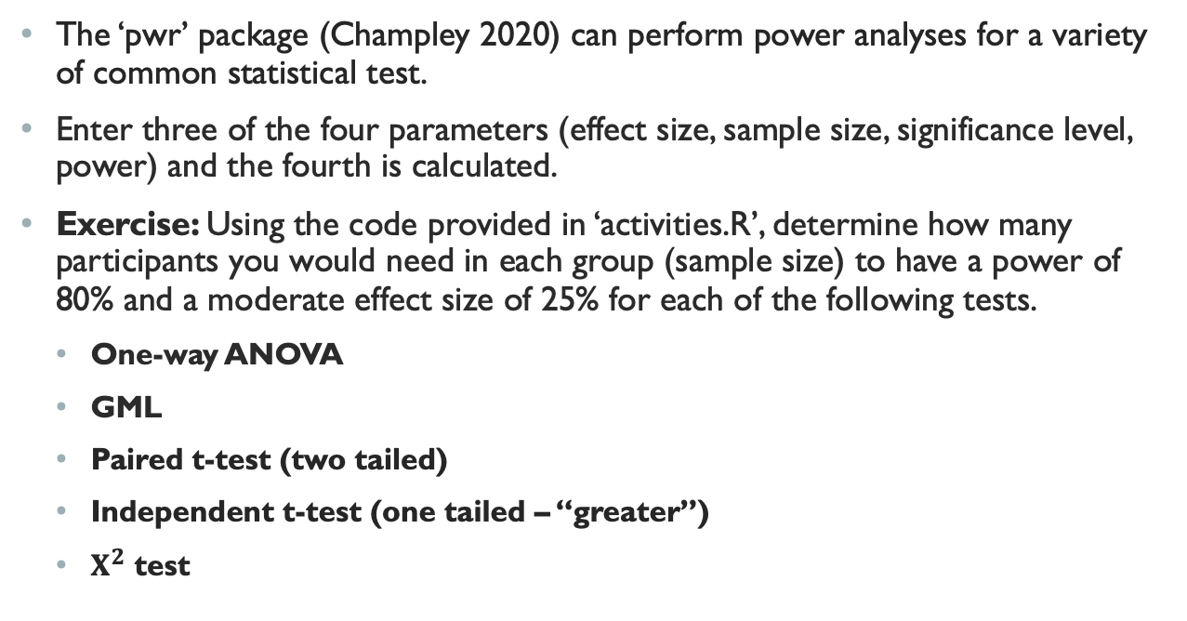
Activity 1: Power Analysis in R
The ‘pwr’ package (Champley 2020) can perform power analyses for a variety of common statistical test.
Enter three of the four parameters (effect size, sample size, significance level, power) and the fourth is calculated.
Exercise: Using the code provided in ‘activities.R’, determine how many participants you would need in each group (sample size) to have a power of 80% and a moderate effect size of 25% for each of the following tests.
One-way ANOVA
GML
Paired t-test (two tailed)
Independent t-test (one tailed – “greater”)
$Χ^{2}$ test
Notes:
10 minutes

Slide 17
Probability, Probability Distributions, and Data Cleaning

Slide 18
Basic Probability Concepts

Slide 19
Common Probability Distributions in Computational Biology

Slide 20
Activity 2: Probability in Computational Biology
Interactive simulation
Notes:
Quick: 5 minutes tops

Slide 21
Transformations

Slide 22
Outlier Analysis

Slide 23
Zero-Inflated Data

Slide 24
Statistical Inference

Slide 25
Basics of Hypothesis Testing

Slide 26
Confidence Intervals

Slide 27
5-Minute Break
Stretch, use the restroom, grab a snack!
Meeting back here shortly.

Slide 28
Statistical Methods for Genomics

Slide 29
Types of Data in Genomics

Slide 30
Common Analysis Methods: Logistic Regression

Slide 31
Common Analysis Methods: ANOVA & GMLs

Slide 32
Common Analysis Methods: Multiple Comparisons

Slide 33
Activity 3: Multiple Comparisons
Hands-on multiple comparisons analysis
Notes:
10-15 minutes

Slide 34
Interpretation and Data Visualization

Slide 35
What is a p-value?

Slide 36
How to interpret Significance Values

Slide 37
Measures of Effect: Direction and Magnitude

Slide 38
Principles of Data Visualization

Slide 39
Visualization Techniques for Genomics

Slide 40
Activity 4: Data Visualization
Design and create visualization with real genomic data
Group discussion on best practices and interpretation
Notes:
20 minutes

Slide 41
Ethical Considerations and Challenges

Slide 42
Ethics of Handling and Analyzing Biological Data

Slide 43
Challenges and Limitations

Slide 44

American Statistical Association Ethical Guidelines

Slide 45
Activity 5: Ethical Dilemmas
Case studies and group discussions
Notes:
10 minutes

Slide 46
Wrap-up and Q&A

Slide 47
Key Takeaways

Slide 48
Questions?
Thank you!

