Slide 1
Statistics for Computational Biology Projects
Erica Holdmore
DFCI Department of Data Sciences
March 27, 2024 – 10am-12pm
Notes:
Talk + Q&A: 50 minutes
Activities: 1 hour
Break: 10 minutes

Slide 2
Introduction to Stats and Computational Biology

Slide 3
Computational Biology and Its Applications
Seeks to understand biological systems and their relationships through data analysis, mathematical modeling, and other quantitative tools.
Often applied to understand:
Population genomics
Evolutionary genomics & proteomics
Regulatory & metabolic networks
Gene-disease associations
Biomedical imaging analysis
Infectious disease dynamics
Many more!

Slide 4
Statistics in Computational Biology
Computational biology approaches typically generate large amounts of data.
Purpose of data analysis is to identify patterns and trends in biological data.
Allows us to rigorously test hypotheses about biological processes and their relationships.
Helps estimate parameters, fit models, and validate models and simulations.
Provides guidance on appropriate experimental design.
Can be used to make predictions and guide future research directions.

Slide 5
Beginning a Project with Statistics in Mind
Can provide advice about aspects of experimental design.
Sample size
Replication
Randomization & Controls
Batch effects
Important to plan appropriate analyses before an experiment begins.
Increase power of analyses
Reduce likelihood of Type II error (”false negatives”)

Slide 6
Beginning a Project with Statistics in Mind
Important to plan appropriate analyses before an experiment begins.
A Priori Analysis
Post hoc Analysis
“Prospective”, “planned”
Hypothesis-driven
Increased power against Type II error
More thoughtful research design
Not always possible
“Posteriori”, “unplanned”
Exploratory
Provides insight and generates ideas
Need to adjust significance value for multiple comparisons
Interpret with caution
Not advised for estimating treatment effect in randomized clinical trials
Notes:
Helpful: https://typeset.io/questions/what-are-the-advantages-and-disadvantages-of-each-post-hoc-2y0f3tm72p
Refer to https://eric.ed.gov/?id=ED364597 for a demonstration of advantages of planned comparisons

Slide 7
Workshop Outline
Experimental Design
Probability Distributions & Data Cleaning
Statistical Inference
Statistical Methods for Genomics
Interpretation & Data Visualization
Ethical Considerations & Challenges
Wrap-up and Q&A
Notes:
My intent is to provide a practical overview, so I will not get into nitty gritty theory, derivations, or equations. See Works Cited and Further Reading if you want to know more!

Slide 8
Experimental Design

Slide 9
General Considerations for Experimental Design
Appropriate controls
Replication
Sample size
Batch Effects

Slide 10
Appropriate Controls
Control minimize the effects of all variables other than the one(s) being tested.
How do we design an experiment with good controls?
Make observations
Know your study system
Have a clear hypothesis
Select a specific, measurable independent variable
Decide on appropriate control groups
Include randomization where appropriate
Monitor controls throughout experiment
Notes:
Control group should be as similar as possible to experimental group in every way other than the independent variable being tested

Slide 11
Sample Size & Replicates
Sample = subset designed to represent the population being studied
Replicates = multiple experimental runs under the same treatment
Proper replication is an essential component of any experiment.
Ensures conclusions about experimental treatments are reliable
Provides information about natural variability in response variables
Notes:
Cover sample size, then allude to power analysis/effect size and note we’ll talk about it later in the workshop.

Slide 12
Pseudoreplication & Batch Effects
Psuedoreplication = "the use of inferential statistics to test for treatment effects with data from experiments where either treatments are not replicated (though samples may be) or replicates are not statistically independent.” (Hurlbert 1984)
Should be avoided or, when unavoidable, statistically accounted for using a repeated measures test.
Example: A study participant’s blood pressure is taken before being administered a blood pressure lowering drug. Their blood pressure is taken again 10 minutes and 60 minutes after the drug is administered.
Notes:
Many different statistical tests will have a “repeated measures” version to account for these designs.
See “further reading” for some useful demos in R.

Slide 13
Record keeping

Slide 14
Power & Effects size
Power = the probability that a statistical test will reject a false null hypothesis
A larger sample size provides more power, meaning your statistical test is more likely to detect an effect.
Effect size = the absolute difference between groups + variability
Cohen (1988) provides cutoffs for effect sizes as:
Small ≥ 0.02,
Medium ≥ 0.15
Large ≥ 0.35
Notes:
May want to move this after statistical methods section?? After we talk about null hypotheses and each of these tests?
Helpful: https://www.bioinformatics.babraham.ac.uk/training/R_Statistics/Power%20Analysis%20with%20R.pdf

Slide 15
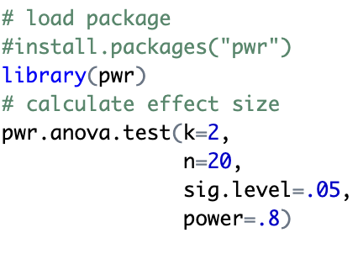
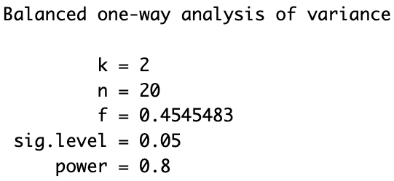
Activity 1: Power Analysis in R
Input:
The ‘pwr’ package (Champley 2020) can perform power analyses for a variety of common statistical test.
Enter three of the four parameters (effect size, sample size, significance level, power) as well as your number of groups and the fourth is calculated.
On the right is an example power analysis for ANOVA.
Note that sample size is per group!
Output:

Slide 16
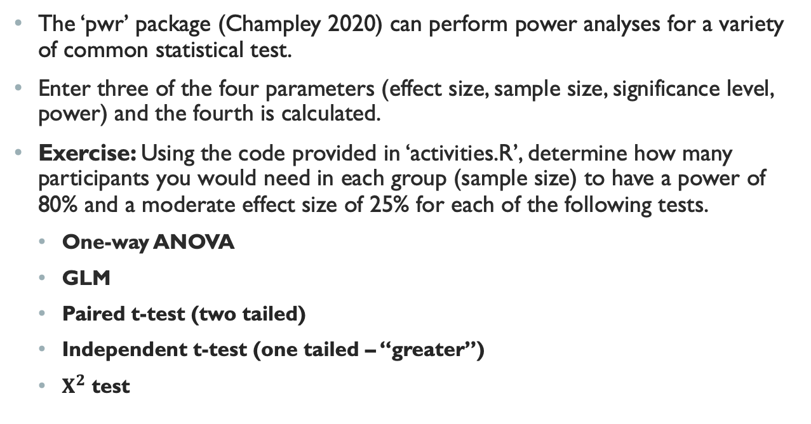
Activity 1: Power Analysis in R
The ‘pwr’ package (Champley 2020) can perform power analyses for a variety of common statistical test.
Enter three of the four parameters (effect size, sample size, significance level, power) and the fourth is calculated.
Exercise: Using the code provided in ‘activities.R’, determine how many participants you would need in each group (sample size) to have a power of 80% and a moderate effect size of 25% for each of the following tests.
One-way ANOVA
GLM
Paired t-test (two tailed)
Independent t-test (one tailed – “greater”)
$Χ^{2}$ test
Notes:
10 minutes

Slide 17
Probability, Probability Distributions, and Data Cleaning

Slide 18
Basic Probability Concepts
Probability is an area of mathematics that deals with the likelihood of events occurring.
Many statistical concepts are based upon probability including:
Sampling
Hypothesis testing
Significance values
Error & confidence
Course GitHub includes suggested reading on probability.

Slide 19
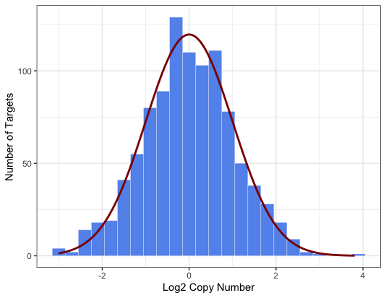
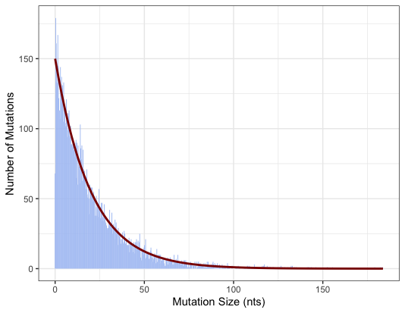
Probability Distributions
Normal Distribution
used to model log2 copy
number ratios
In statistics, we use probability distributions to model ”random” variables and quantify uncertainty.
Fitting observed data to specific distributions allows for predictions, inferences, and simulations about populations.
Exponential Distribution
used to model the size of
mutations

Slide 20
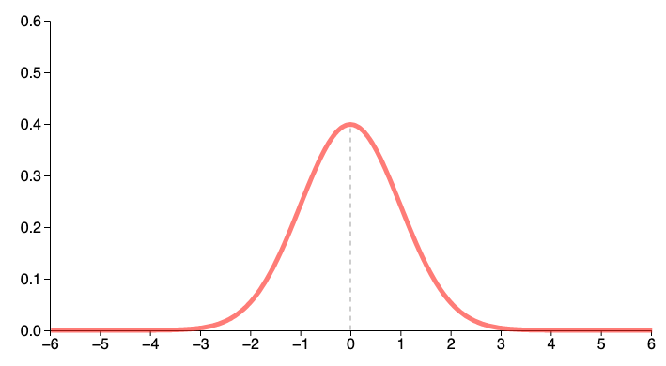
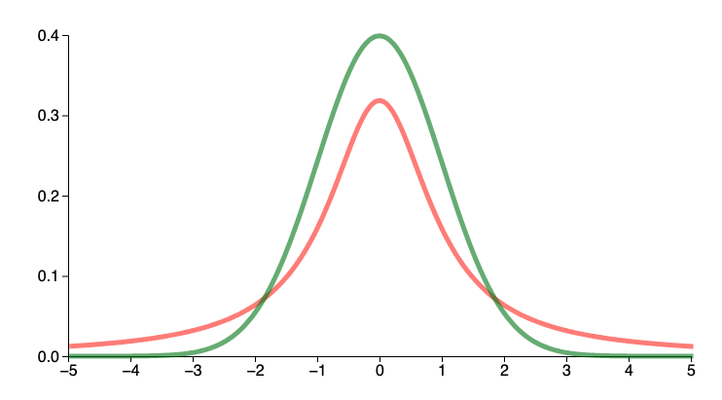
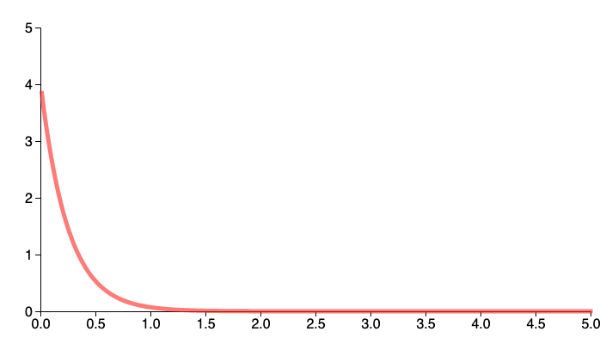
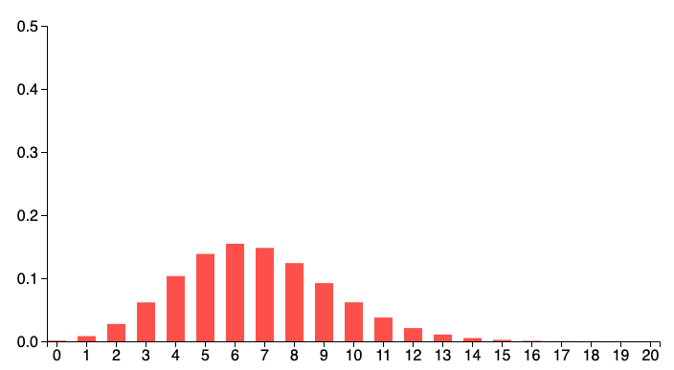
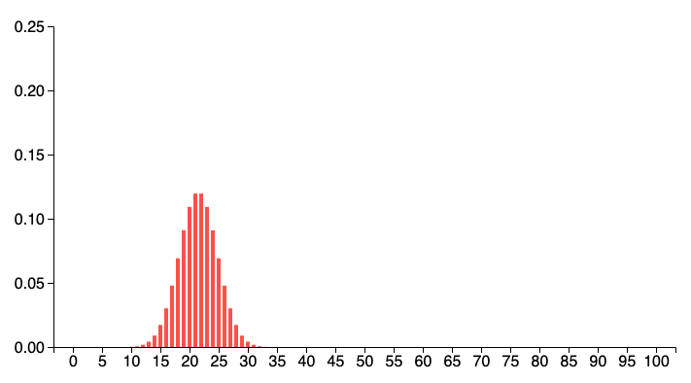
Common Probability Distributions in Computational Biology
Adapted from S. Glen (2020)
Continuous
Discrete
Distribution
Normal
Student’s T
Exponential
Poisson
Binomial
Appearance
Characteristics
Bell shape
Shorter, wider
Long left tail
Integer values
Two outcomes
Example Data
Height, weight, test scores
Small sample size
Time between events
Number of events
“Coin toss”
Application
Least squares & uncertainty
Unknown variance
Continuous-time Markov chain
Waiting time between events
Anytime data is binary

Slide 21
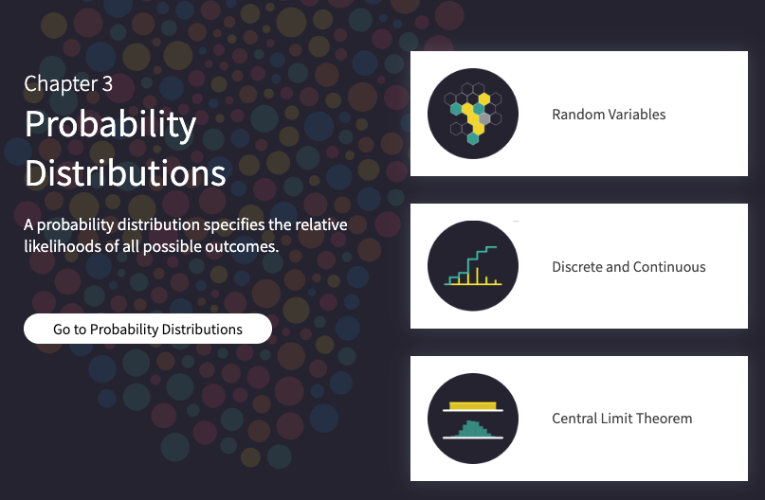
Activity 2: Probability in Computational Biology
Interactive simulation
https://seeing-theory.brown.edu/probability-distributions/index.html
Additional resource:
https://probstats.org/
Notes:
Quick: 5 minutes tops

Slide 22
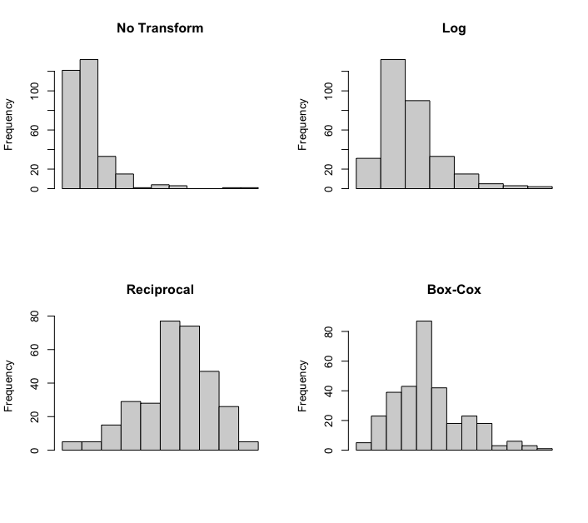
Transformations
Data transformation = applying the same deterministic function to all data points to facilitate statistical inference and/or interpretation
For example, many statistical tests assume data is normally distributed.
Right skewed distributions are the most common in biological data.
Use tests such as Shapiro-Wilk to rigorously tests for deviations for normality.
Notes:
Note: you may need to take additional steps when transforming data that includes zeros (e.g. log(0) will return Inf)

Slide 23
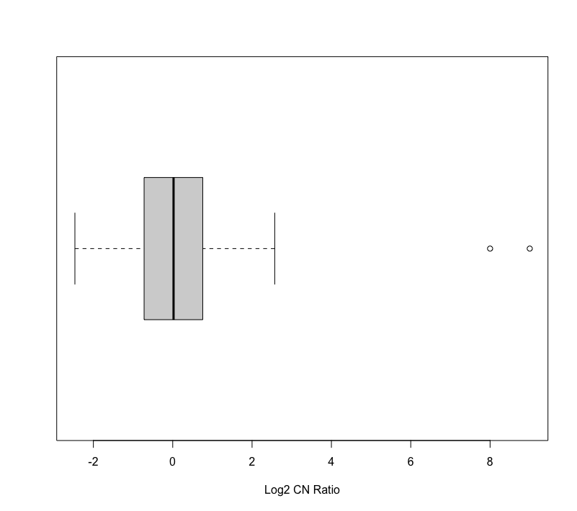
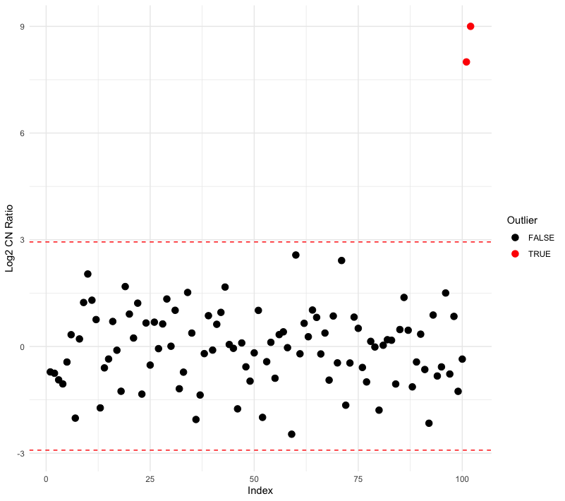
Outlier Analysis
Outlier analysis seeks to identify and evaluate data points that are unusually far away from the mean of a dataset.
Outliers may be caused by:
Experimental error
High variability (noise)
Something genuinely biologically interesting!
Methods for detecting outliers:
Descriptive: interquartile range (IQR), boxplot, Tukey
Significance Tests: Grubbs’, Dixon’s, Rosner
Unsupervised Clustering: DBSCAN
Plots adapted from Diachkov (2024)
Notes:
Descriptive methods: univariate

Slide 24

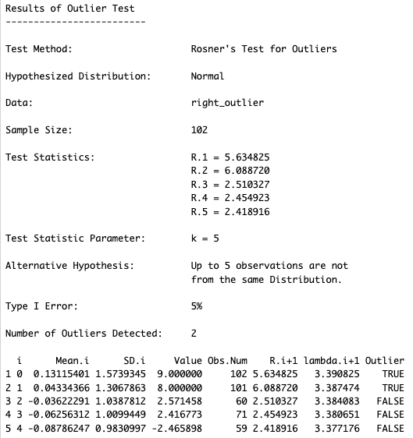
Outlier Analysis
Outlier analysis seeks to identify and evaluate data points that are unusually far away from the mean of a dataset.
Outliers may be caused by:
Experimental error
High variability (noise)
Something genuinely biologically interesting!
Methods for detecting outliers:
Descriptive: interquartile range (IQR), boxplot, Tukey
Significance Tests: Grubbs’, Dixon’s, Rosner
Unsupervised Clustering: DBSCAN
Notes:
Significance tests: univariate, some can only test 1 outlier at a time, assume normality

Slide 25
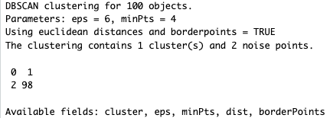
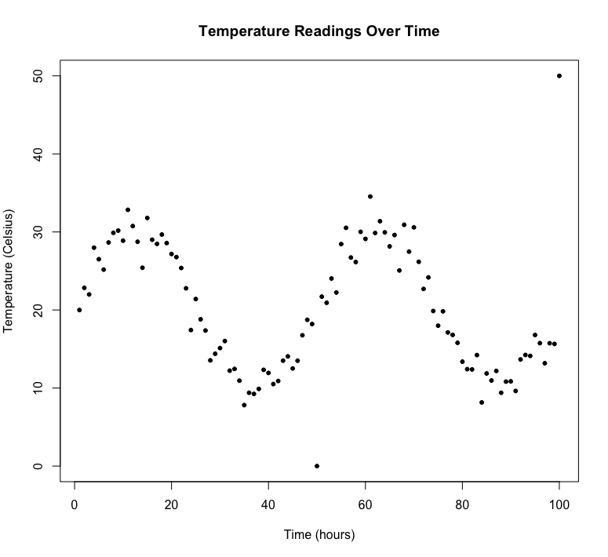
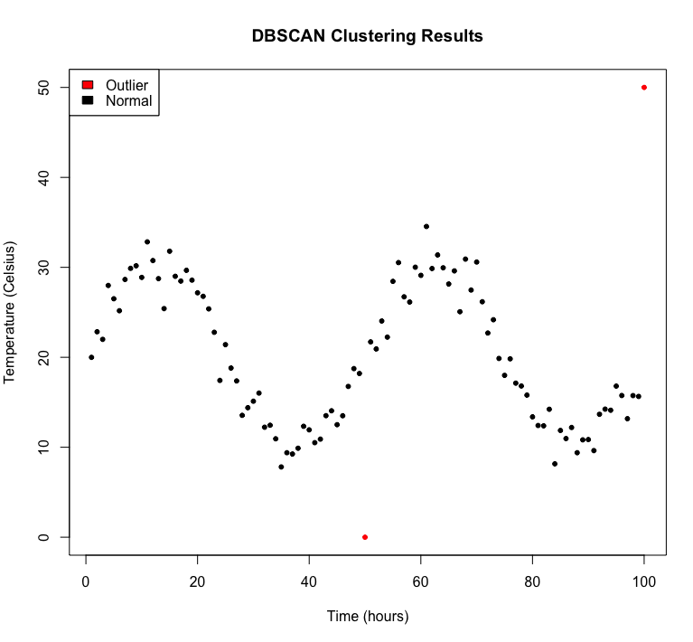
Outlier Analysis
Outlier analysis seeks to identify and evaluate data points that are unusually far away from the mean of a dataset.
Outliers may be caused by:
Experimental error
High variability (noise)
Something genuinely biologically interesting!
Methods for detecting outliers:
Descriptive: interquartile range (IQR), boxplot, Tukey
Significance Tests: Grubbs’, Dixon’s, Rosner
Unsupervised Clustering: DBSCAN
Plots adapted from Diachkov (2024)
Notes:
Unsupervised Clustering: multivariate, no assumptions about underlying distribution, Density-Based Spatial Clustering of Applications with Noise

Slide 26
Outlier Analysis
Quick demo of Grubbs’ test and DBSCAN
https://www.graphpad.com/quickcalcs/grubbs1/
https://builtin.com/data-science/how-find-outliers-examples

Slide 27
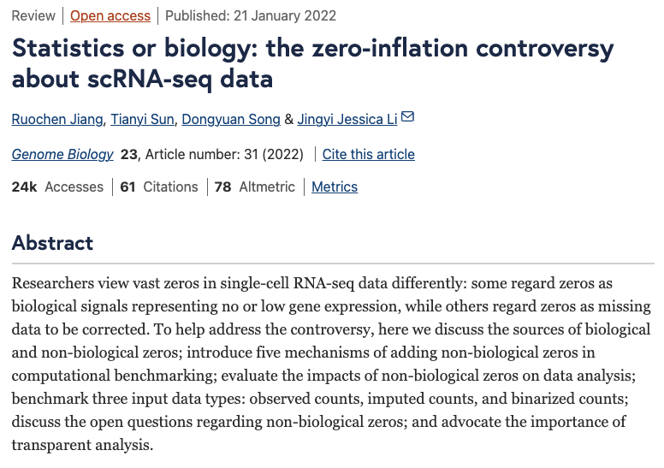
Zero-Inflated Data
There are many reasons why your data may contain many zeros.
Zero adverse effects
Zero copy-number alterations
Zero expression of certain markers
If the number of zeros in a dataset exceed what is expected by a Poisson distribution (or negative binomial), it is considered zero-inflated.
There are many methods for dealing with zero-inflated data but lets like a look at one: generalized linear models (GLMs).
Notes:
How do I know if my data is “zero-inflated”? A quick check on the % of values that are 0’s is a good place to start.

Slide 28
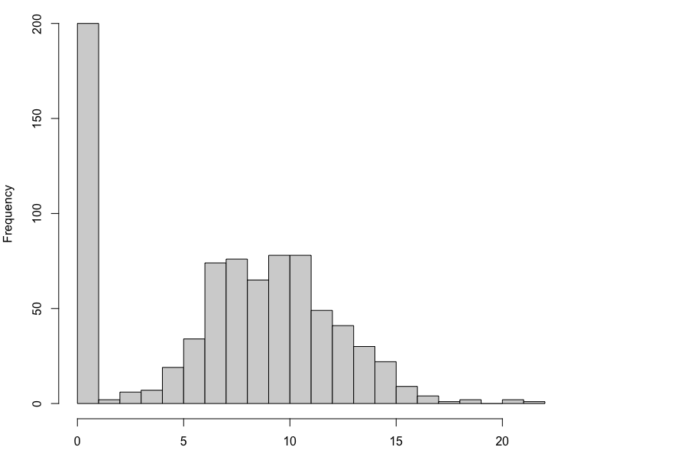
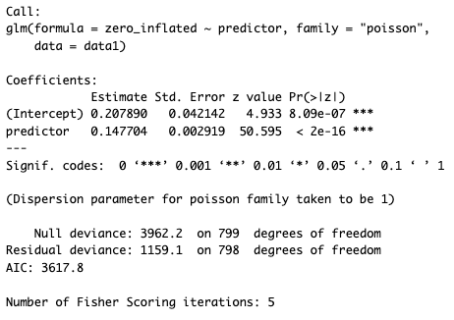
GLMs for Zero-Inflated Data

Slide 29
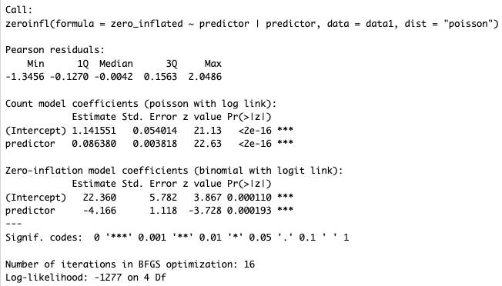
GLMs for Zero-Inflated Data

Slide 30
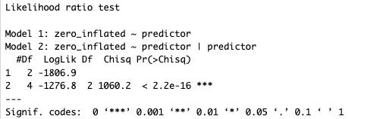
GLMs for Zero-Inflated Data
Standard GLM
Zero-inflated GLM
Notes:
Compare two tests with likelihood ratio test

Slide 31
Statistical Inference

Slide 32
Testing for Differences
One of the most common tasks in statistics is comparing 2+ sets of samples.
Healthy vs disease
Treatment vs placebo
Simple taking the difference between means does not account for variability.
Small differences could be due to chance.
Is the difference we observe between groups comparable to the difference we would see due purely to sampling (chance)?
This is the basis for hypothesis testing.

Slide 33
Basics of Hypothesis Testing
Hypothesis testing is the fundamental process by which we make inferences about a population based on sample data.
Form Hypothesis
Null (H₀)
Choose Test Statistic(s)
Alternative (H_{A})
Collect Data
Calculate Test Statistic(s)
Interpret Results & Draw Conclusions

Slide 34
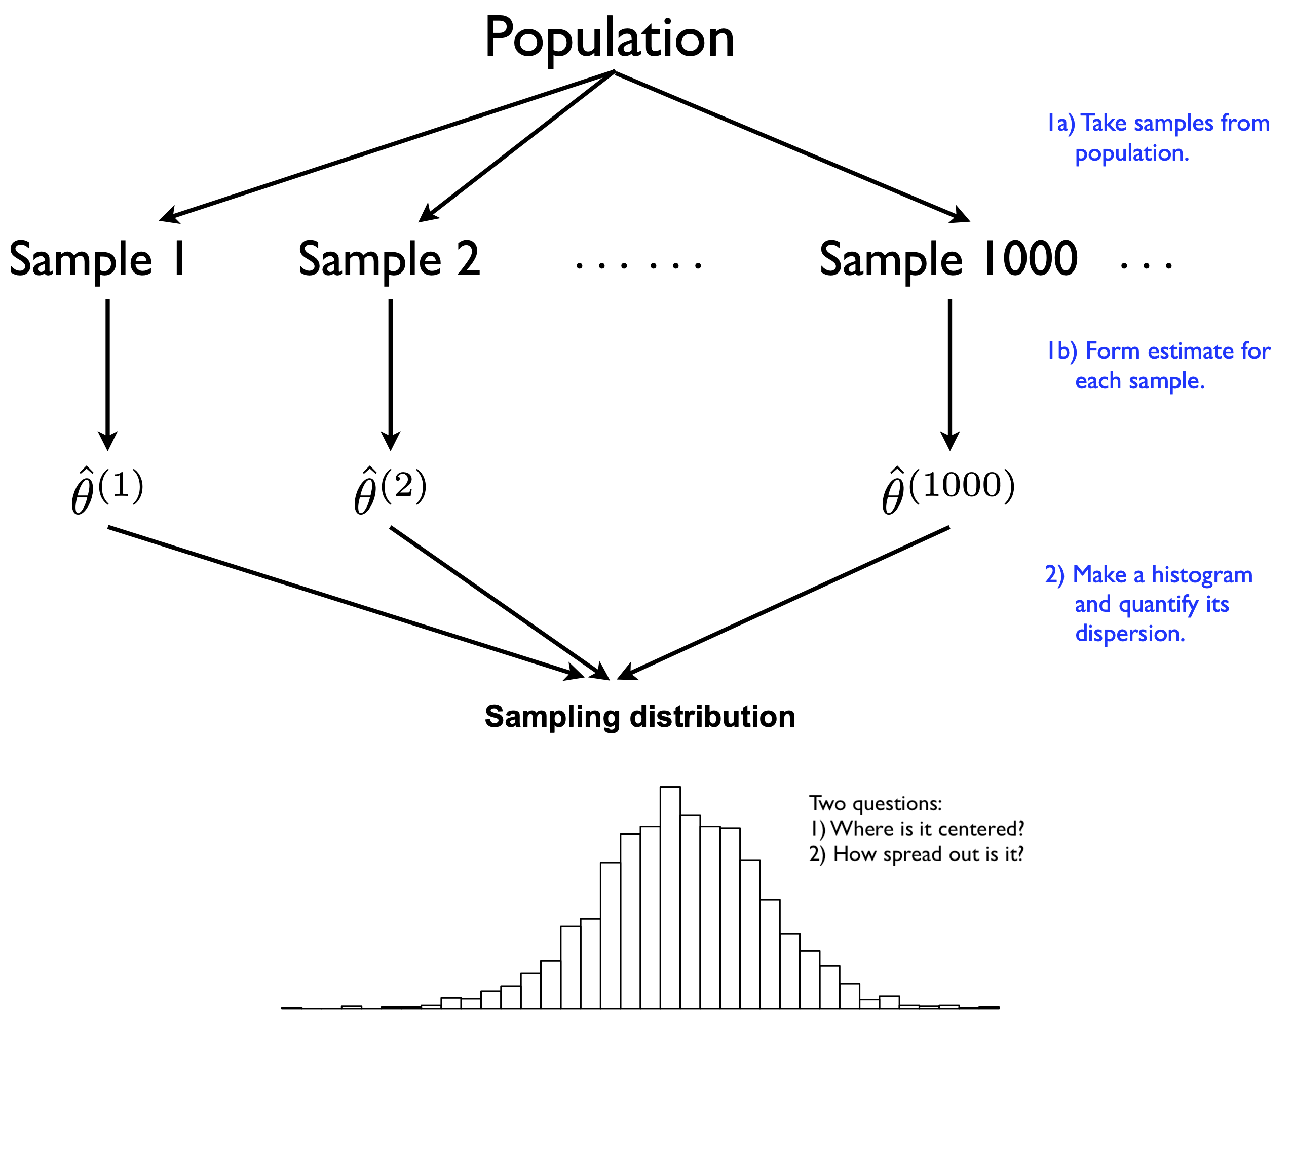
Uncertainty
Uncertainty describes how much an estimate may differ from the true value.
Fundamentally, it arises from the fact that we must use a sample to make inferences about a population.
Mechanistically, uncertainty can arise through measurement/reporting error or variability that is intrinsic to individuals or processes.
Quick demo: https://www.statcrunch.com/applets/type3&samplingdist
Fig 8.5 from J. Scott (2021)
Notes:
Helps us understand how much confidence we should put in an estimate.
Commute analogy

Slide 35
Uncertainty
How do we quantify uncertainty?
Variance/Standard deviation/Standard error
Confidence intervals
Correct: A 95% confidence interval has a 95% chance of containing the true mean.
Incorrect: There is a 95% probability that the true mean lies within the interval.
Notes:
Standard error is essentially the standard deviation of the sampling distribution (or an estimate of what that true value is, at least)
Note: we commonly mean standard error of the mean when we say standard error, but you can compute SE for any statistic, though it may be less straight forward

Slide 36
5-Minute Break
Stretch, use the restroom, grab a snack!
Meeting back here shortly.

Slide 37
Statistical Methods for Genomics

Slide 38
Types of Data in Genomics
Sequences
FASTA/FASTQ/FAST5
Alignments
BAM/SAM
Variants
VCF
Annotations
TSV/CSV/VCF
Notes:
Need to add BED/interval files, GTF/GFF, wig/BEDgraphs

Slide 39
Common Analysis Methods: Regression
Linear
Continuous response variable
Example: gene expression levels
Logistic
Discrete response variable
Example: survival status (alive/deceased)

Slide 40
Common Analysis Methods: Regression
Quick example of each (demo in R)

Slide 41
Common Analysis Methods: ANOVA & GMLs
Generalized linear models (GLMs)
“Everything is a GLM”
Analysis of variance (ANOVA)

Slide 42
Common Analysis Methods: ANOVA & GMLs
Quick example (demo in R)
https://dshizuka.github.io/RCourse/05.1.Stats_LinearModels.html

Slide 43
Common Analysis Methods: Multiple Comparisons
Hypothesis testing is not an error-free process.
More tests on the same data = more type I errors (aka “false positives”)
Example: Compare expression of 3226 genes between two mutational types (BRCA1 & BRCA2)
To account for this, most methods “adjust” the p-value.

Slide 44
Common Analysis Methods: Multiple Comparisons
So what can we do in these cases?
Control the familywise error rate
Familywise error rate = proportion of all tests that yield a false positive
Bonferroni correction: p-value x number of tests
This method is “harsh” in that they increase type II error (false negative) rates
Control the false discovery rate
False discovery rate = proportion of all significant tests that yield a false positive
Benjamini-Hochberg (BH or FDR)
Notes:
Avoid ever making a type I error
Avoid type I error while also avoiding rejecting “good” hypothesis
What does a 5% p-value tell you? What does a 5% FDR tell you?
Answer:
P-value = 5% of all tests are false positives
FDR = 5% of significant tests are false positives

Slide 45
Activity 3: Multiple Comparisons
Hands-on multiple comparisons analysis in R
Notes:
10-15 minutes

Slide 46
Choosing An Appropriate Test
Continuous
Categorical
Multiple
Continuous
Counts
Binary
Proportions
Continuous
Counts
Continuous
Categorical
Linear Regression
Or
GLM w/ Gaussian
GLM w/ Poisson
GLM w/ Binomial
GLM w/ Binomial
T-Test (means)
Or
ANOVA
Chi-Square Test
Linear Regression
Or
GML
Linear Regression
Or
GML

Slide 47
Interpretation and Data Visualization

Slide 48
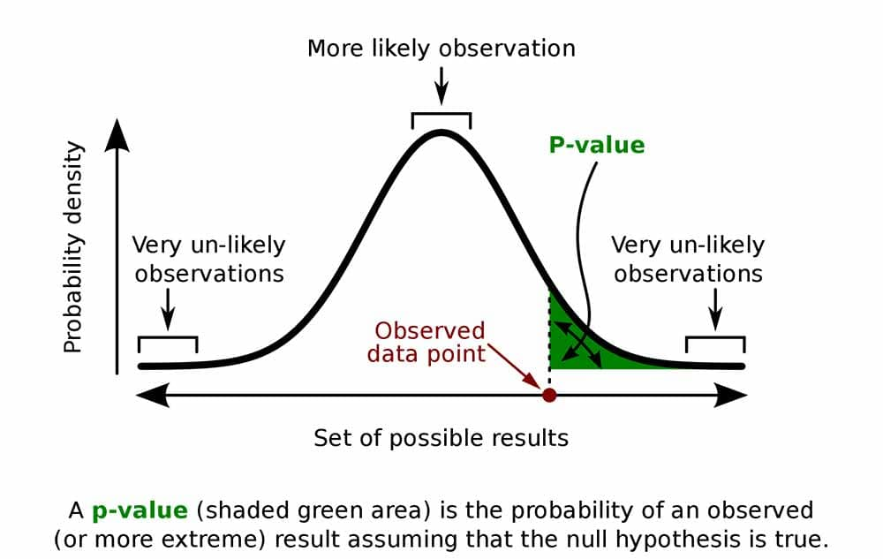
What is a Significance value?
p-value = what is the probability of observing a particular test statistic value given a particular distribution?

Slide 49
What is a Significance value?
 | True | False
Accept H₀ | ✓ | Type II Error “False Negative”
Reject H₀ | Type I Error “False Positive” | ✓
Notes:
Hypothesis testing is not an error-free process.

Slide 50
How to interpret Significance Values
Caution when interpreting since ⍺ is inherently arbitrary.

Slide 51
Measures of Effect: Direction and Magnitude
Where significance tells us how likely it is that results are due to chance, measures of effect help us understand the magnitude and direction of differences.

Slide 52
Principles of Data Visualization
Color
Monochromatic, contrasting, complementary
Colorblind friendly palettes
Keep it simple
Don’t show too much data in one figure.
Keep it honest
Avoid confusing scales on axes.
Be clear
Decide exactly what you want to show and show only that.
Remain consistent.
Know your audience.

Slide 53
Visualization Techniques for Genomics & Transcriptomics
Sequence Analysis
Tracks
UCSC Genome Browser/IGV
Circular maps
Annotation
Expression Profiles
Heat maps
Gene Function
Gene Ontology (GO) https://geneontology.org/
Molecular Pathways
Network maps
Notes:
Genomics and transcriptomics often deal with large amounts of data, so effective visualization can be a challenge.
Keep the principles we just discussed in mind.

Slide 54
Activity 4: Data Visualization
Design and create visualization with real genomic data
Group discussion on best practices and interpretation
Notes:
20 minutes

Slide 55
Ethical Considerations and Challenges

Slide 56
Ethics of Handling and Analyzing Biological Data
Ethical considerations are always important in science and statistics, especially when the data you are analyzing will be used to make individual and/or public health decisions.

Slide 57
Challenges and Limitations
Data Quality
Interdisciplinary Collaboration
Development & Optimization
Education & Training
Ethics & Communication

Slide 58
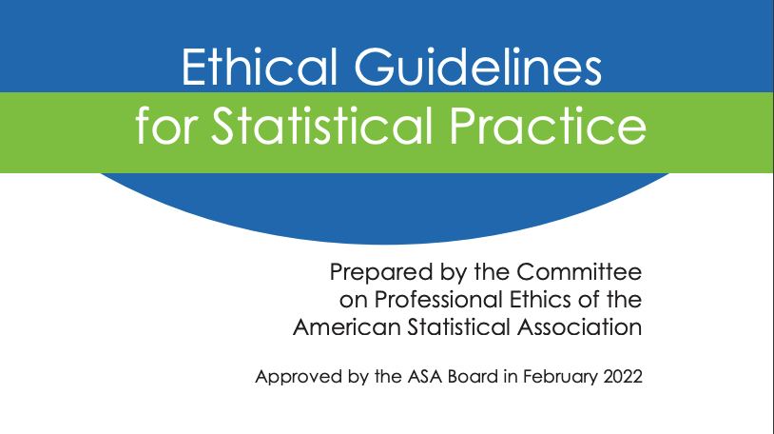
American Statistical Association Ethical Guidelines
Notes:
https://www.amstat.org/docs/default-source/amstat-documents/ethicalguidelines.pdf?Status=Master&sfvrsn=bdeeafdd_6/

Slide 59
Activity 5: Ethical Dilemmas
Case study and group discussions
Notes:
10 minutes

Slide 60
Wrap-up and Q&A

Slide 61
Key Takeaways
Statistics is one tool that computational biologist use to identify patterns in biological data and rigorously test hypotheses.
It’s important and beneficial to begin a project with statistics in mind.
Use appropriate techniques to explore and improve the quality of data.
Similarly, use appropriate statistical tests for the experimental design and data at hand.
Careful interpretation and visualization and key to good scientific communication.
As someone who handles data and analyses, you have ethical responsibilities to your colleagues, the scientific community, and society at large.

Slide 62
Questions?
Thank you!

