Slide 1


IefPolicies PowerShell Module
Marius Rochon

Slide 2


Agenda
Purpose
Installation
Simple use case
Documentation

Slide 3
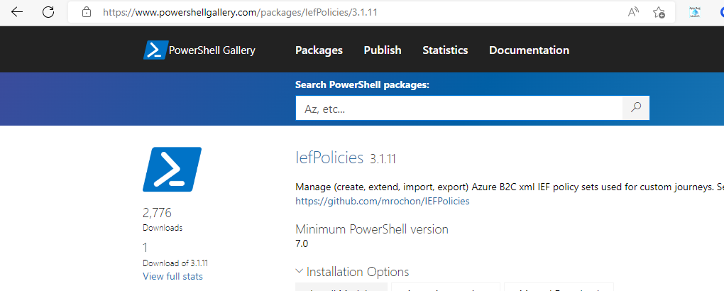
Purpose
Operate on sets of IEF policies, e.g. complete Starter Pack
Download, upload, update for a specific B2C tenant
Add features, e.g. IdP federations
Static code analysis

Slide 4
Installation
Requires PowerShell 7
Runs on Windows, MAC or Linux
Require account to signin to B2C

Slide 5
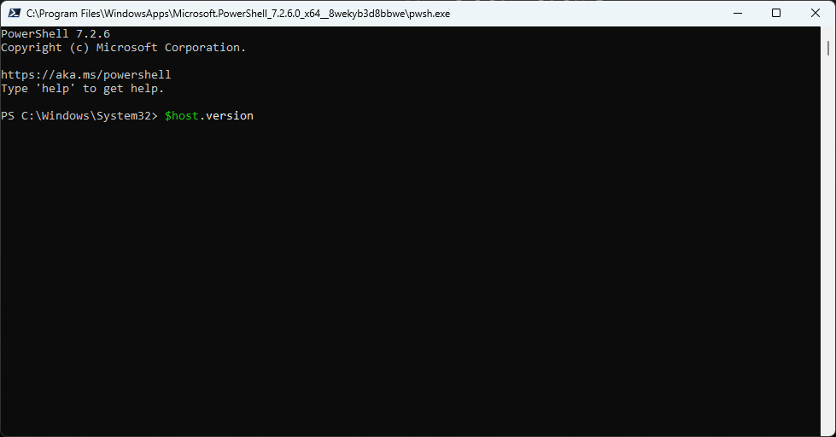
Installation

Slide 6
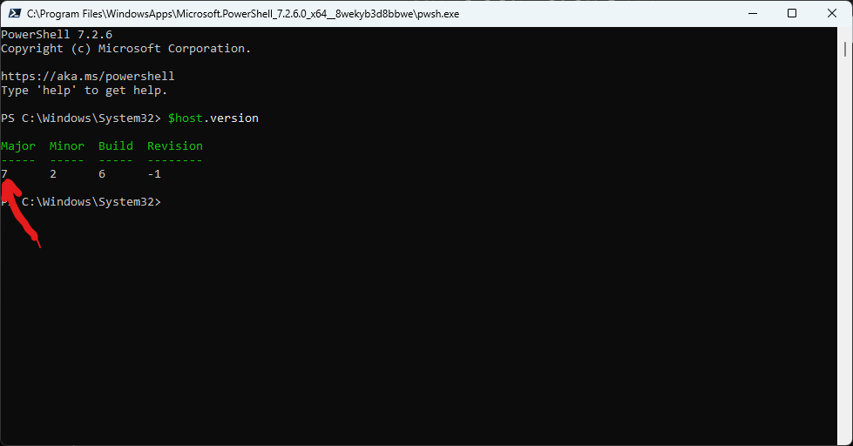
Installation

Slide 7
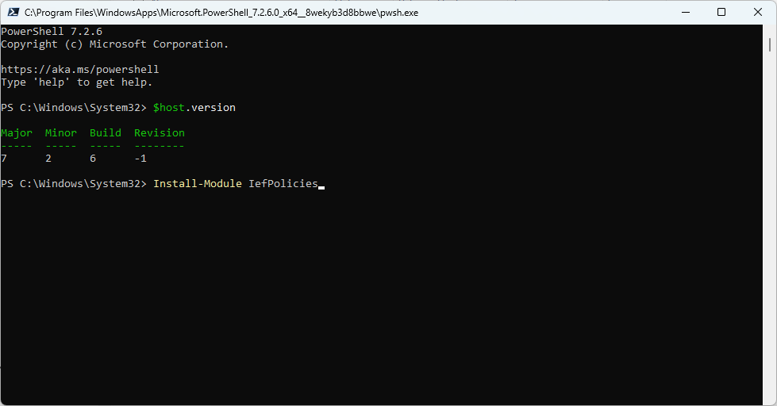
Installation

Slide 8
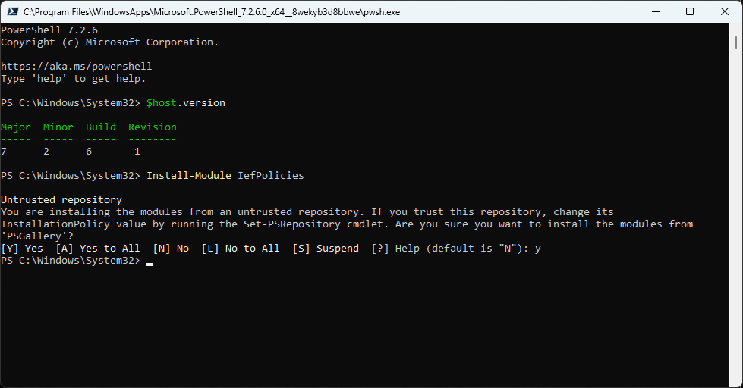
Installation

Slide 9
Simple use case
Get a Starter Pack
Upload to B2C
Add AAD as multi-tenant federated IdP
Scan for coding errors
Upload to B2C
Cleanup B2C

Slide 10
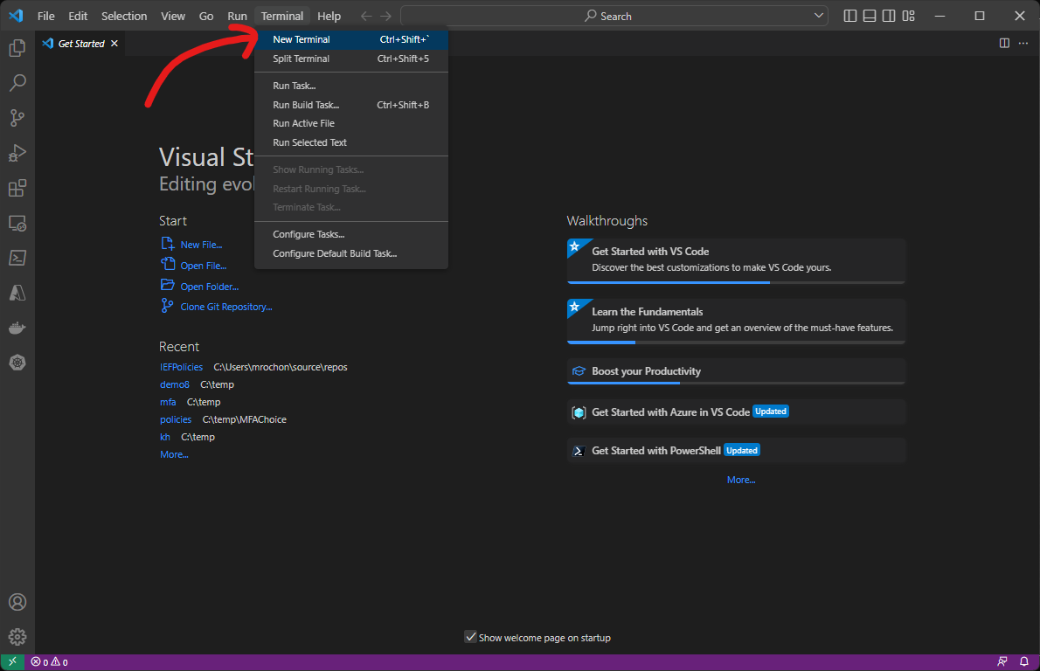

Slide 11
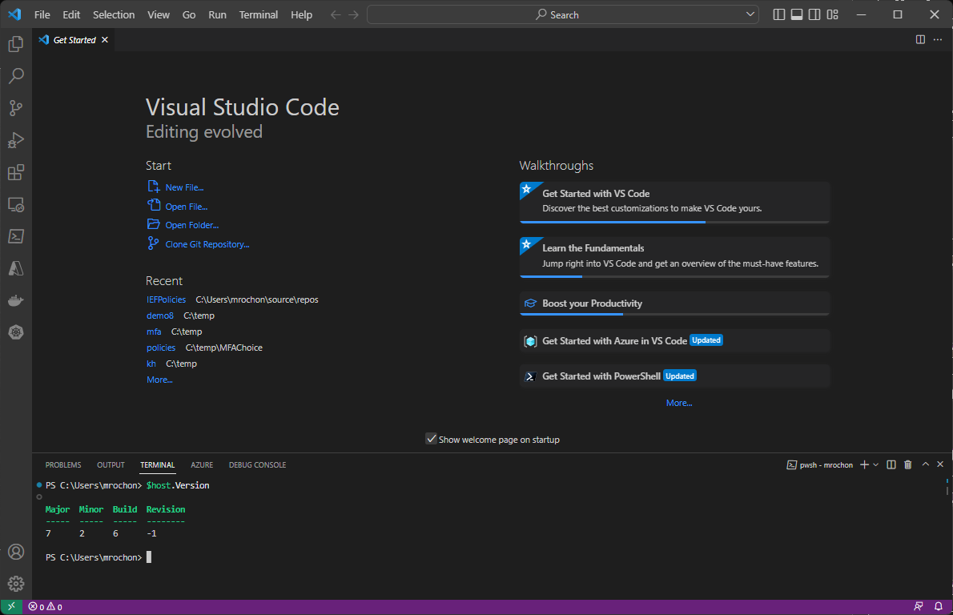
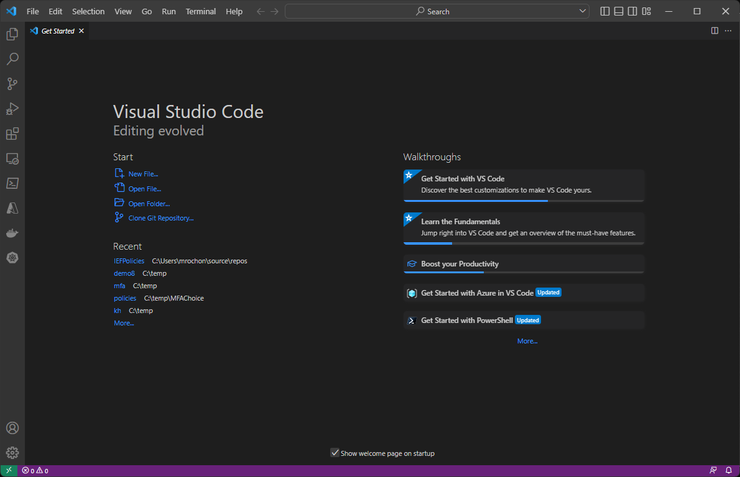

Slide 12
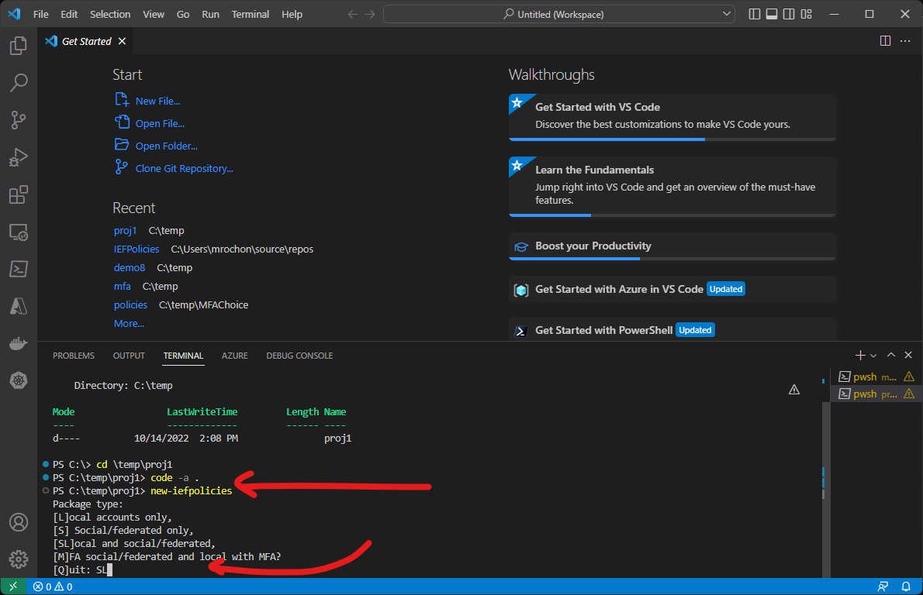

Slide 13
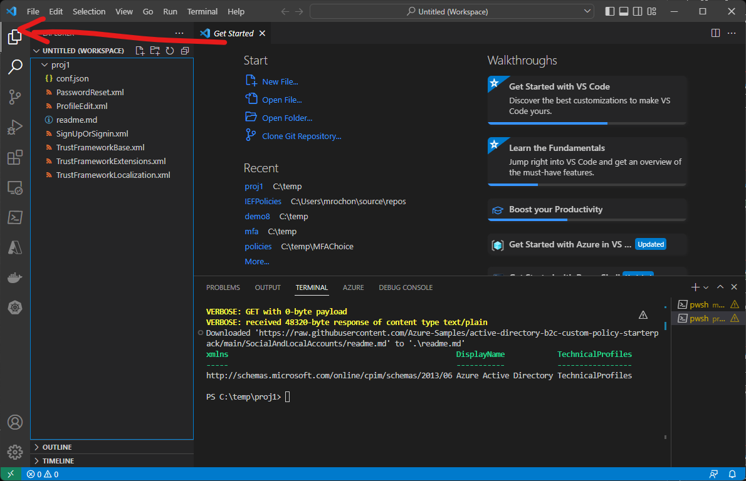

Slide 14
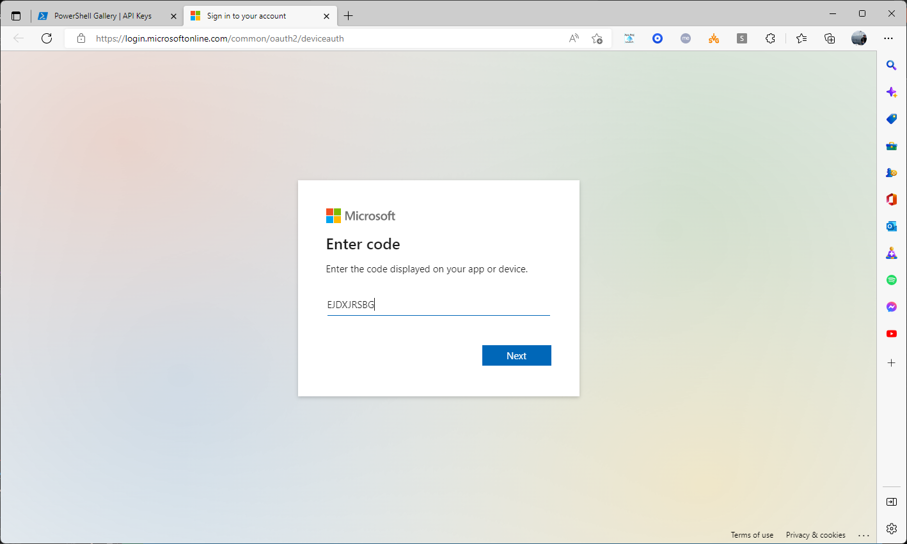

Slide 15
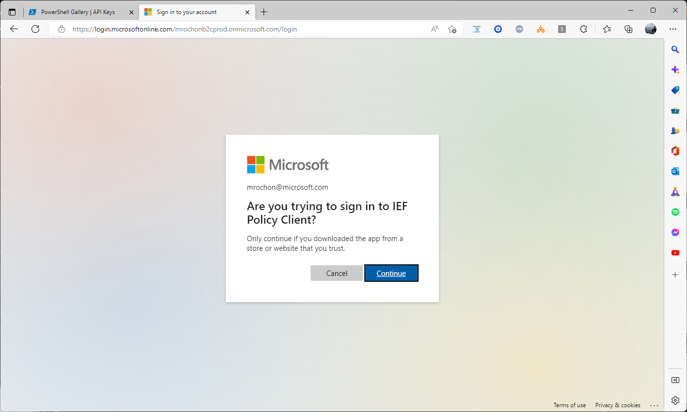

Slide 16
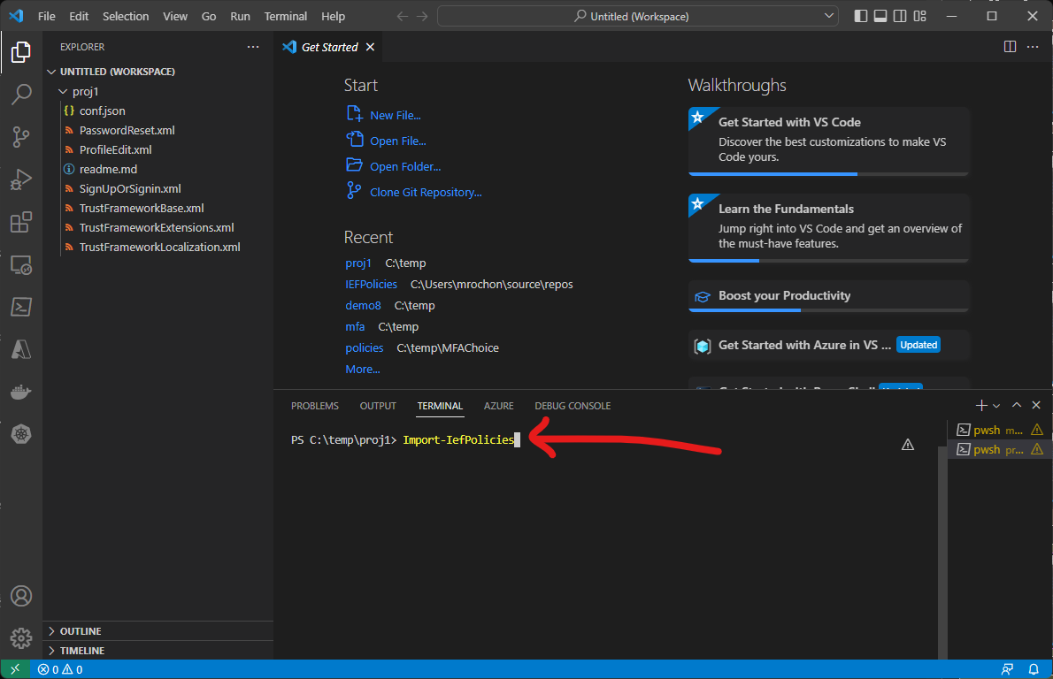

Slide 17
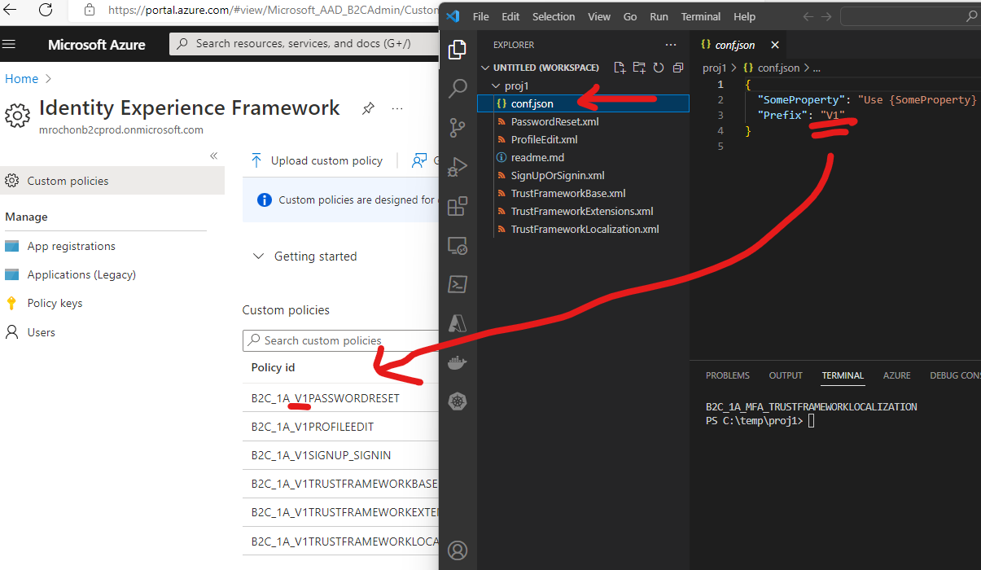

Slide 18
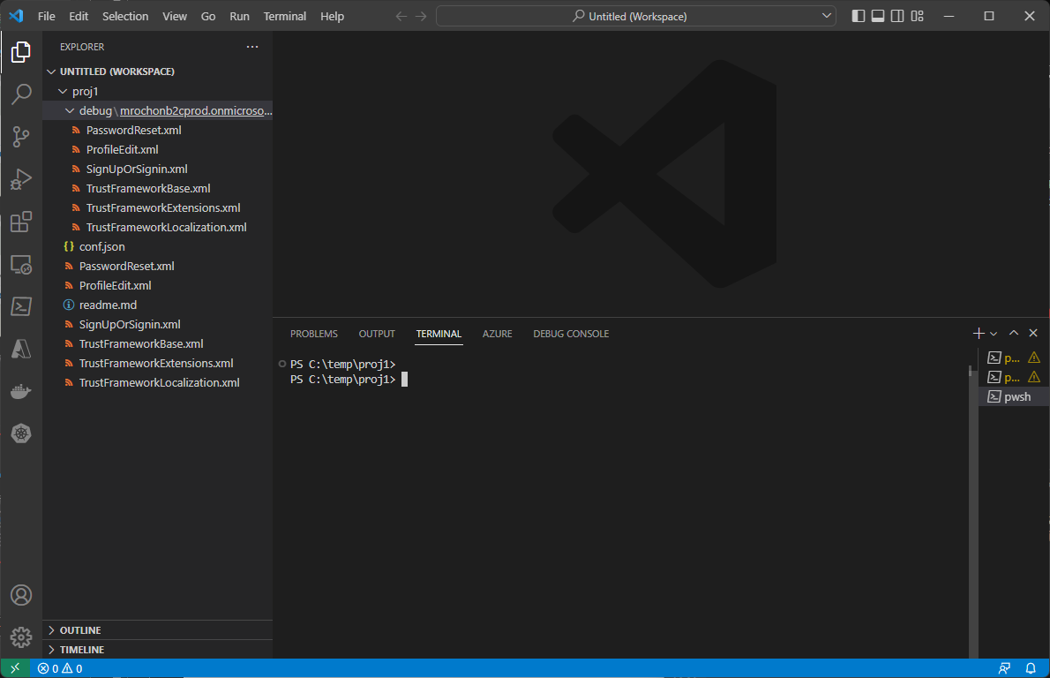
Updated and uploaded files
(FYI only)
Original files

Slide 19
Import-IefPolicies
Sequence upload based on policy dependencies
Upload only policies changed since last import
Change all yourtenant to current B2C tenant name
Add Prefix to policy names – a way of creating groups of policies
Modify IEF App and Proxy app with correct values from current tenant
Replace any properties defined in conf.json or yourtenant.json in xml
Save in Debug folder
Upload to B2C

Slide 20
Other frequently used cmds
Cmd | Purpose
Initialize-IefPolicies | Set up B2C for use with IEF (IEF app, proxy app, keys)
Add-IefPoliciesIdP OIDC|SAML –name Contoso | Add TPs and journey steps for a new IdP
Add-IefPoliciesIdP AAD –name WORK | Register a MT app in B2C, add it as OIDC IdP to policy set
Add-IefPoliciesSamlRP | Add TPs and RP xml to support a SAML application
Export-IefPolicies XY | Download policies whose name uses XY prefix
Remove-IefPolicies XY | Delete policies with XY prefix
Debug-IefPolicies | Do a code scan for some common error otherwise not handled by load or difficult to find

Slide 21
Source code and documentation
mrochon/IEFPolicies: PowerShell module for handling B2C custom journeys (github.com)

