Slide 1
PARS
Ethan Hower
Alan Yang
Jonas Funk

Slide 2
Why PARS?
Audience: Musicians
Purpose: Allows musicians access to specific pieces of music (vocals, beats, percussion, instruments, etc.) to help them create their own music
Allows for an easy way to make music and remixes

Slide 3
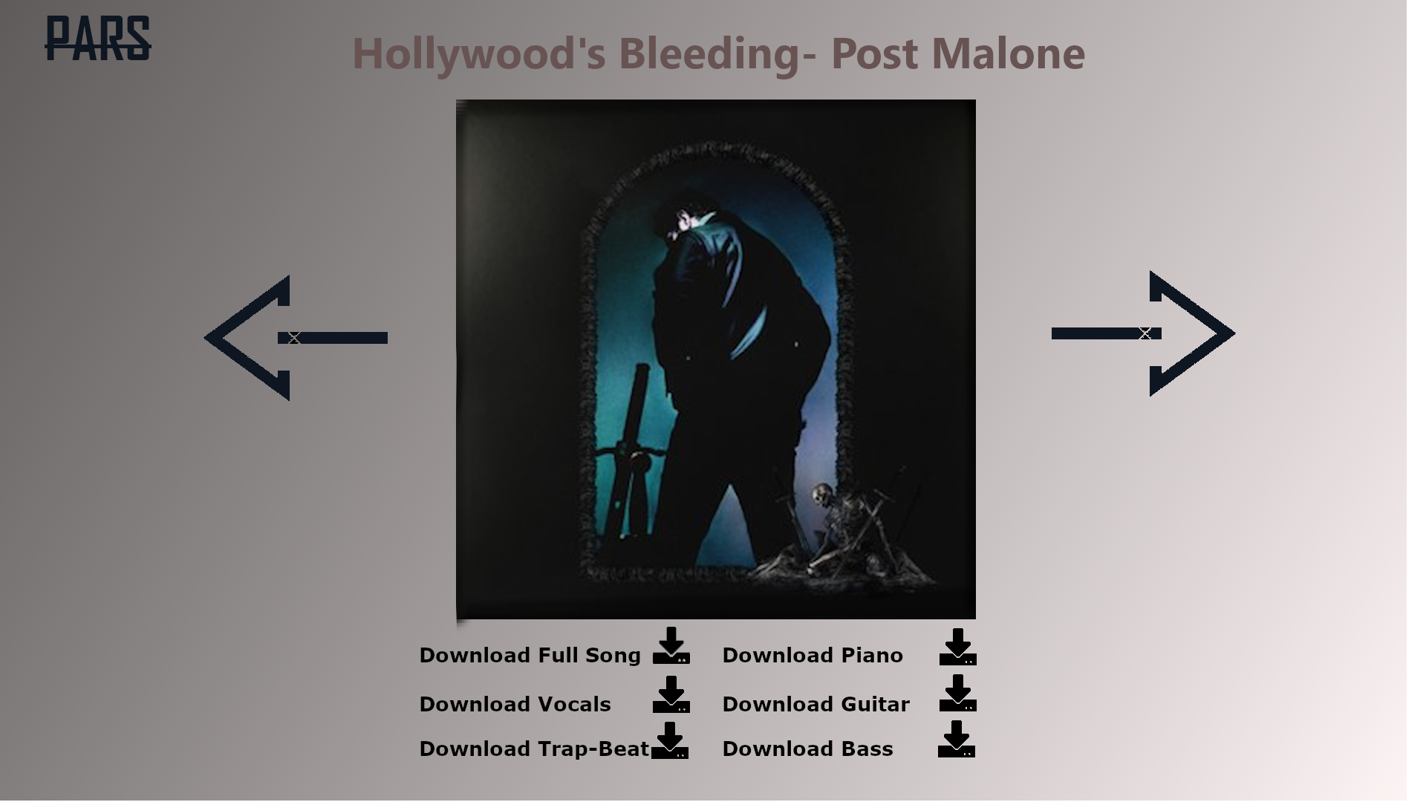
Download Menu

Slide 4
What?
Allows the user to search or browse through pieces of music to download for their own music creation
You can favorite pieces of your liking
Provides recommendations for user through algorithm
Easily compatible with music editors (able to download it right into music editor software) or download it onto your computer for later use

Slide 5
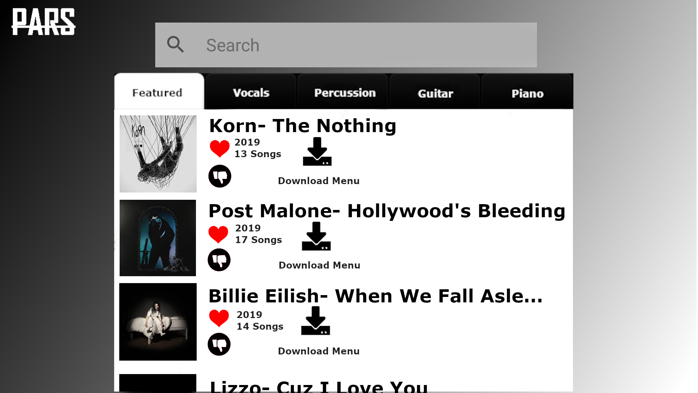
Opening Menu

Slide 6
The Name
“PARS” is Latin for “pieces”
Short and simple allowing for people to remember the name
Unique

Slide 7
Cost
Free version: ads, download cap, limited access
Premium: no ads, no download capacity, more access to featured pieces, and more compatible with other music software
Everyone starts with one week free trial
$15 a month or $120 a year (30% discount!)

